Slide 1
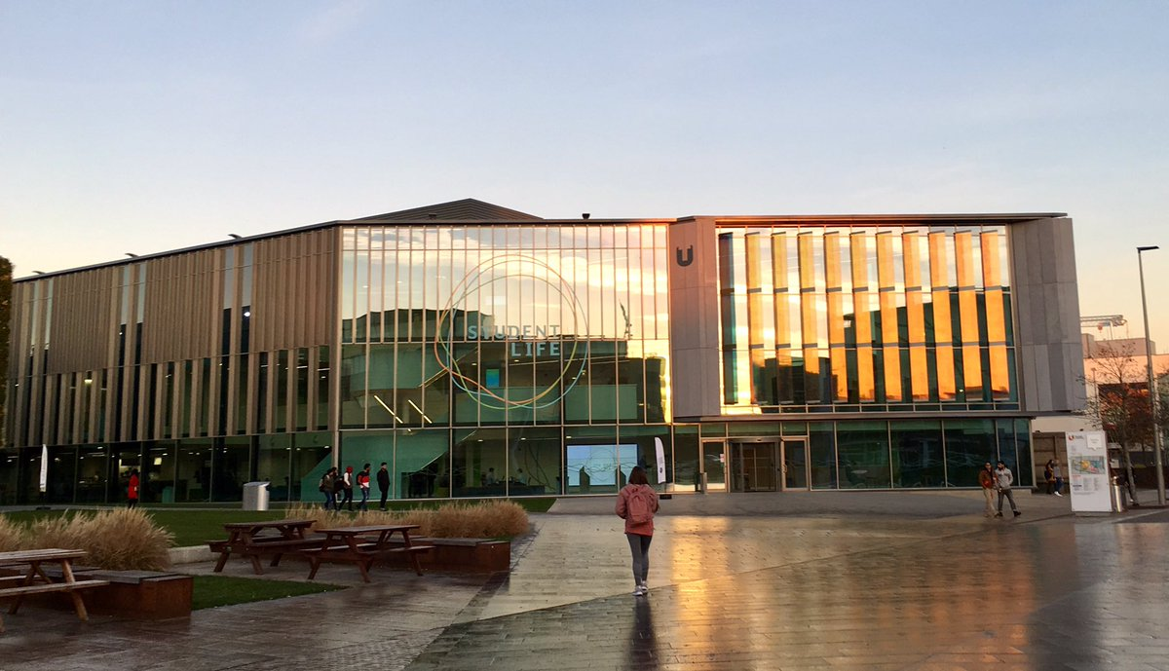

Student Life
December 2020

Slide 2

Disclaimer: Please don’t be alarmed by the lack of Covid-secure measures, such as protective screening, social distancing or PPE.
Many of these photos were taken prior to the Covid-19 pandemic.

Slide 3
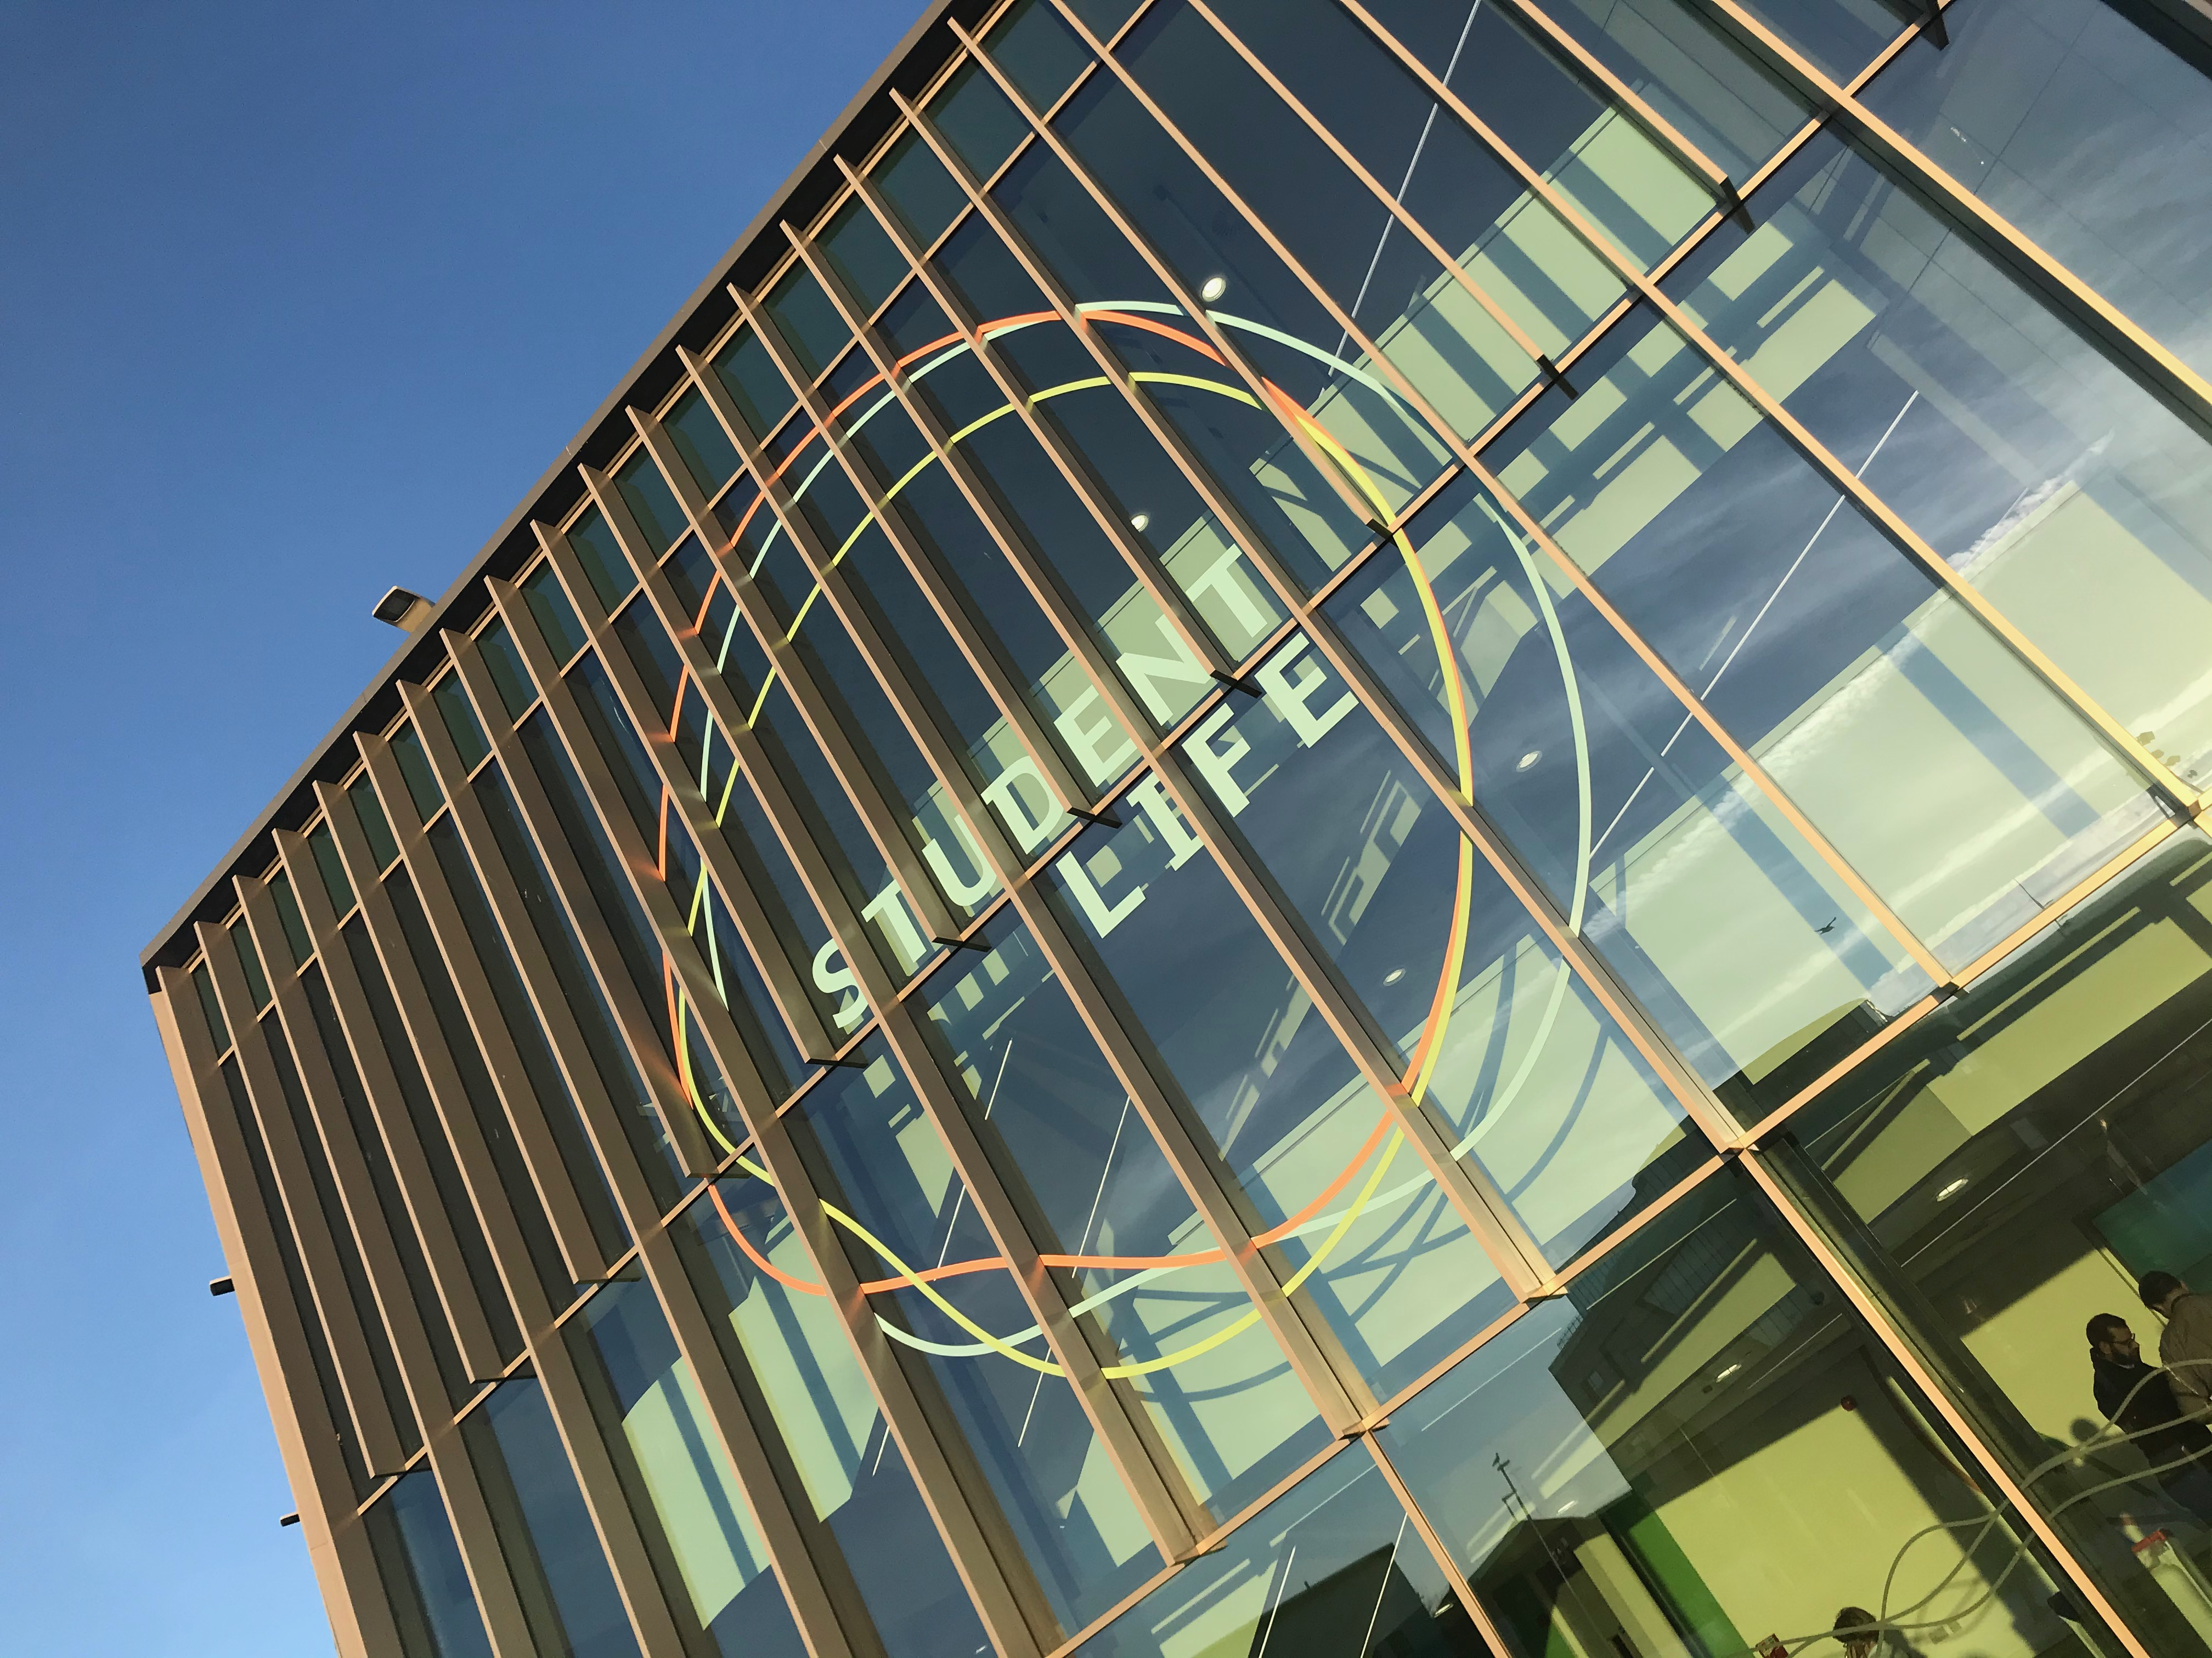
What is Student Life?
A central campus home for all student-facing services
A “one stop shop” for students to ask any questions they have about their learning and life. Everything students need outside the classroom.
IT/Digital support, Accommodation, Student Futures, Timetabling, Welfare & Finance Advice, Disability & Mental Health, International student advice, Faith & Reflection, Wellbeing, Counselling services all based in the building.
Other services accessible via drop-in appointments or secondary referrals – Student Records, Payments/fees/finance, Admissions, Complaints.

Slide 4
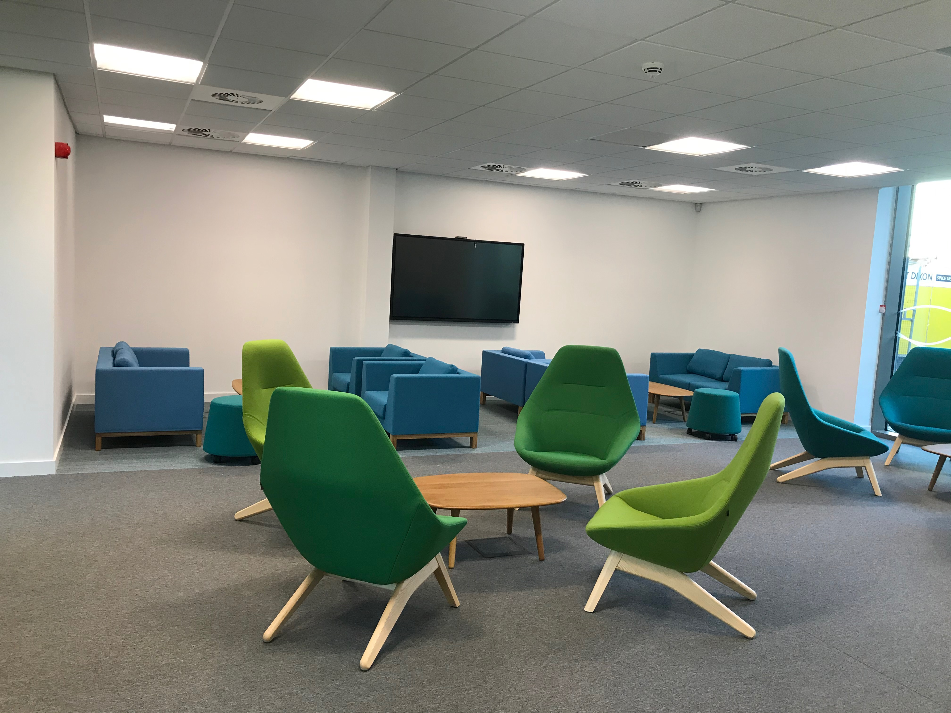
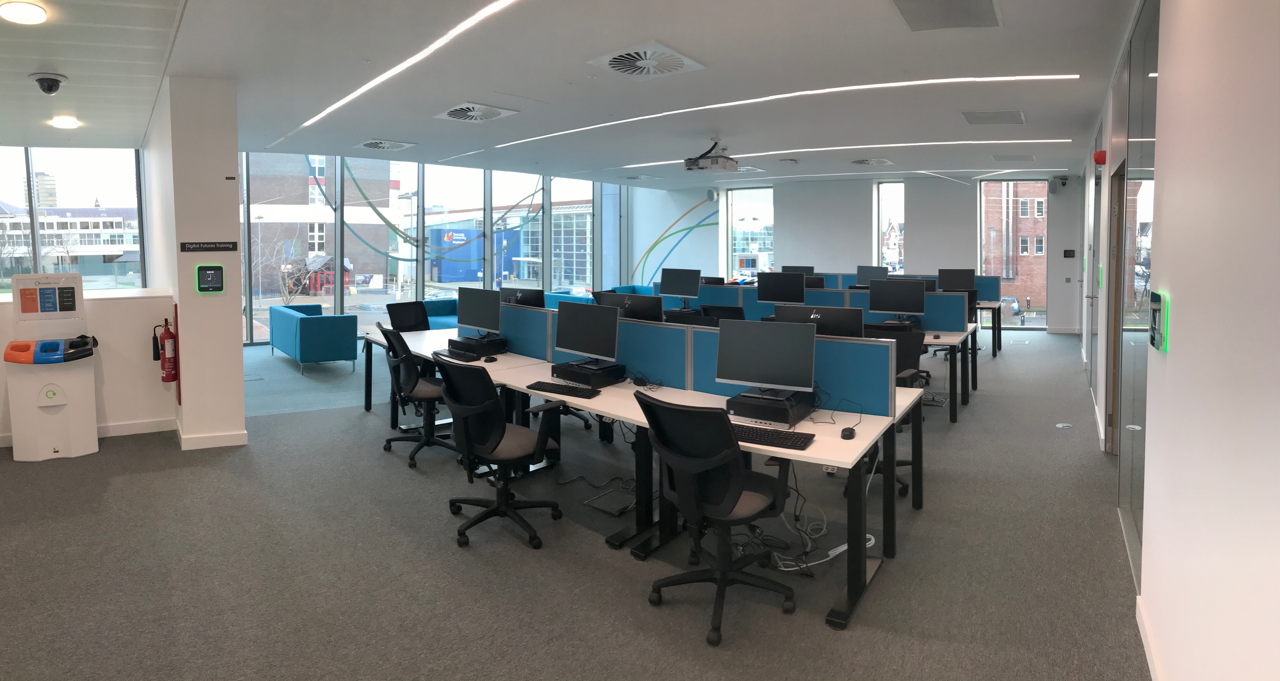
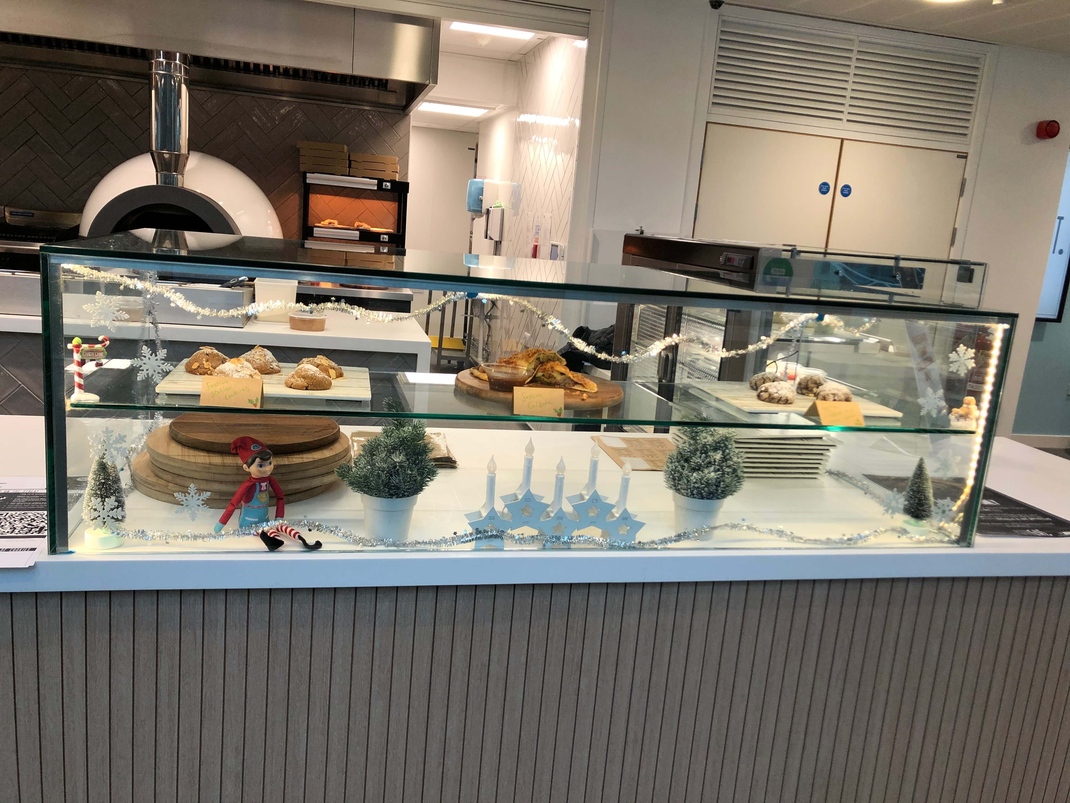
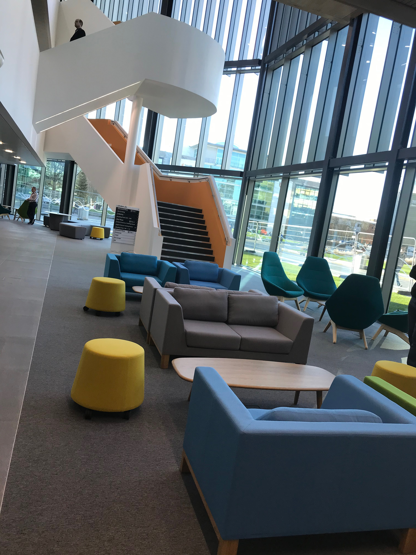
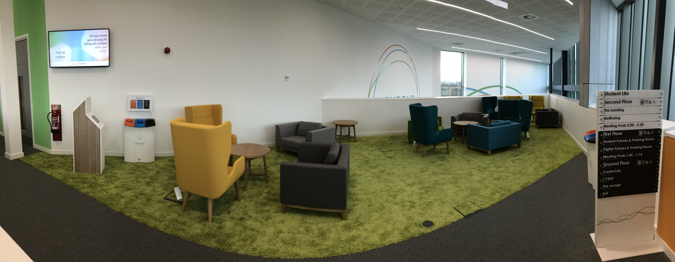
Learning environment
Study spaces
Social learning
Open access PCs
Meeting Pods
Group work facilities
Café
Lounge
Landing

Slide 5

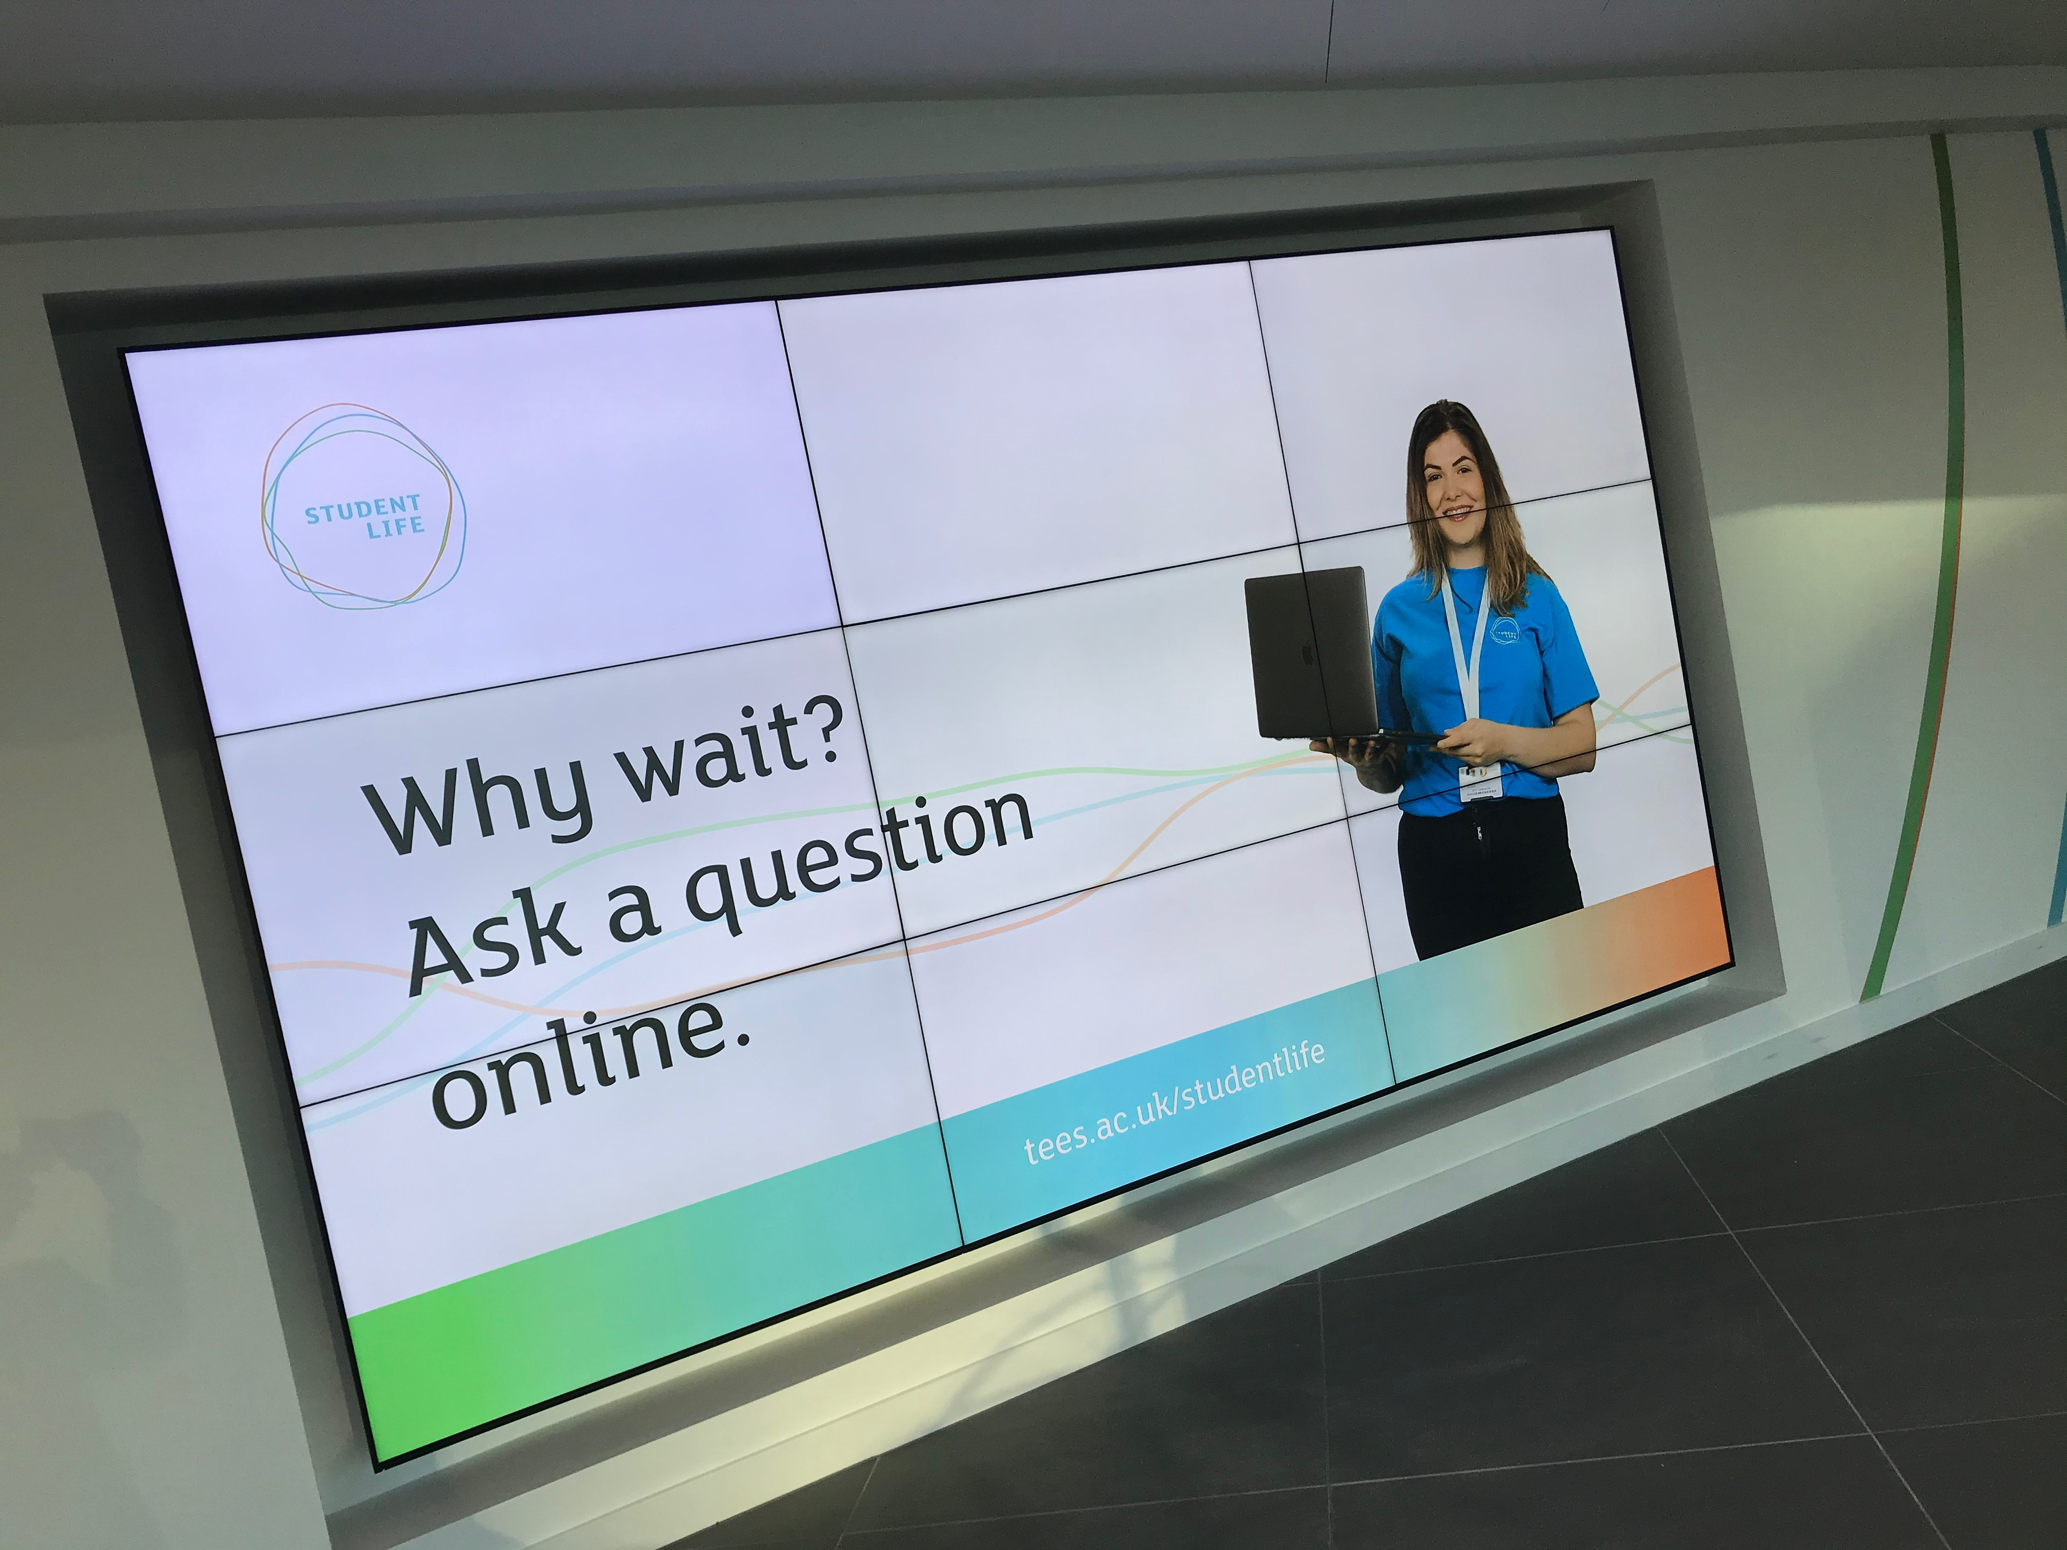
Service model
Self
service
One-stop shop
Try to answer as many questions as possible at the first time of asking
Supported by Knowledgebase and associated digital tools
Promote self-service
Face to face
Phone
Online
Assisted
service
Attended
service

Slide 6
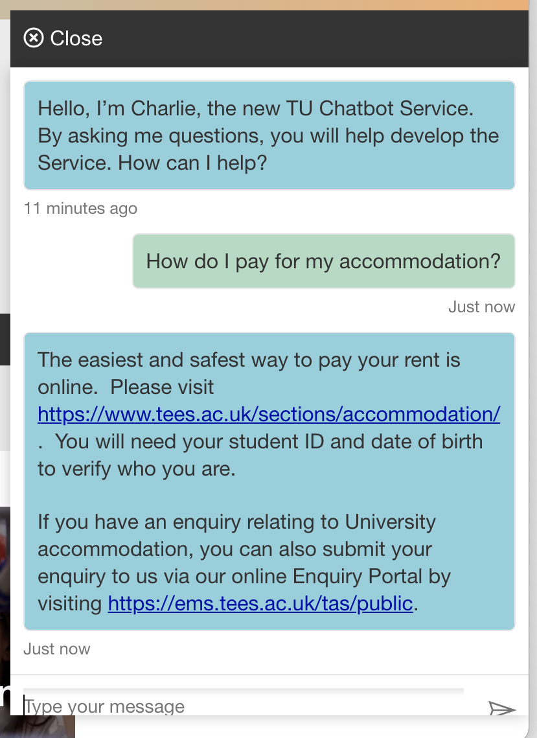
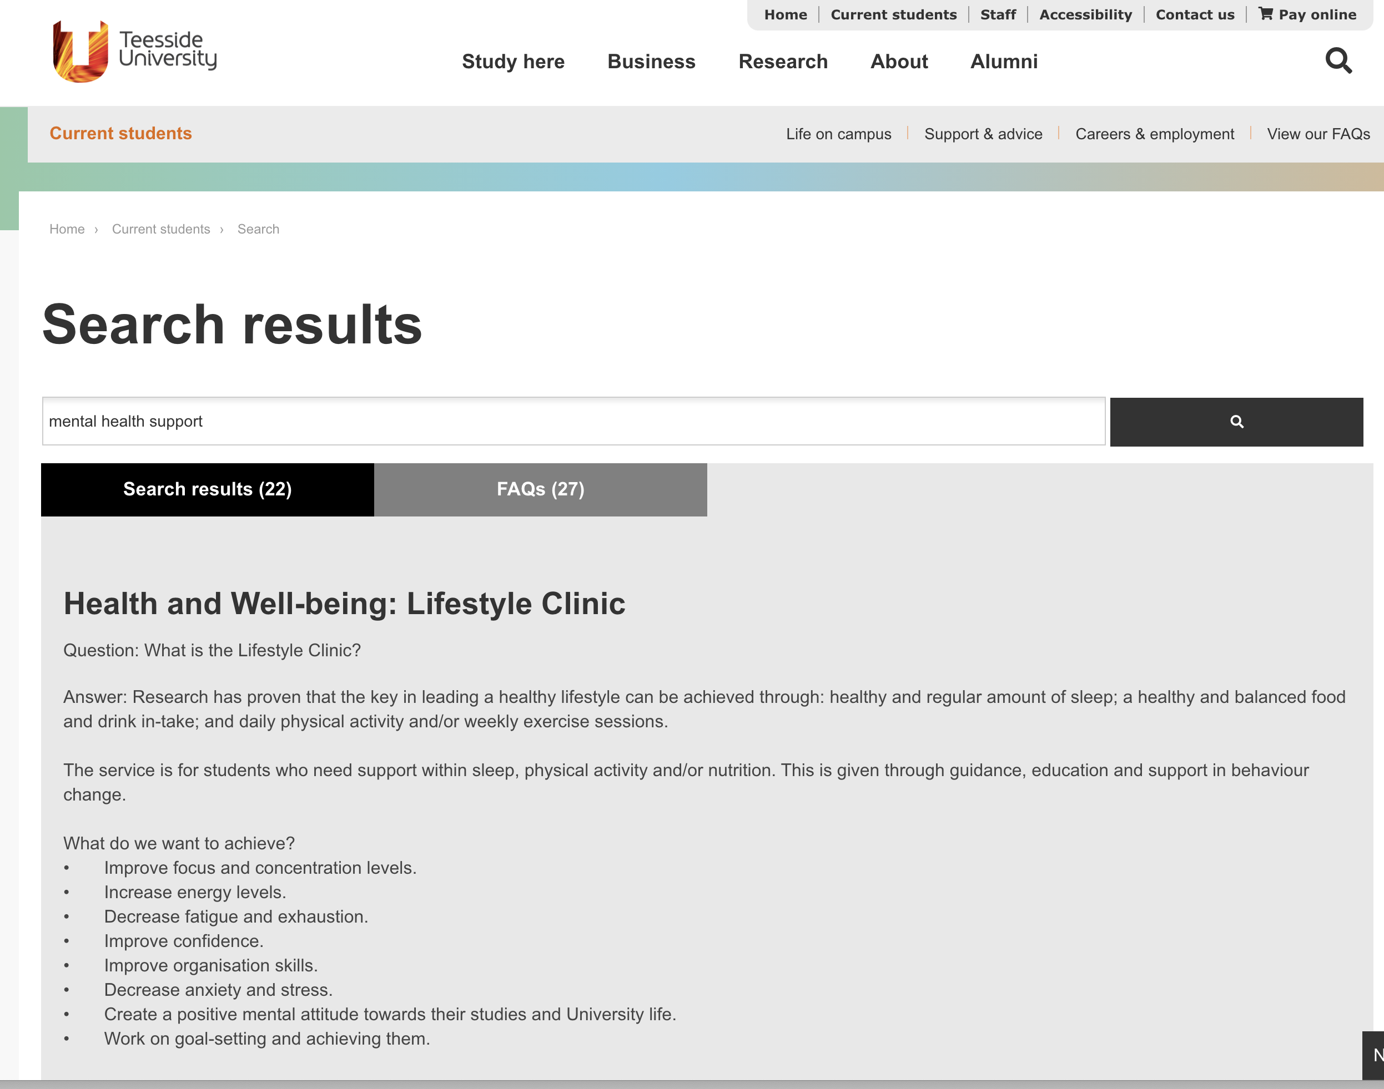
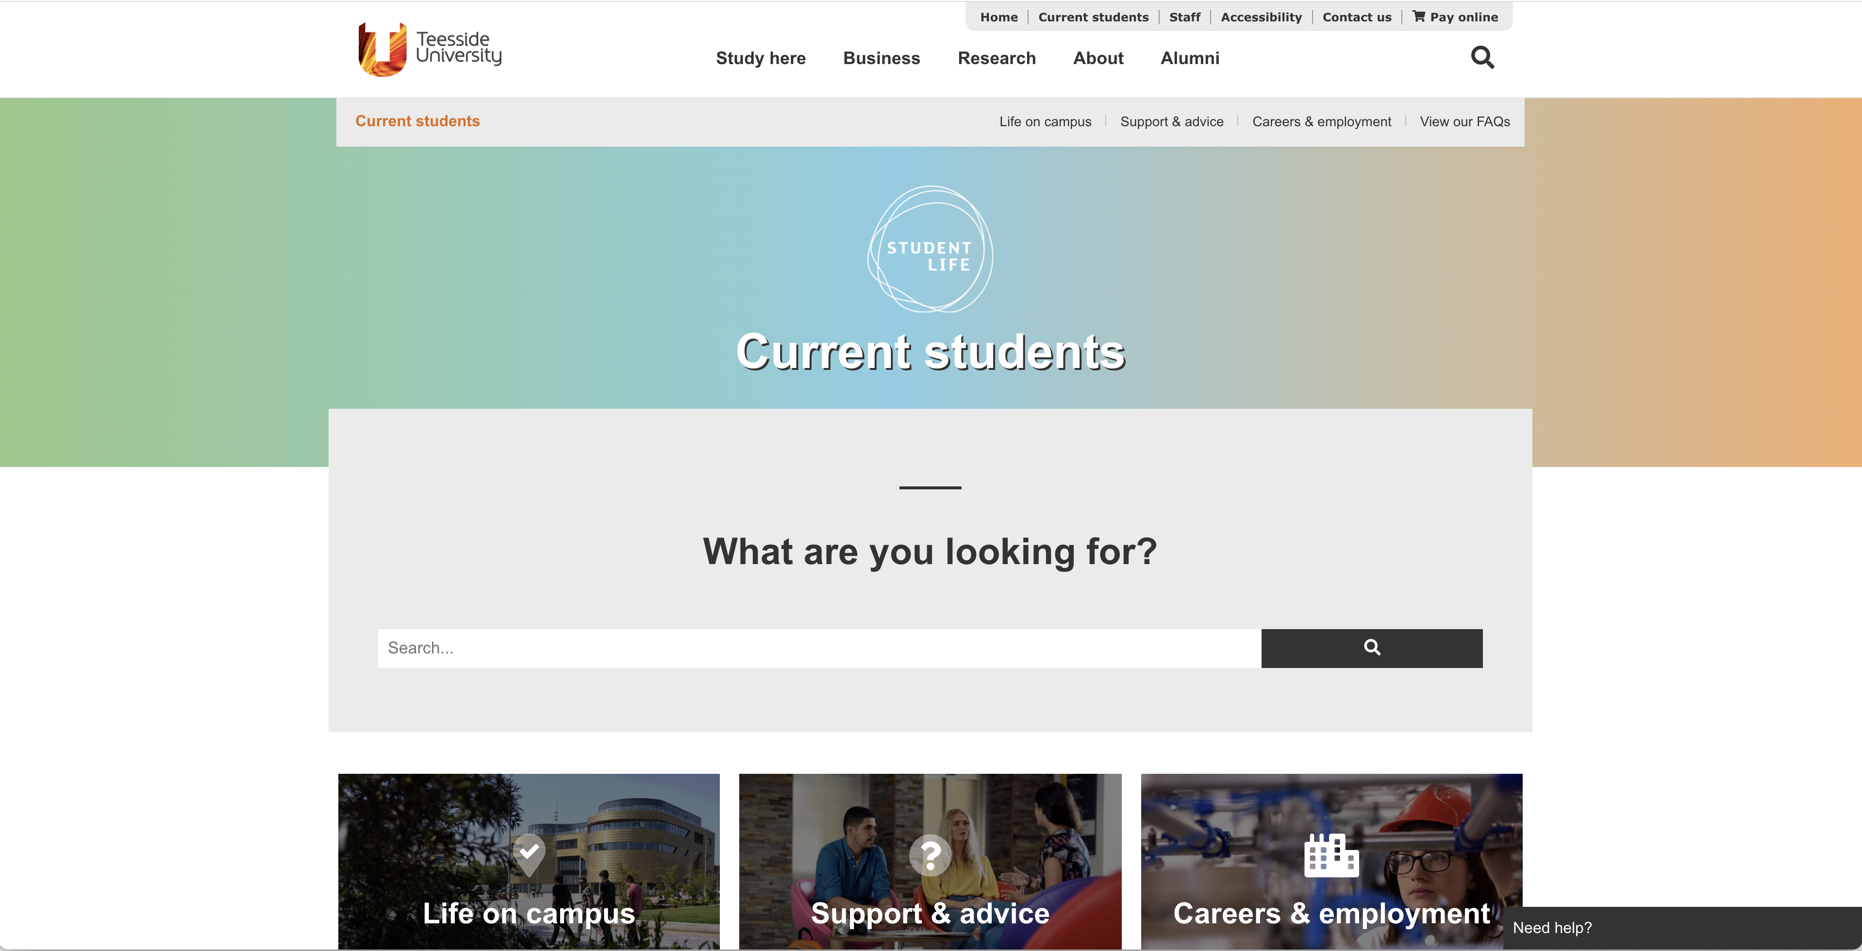
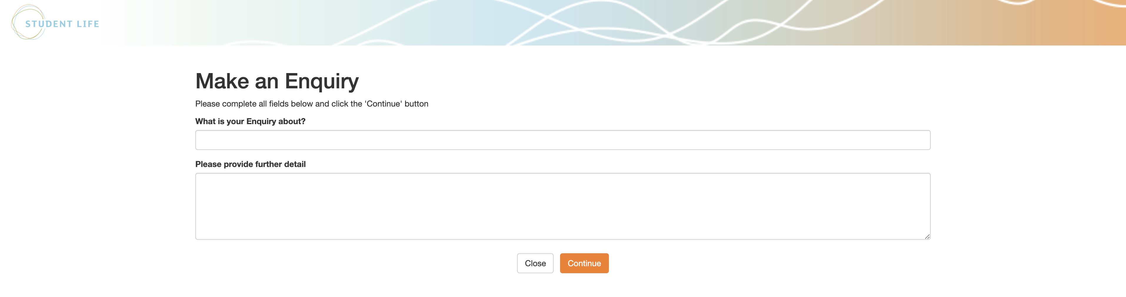
Supporting tools
Website, FAQs
Chatbot
Self-logging of enquiries

Slide 7
Student Life Enquiry Team
Welcome / “Front of House” services
First point of contact for all Student Life services
Responsible for students getting a great first impression
Building custodians
Events coordination
Liaison between all service providers
Notes:
Working together to provide an excellent service

Slide 8
Covid-19
Switch to remote service entirely from March to September.
Wellbeing services provided specific support to staff and students during closedown.
Building reopened in September:-
  Protective measures (screens, one-way systems, sanitising stations, PPE)
  Reduced capacities in all spaces (removing furniture)
  Social distancing
  Fewer staff on site
  Encourage students to continue to access remote support
Notes:
Working together to provide an excellent service

Slide 9
Covid-19
Remote support switched to over 90% calls since March
95% response at first line
Disability/Mental Health & Finance queries very common during lockdown
Remote support now preferred method of contact for most
Notes:
Working together to provide an excellent service

Slide 10
Q & A
Thank you!

