Slide 1
Supporting ourselves and our colleagues
Crafty Coffees and
The Great Library Takeaway!
Charlie Hill
Mercian Collaboration Conference Group member
Customer Services Team
Birmingham City University
Susan O’Sullivan
Learning Teaching and Research Services Team
Birmingham City University

Slide 2
23 March 2020
Boris Johnson told the country that people must stay at home.
This brought about a number of significant changes…

Slide 3

Public Mental Health - GOV.UK

Slide 4
…Crafty Coffees

Slide 5
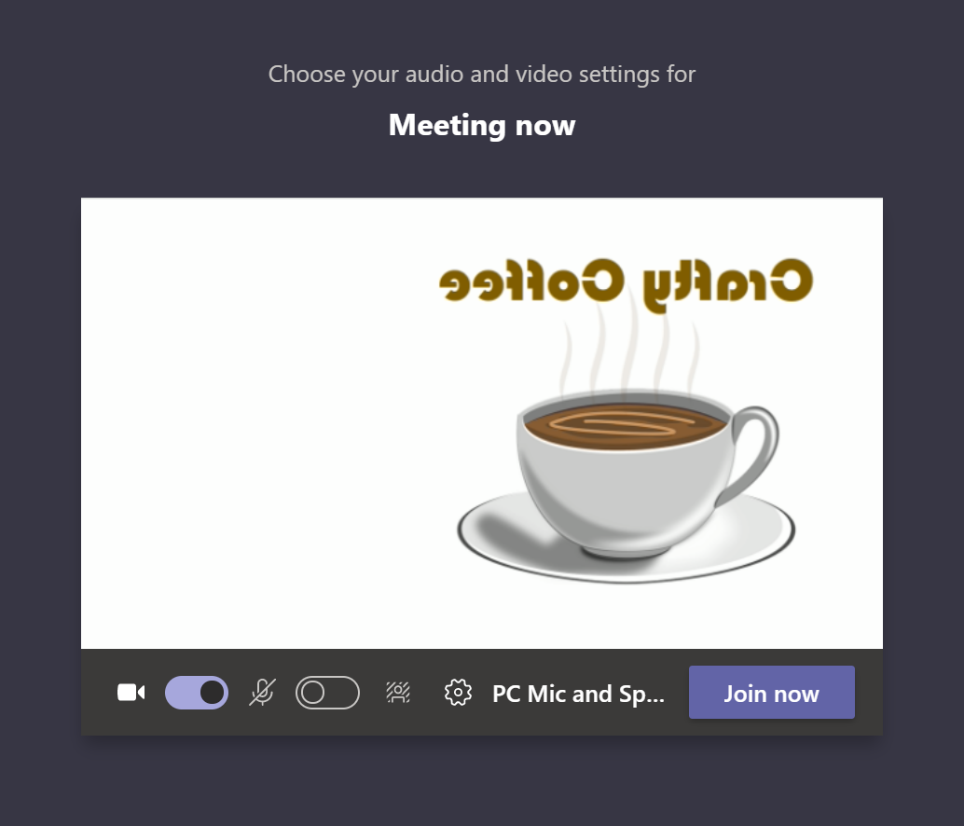

Slide 6
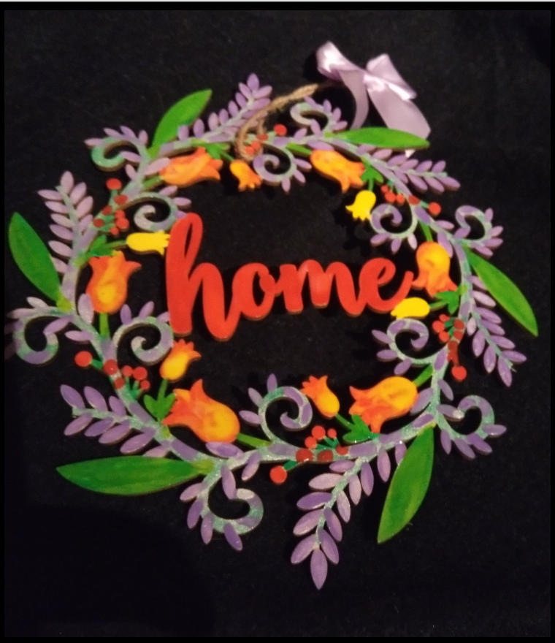
Crafty Coffee – weekly via MS Teams
Hobbycraft supplies

Slide 7
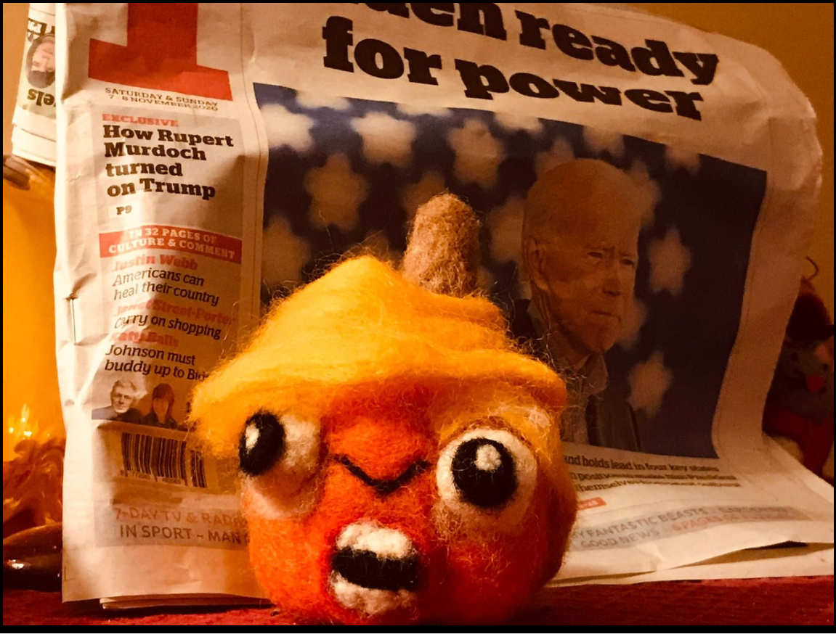
Crafty Coffee – weekly via MS Teams
Halloween TRUMPkin
- a needle felt kit completed during the US elections
Etsy supplies

Slide 8
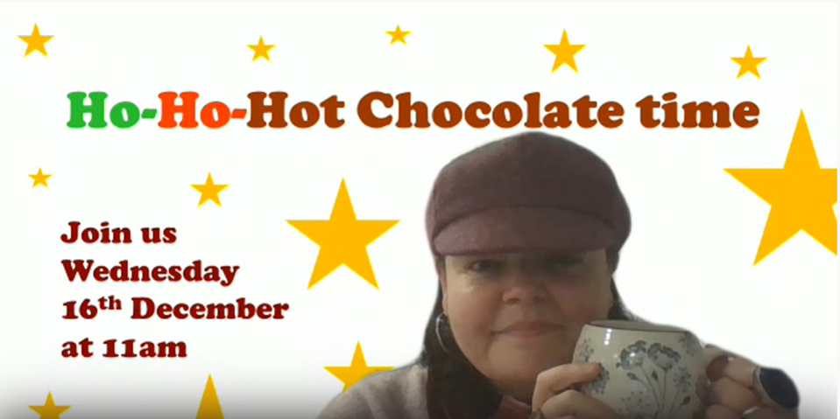
Synchronised Ho-Ho-Hot Chocolate…

Slide 9
Pause...
Any thoughts?

Slide 10
The Great Library Takeaway!
Charlie Hill
Mercian Collaboration Conference Group member
Customer Services Team
Birmingham City University

Slide 11
Background:
Unfortunately the Mercian Collaboration Dissolving Barriers Conference could not go ahead as planned and the Committee announced that the event was cancelled.
So…

Slide 12
As an alternative an in-house event was developed –
The Great Library Takeaway!

Slide 13
“ The Great Library Takeaway! is all about the relationship between this force and this outcome, between change and excellence.
It aims to address some key questions:
What have we learned from the experience of providing our services during lockdown?
What are we doing differently?
What insights into the needs of library users have our new ways of working given us?
And how can we apply what we have learned from lockdown to improve the services we provide? ”

Slide 14
Scheduled in September 2020
Ran between 2pm and 4pm via MS Teams.
Consisted of various ten minute presentations - break of 15 minutes in the middle for mingling
Each presentation looked at an aspect of our operation during lockdown and how our successes might feed into our service delivery in the 1st Semester and beyond
Presentations in the form of a 'takeaway': to-the-point, lively and entertaining

Slide 15
The Great Library Takeaway!
Customer Services – statistics and How to
Front of house support – online Chat
Library space management
Digitalisation service and publishing deals
Academic engagement
etc….

Slide 16
The Great Library Takeaway!
Provided an opportunity for reflection
Provided an opportunity to learn and take good practices forward
Provided an opportunity to see an overview and how things connect
Brought BCU Library and Learning Resources together

Slide 17
Thank you.
Any thoughts….?

