Slide 1

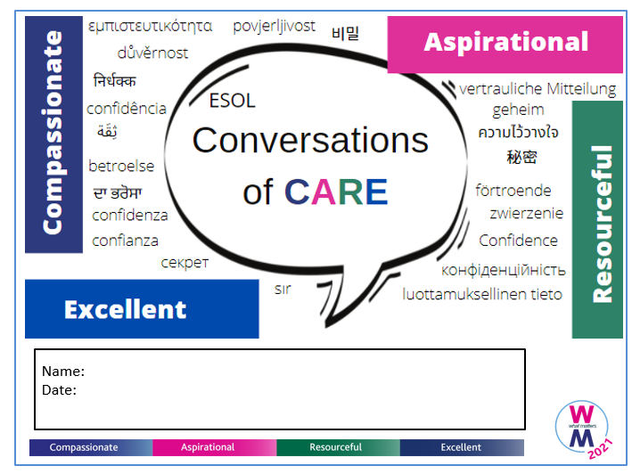
Conversations of CARE
An engaging, interactive conversation programme for international staff at the Royal Berkshire NHS Foundation Trust
Alison Horner Le Riche and Katie Wise

Slide 2

Background
Launched February 2022 by Learning & Organisational Development and Library & Knowledge Services.
Purpose: for international staff to practice their English speaking skills in an informal setting with a programme designed around the Trust’s CARE values
Compassionate
Aspirational
Resourceful
Excellent
Launched redesigned course in May 2022.
Notes:
In February 2022, we launched a programme called ‘Conversations of CARE’, initially designed by a member of the Learning & Organisational Development team. The purpose of the course was to provide international staff who have English as a second language a chance to practice their English speaking skills in an informal setting, with a programme designed around the Trust’s CARE values. They would learn more about each value and the behaviours expected, discuss examples in their own role, identify opportunities to develop these values further, and learn how to recall examples that could be used in their annual appraisals.
It was created for several reasons:
L&OD had noticed that staff on bands 1-4 had a low completion rate of their appraisals – demonstration of the CARE values (the Trust’s core values) makes up 50% of the appraisal so this could be a barrier to staff progressing in their careers.
There were no training courses specifically for staff on bands 1-4.
There were also no opportunities for developing and practicing English speaking skills for international staff.
A member of the LKS (Katie) inherited the course when the L&OD staff member left in March. She reflected on the first cohort, redesigned the content and launched cohorts 2 and 3 in May. The feedback received has been very positive – overall the course has been rated 9.1 out of 10. 22 staff members between bands 1-4 have completed the course, from 13 different countries, and 15 gave feedback. (including last cohort?)

Slide 3
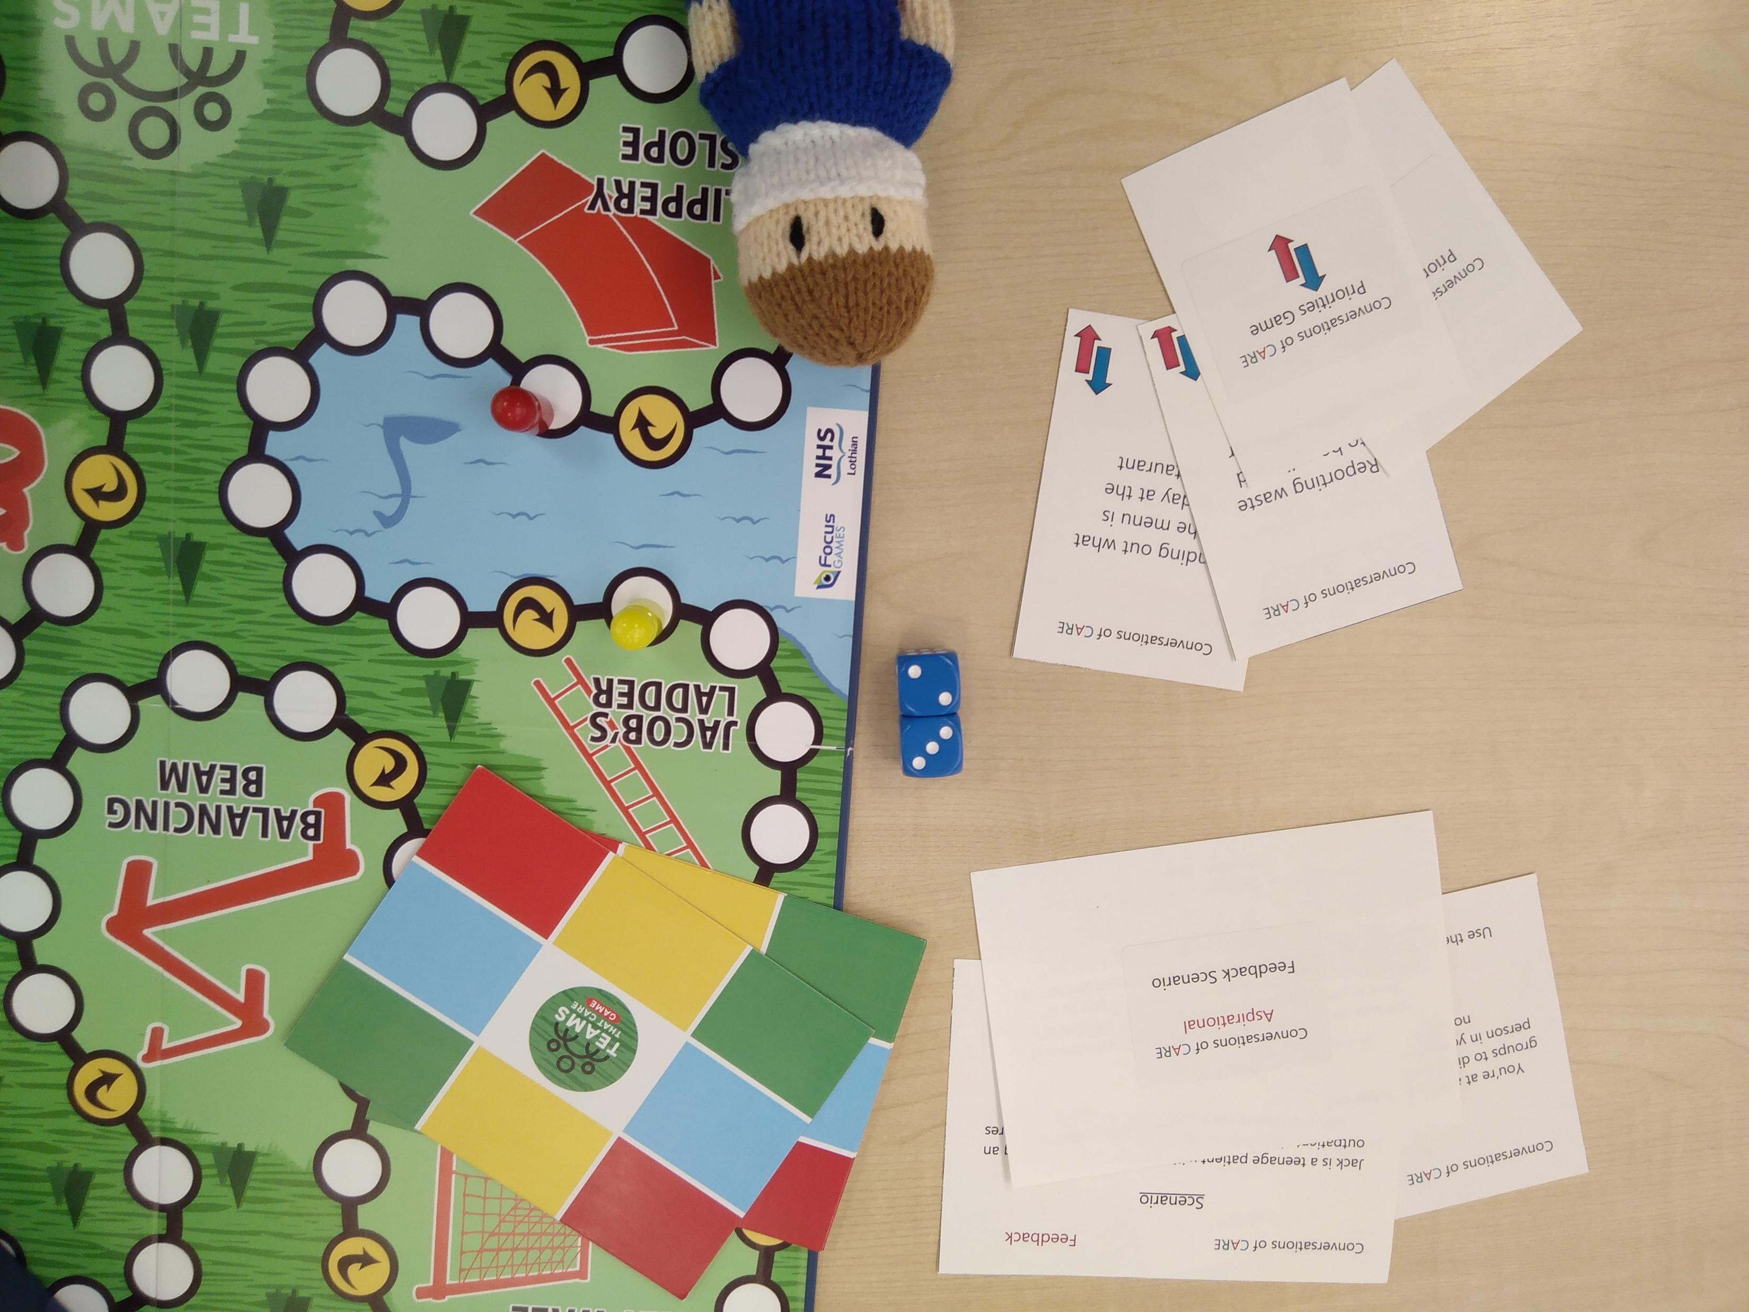
Conversation based
Games
Activities
Videos
Group discussions
Peer-learning
Reflective exercises
Photo: Katie Wise
Notes:
The course consisted of 5 sessions of 1.5 hours spread over 5 weeks, with the first week as an introduction and the remaining 4 sessions looking at each CARE value. This was later reduced to three sessions of 2 hours each to make it more accessible for busy clinical staff who couldn’t commit to five weeks of sessions.
It was important that the course was engaging and interactive, with the majority of exercises being conversation based.
Each week had at least a game, an activity, a video, a reflective exercise, group discussions and peer-learning, all themed around the behaviours relating to that care value. All of these were added for the relaunch of the course in May 22.

Slide 4
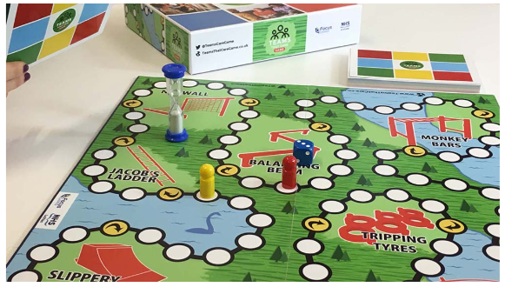
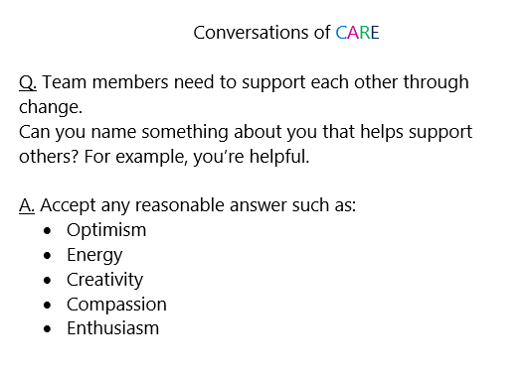
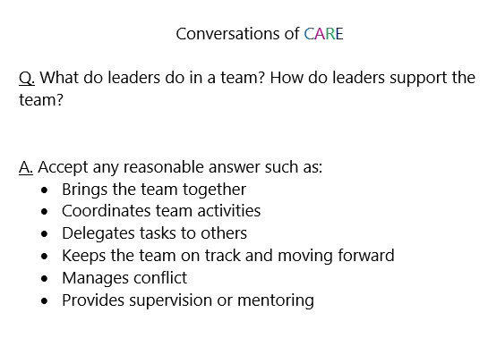
Games
Photo: Focus Games
Teams that Care (Focus Games)
Similar to snakes and ladders
Two teams
No time limit
Pre-selected question cards
Benefits
Ice breaker
Encourages discussion
Sets the tone for the course
Drawbacks
High language level on the game cards
Notes:
We wanted to bring in some board game elements and so we chose to use a game that the Library already had in the collection – Teams That Care, from Focus Games. This is similar to snakes and ladders, where the attendees are split into two groups and on each roll they have to answer a question from a card. We removed the timed element of the game, so there is no limit to how long they have to answer and other team members can contribute as well. We also pre-selected question cards that were related to any of the CARE values.
The benefits of using this board game were that it was a great ice breaker. It encourages discussion from all attendees but in an informal fun way. It also sets the tone for the course – it’s going to be interactive, conversational, supportive, fun. And as the first session is a chance for the trainer to determine the attendees’ levels of English, it encourages everyone to participate.
The only drawback we found was that the cards included in the game had quite high language levels and some were quite complex to explain. This meant that the trainer had to reword the cards before reading them out to make sure that everyone understood what they were asking. Going forward, we would like to either create our own board game with bespoke cards, or create edited cards that are written in a simpler way (e.g. the cards on the slide – before it was reworded, the left card said about ‘what behavioural traits you have’ which was difficult to explain to someone who had English as a second language.

Slide 5
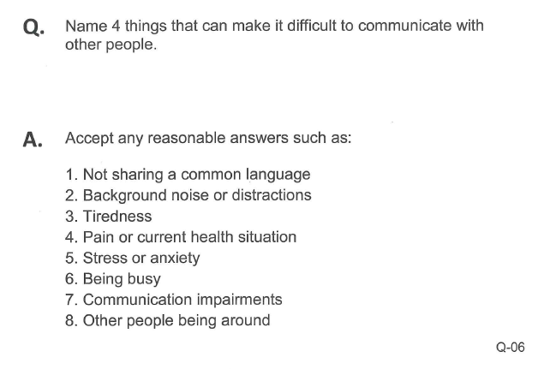
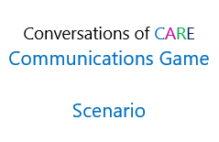
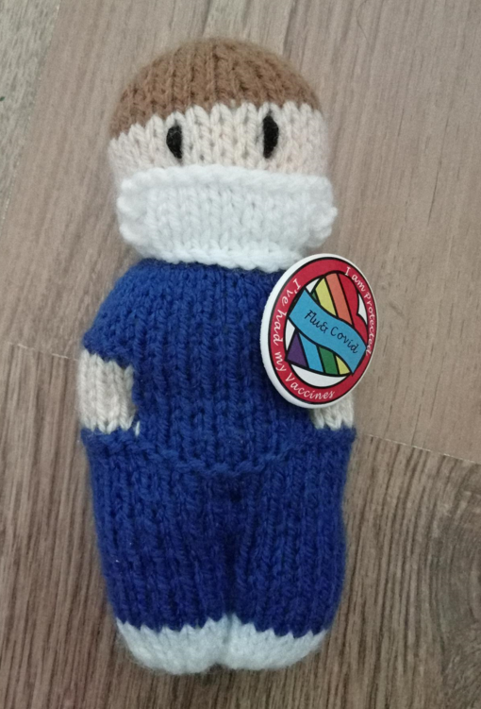
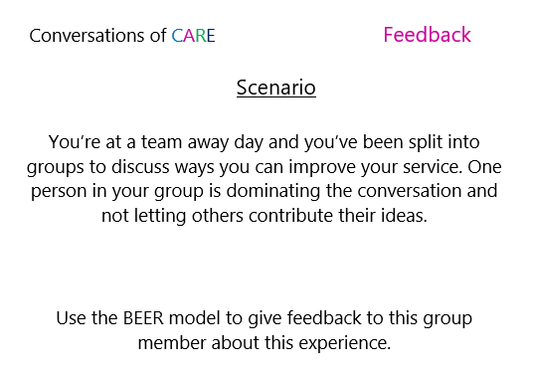
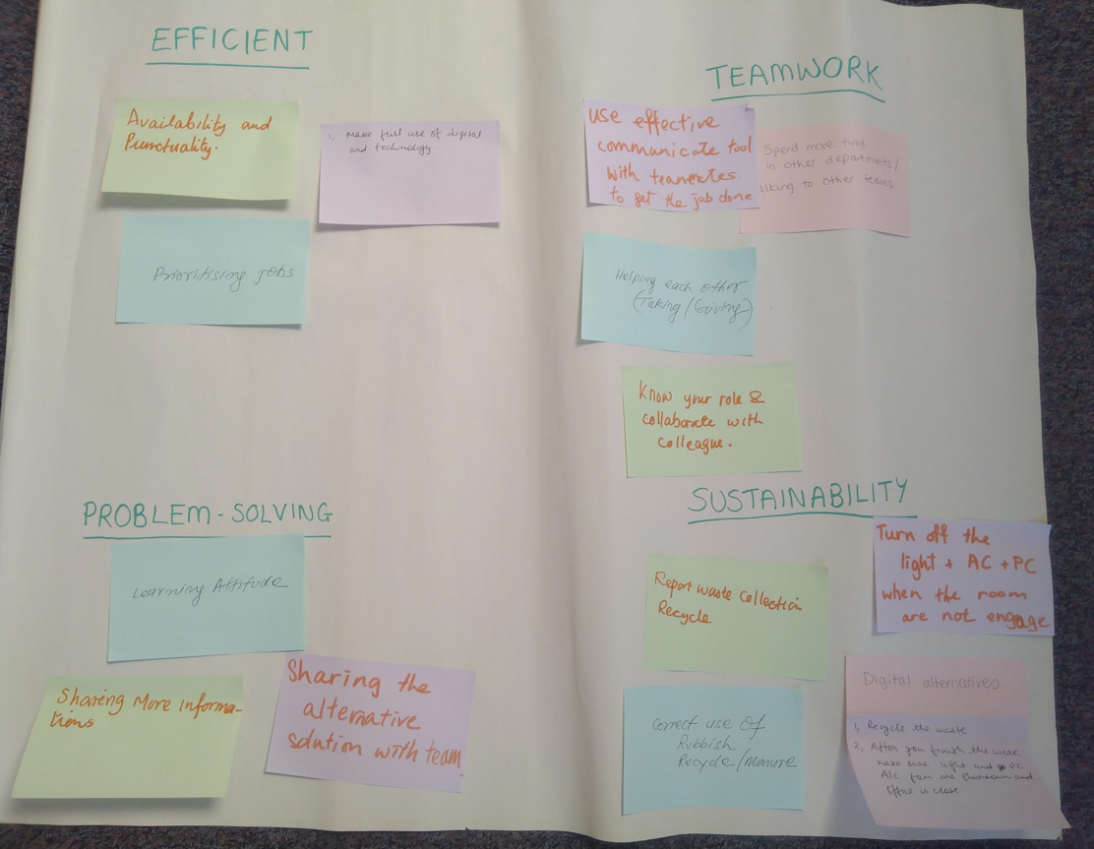
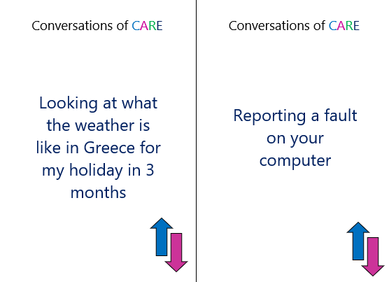
Activities
Lots of activities that included different styles and formats
World Map (Week 1)
Communication Card Game (Compassionate)
Soft Toy Questions (Aspirational)
Feedback Cards (Aspirational)
Flipcharts and Post-its (Resourceful)
Priorities Game (Resourceful)
Images: Katie Wise
Notes:
The course includes lots of different types and styles of activities. Each week includes at least one activity which engages all the attendees and explores a behaviour in more detail.
The World Map activity is during week 1 and is simply where the attendees put stickers on a world map of where they are from. As we use the same map for all cohorts, you can see how international the Trust really is. Everyone then introduces themselves and says what their favourite national food is.
In Week 2, we use the Communication Card Game, which is based on the Communication Game from Focus Games. We selected some question cards and some scenario cards from the game and marked them as either blue (easy) or black (harder). Cards are given out to each person and they split into pairs and ask each other the question on their card. Everyone then comes back together and feedbacks to the group.
For Week 3, Aspirational, we start with a soft toy game. Everyone stands up and spreads out around the room. We ask a question (what do you think aspirational means?) and throw the toy to someone, who answers with a short sentence or a few words. They then throw it to someone else until everyone has contributed. We repeat that with two more questions (how does it feel when you do something that’s really difficult? And how does it feel when you succeed?). This is a great activity because it’s really simple, but it gets everyone engaged straight away. They have to stand up and physically engage with the session, but the questions are easy enough that people don’t feel on the spot and they can always say ‘don’t know’.
Week 3 also uses Feedback cards, where each person gets a scenario and then, in pairs, gives feedback using the BEER feedback model that we discuss. These cards have been created specifically for this course.
During week 4, we use flipcharts and post it notes for an activity around what it means to be resourceful – attendees write or draw what they think being resourceful is and add them to a flipchart. At the end of the session, they do a similar activity where they write ideas down for how they can be more resourceful at work on post it notes and then put them on a flipchart under the different behaviour headings.
In week 4, we also play the Priorities Game which was also bespoke – each person gets five cards which have an action that they might do at work. They have to rank them in order of how important that task is. We go around and ask what was your most important task? Why did you choose that one? Which is your least important card? Then we’ll discuss about how the priorities might change based on the situation or the time of day.

Slide 6
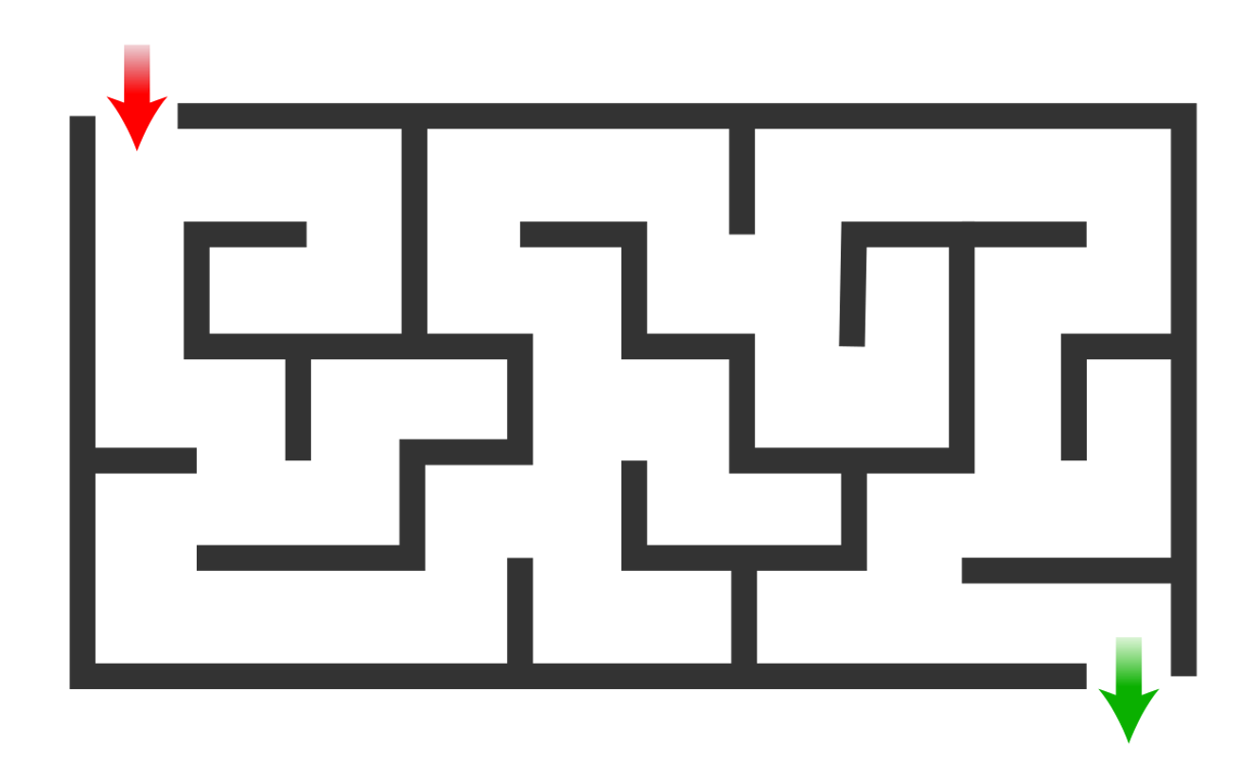
Activities
Maze Game (Excellent)
Benefits
Demonstrates the behaviours
Healthcare specific examples
Tactile items
Encourages peer learning
Drawbacks
Takes time to create
Notes:
The final activity that we do in week 5, is the Maze Game. This was added at the last minute before the course launched but has proved to be the most fun activity, and the most enlightening.
It’s very simple, all you need is a simple maze image on a piece of paper and something to move like a counter or magnet. Each pair gets a maze and a counter, and one person has to move the counter through the maze with their eyes closed while their partner helps them in whatever way they want. Then, they repeat it but this time, the partner cannot support them.
The purpose of this game is to explore how it feels when someone is supporting you, or you are supporting someone else. This game leads to discussions around trust, and how it can be difficult to not help someone when you see they are struggling. One attendee, even though we’d told her that she couldn’t give any help to her partner, she sat there and cheered her on saying ‘you’re almost there, you can do it, don’t give up!’ This was a really lovely way of demonstrating how you can still support someone, even if you can’t help or don’t know how to help.
Doing all of these activities had lots of benefits. They demonstrate the behaviours in a more practical way, with activities like the Communications Cards and the Priorities Game written specifically for the healthcare setting. Using tactile items such as toys, cards, post it notes, makes it more engaging than just asking them a question and encourages more peer learning and group discussions.
The drawback to using lots of activities like this, is that it takes a lot of time to create. We created several bespoke games, and adapted a few others, which meant that we couldn’t launch the course until May because we creating all this content. It would be quicker and easier to just ask questions, but we wanted to make it more interactive.

Slide 7
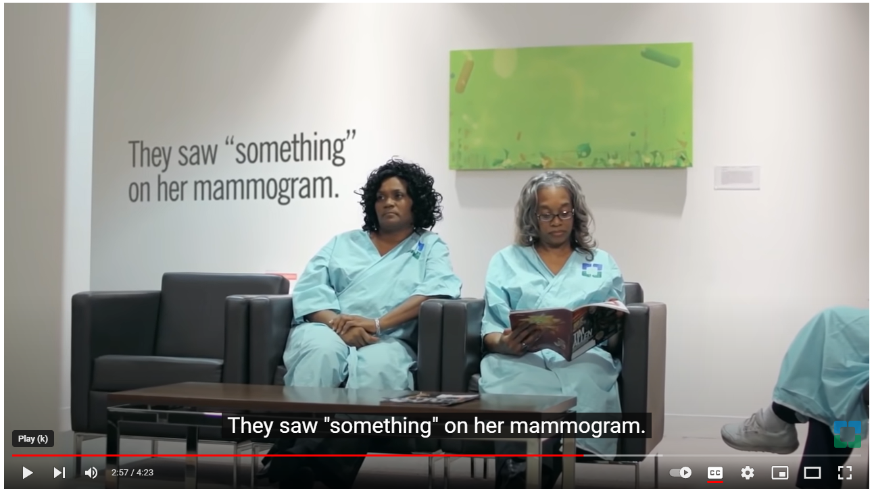
Videos
Four videos used in the course
RBFT strategy and vision
Empathy: The Human Connection to Patient Care
RBFT Freedom to Speak Up Guardian
Sustainability at RBFT
Benefits
Good for visual learners
Can link back to the organisation with examples
Drawbacks
Difficult to find appropriate videos
Empathy: The Human Connection to Patient Care, Cleveland Clinic, https://youtu.be/cDDWvj_q-o8
Notes:
We also used videos throughout the course, with 4 videos being used.
Videos can be good for visual learners, and one piece of feedback we got was that someone wanted more videos because it helped her understand and remember the content. They were also good for showing Trust examples, such as who our Freedom to Speak Up Guardian is and examples of how staff at the Trust were making sustainable changes.
However, it can be difficult to find videos that are appropriate for the content, give the message that you’re trying to make, and are understandable by different nationalities.

Slide 8
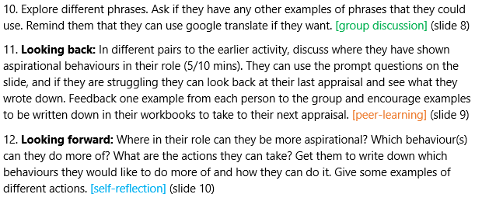
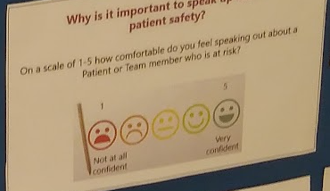
Group Discussions
Used to explore questions as a group
‘Why is it important to speak up about patient safety?’
Peer-learning
Used each week in a ‘looking back’ exercise
Discussions in pairs or small groups
Self-reflection
Rating themselves – ‘how comfortable do you feel speaking out about someone at risk?’
Role models
‘Looking forward’ exercise
Notes:
Finally, the other types of teaching we used were Group Discussions, Peer Learning and Self-reflection. In the guidance for facilitators document, it identifies the type of activity it is.
Group discussions are used to explore wider questions like ‘why is it important to speak up about patient safety?’.
Peer learning was where they discussed questions in small groups or pairs and was used each week in a ‘looking back’ activity, where they identified where they have shown examples of the behaviours in their work.
Self reflection was for exercises where they were relating it back to their own practice which they might want to keep private. There were a few exercises where they rated themselves on a scale – e.g. how comfortable they feel speaking out about risk, we looked at our role models and what behaviours they show, and a looking forward exercise where they plan where they can practice the behaviours more. Each learner has a Conversations of CARE workbook which has space for each of these activities and space to reflect.

Slide 9
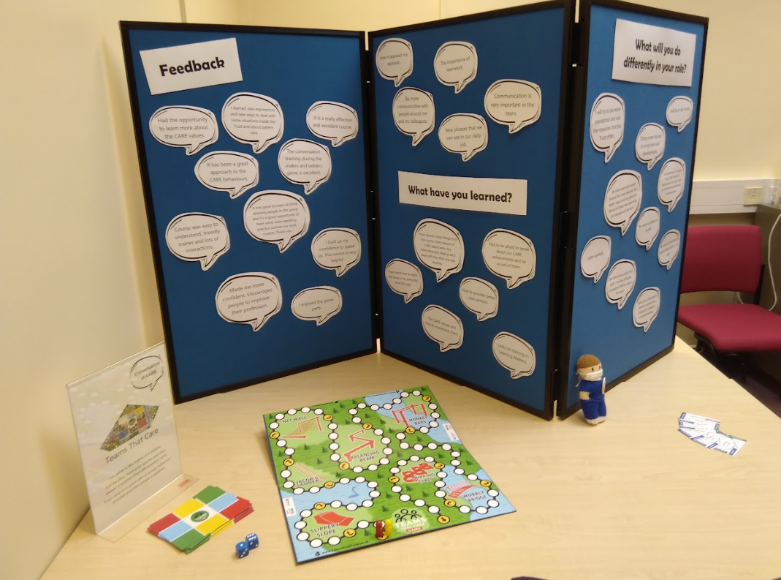
Inclusivity
Breaking down the CARE values
Language barriers
Rewording, explaining
Google translate on iPads
Practicing English conversations
Healthcare examples
Combining different activity styles
Reducing the course length
Photo: Katie Wise
Notes:
The purpose of the programme was to make the CARE values more accessible and break them down so they can be understood by our international staff. There were some language barriers – using words like compassionate and aspirational, and behaviours like ‘empathy’ can be difficult to translate or explain what you actually mean by them.
We tried to make them more inclusive by rewording sentences, asking questions, exploring words and explaining. We also provided iPads with google translate loaded so learners could translate words if they needed to.
A lot of it was about confidence having conversations in English as well, which we’ve also achieved by launching as a result of this, a Conversation Café in April 2023. When asked what the attendees would do differently in their role since completing this course, many said they would practice having more conversations, they would speak up more, and have more confidence in themselves. The activities encouraged them to speak up and contribute to discussions, even if they were worried they would get words wrong, which gave them the confidence to take this back to their wards and departments.
We also wanted the content to be relatable to their work – we used healthcare examples and where possible, linked things back to the organisation’s policies, culture and systems. The looking back and looking forward activities were designed so that staff identified specific actions they could bring out in their appraisal.
By combining different types of activities, it gave attendees a chance to engage in whatever content they prefer. If they don’t like speaking out in large groups, they don’t have to engage with those parts, and there are self-reflection activities and peer learning they can do instead. If they prefer to discuss everything as a group instead of in pairs, the course is flexible enough to allow that.
Finally, after several cohorts, we wanted to try and reduce the course length from 5 weeks to 3, as lots of attendees struggled to attend all 5 sessions with clinical shifts. It was also a lot of work for the trainer, especially running multiple cohorts at once.

Slide 10
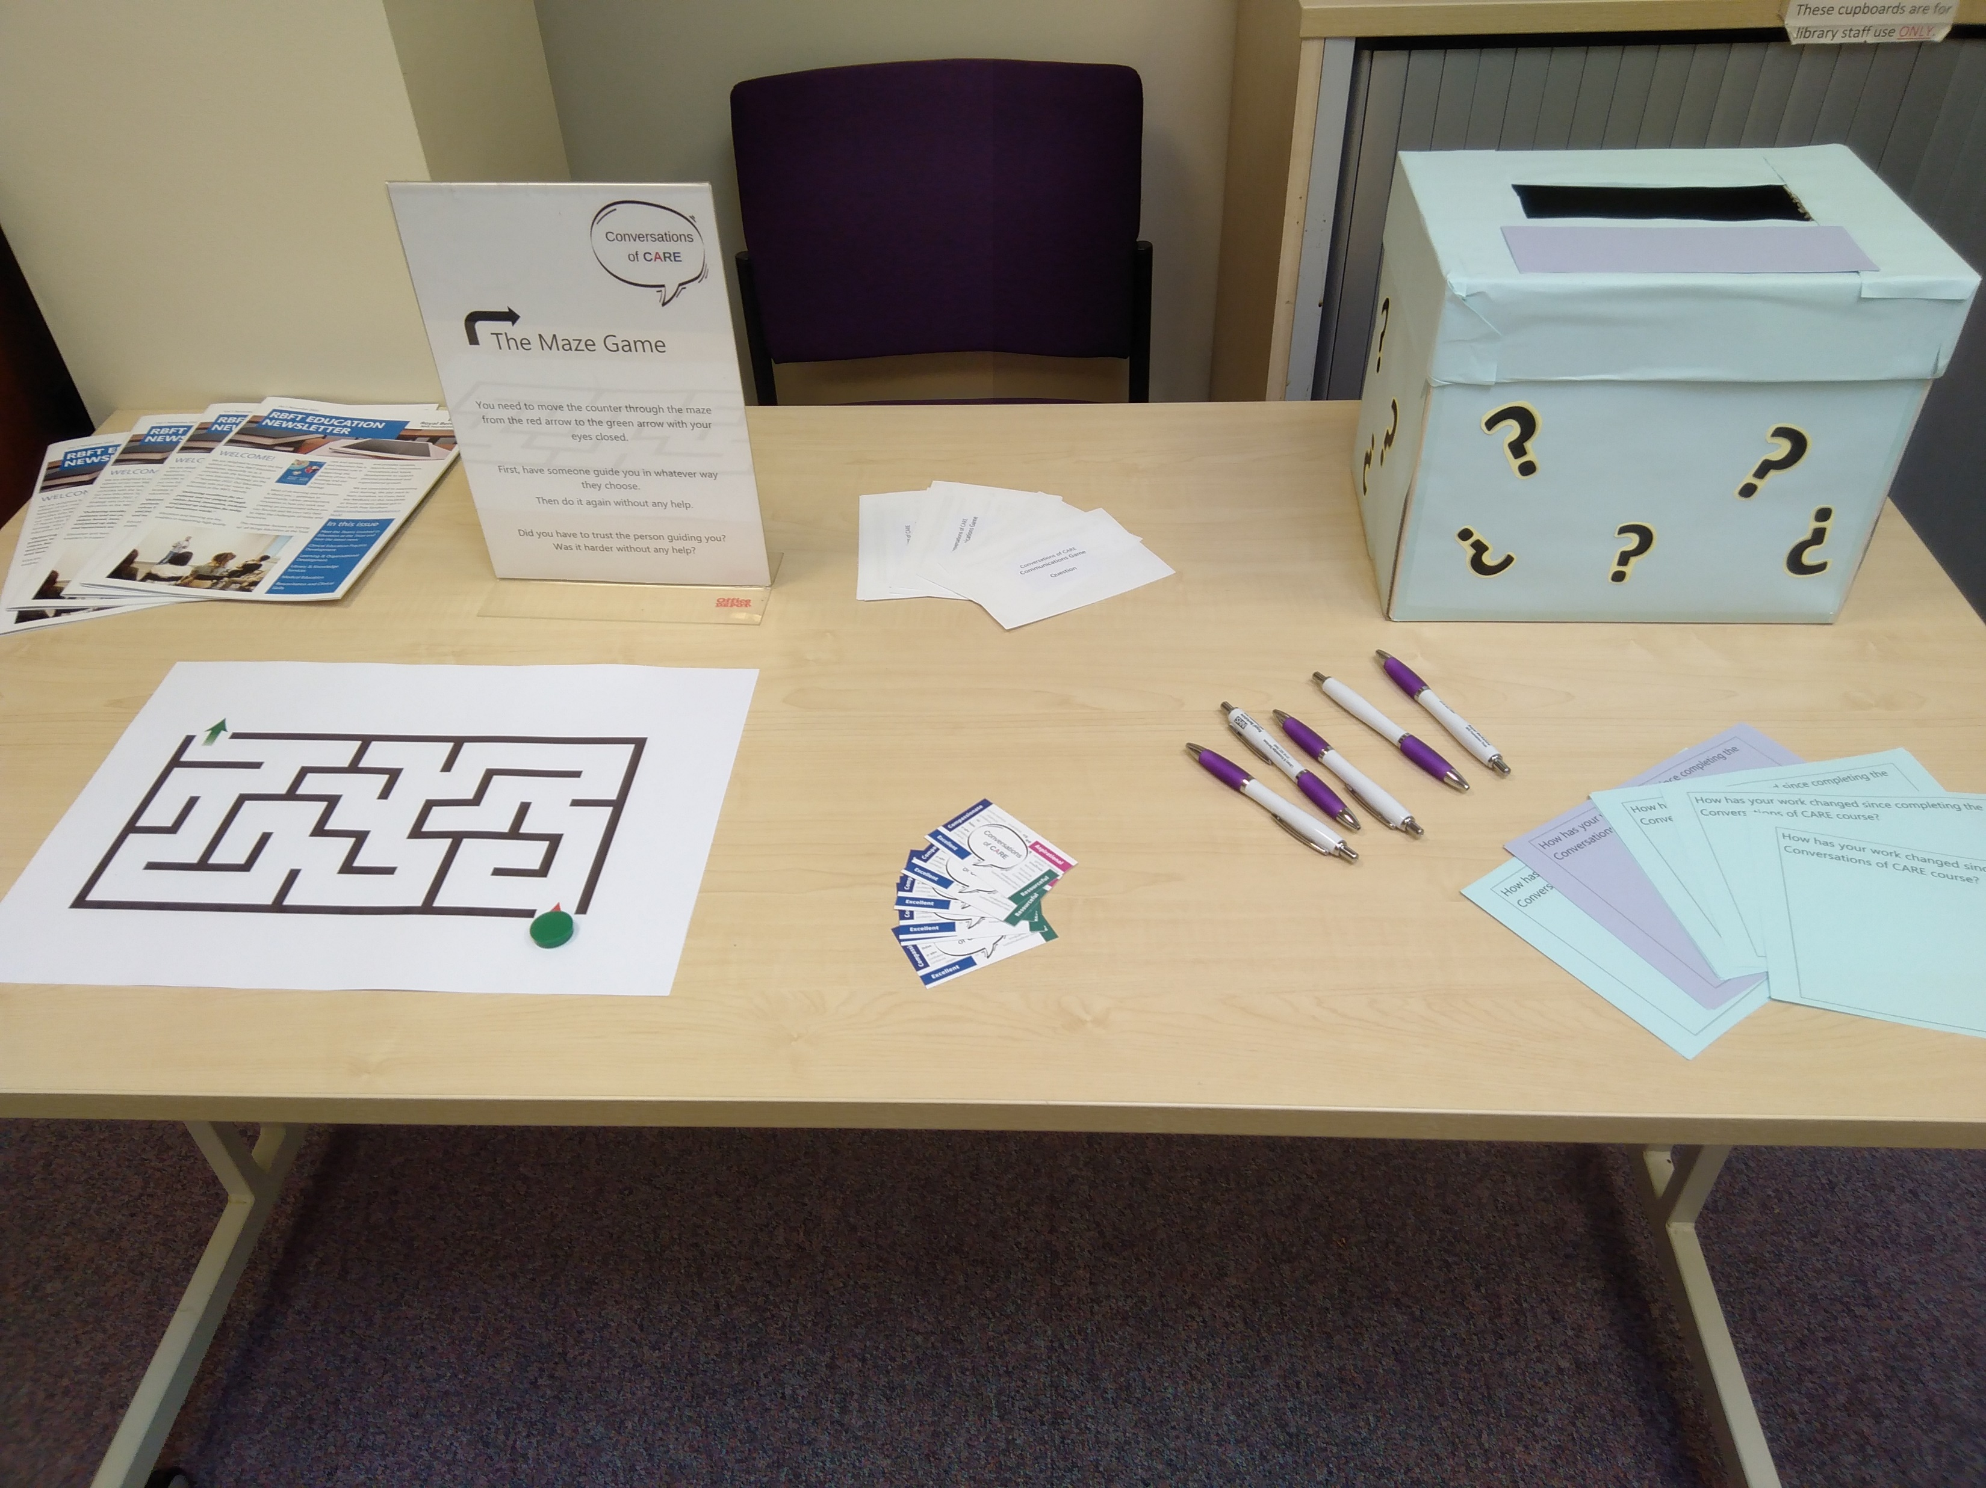
What next?
Photo: Katie Wise
Continue to run the course
Launched a Conversation Café
Expanding the course to band 6 Medical Support Workers
Measuring impact
Any Questions?
Notes:
We continue to run the course and make improvements and changes where we need to. We learn more every time the course is run, so it is constantly evolving.
As I said earlier, from the back of this we have launched a Conversation Café as a collaboration with Practice Development, to provide ongoing language support for international staff on a more informal basis.
We were also asked to expand the course for band 6 Medical Support Workers, who are international doctors who have not yet registered in the UK. We did a trial cohort in October 2022, but it was felt that we needed more information about the MSWs and that the content wasn’t entirely suitable for them. Despite this, the feedback received from the cohort was really positive so it might be something that is looked into again in the future.
Finally, we’d like to be able to measure the impact the course has had for previous attendees but we’re not yet sure how to collect this data.

