Slide 1


Collections on the go: A walking tour app for Paralympic heritage
Samuel Brady
PhD student and volunteer at the National Paralympic Heritage Trust
Bethany Watrous
Director
Experience Heritage
s.brady.1@research.gla.ac.uk
sam.brady@paralympicheritage.org.uk
@SamB24 (Twitter)
bethany@experience-heritage.com
www.linkedin.com/in/bethanywatrous/
www.experience-heritage.com

Slide 2
Today’s talk:
Sam - Historical information about Stoke Mandeville and impetus for project
Bethany – More about Experience Heritage, and development of app
Sam – app content
Bethany - app design
Sam - Notes on feedback and accessibility

Slide 3
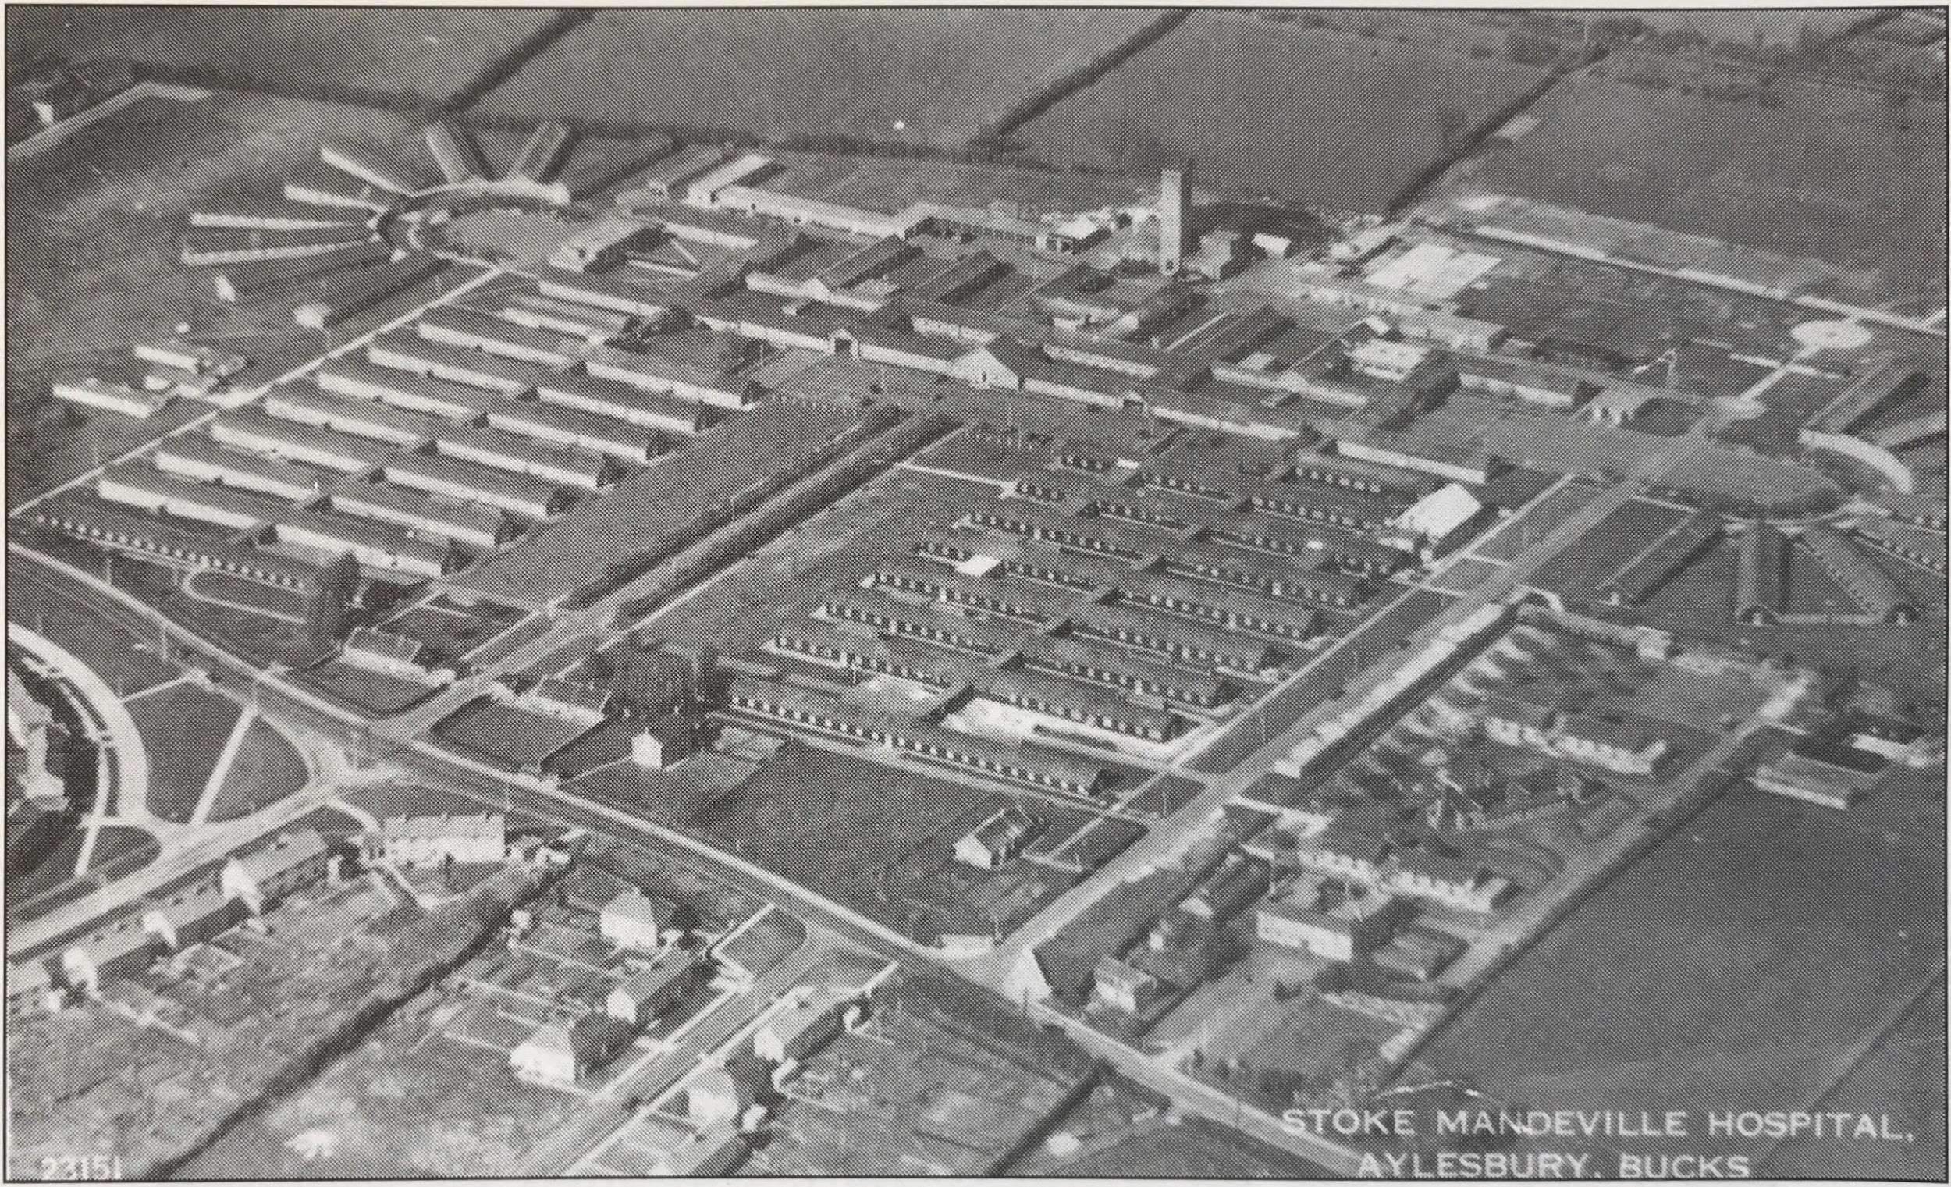
Stoke Mandeville Hospital in 1942.
Source: Stoke Mandeville: Road to the Paralympics, Joan Scruton.

Slide 4
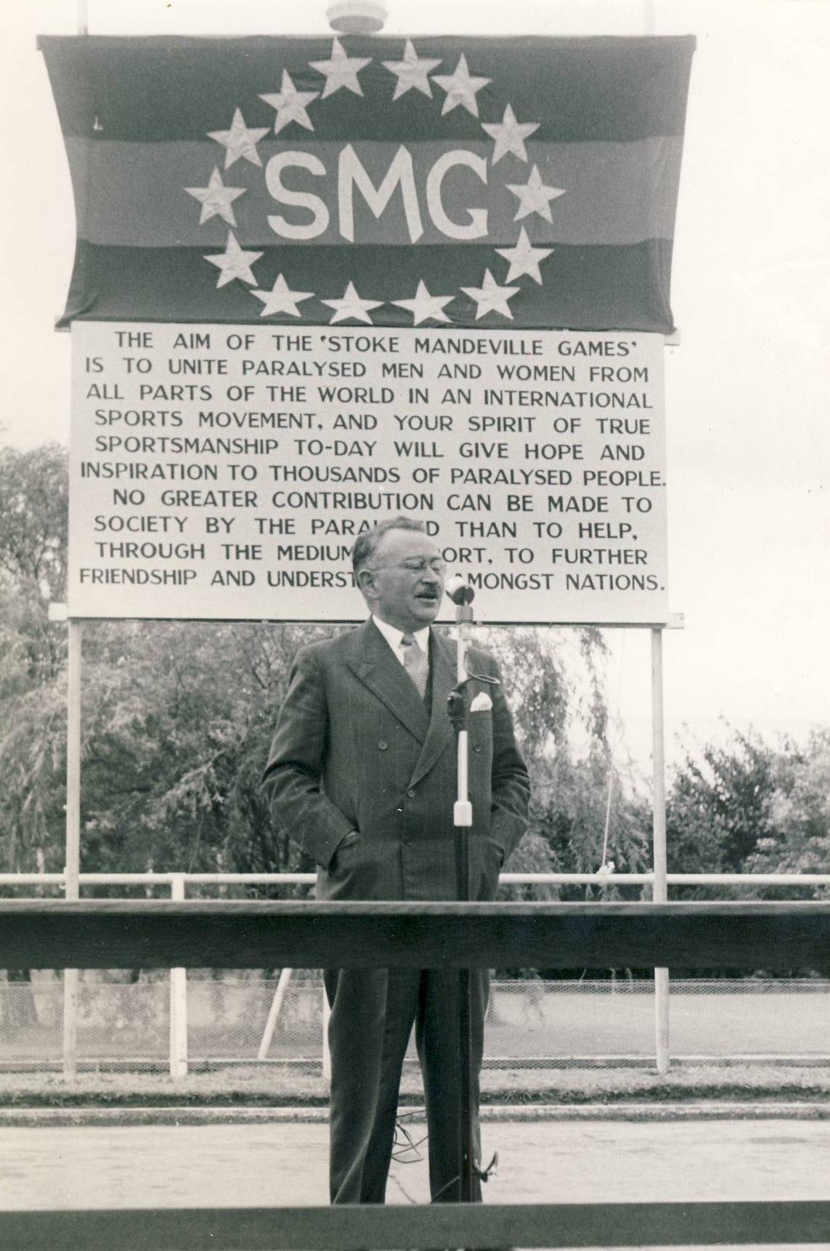
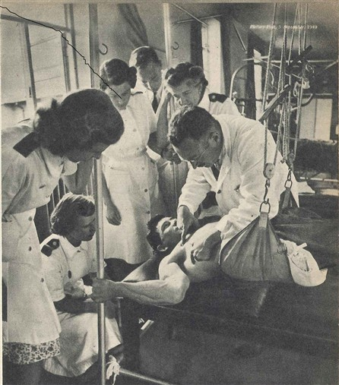
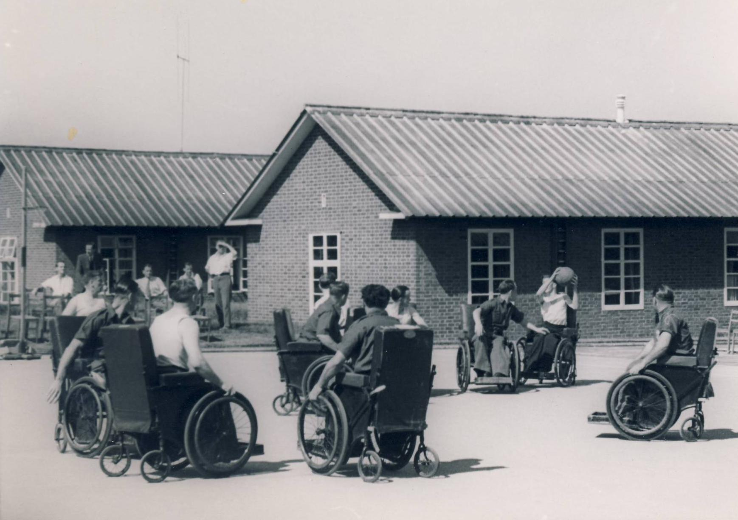
Dr Ludwig Guttmann with a patient and nurses at Stoke Mandeville Hospital
Copyright NPHT
Wheelchair Basketball at Stoke Mandeville C. 1950s.
Copyright WheelPower
Guttmann speaking at the 1953 Stoke Mandeville Games (Precursor name to the Paralympics)
Copyright WheelPower

Slide 5
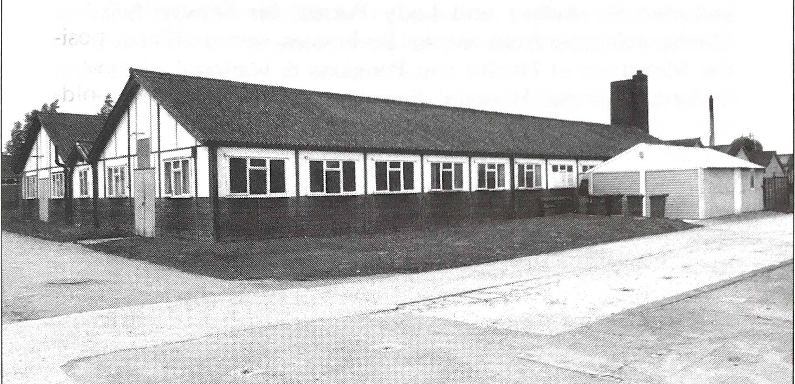
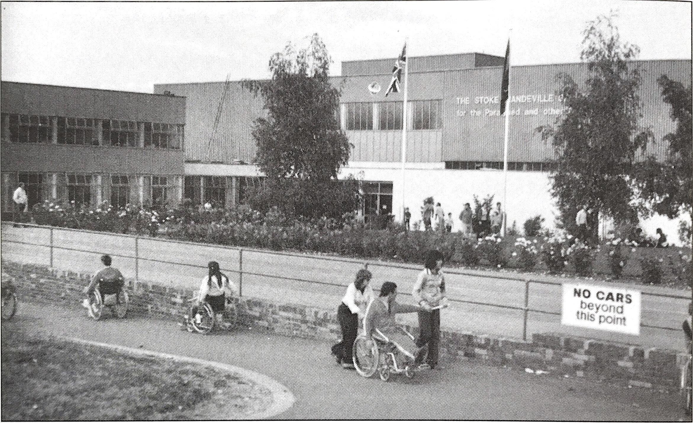
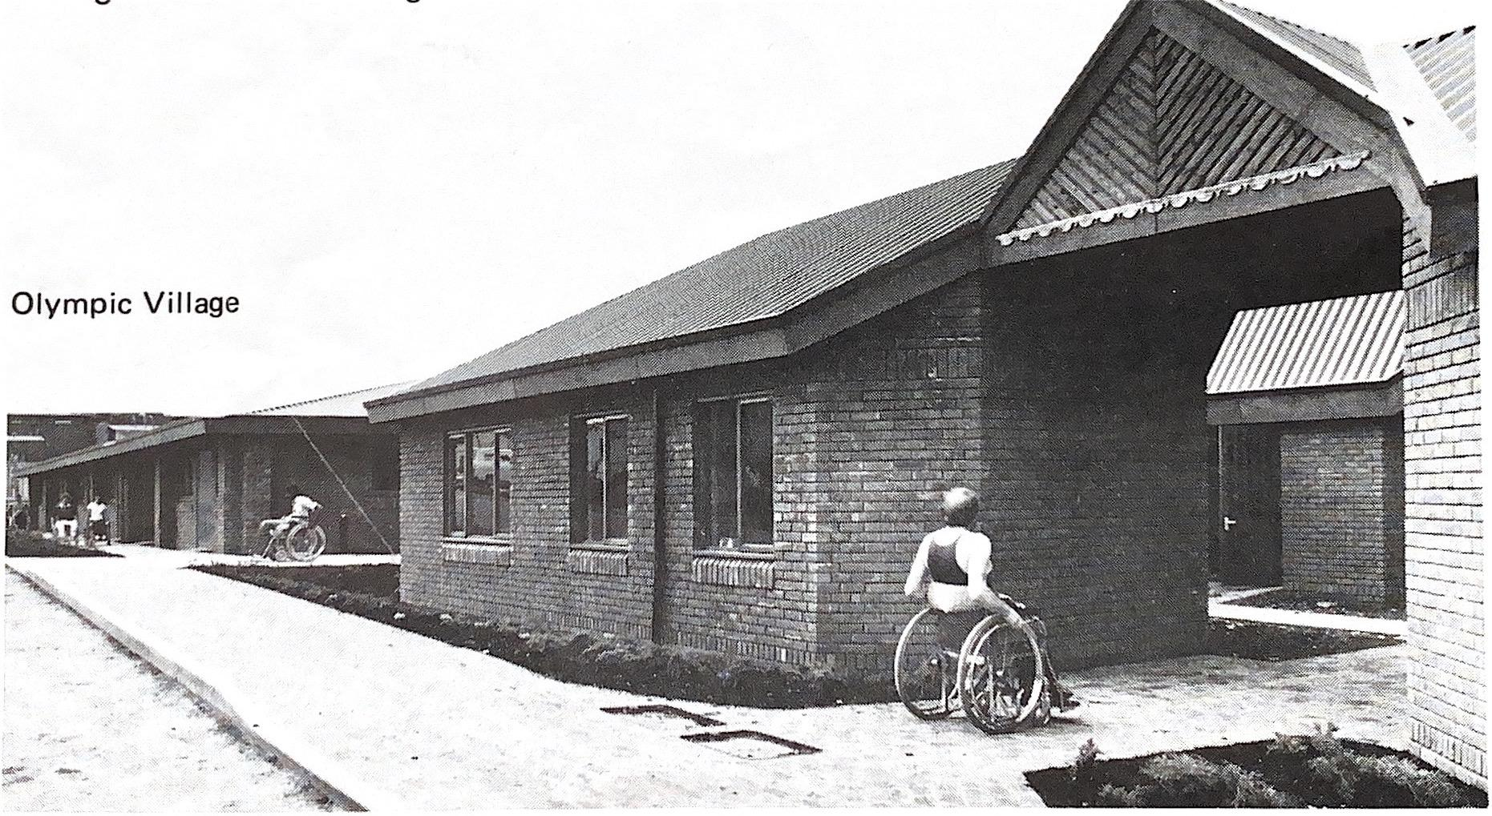
Hospital-style huts, built as athlete accommodation in the 1950s and 1960s.
Source: Stoke Mandeville: Road to the Paralympics, Joan Scruton.
Stoke Mandeville Stadium in early 1970s, before redevelopment in early 2000s
Source: Stoke Mandeville: Road to the Paralympics, Joan Scruton.
The Olympic Village, built as athlete accommodation in 1980. Renamed the Olympic Lodge in the early 2000s
Copyright WheelPower

Slide 6
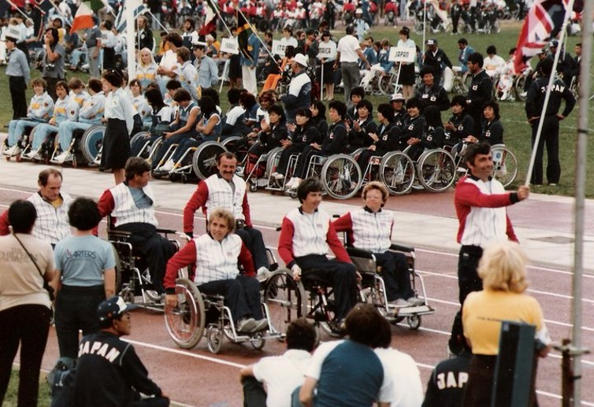
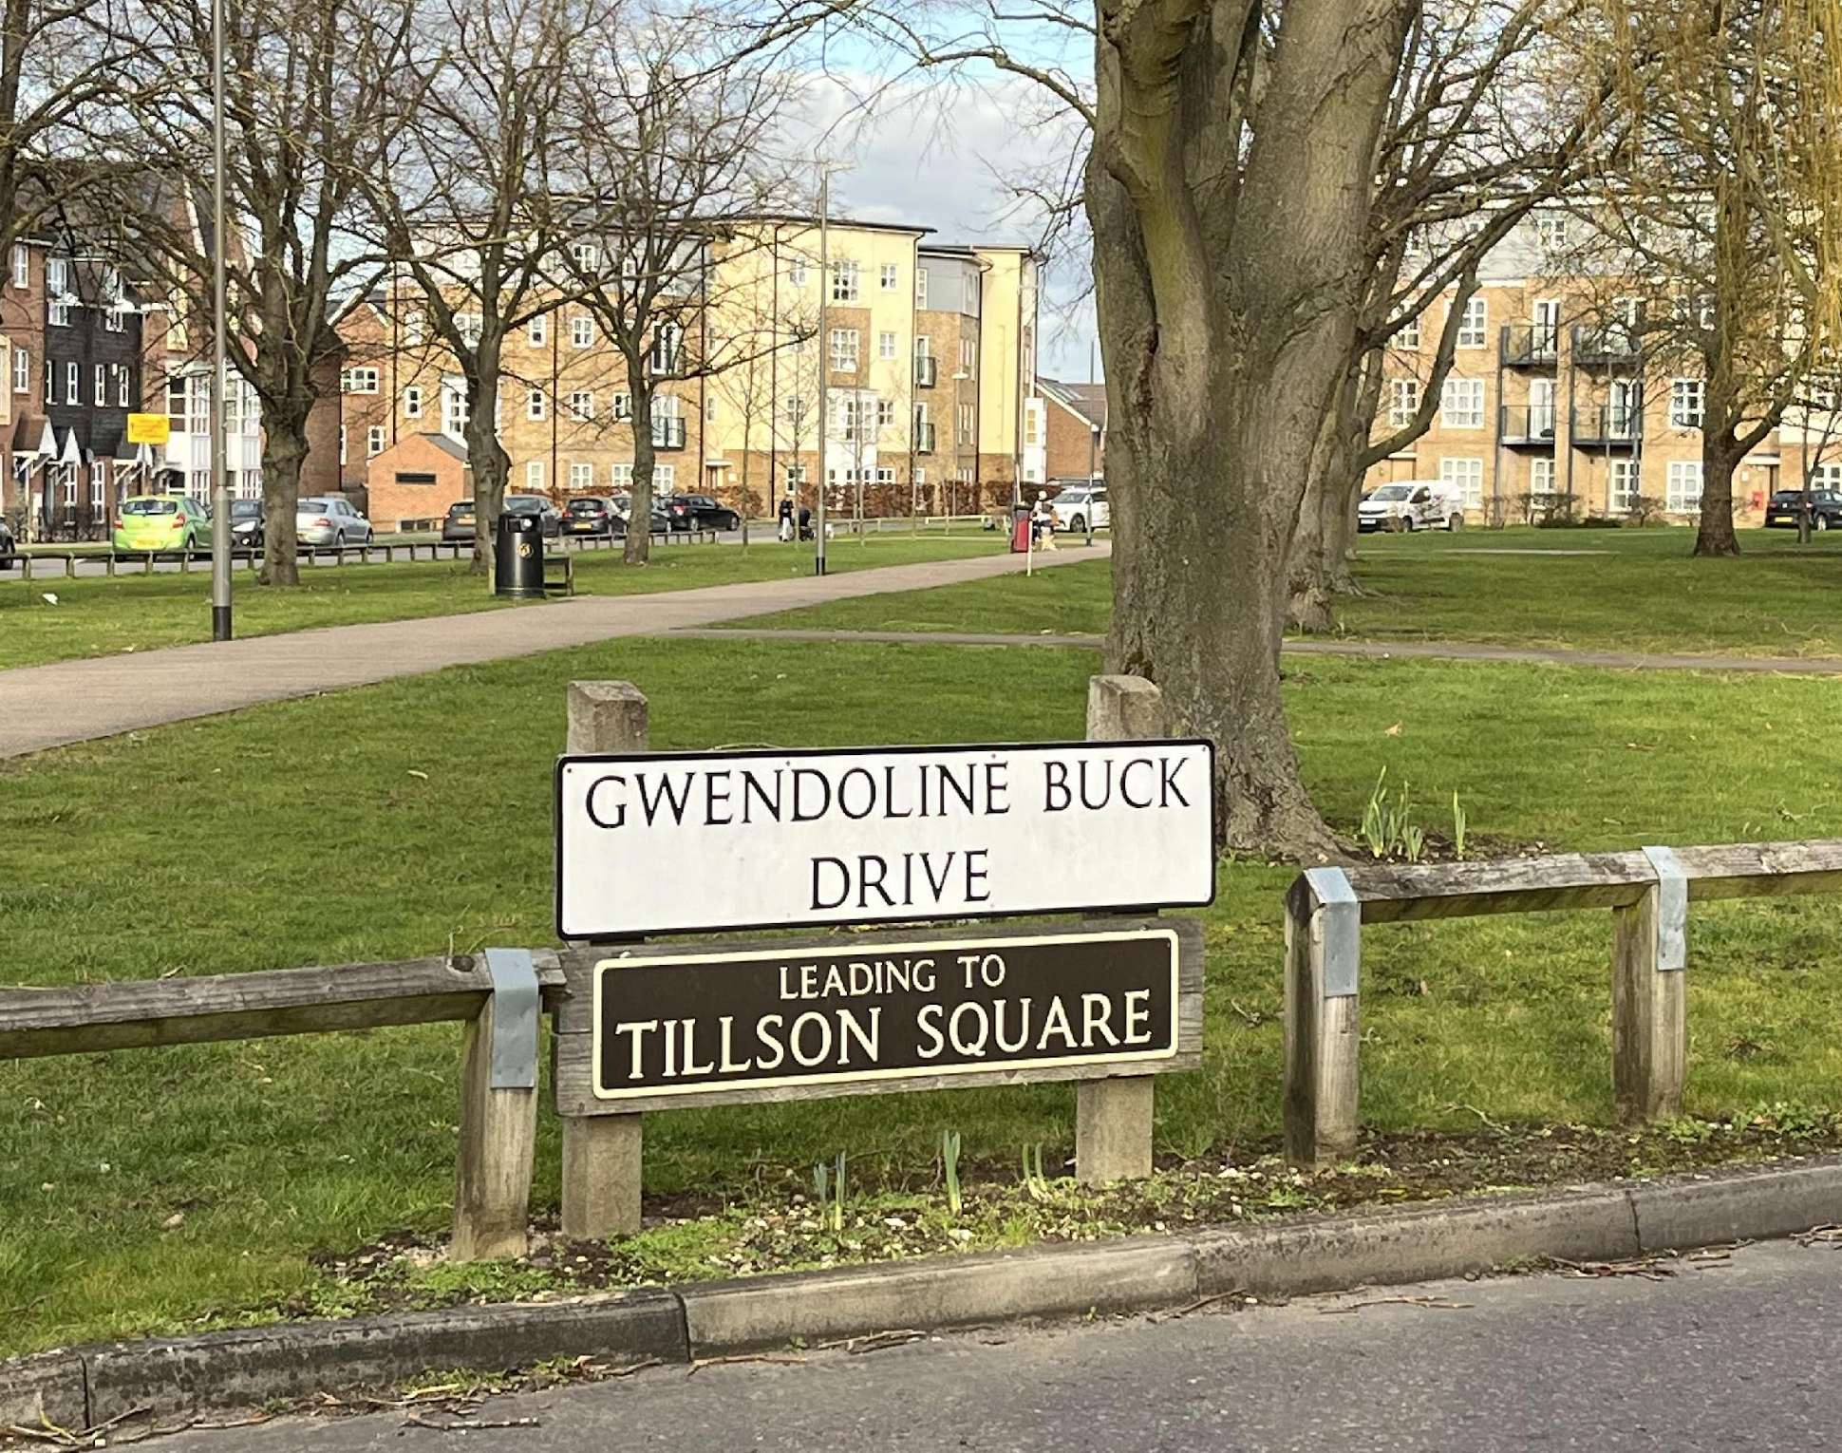
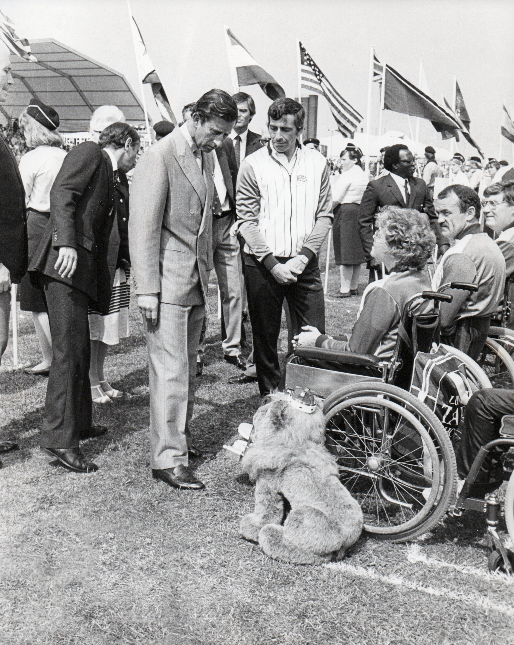
Members of the British team at the Opening Ceremony of the 1984 Games
Copyright WheelPower
Gwendoline Buck Drive, off Stadium Approach. Named after British Paralympian Gwen Buck
Image taken by Sam Brady
King Charles at the Opening Ceremony of the 1984 Games
Copyright NPHT

Slide 7
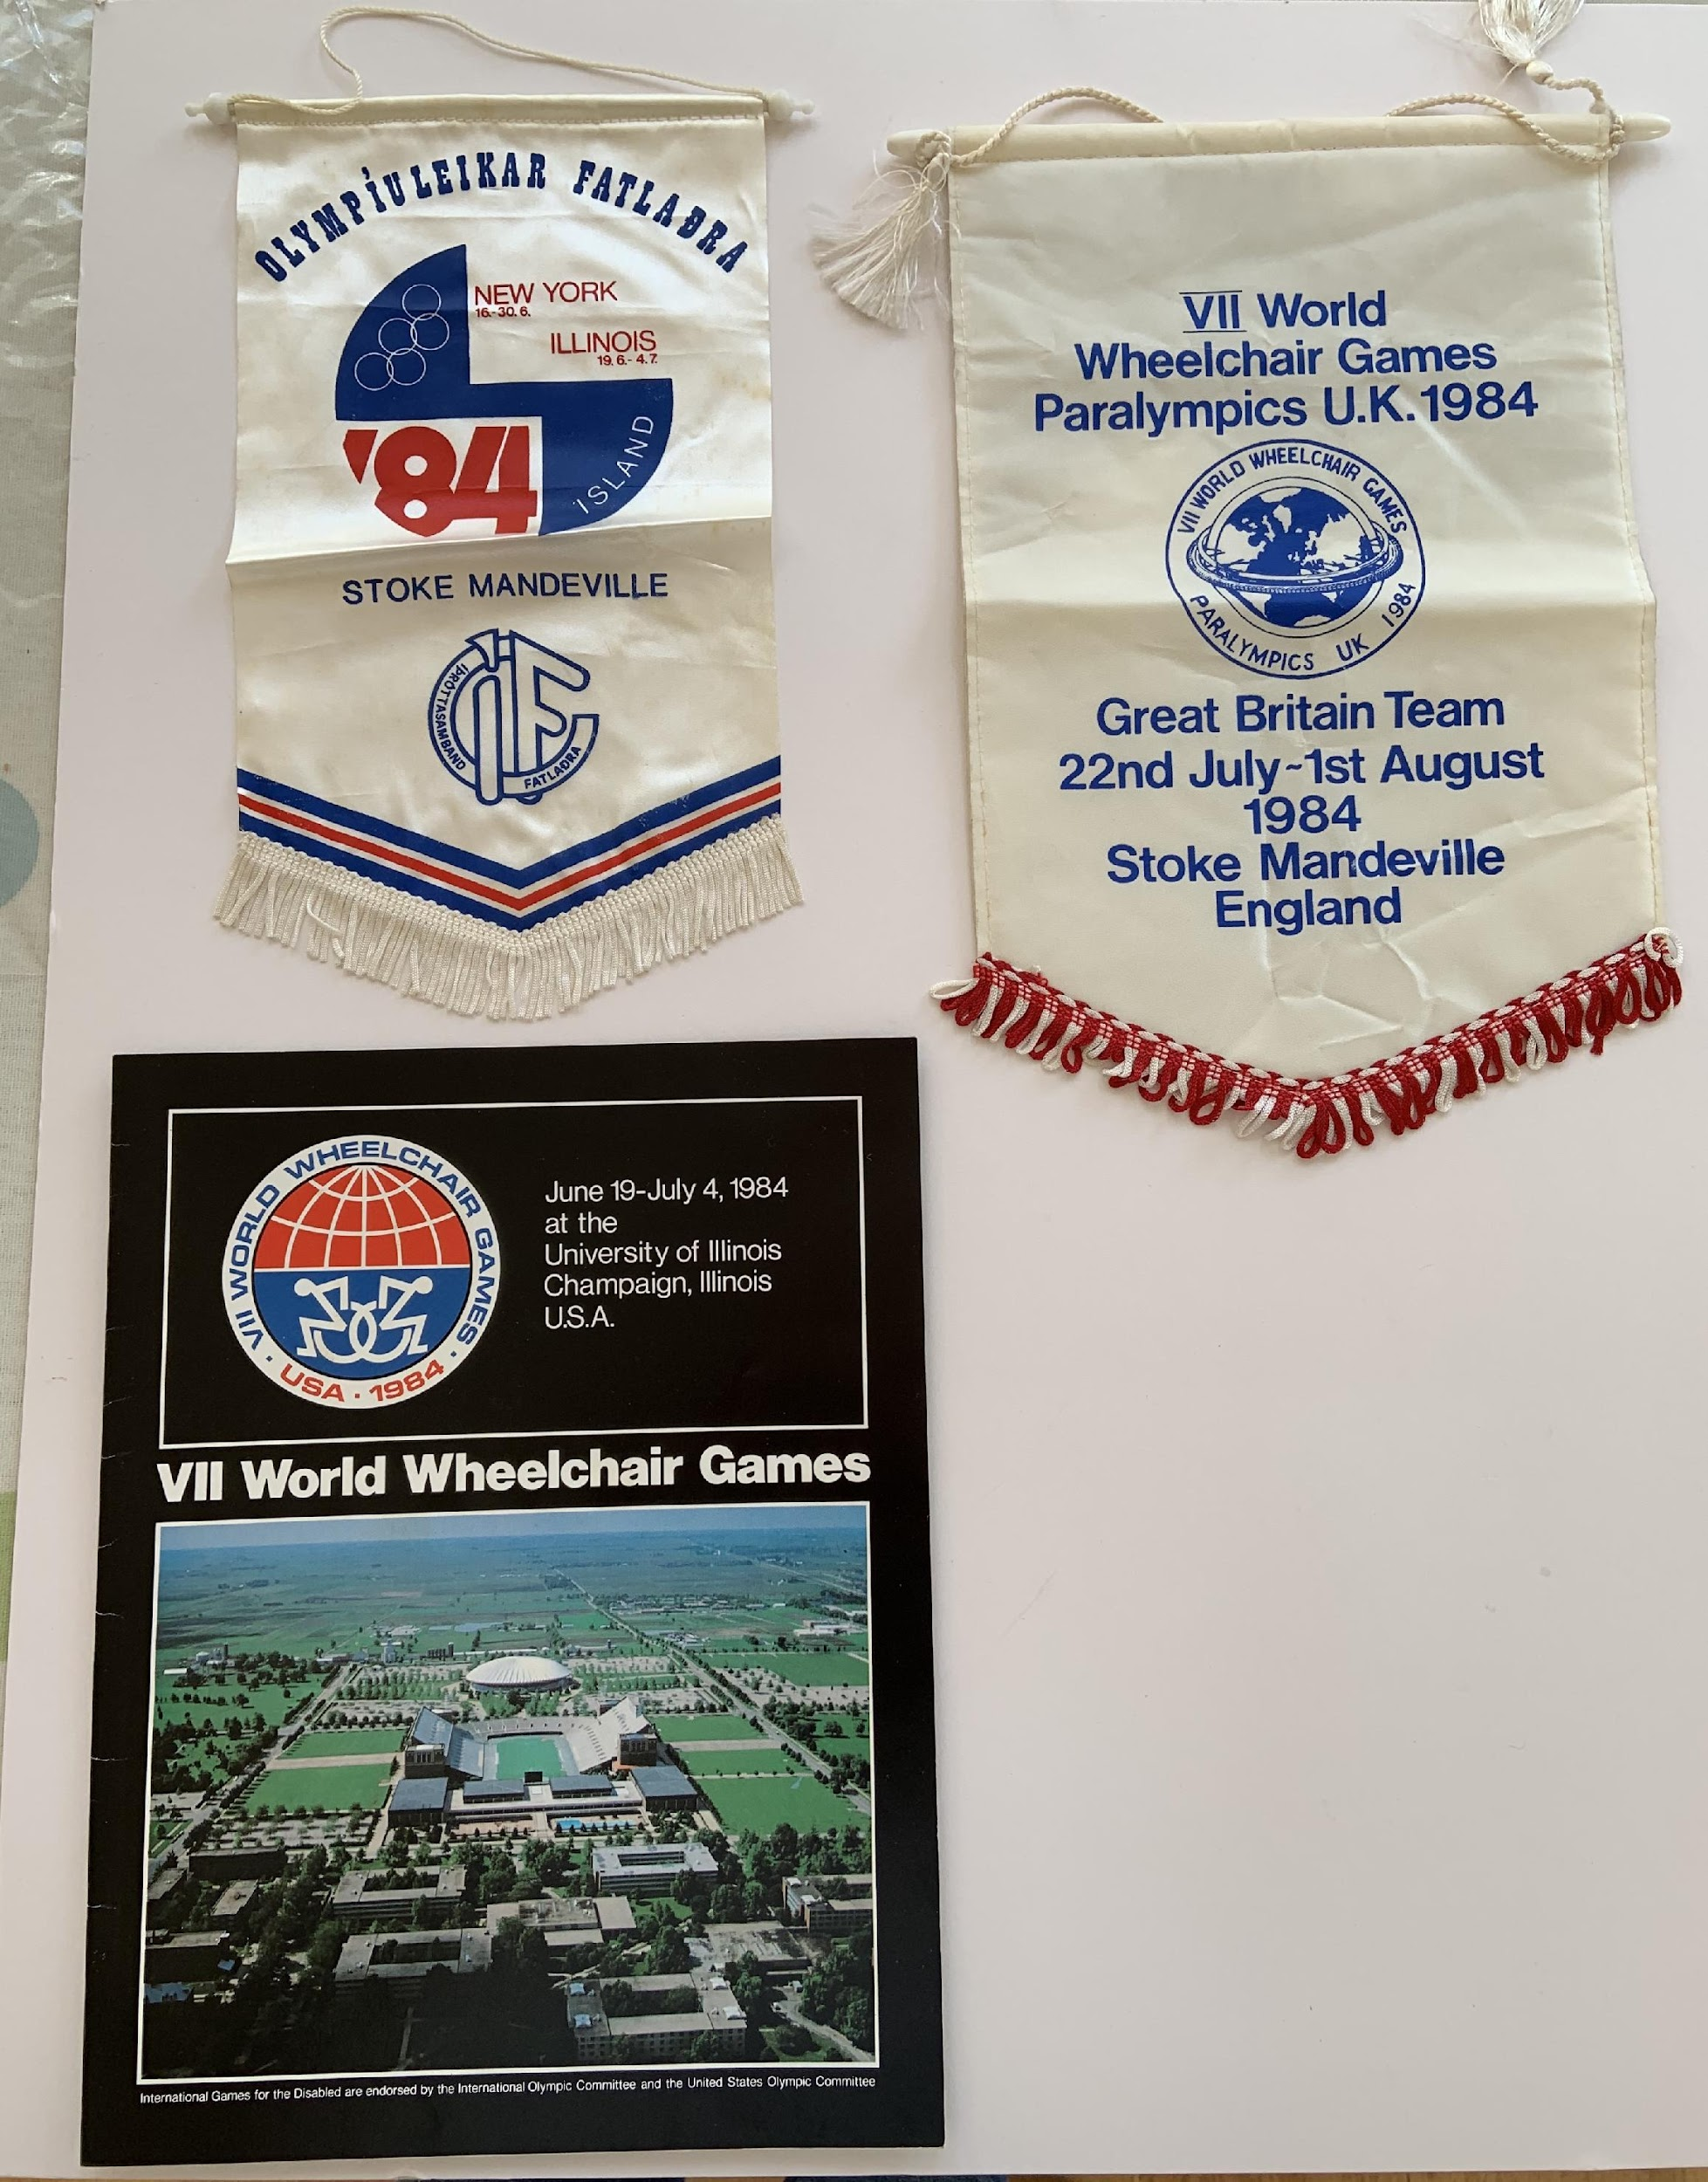
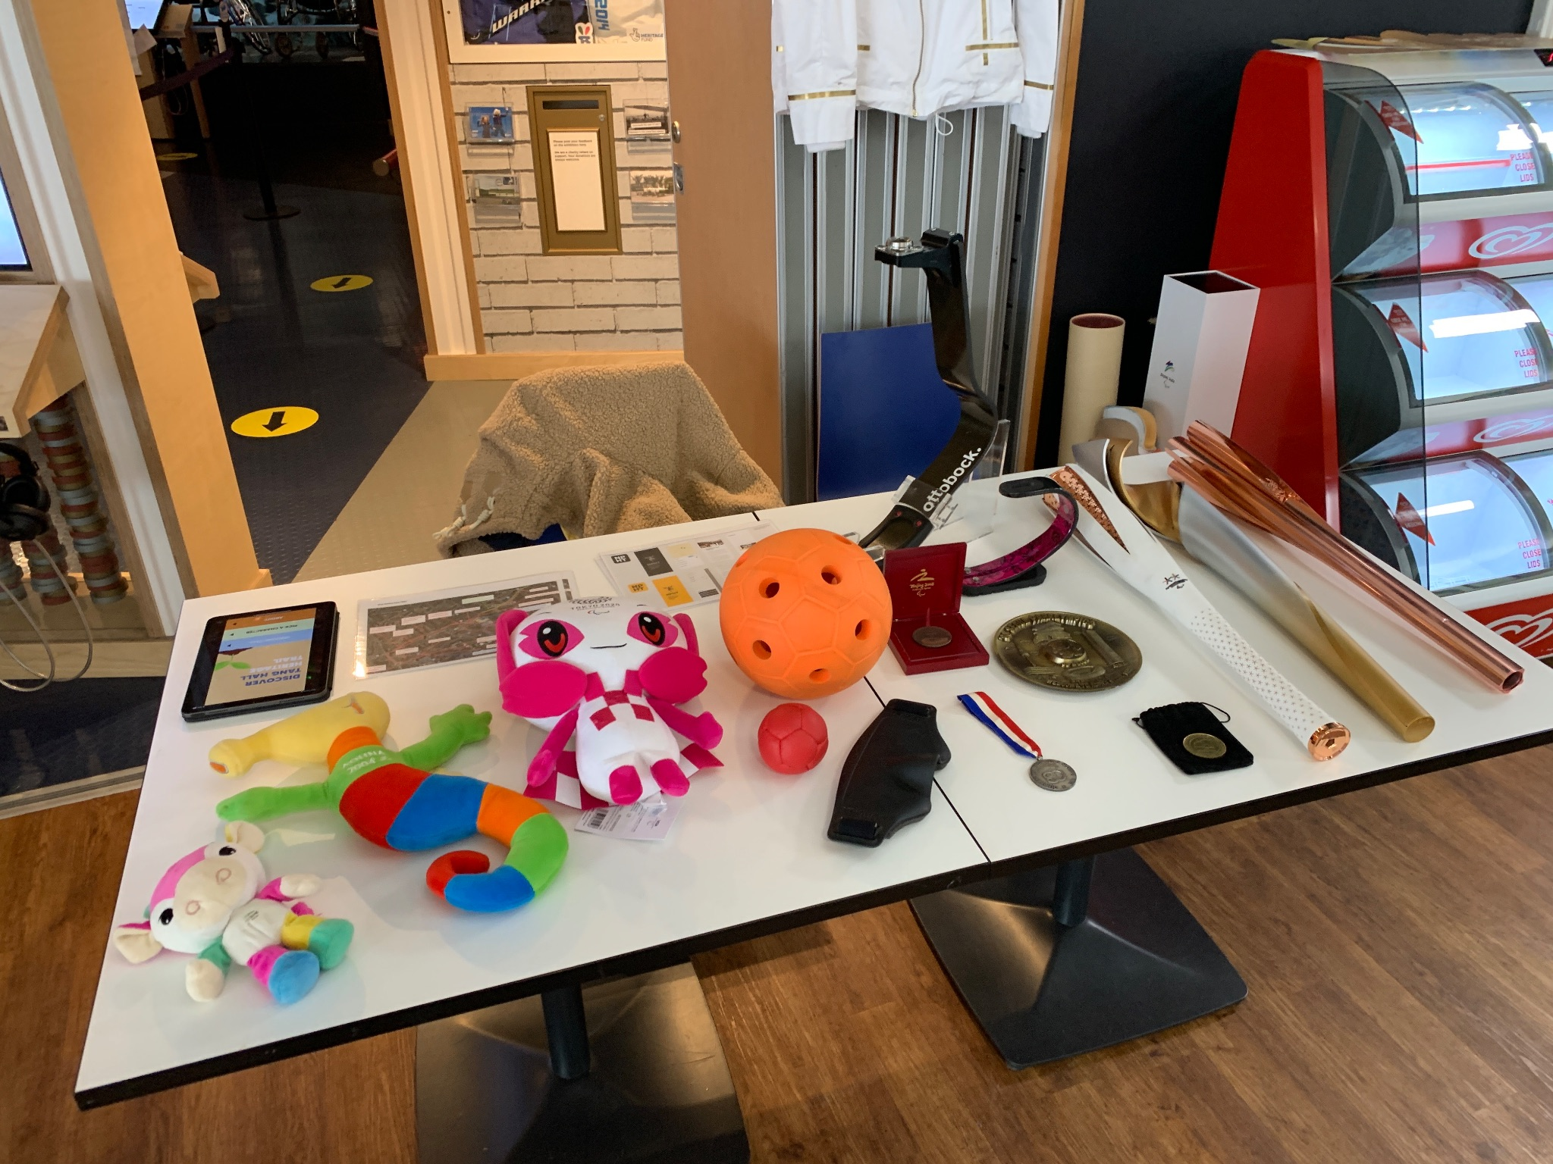
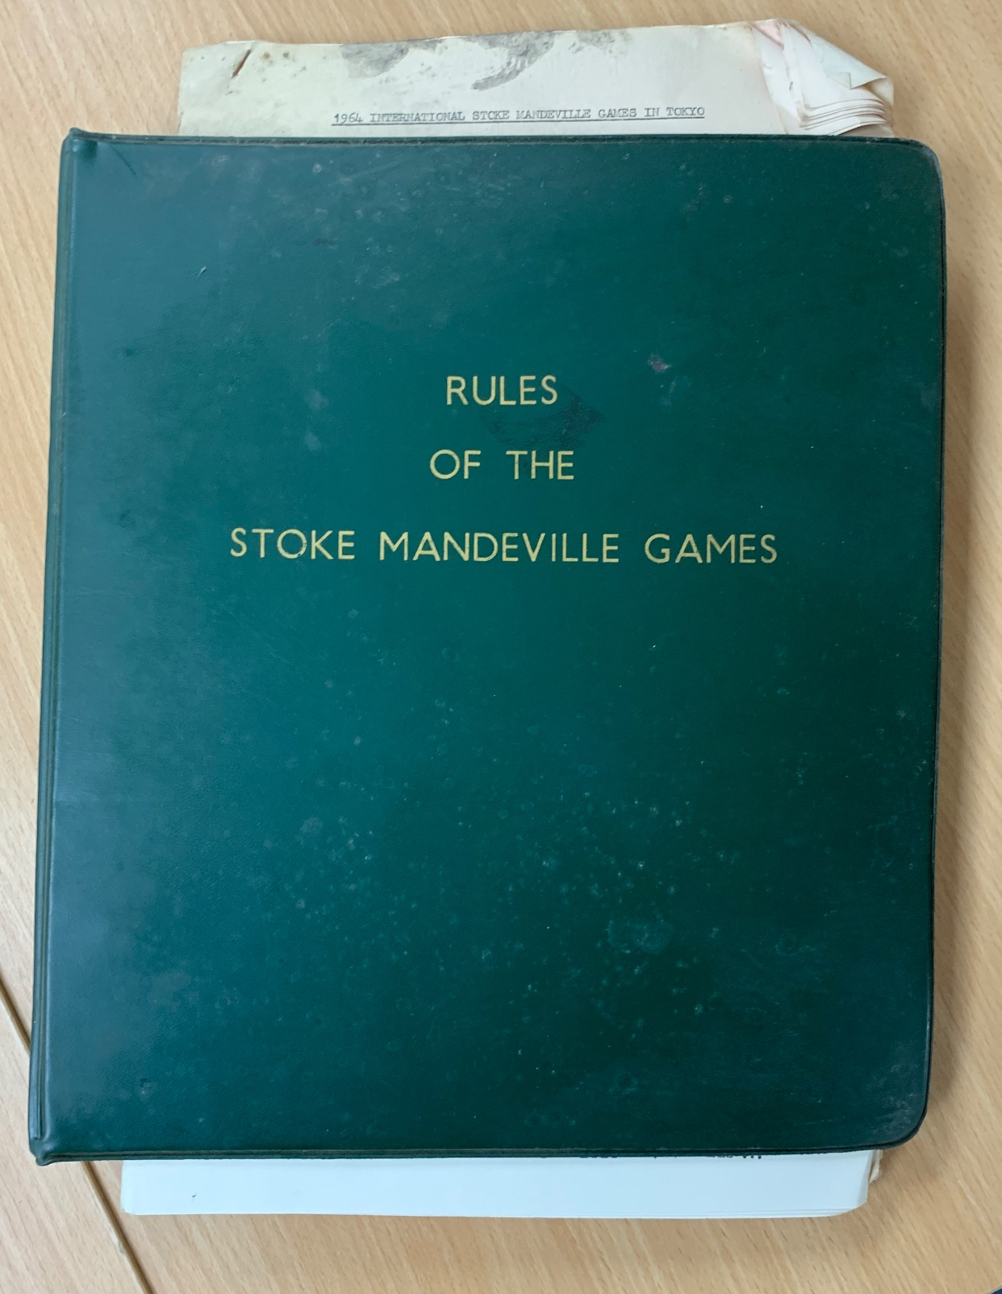
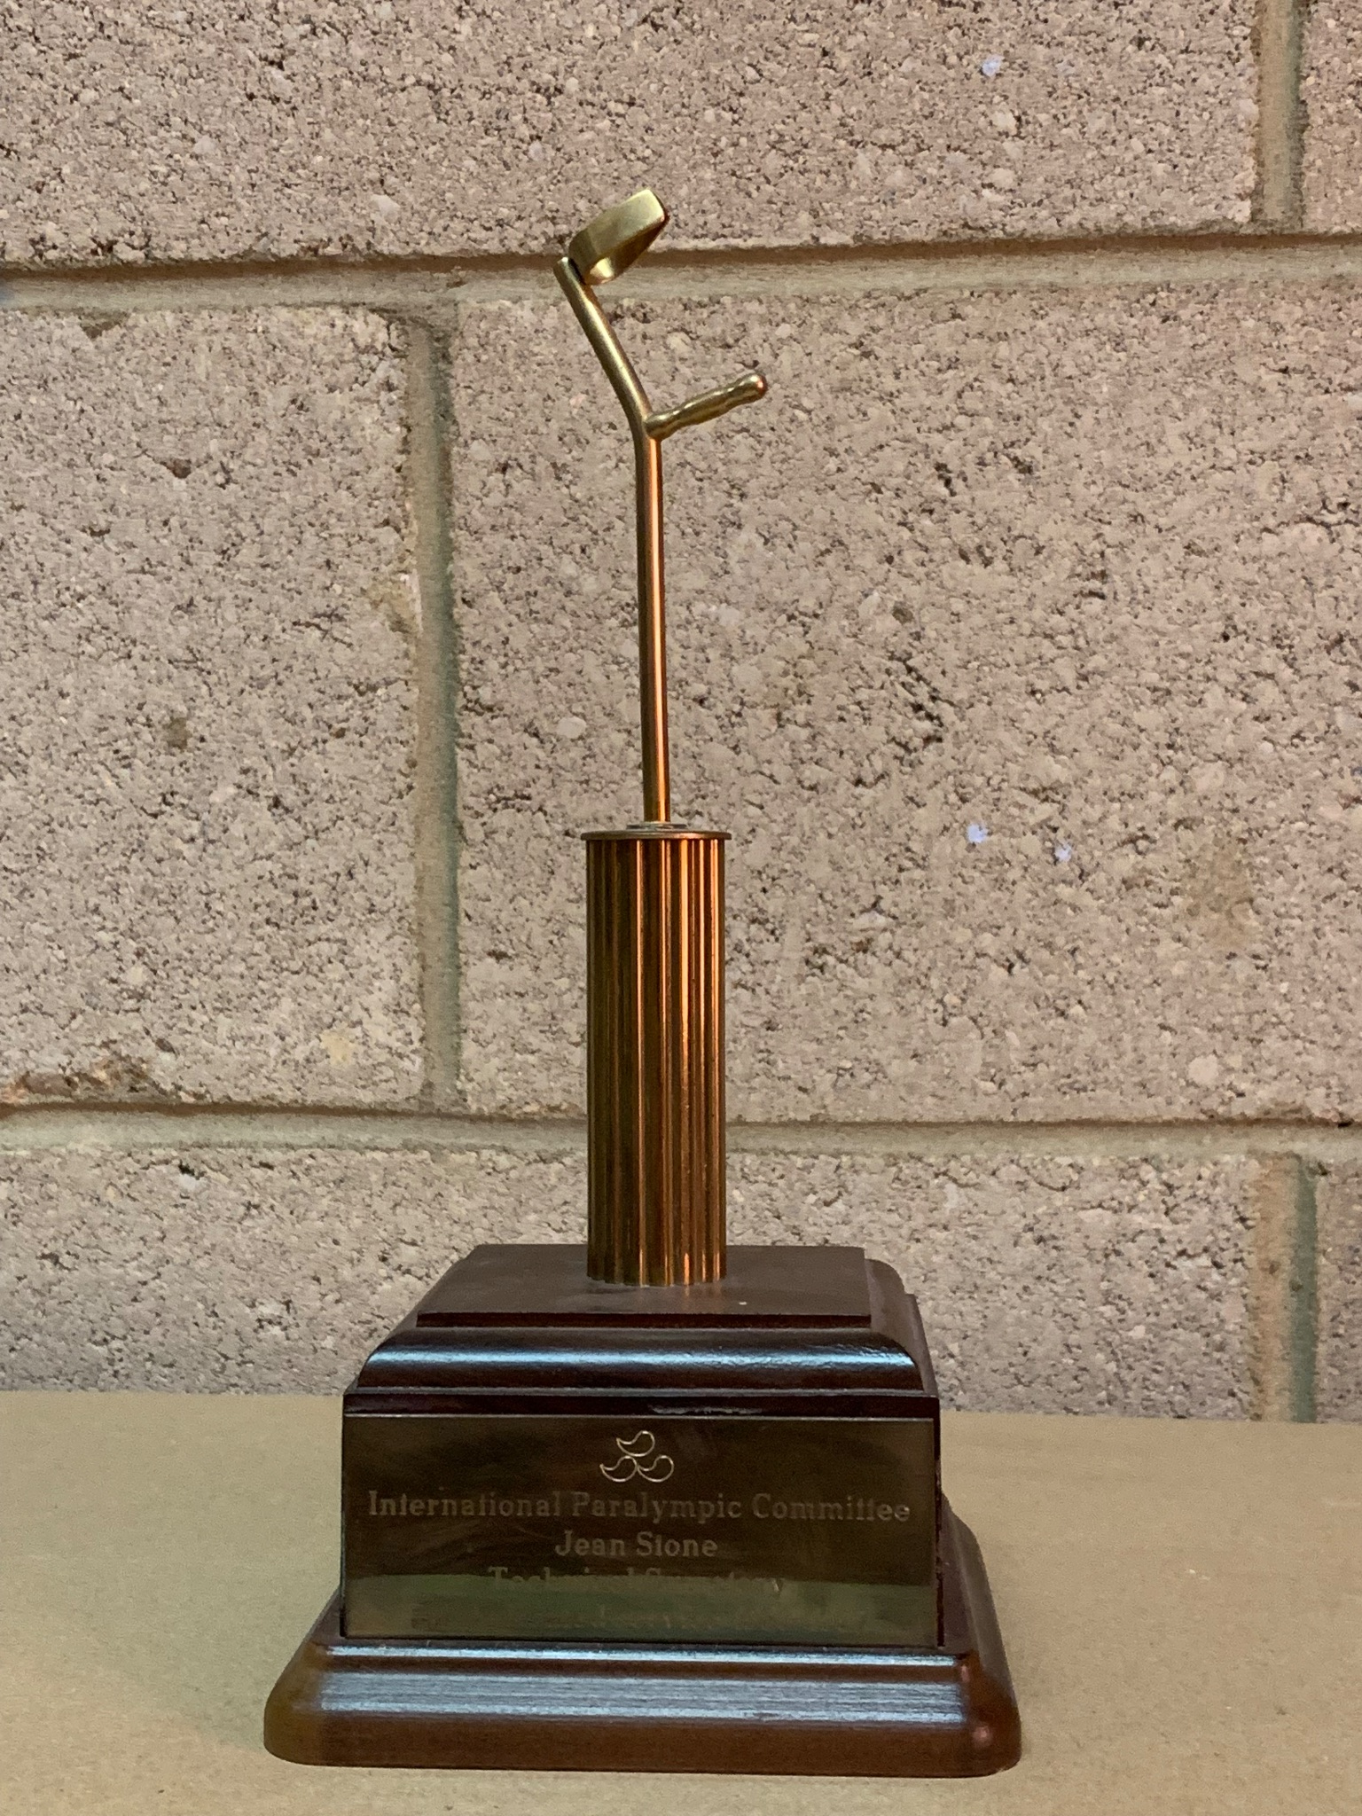
Paraphernalia from the 1984 Games – Programme and pendants
Copyright NPHT
Table of handling objects, including 2020 Tokyo Games Torch and mascot, medals, and running blade prosthetic leg model.
Image taken by Sam Brady
Stoke Mandeville Games Rulebook, c.1964
Copyright WheelPower
IPC award to Jean Stone for her support as technical secretary 1989-1997
Copyright WheelPower

Slide 8
The Heritage Trail Project:
Funding secured from the HS2 Community and Environment Fund.
This allowed us to not only share the historic legacy of the area, but also get local communities involved.
Initial idea for there to be a series of physical information boards around the agreed route.
But this was scrapped due to the Pandemic and other administrative barriers.

Slide 9
Sam came onboard to the project in November 2021 as part of placement with NPHT.
Switch to app approach to the trail, for a number of reasons:
  More accessible for a wider number of possible users
  More control and flexibility over content
  Quicker/easier in some ways!
Contracted Experience Heritage to work develop the app after testing their previous walking tour app.
The Heritage Trail Project:

Slide 10

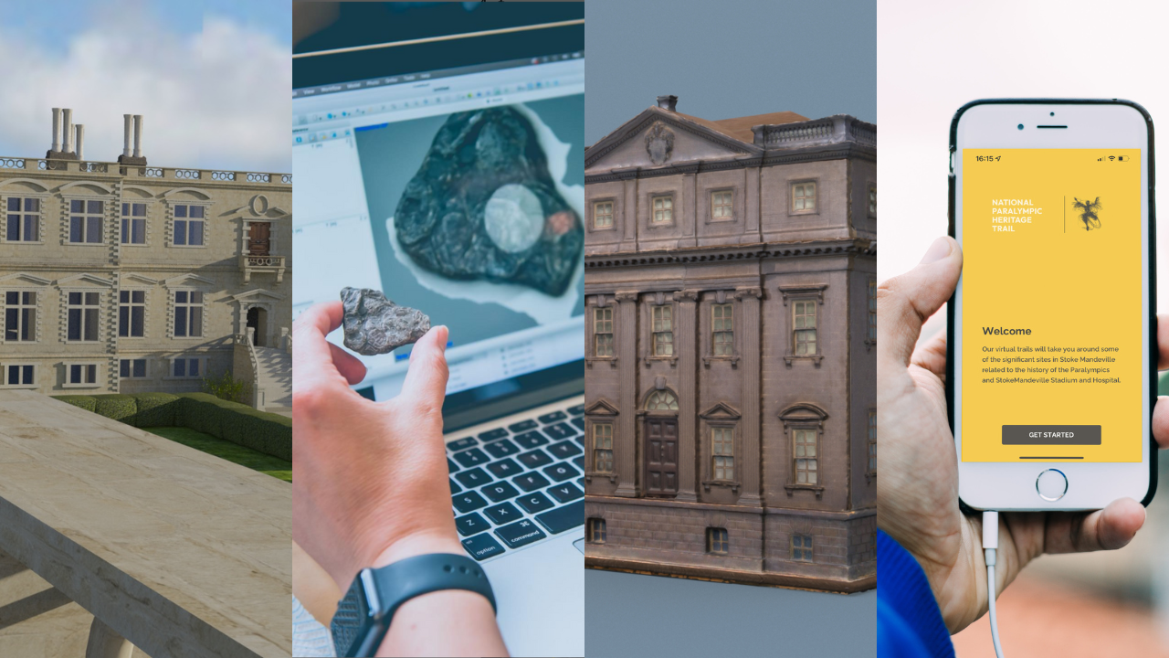
About Experience Heritage
Bridging archaeology and digital backgrounds to create immersive interpretation for heritage.
Trail apps
3D models
  Research
  Photogrammetry
  Structure-from-motion
Mixed reality, virtual tours, digital animations
About EH
Copyright Experience Heritage
www.experience-heritage.com

Slide 11
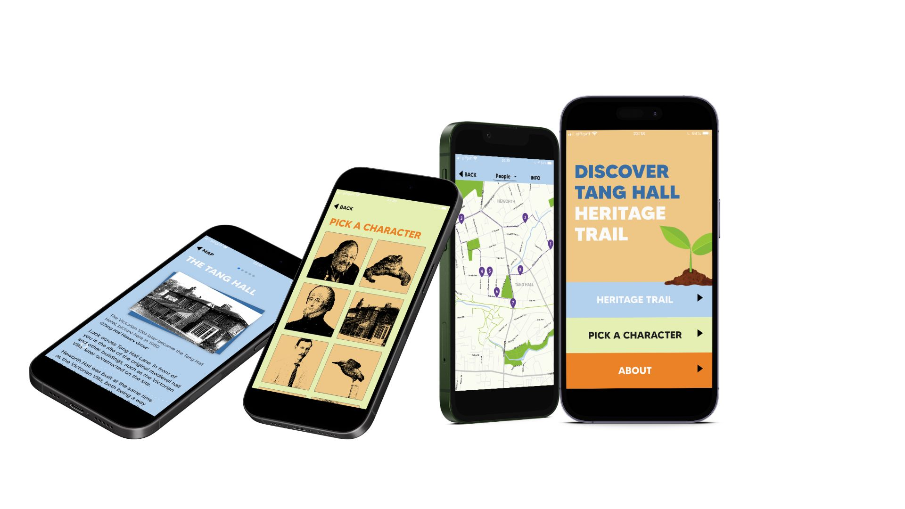
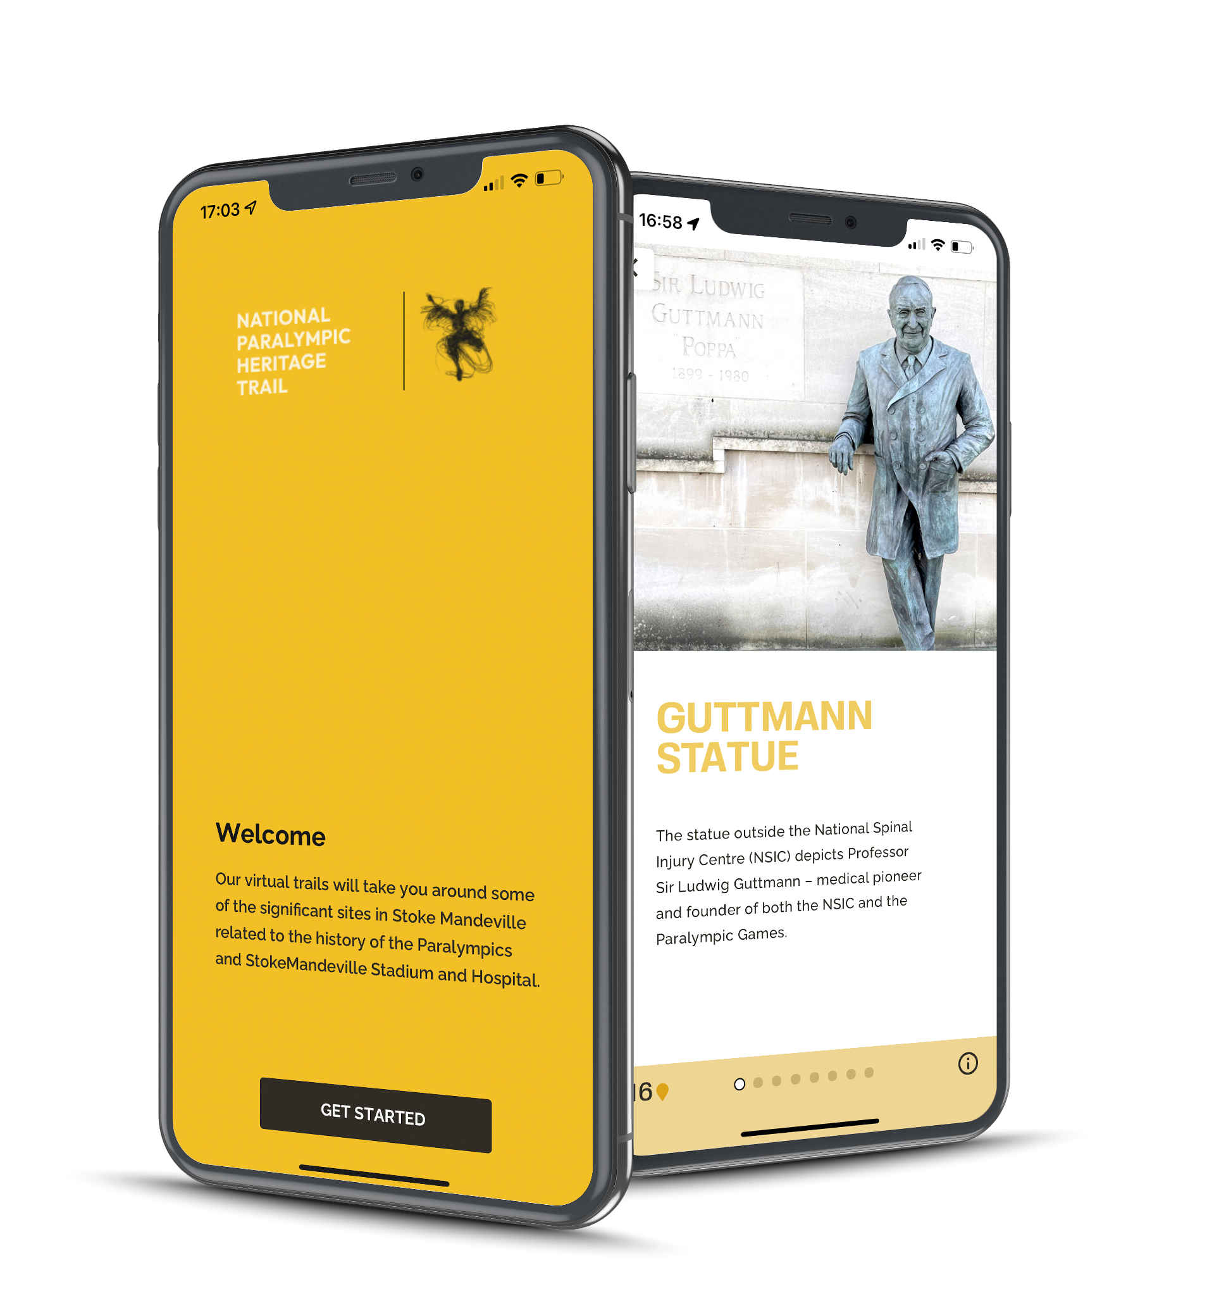
About NPHT App Development
Software Development 15+ years
Previous app (Tang Hall)
Working with NPHT
  Content - 3d models, organisation
  Design
  Goals
About the development
Discover Tang Hall App
NPHT App
Copyright Experience Heritage

Slide 12
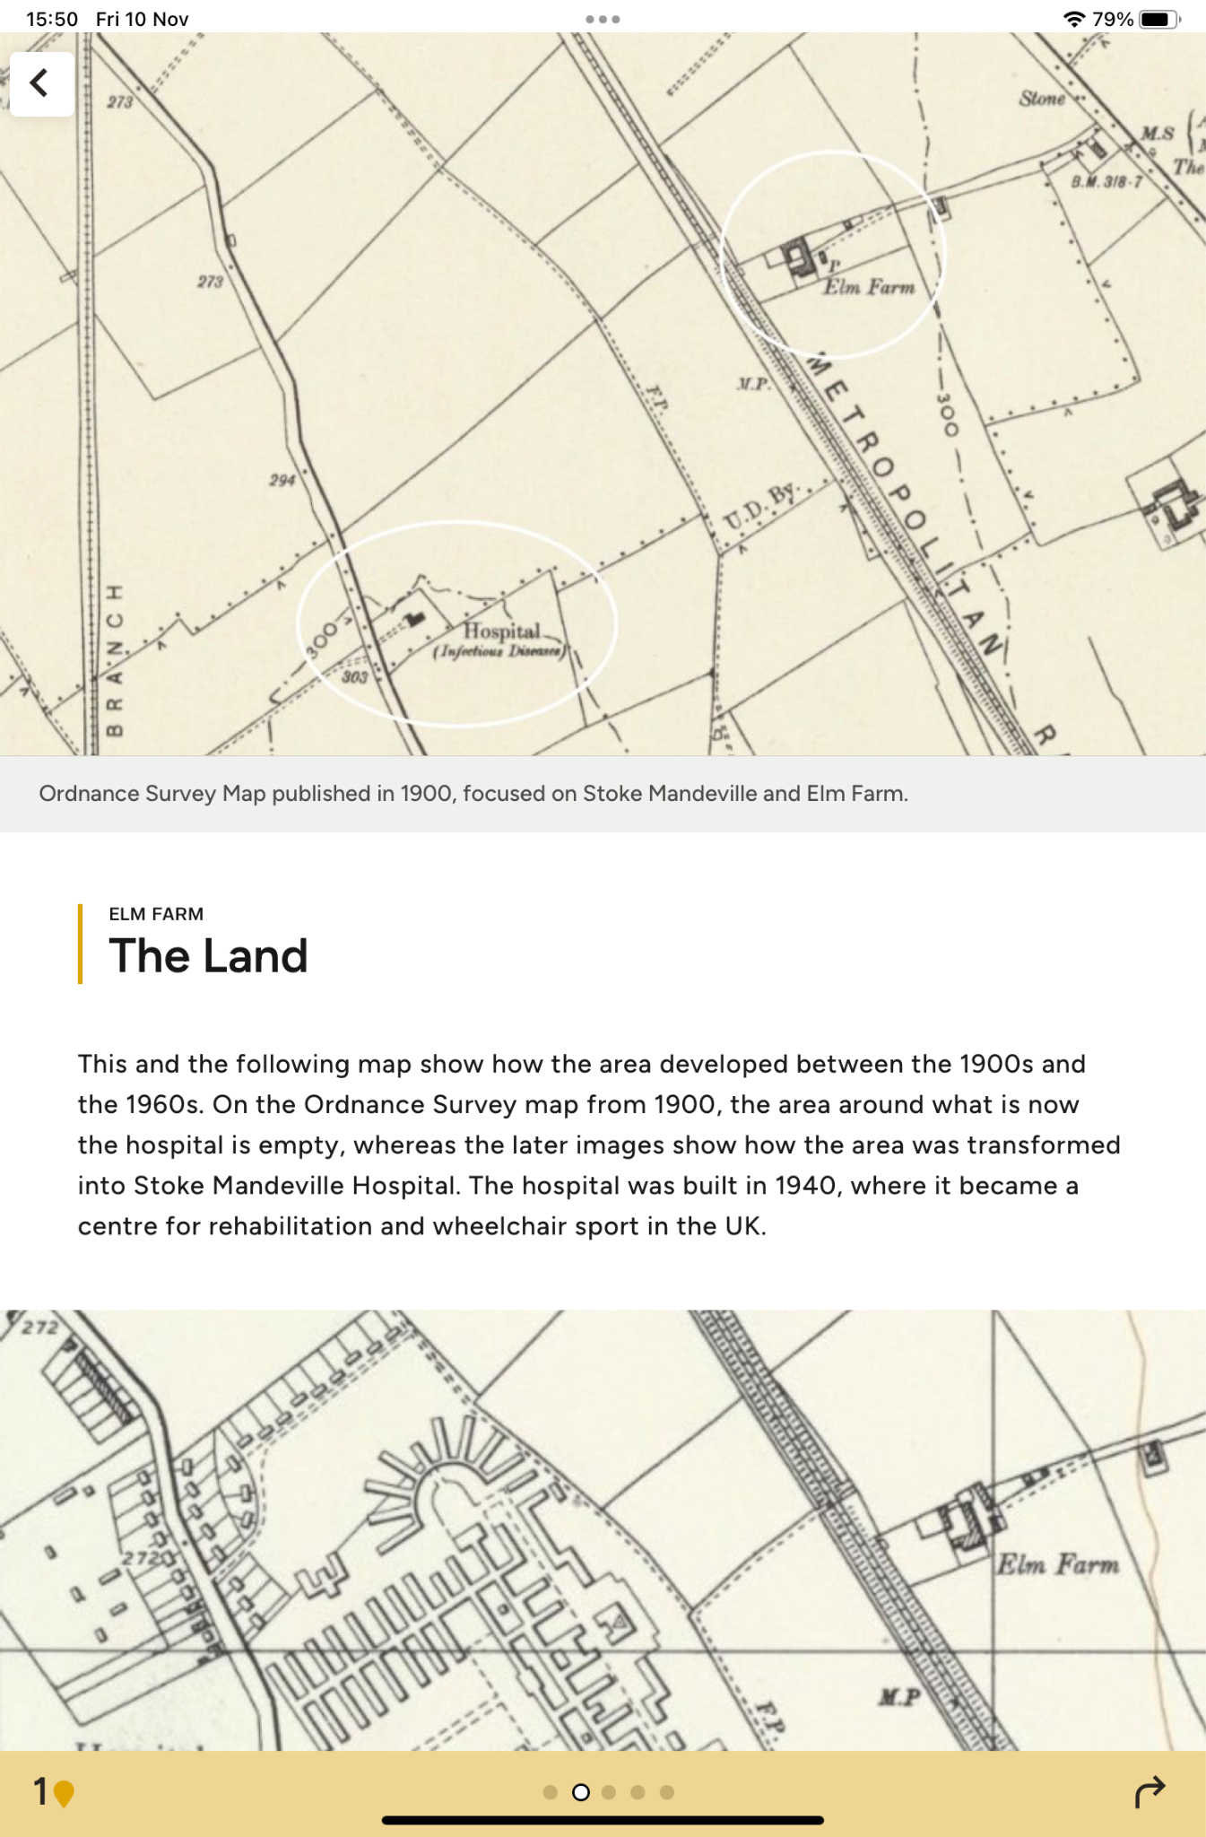
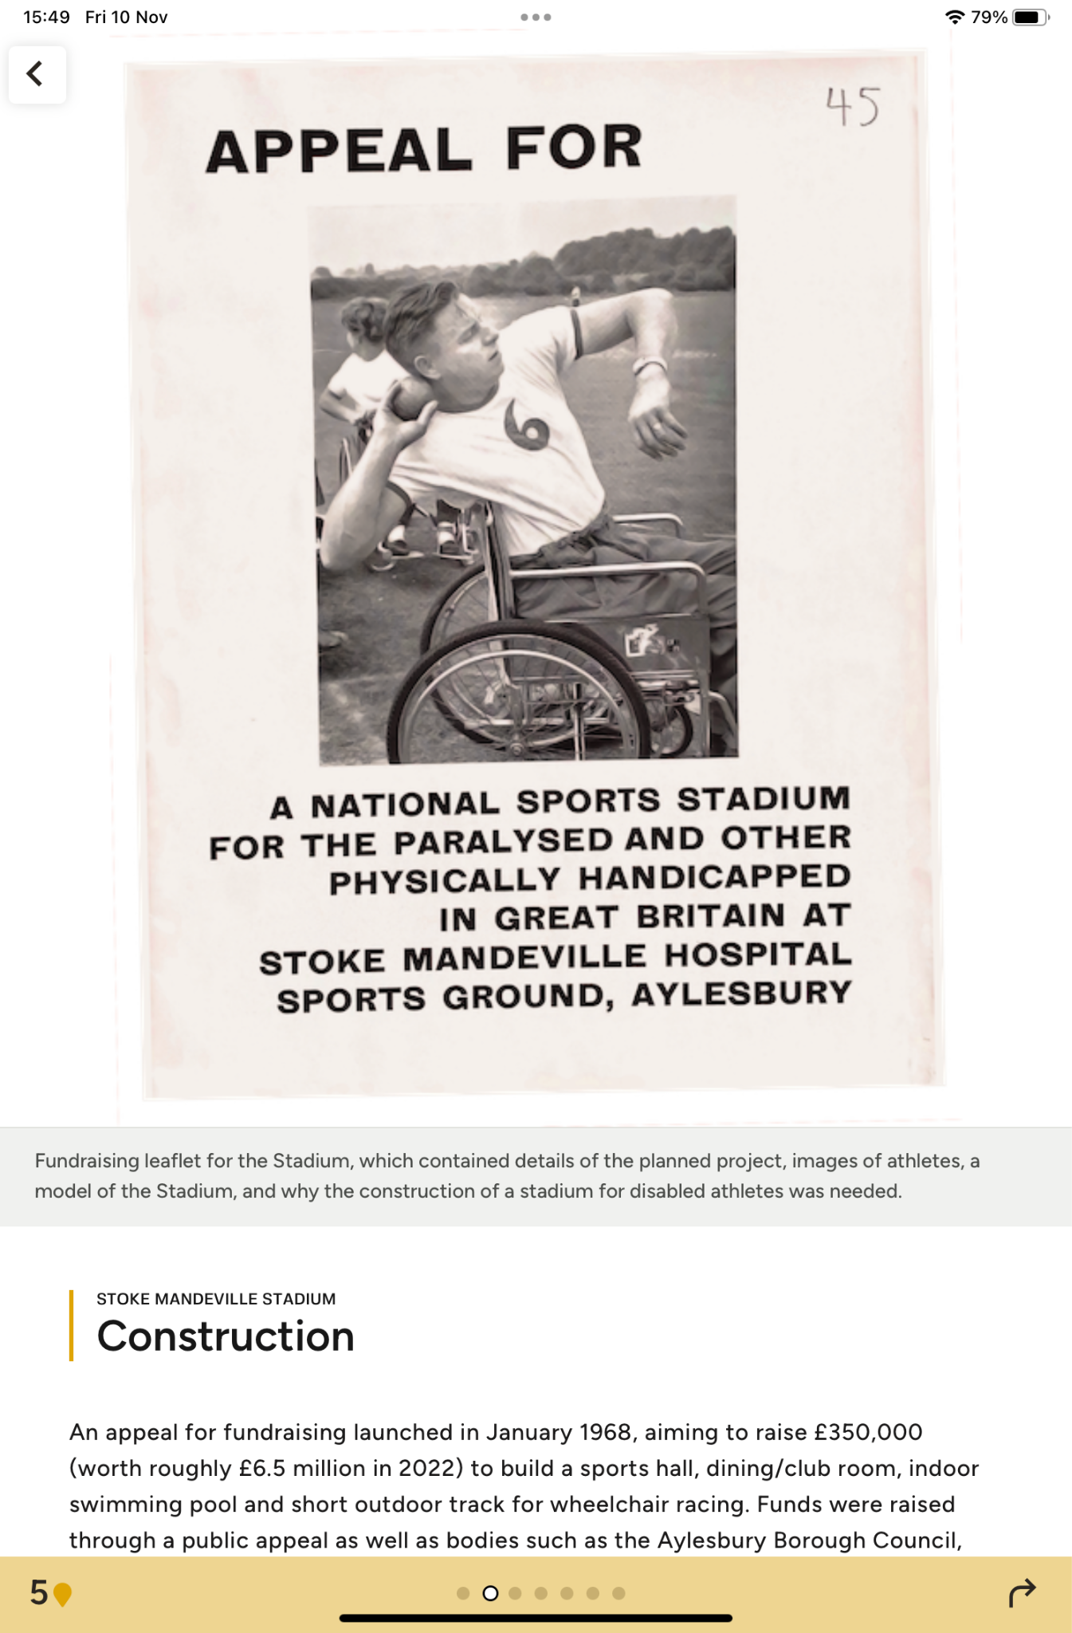
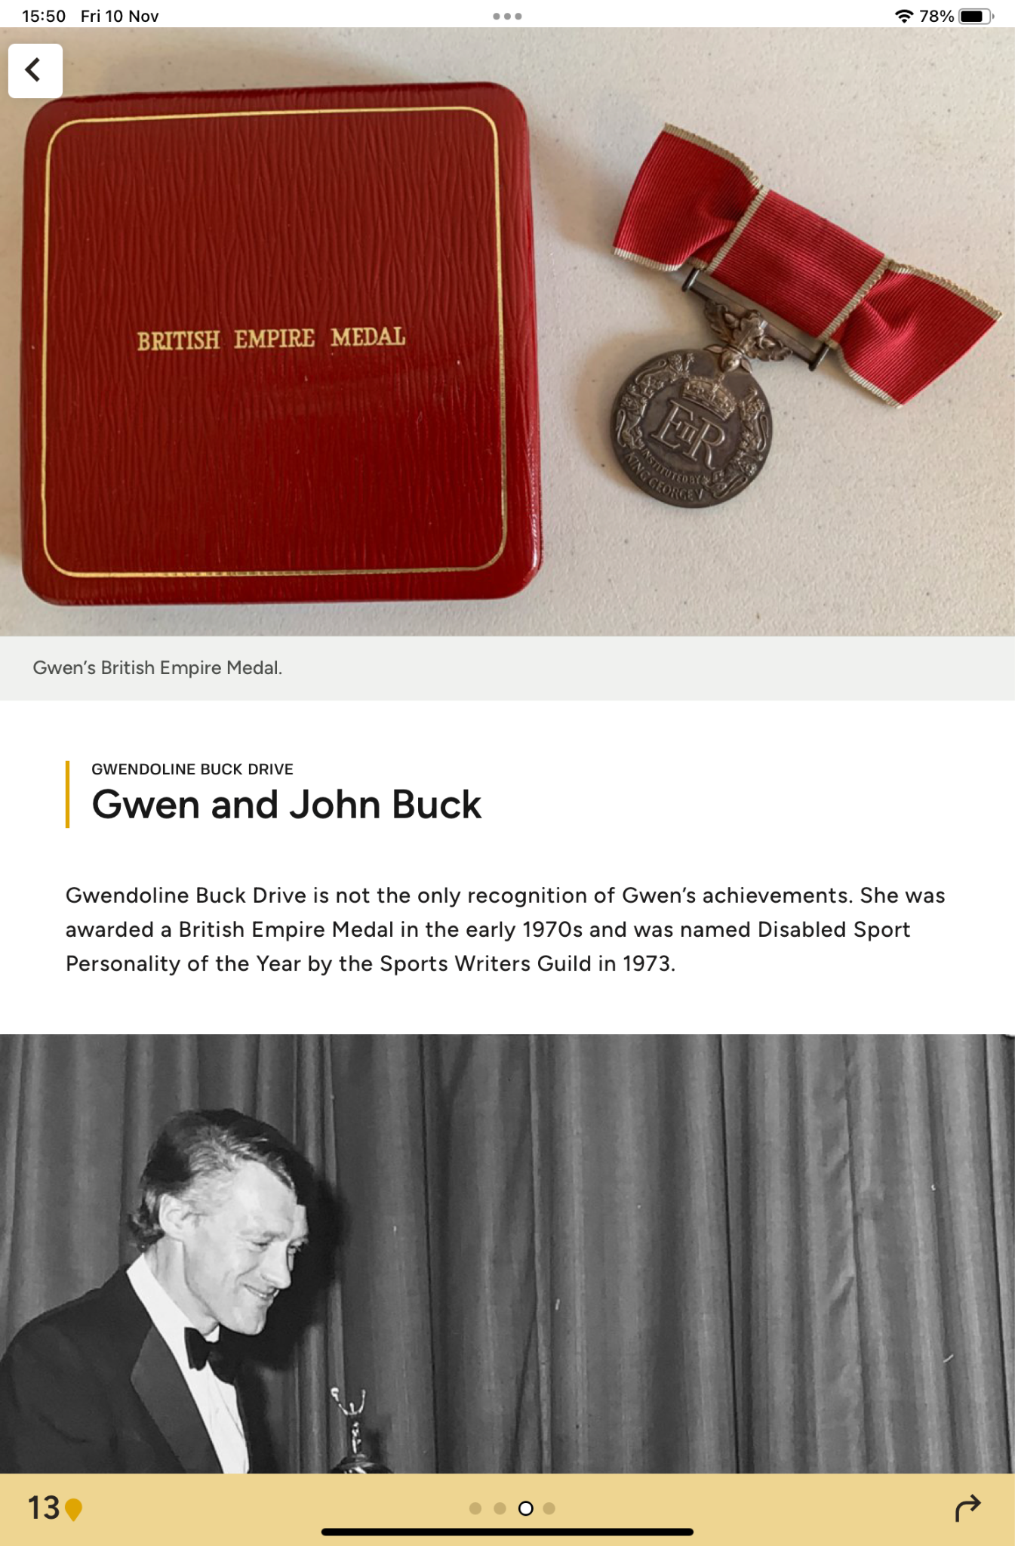
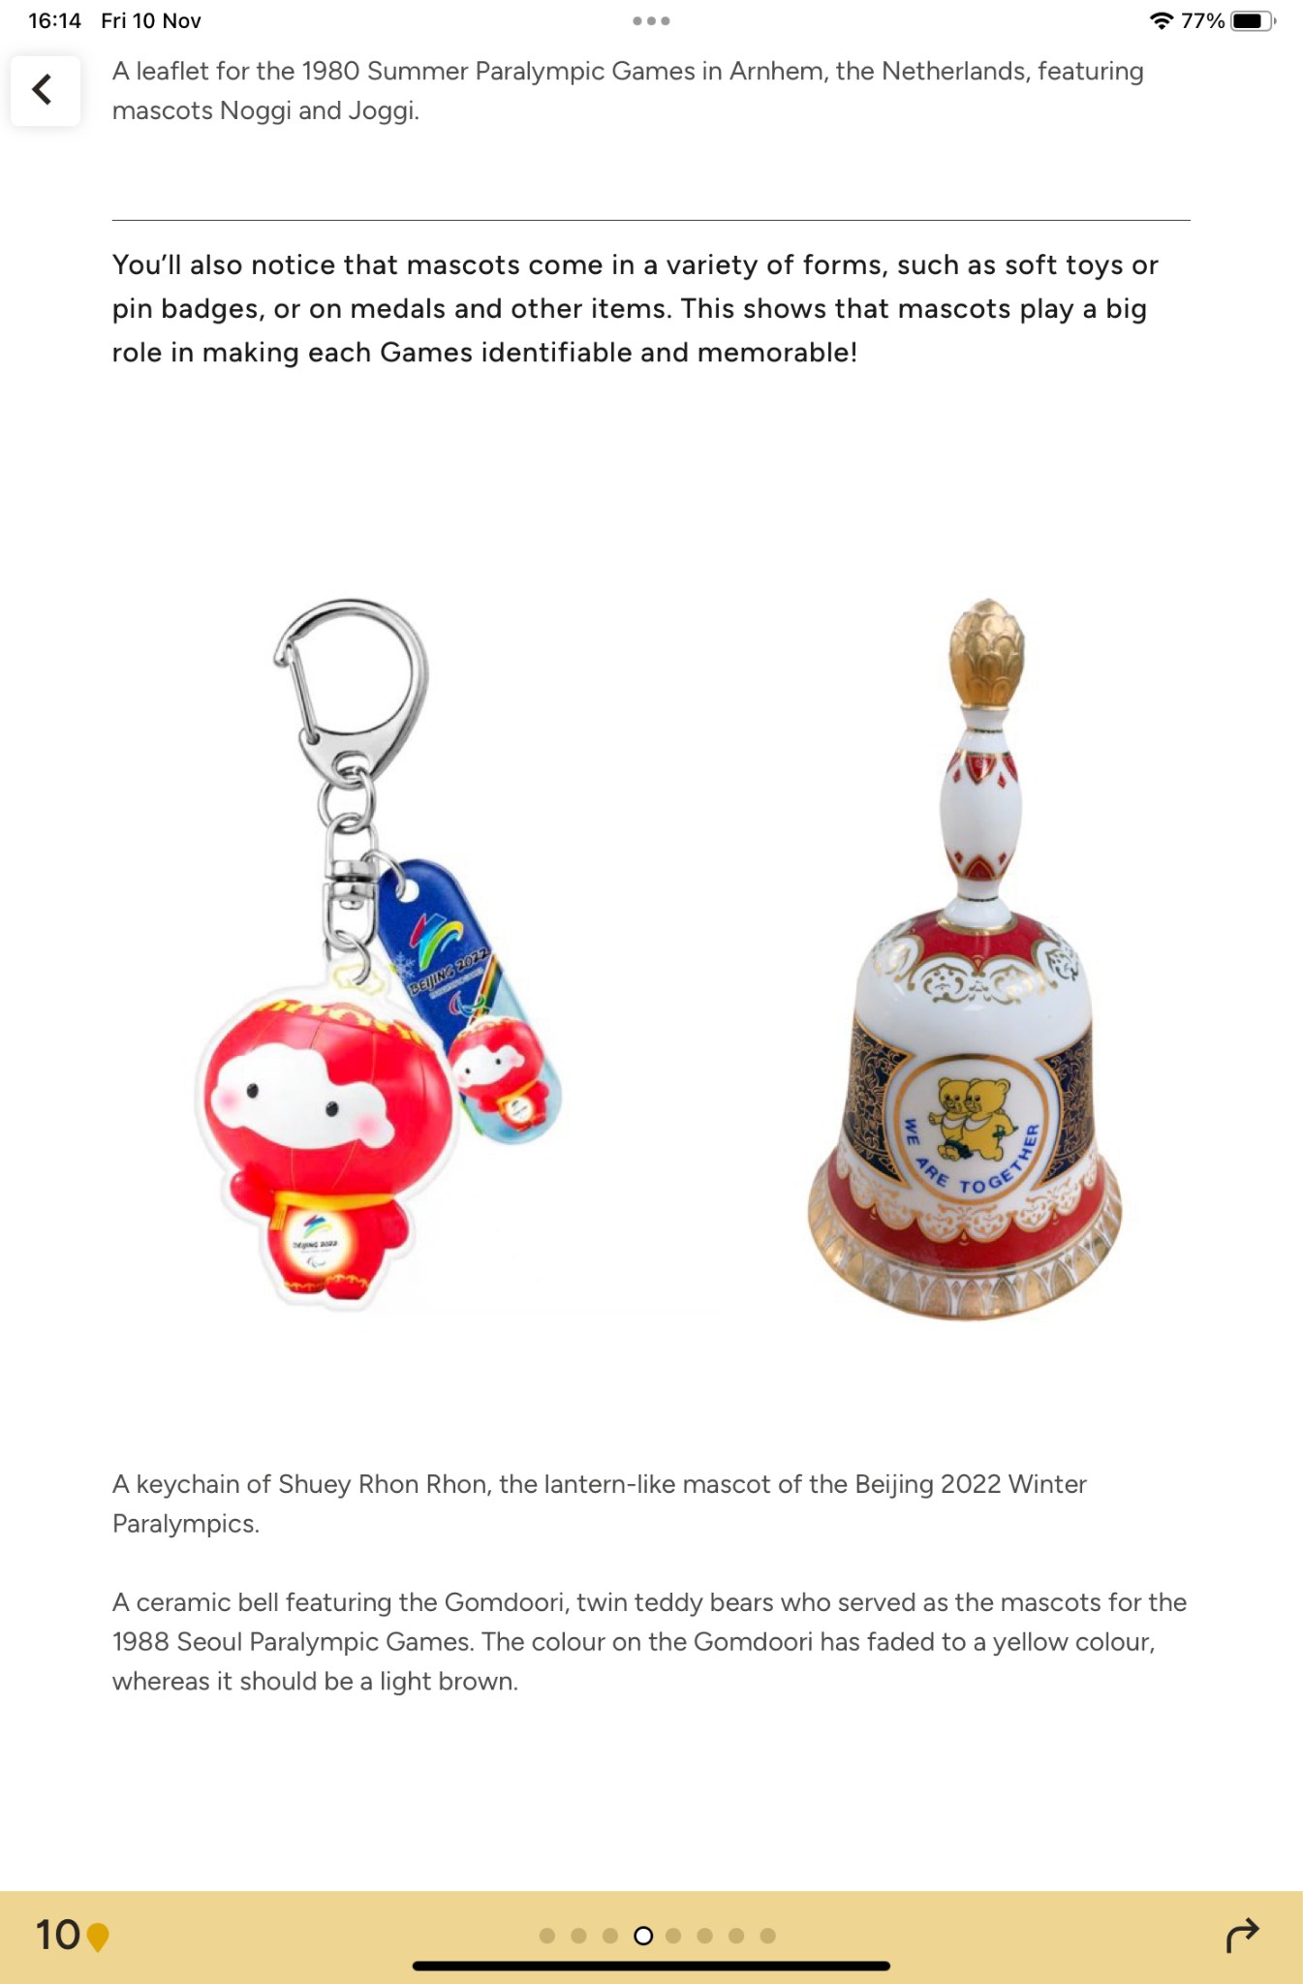
Inclusion of multiple types of content, such as:
Images of objects in the archive, such as maps, documents, mascots and medals
Objects and images in screenshots copyright of WheelPower and NPHT
Notes:
https://sketchfab.com/npht

Slide 13
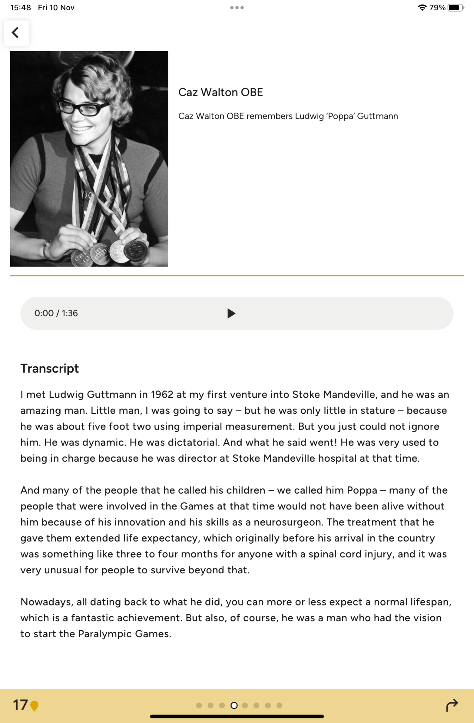
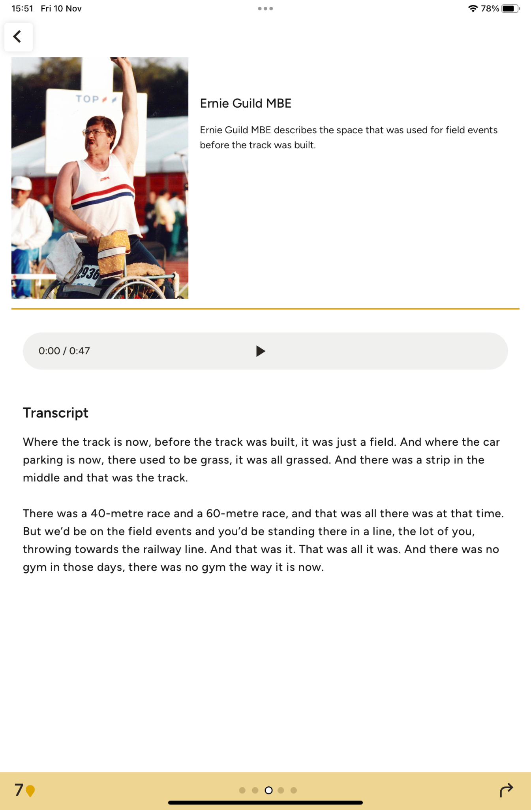
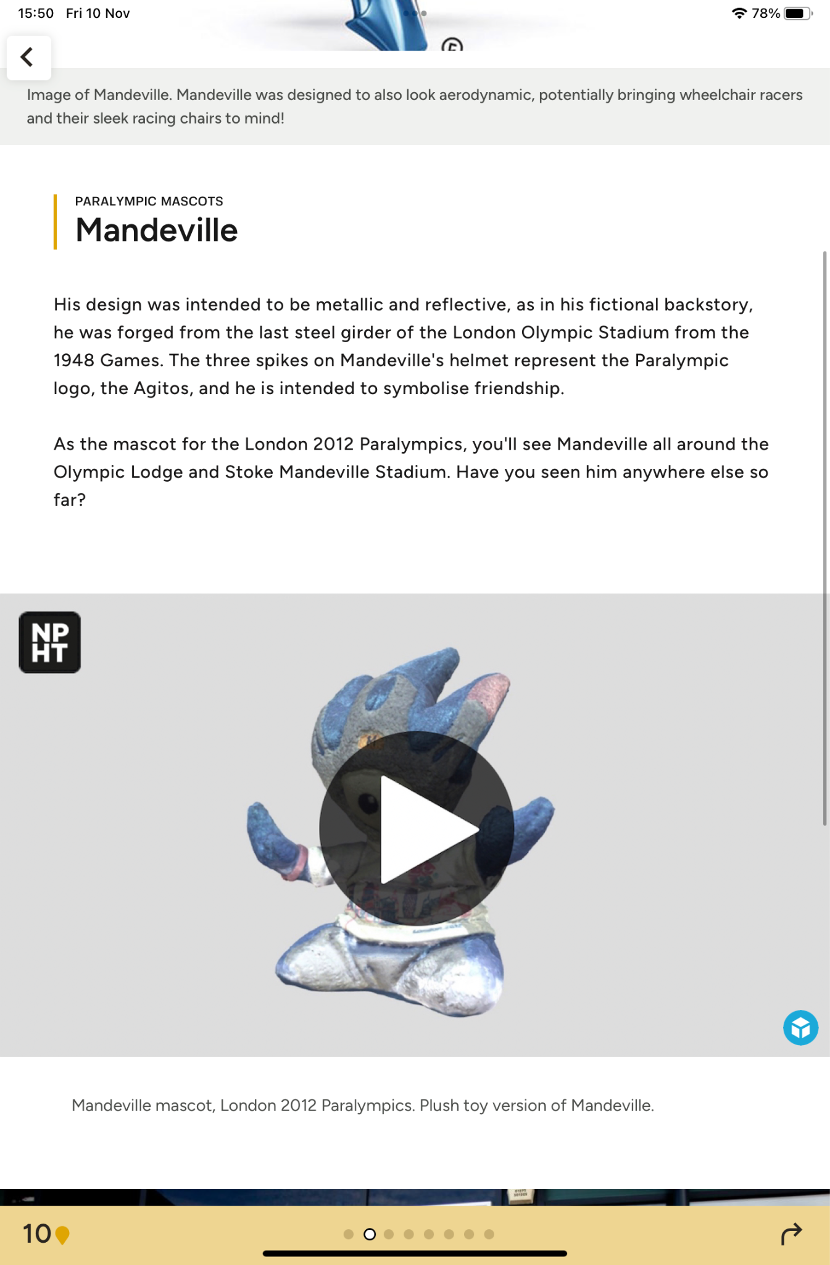
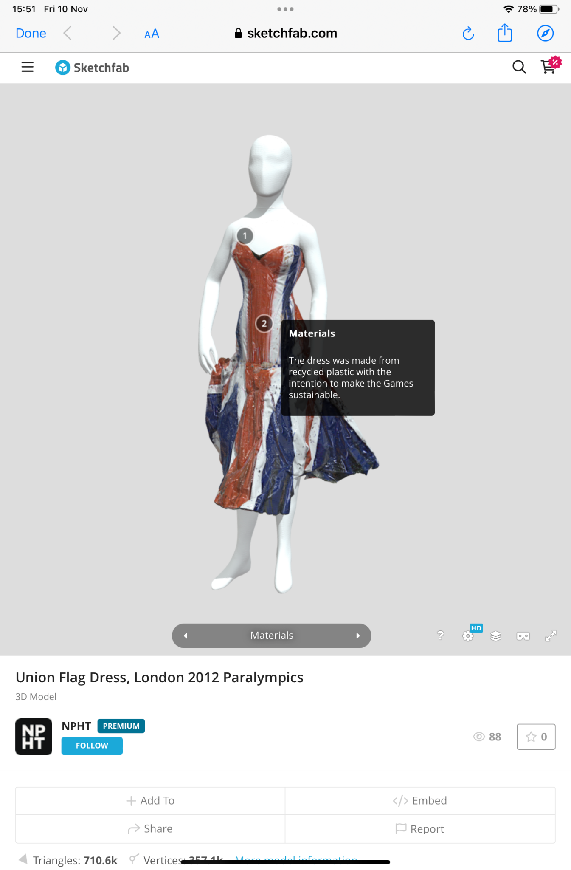
Inclusion of multiple types of content, such as:
Audio Oral History clips
3D Models of objects, from the Digital Explorations project
Notes:
https://sketchfab.com/npht

Slide 14
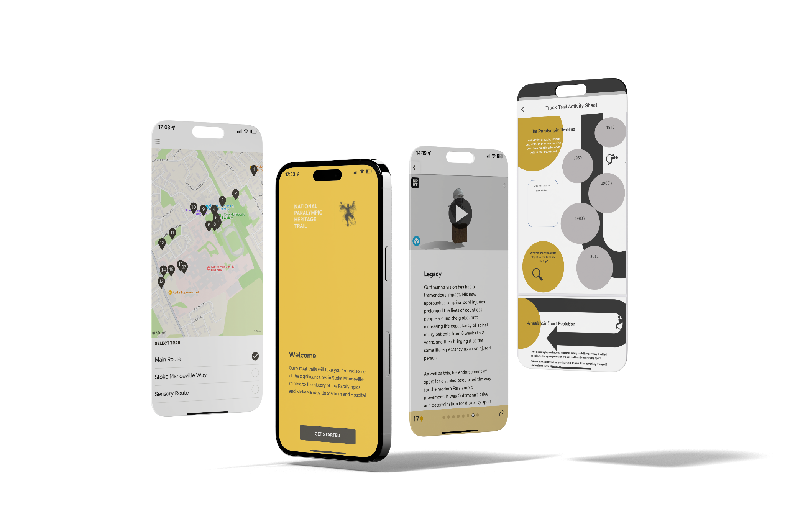
Development and Testing:
Development
For the app, React Native JavaScript was used, and these builds were accessed on Expo, and later TestFlight (Apple) using our own devices.
A pilot project - Focusing on NPHT requirements while keeping in mind future use-cases
Problem-solving
  Audio
  Integrating 3D models (Sketchfab)
  Accessibility - map
  Design
Copyright Experience Heritage

Slide 15
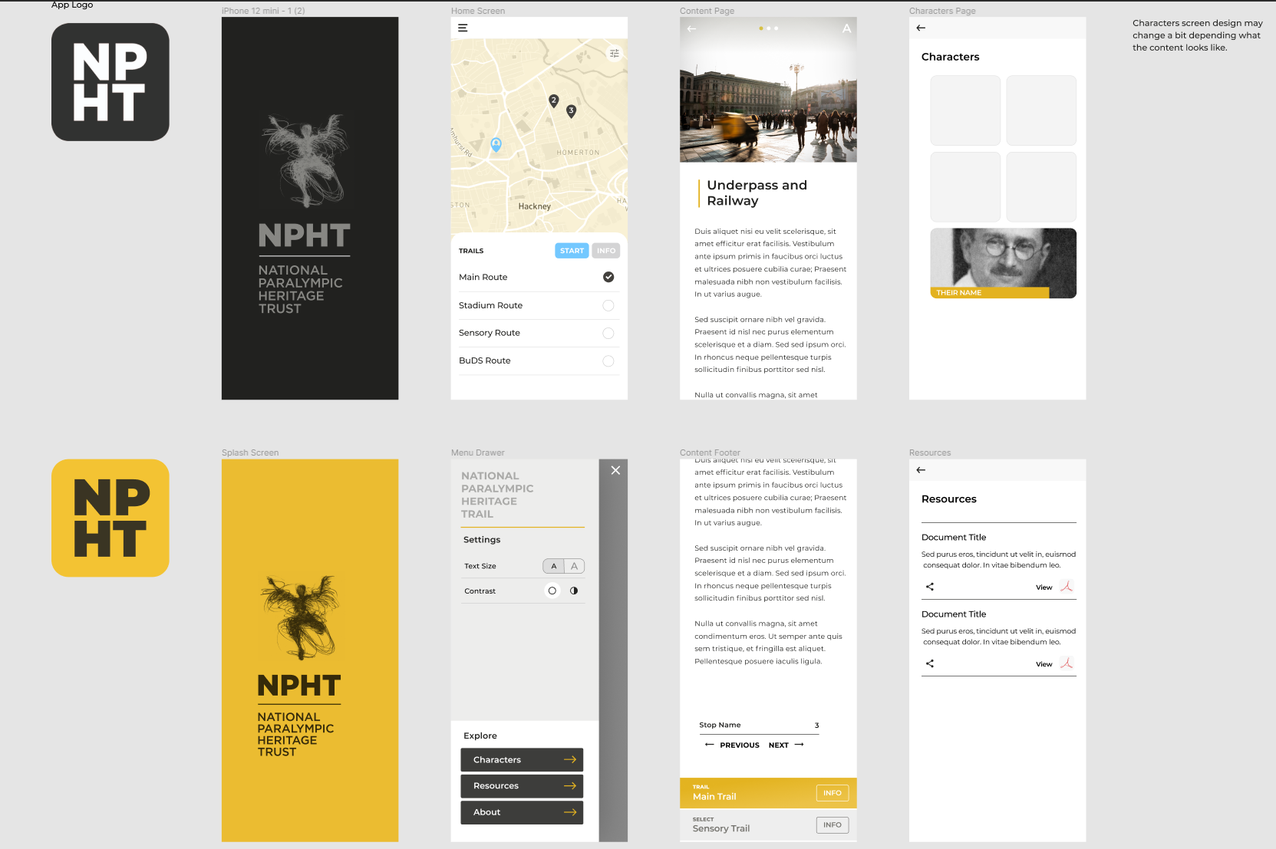
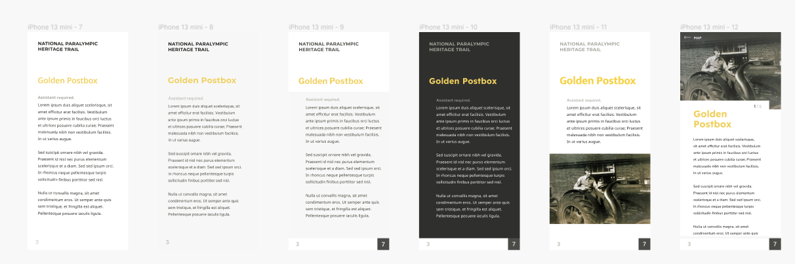
Development and Testing:
Design
The look and functionality of the app altered over time, as we went through some different designs for the user interface
Interns...
Early design concepts, March 2022
Design and User Experience Design testing
Copyright Experience Heritage

Slide 16
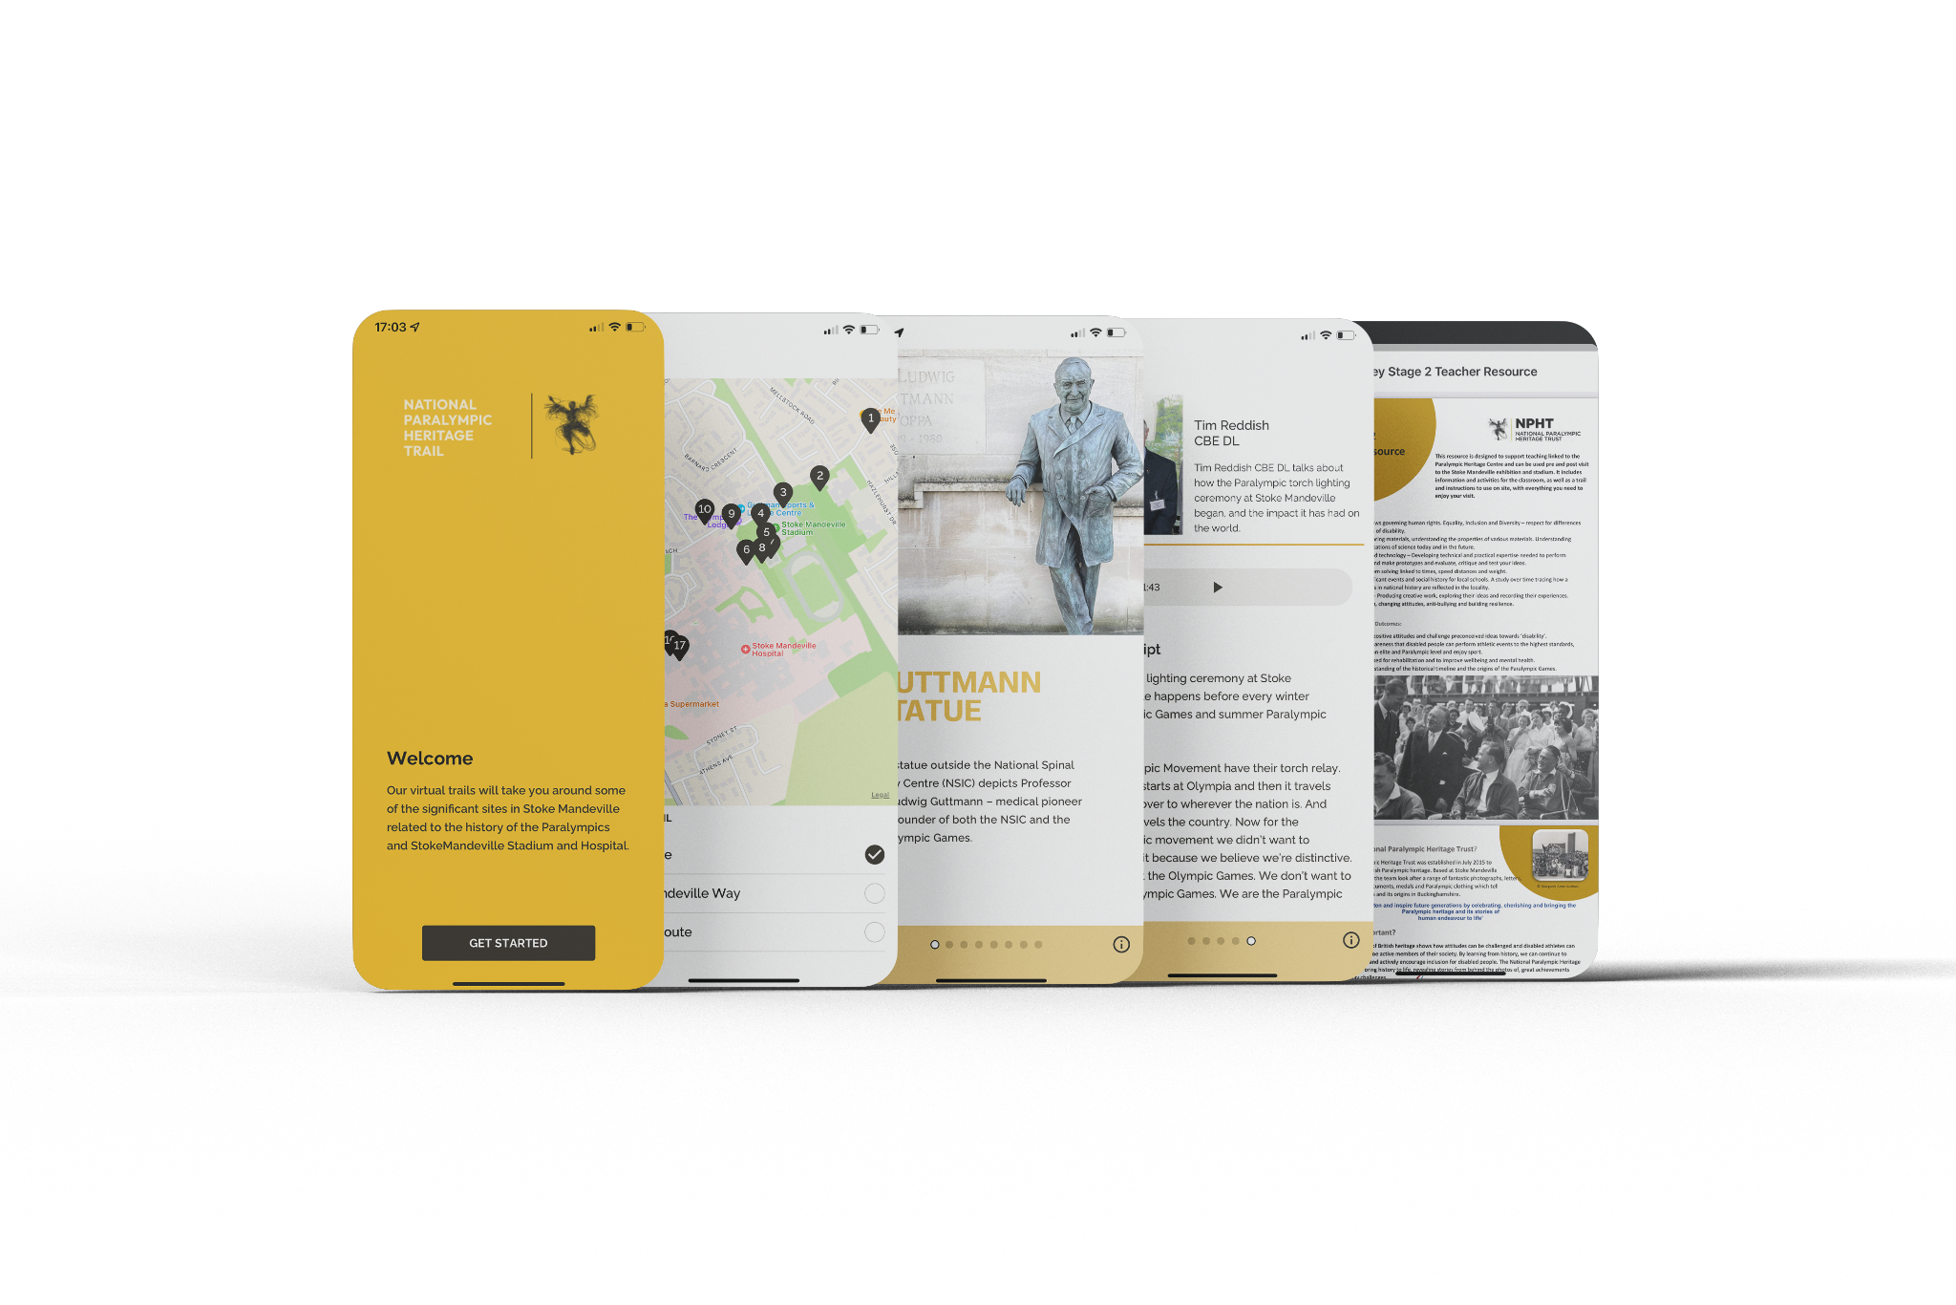
Development and Testing:
Problem-solving
  Displaying and distinguishing ‘hero’ images
  Where to put things? Like trail info
  Working with different image layouts
  How and where should settings be available
Final Design
Copyright Experience Heritage

Slide 17
Development and Testing:
Accessibility
Accessibility an important part of the design of the app, due to the the NPHT’s values, audience and topic.
Digital access something we worked towards from the outset of the project.
  For instance, I aimed to make sure all the written content was clear and followable.
  We also added in options for text size and contrast into the app itself
  BBC Accessibility Guidelines were also utilised
We did not want to add too many options however, to avoid interference with device level accessibility options. This is something to review with further feedback.

Slide 18
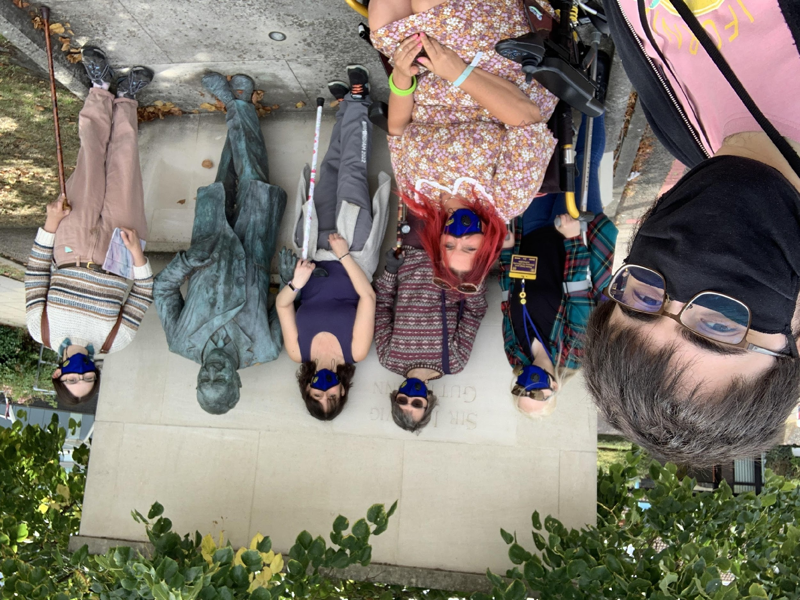
Development and Testing:
Testing
Besides ourselves, other members of the NPHT team assisted with testing and giving feedback.
Entered a phase of testing with people outside the two organisations in the Summer of 2022. Primarily contacted volunteers and supporters of the NPHT
Also contacted Buckinghamshire Disability
Service (BuDS) to assist with feedback on physical access to the route, and the accessibility of the app itself.
Testing with BuDS volunteers, September 2022
Image taken by Sam Brady

Slide 19
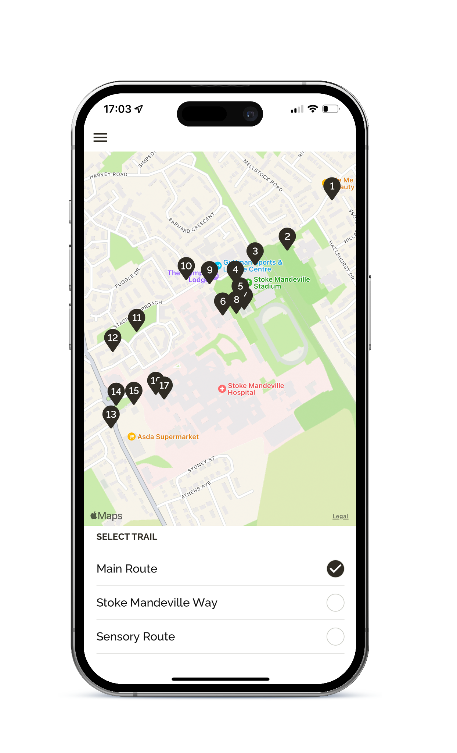
Development and Testing:
Ongoing and future developments
Accessibility ongoing concern, and we will continue to update as we get more feedback from users.
Issues concerning the map home screen and screen reader functionality required more testing and experimentation.
We are also planning on implementing a new directions system to highlight amenities alongside directions to next or previous stops.
Copyright Experience Heritage

Slide 20
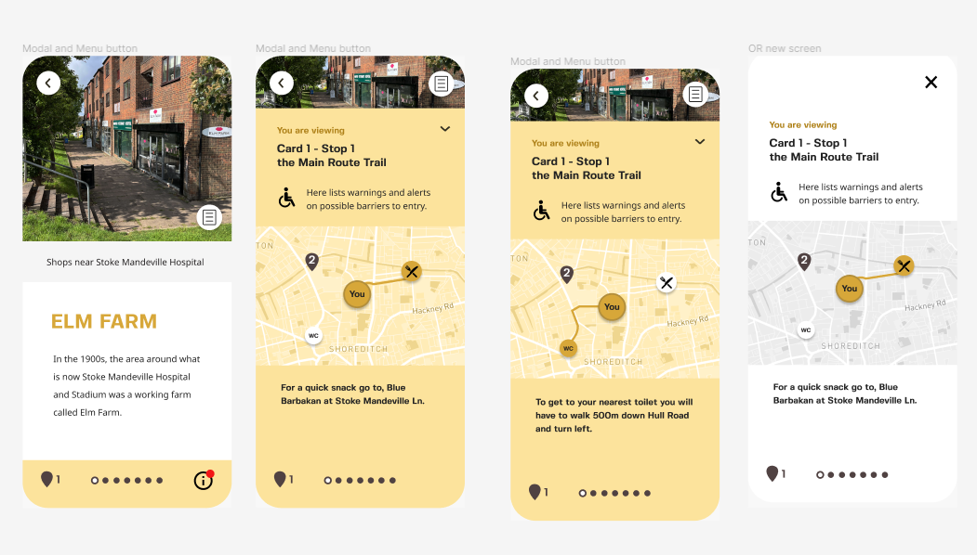
Development and Testing:
Directions and accessibility page designed concept by Ashley Loo
Copyright Experience Heritage

Slide 21
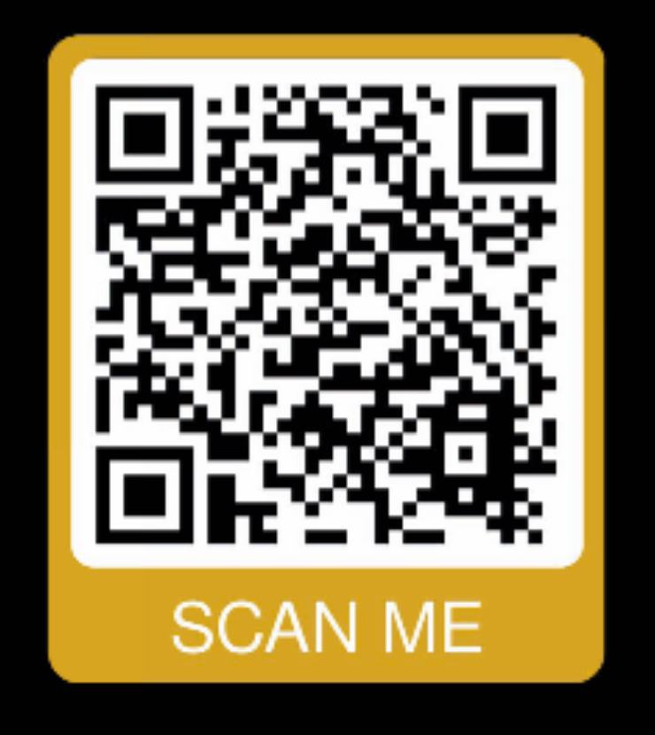
Thank you for listening!
Pictures either my own, or given permission to use by owners:
National Paralympic Heritage Trust (NPHT)
WheelPower
Alamy Image
Getty Image
Buckinghamshire Disability Service (BuDS)
Experience Heritage
s.brady.1@research.gla.ac.uk
sam.brady@paralympicheritage.org.uk
@SamB24 (Twitter)
bethany@experience-heritage.com
www.linkedin.com/in/bethanywatrous/
www.experience-heritage.com
vicky.hopewalker@paralympicheritage.org.uk
https://www.paralympicheritage.org.uk/

