Slide 1

Reflecting on a Library Resource Accessibility session for Neurodiverse Students
Sofia Mavrogeni
Academic Liaison Librarian sofia.mavrogeni@beds.ac.uk
Academic Liaison Librarian Support
Email: librarians@beds.ac.uk

Slide 2
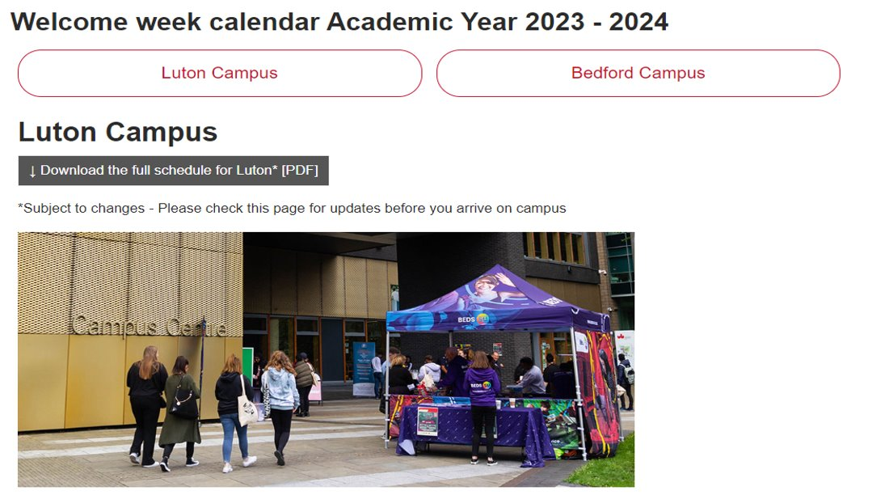
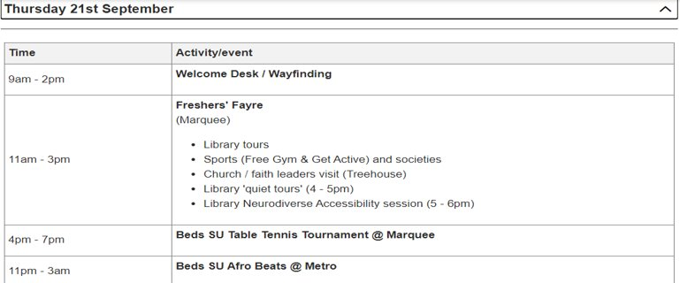

Background Information
Academic Liaison Librarian Support
Email: librarians@beds.ac.uk
Welcome Week- initiative
Quiet Library Tours
Library Induction sessions targeting only Neurodiverse students
Focusing on how to use accessibility tools while using Library resources

Slide 3
Purpose of this presentation
Academic Liaison Librarian Support
Email: librarians@beds.ac.uk
To discuss this experience with you
My aim now is to reflect on the experience using the
What,
So What,
Now What,
model by (Rolfe et al., 2001)

Slide 4
What (The Experience)
Academic Liaison Librarian Support
Email: librarians@beds.ac.uk
The session was planned to last 1 hr between 5-6pm in the Library run by a Librarian and a Library Assistant.
Planning the content and activities for this session, our aim was to keep it simple, not overpowering or overwhelming the attendees with too much information.
We saw ourselves as advocates rather than instructors on how to do things.
We wanted to highlight possible support offered within the University rather than teaching them how to use accessibility software.
Ended up being more difficult to plan than expected.
Notes:
Offering sessions at an alternative time. Neurodivergent people are more likely to access education as mature students. This means they are likely to be balancing multiple responsibilities such as family, work and home life.
We did not feel confident to teach how to use accessibility tools on each browser.
We assumed that students with needs have already found the solutions they need.
Fear that we will not be able to accommodate all different needs/demands.
We expected to have a very diverse crowd , therefore unable to provide personalised learning.
Fear what terminology to use or not to use.
At the end , we were not even sure if we should include the term neurodiversity (labelling/barrier).
We were aware that some of our neurodivergent students do not have an official diagnosis.

Slide 5
What (The Details)
Academic Liaison Librarian Support
Email: librarians@beds.ac.uk
Learning outcomes of the session:
Students to be able to set up their personal devices to suit their needs by adjusting system settings such as background colours and font sizes.
Students to be able to access useful links for free software and guidance to help them manage their university work.
Students to be able to use accessibility options on PDF documents and eBooks, such as to be able to read aloud, annotate and highlight.
Students to be able to recognise and know how to access different support services within the University, such as mental health support and other specialist services.
Structure:
Library Spaces
Library Equipment
Library Resources
Formats of accessing library resources
Study Tips
Time Management
Notes:
Made it clear to attendees that they could leave the session at any point trying to adopt a relaxed environment
Had fidget toys on the tables to be used if needed.
Some of the special equipment to demonstrate such as big keyboards/ colour overlay screens.
Focused to show how to use ebooks using our platforms such as VLE and Proquest.
Found a good selection of free accessible software to improve studying and reading such as mind maps/ have clutter free web pages.
We chose to focus on a soft skill that we always teach as part of IL (time management).

Slide 6
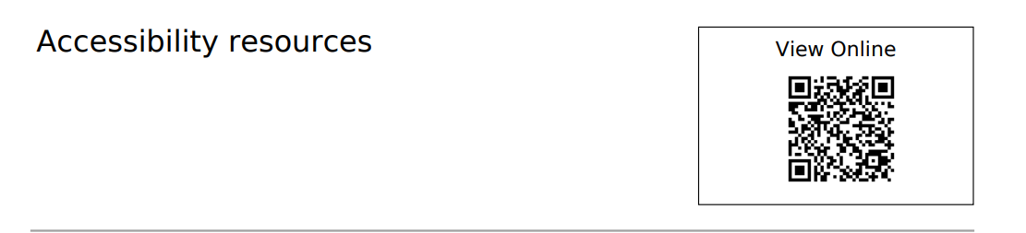
Academic Liaison Librarian Support
Email: librarians@beds.ac.uk
https://rl.talis.com/3/bedfordshire/lists/23286566-79EE-F0E8-AB32-9A57556B7E88.html?lang=en
Created by colleague Janine Bhandol
Notes:
To avoid crowded slides we created a reading list with all the necessary links.

Slide 7
So What (Significance)
Academic Liaison Librarian Support
Email: librarians@beds.ac.uk
A good practice after all.
Made us search and familiarise ourselves with tools that are available.
Good activity to collaborate with other teams within the Library and find out how we support our neurodivergent students.
Highlighted any gaps in knowledge.
Made us to benchmark and see how other Universities approach the topic.

Slide 8
So What (Analysis)
Academic Liaison Librarian Support
Email: librarians@beds.ac.uk
Possible reasons for low attendance
Not using the right communication channels
Wrong timing
Lack of promotional material
Student needs?
Stigmatization?
Neurodivergent students come to Uni and don’t tell you their diagnosis, so why would they come to something that specifically signs them out?

Slide 9
So What (Student Impact)
Academic Liaison Librarian Support
Email: librarians@beds.ac.uk
Positive impact on the neurodiverse students who did attend
Only 1
Autistic student
The student was positive to the initiative

Slide 10
Now What
Academic Liaison Librarian Support
Email: librarians@beds.ac.uk
Express our commitment to supporting neurodiverse students in the library:
Perseverance Plan Repeat
Advertise the session while delivering other IL sessions in lecture rooms.
Run this kind of session not only for welcome week but once each term.
Be consistent by using all available communication and advertising channels.
Highlight our dedication to inclusivity and accessibility in library services by collaborating and liaising with other departments within the University community.

Slide 11
Thank you for listening.
Your feedback is precious!
Academic Liaison Librarian Support
Email: librarians@beds.ac.uk

