Slide 1

LSE – Library Buddying Cafe
Jo Taplin-Green
Reader Services Manager
LSE Library

Slide 2
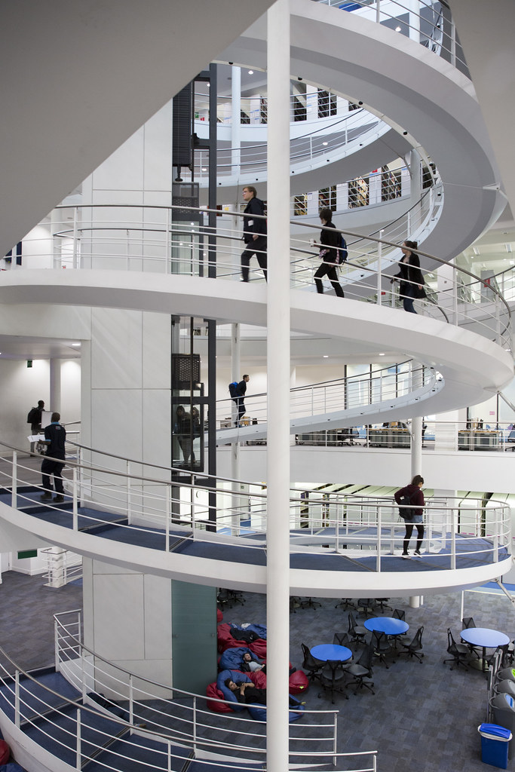
Some background info
Buddying as part of our adjustment package for MAP students
Buddying partnerships

Slide 3
Mis- match and re- aligning our buddy offer
Communication of buddying request
Contacting and first meeting with the student
Buddying Team meetings and improving our match

Slide 4
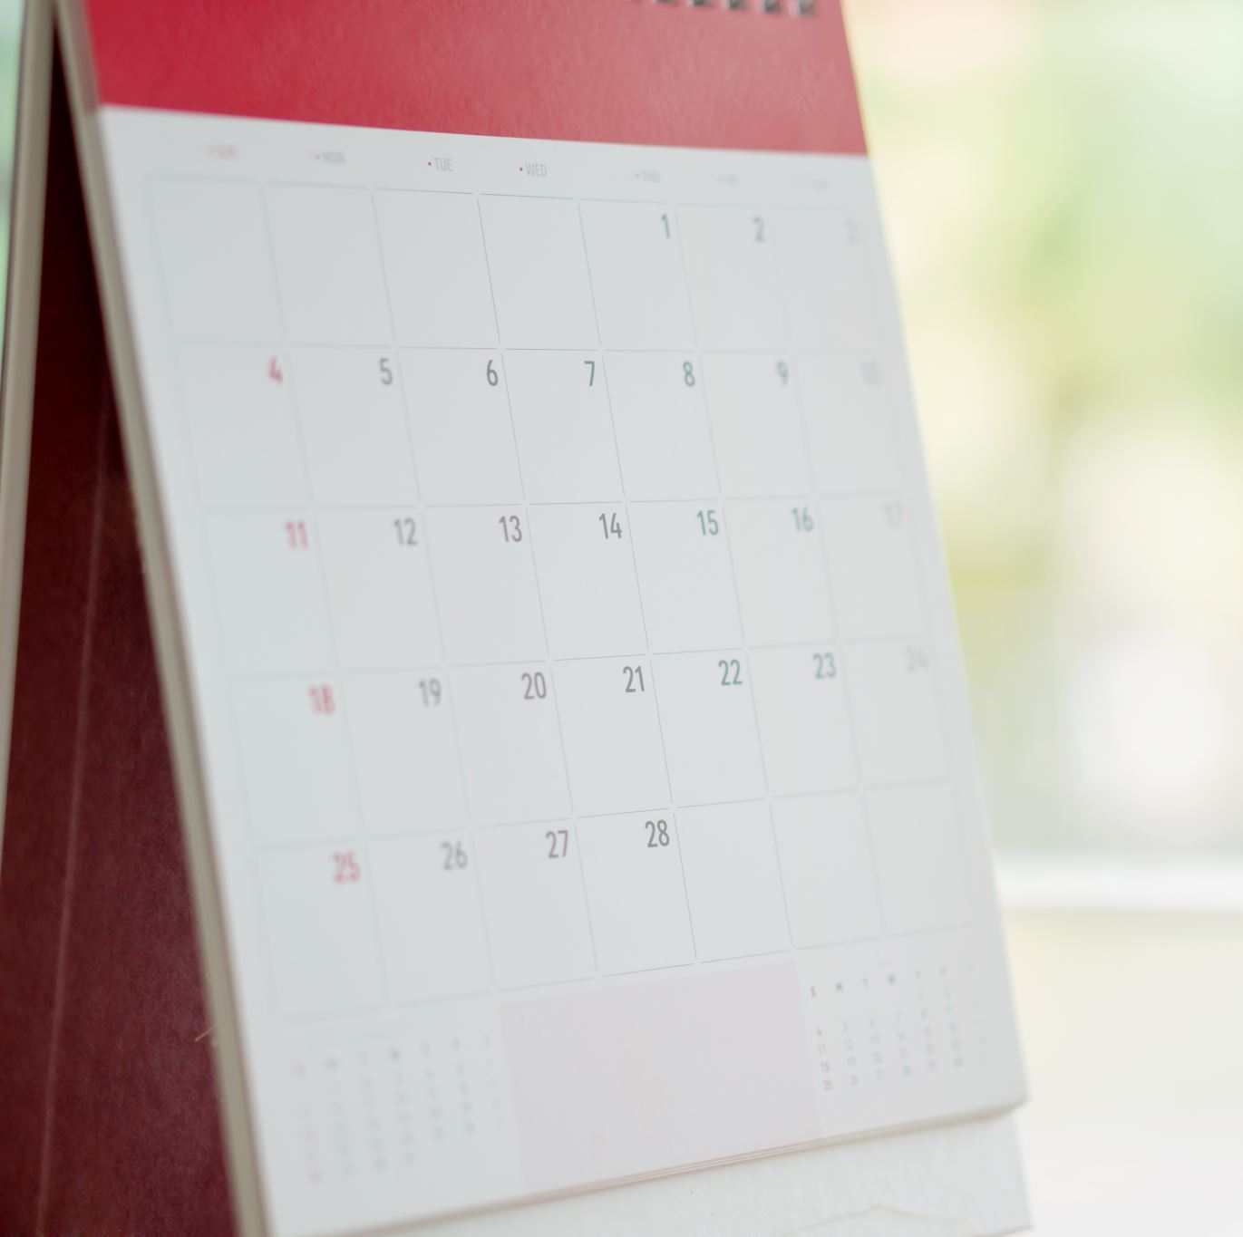
2023 DHM buddying cafe event
DHM 2023
Exciting new Community (shared) Space
Buddying café launch 1 December
Regular commitment

Slide 5
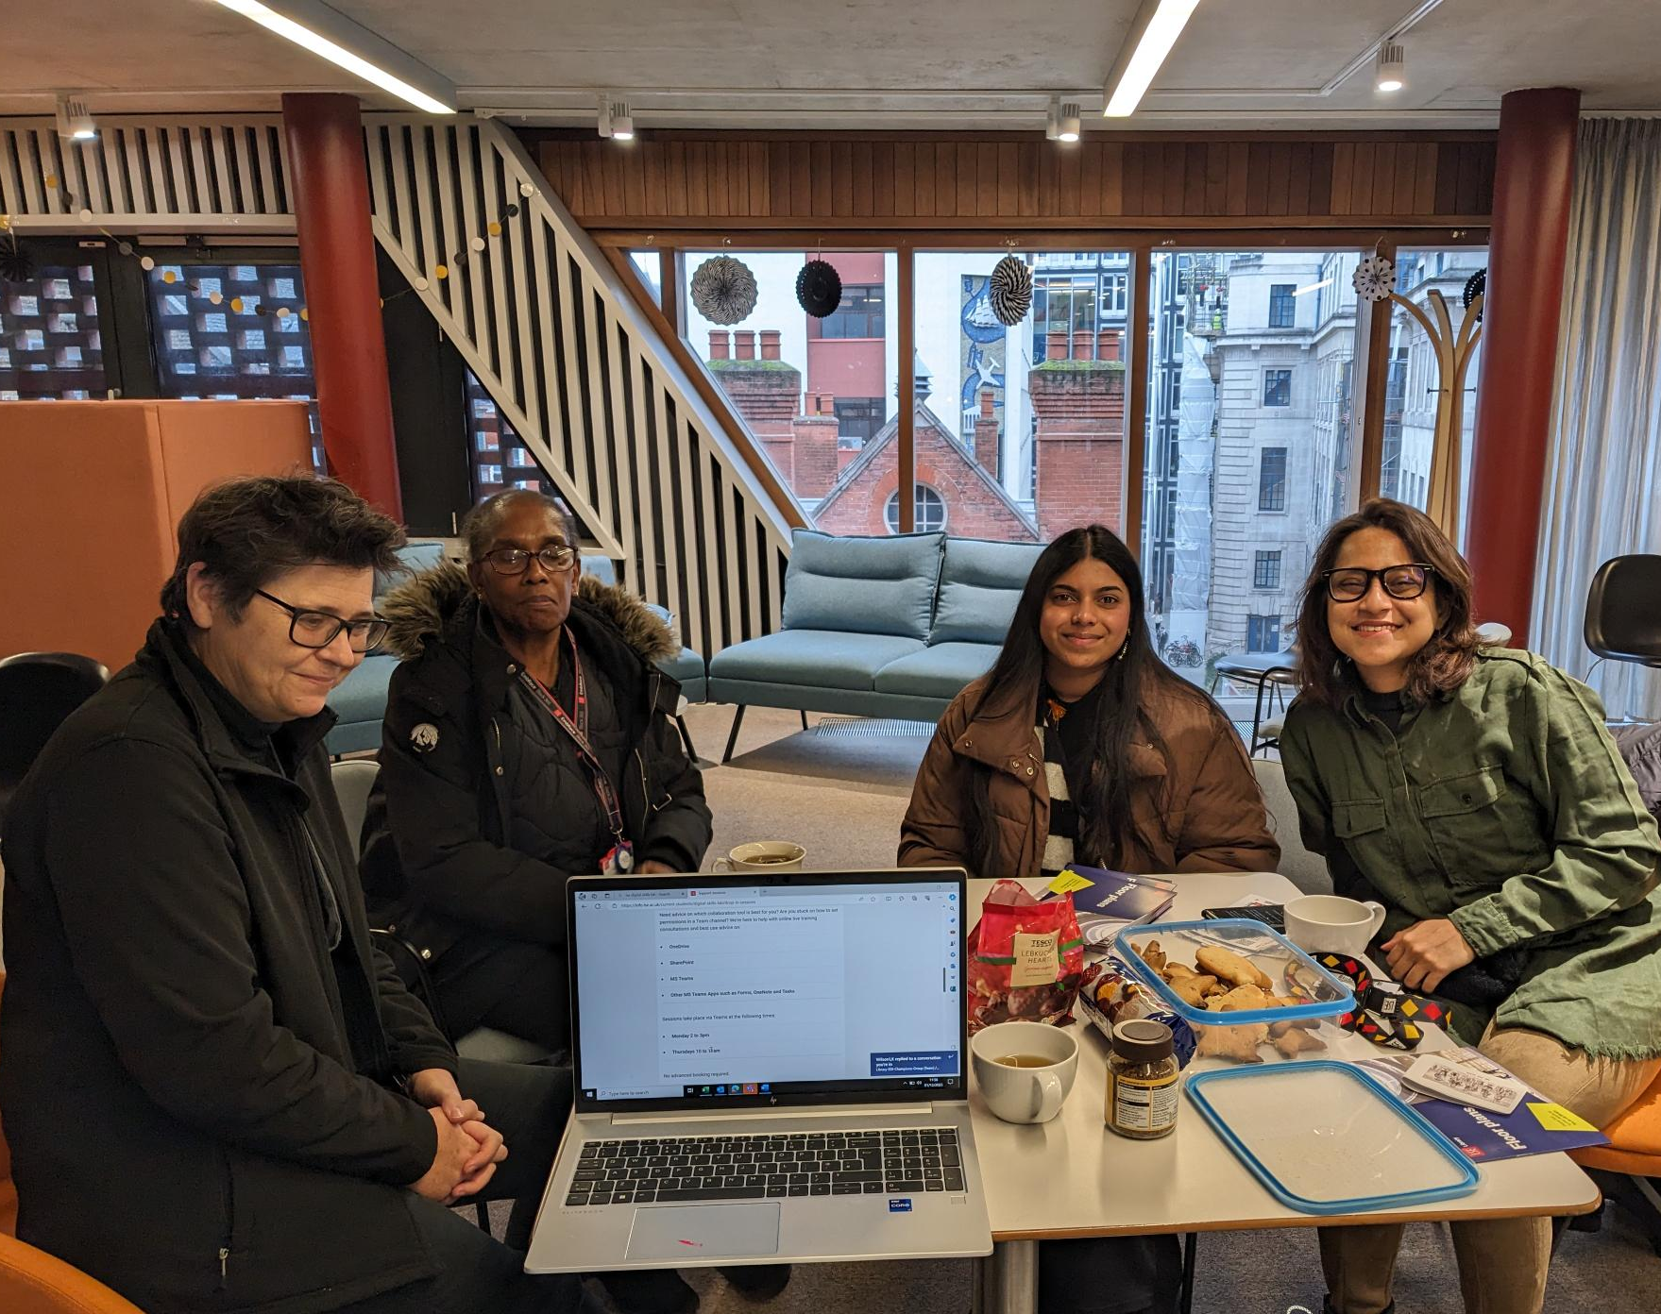
Some further considerations
Feel free to contact me
j.taplin-green@lse.ac.uk

