Slide 1
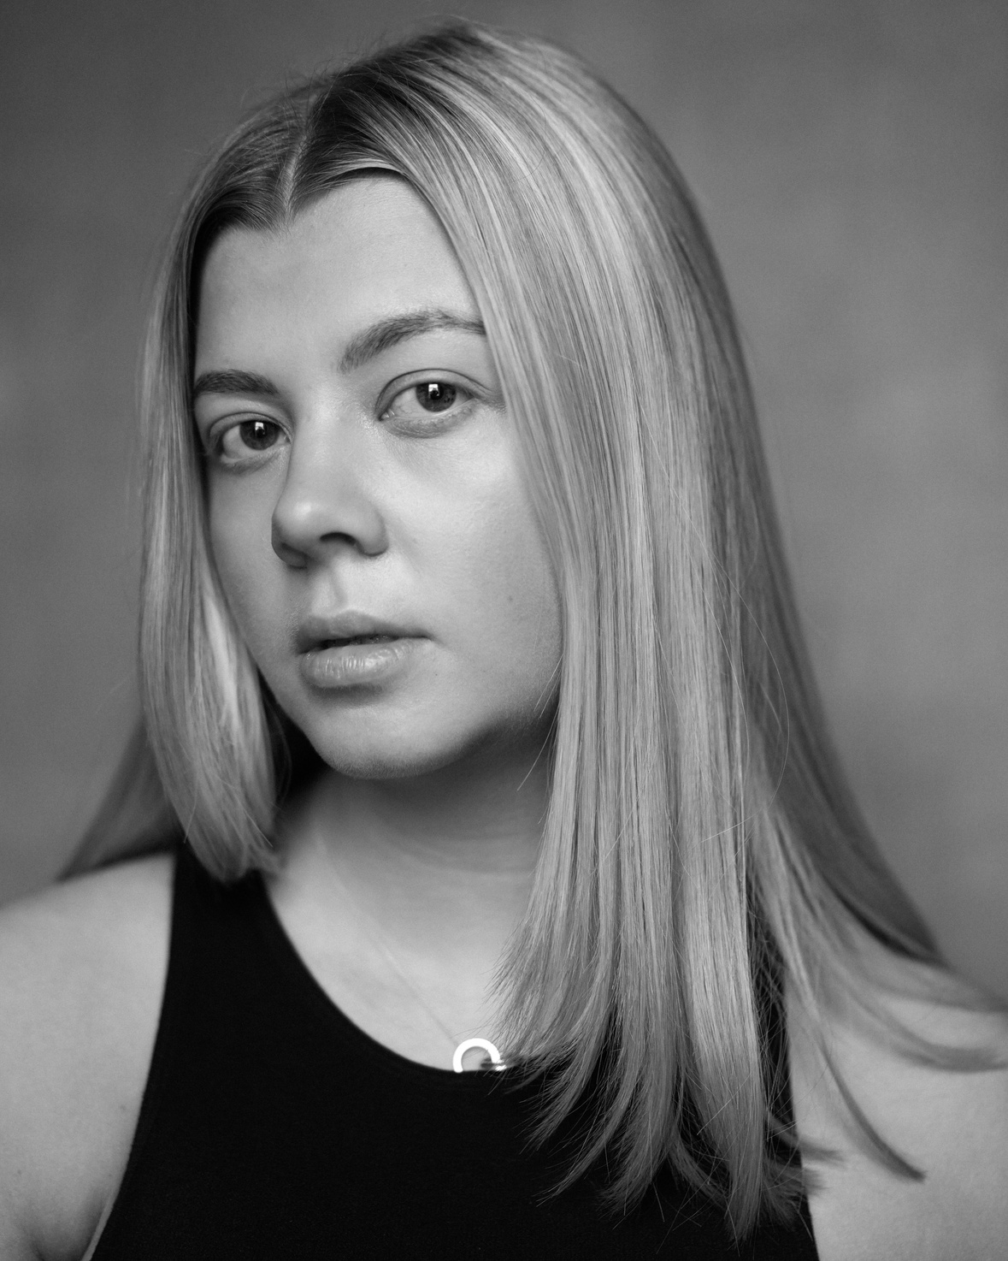
ABOUT ME
  Writing for Performance at the Royal Central School of Speech and Drama
  Main focus of practice = playwrighting
Sophie Hurst
Writer

Slide 2
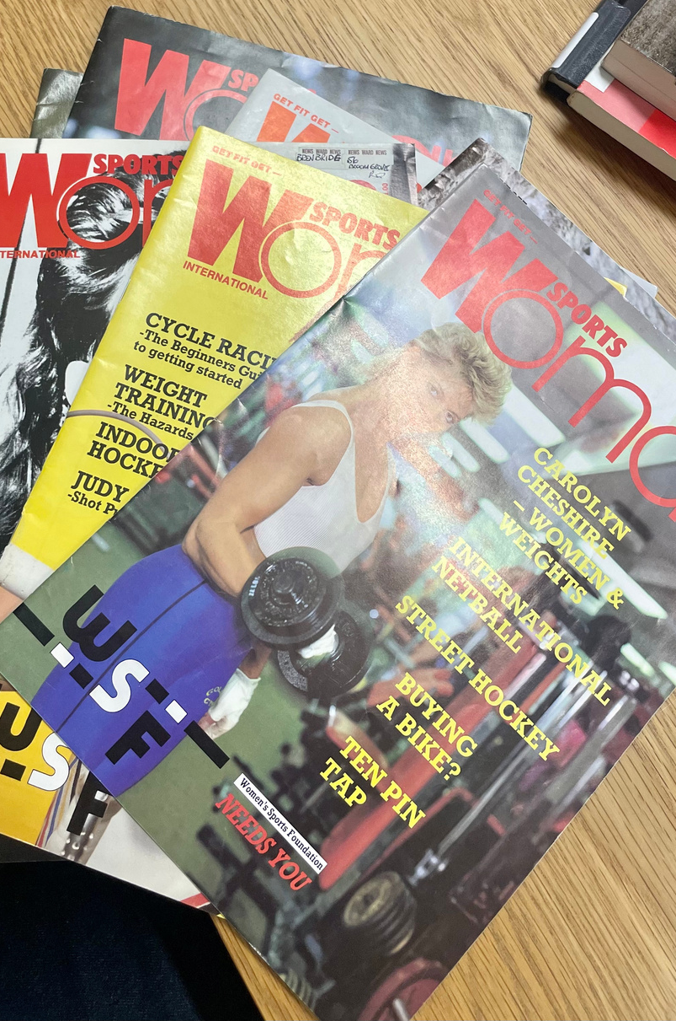
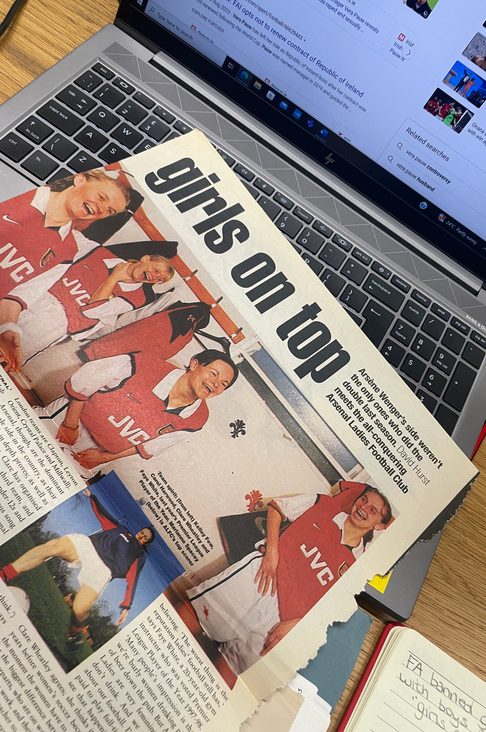
ABOUT MY RESIDENCY

Slide 3
THE 3PM BLACKOUT
  A play discussing current issues within women’s football
  use of poetry and monologues
  influenced by Women In Sport Archive at LSE

Slide 4
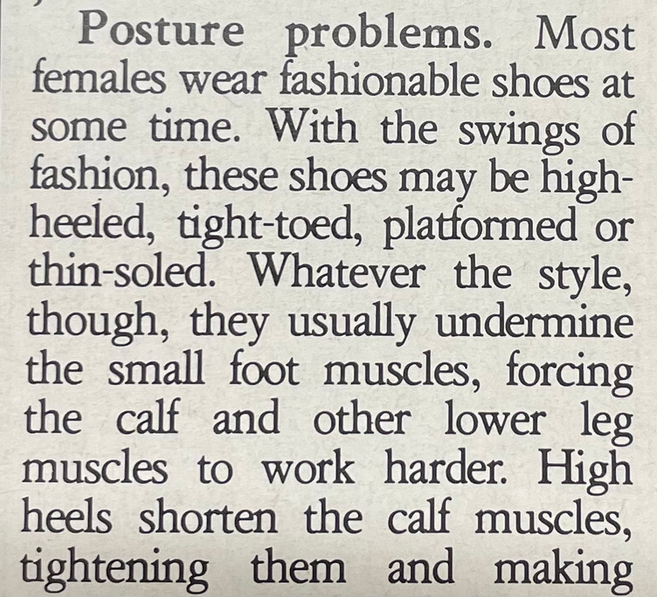
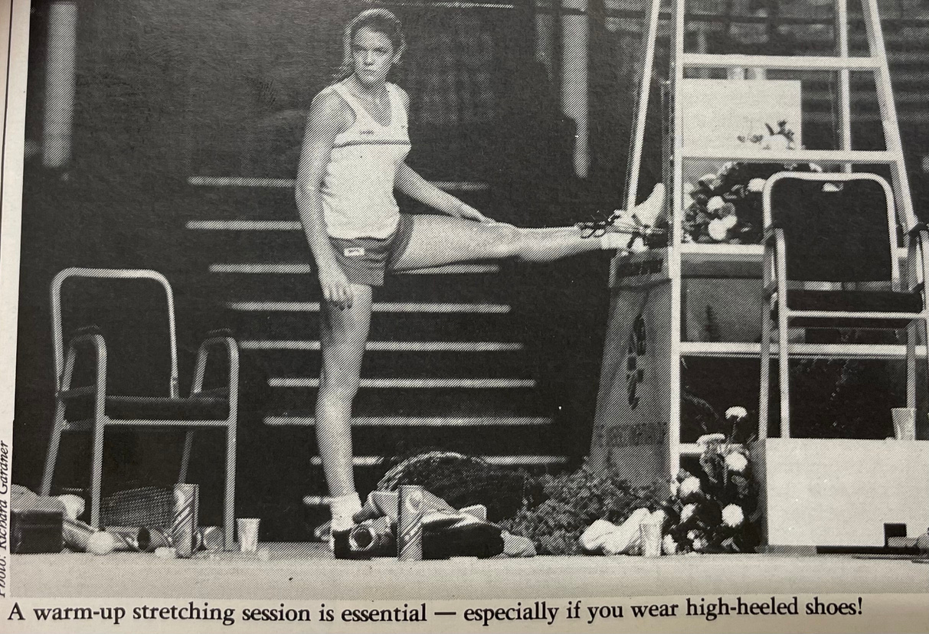
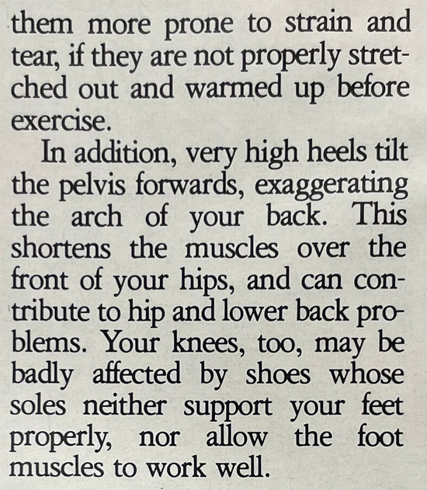
VIVIAN GRISOGONO
Sport’s Physiotherapist

Slide 5
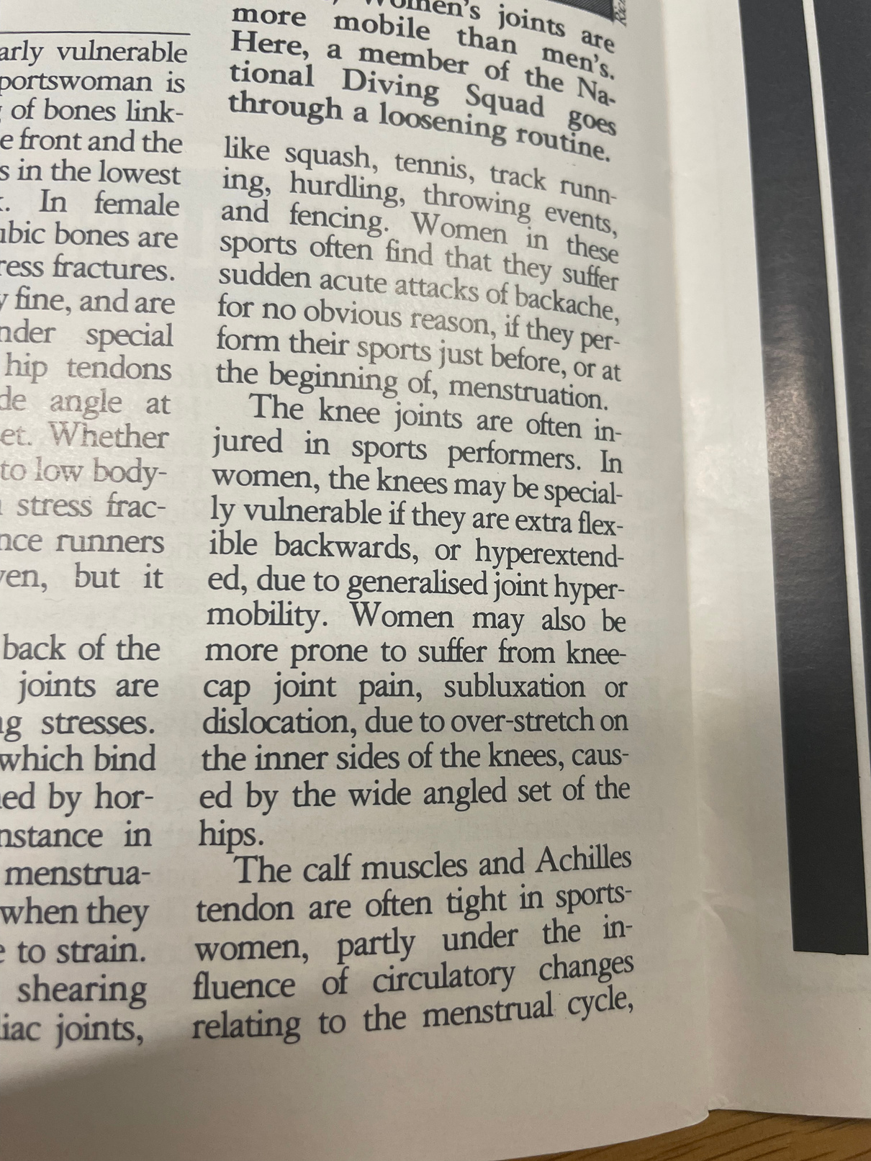
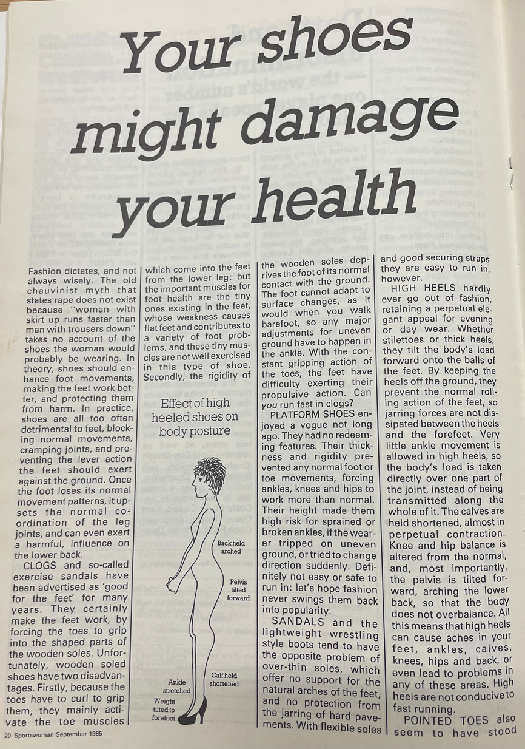
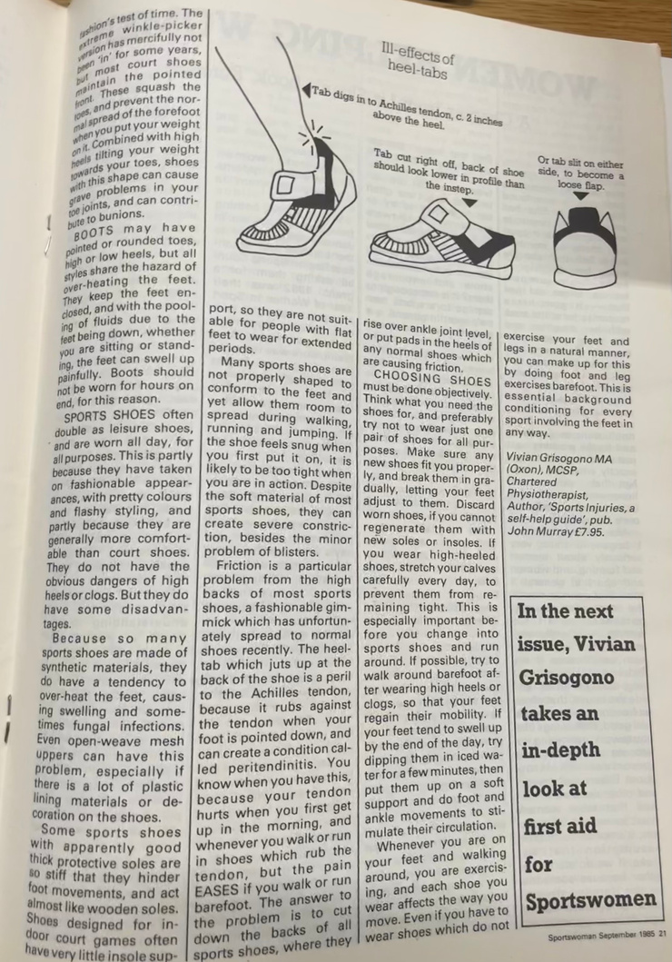
VIVIAN GRISOGONO
CONTINUED

Slide 6
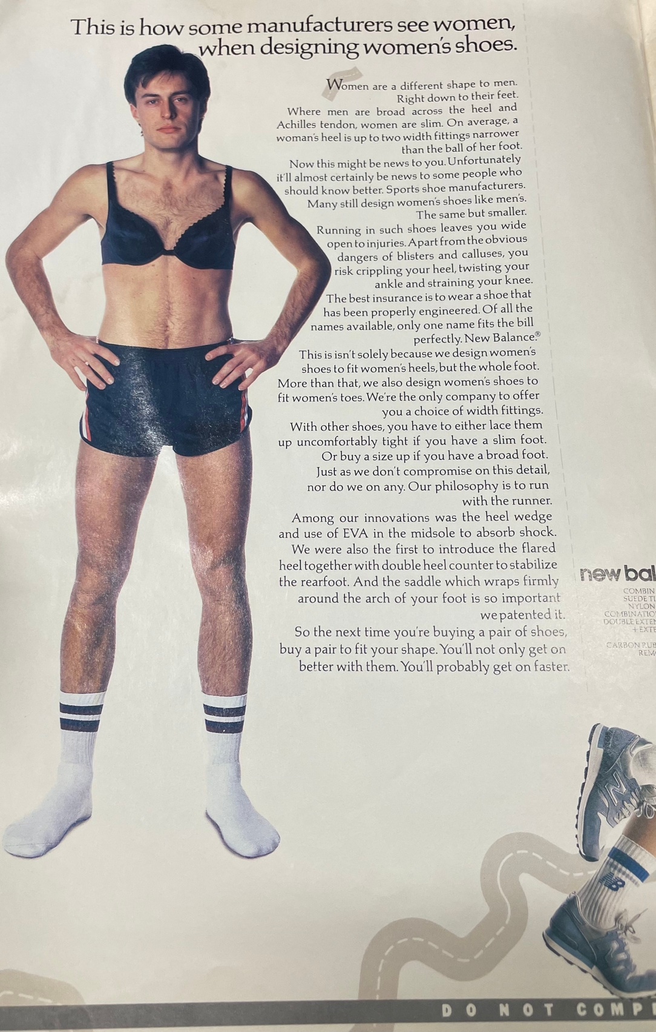
NEW BALANCE CAMPAIGN

Slide 7
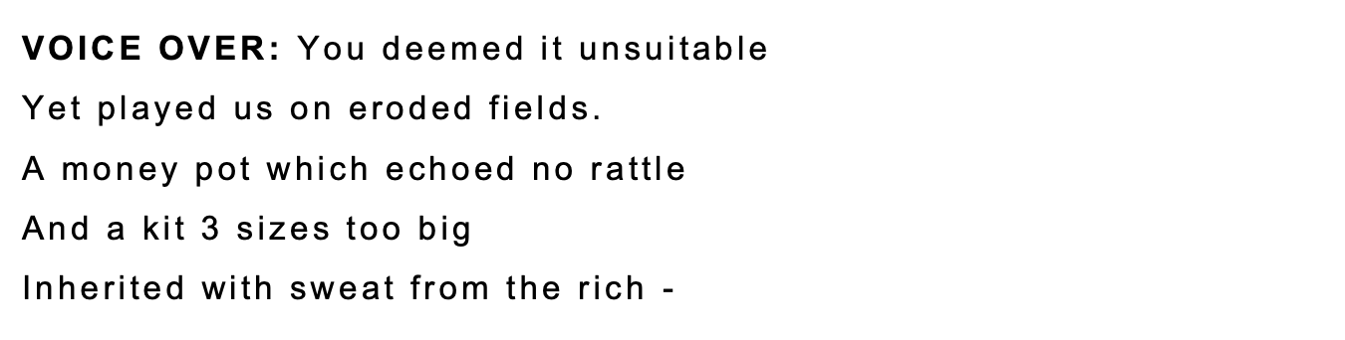
NEW BALANCE CAMPAIGN
Example of where this influenced me in my play.

Slide 8
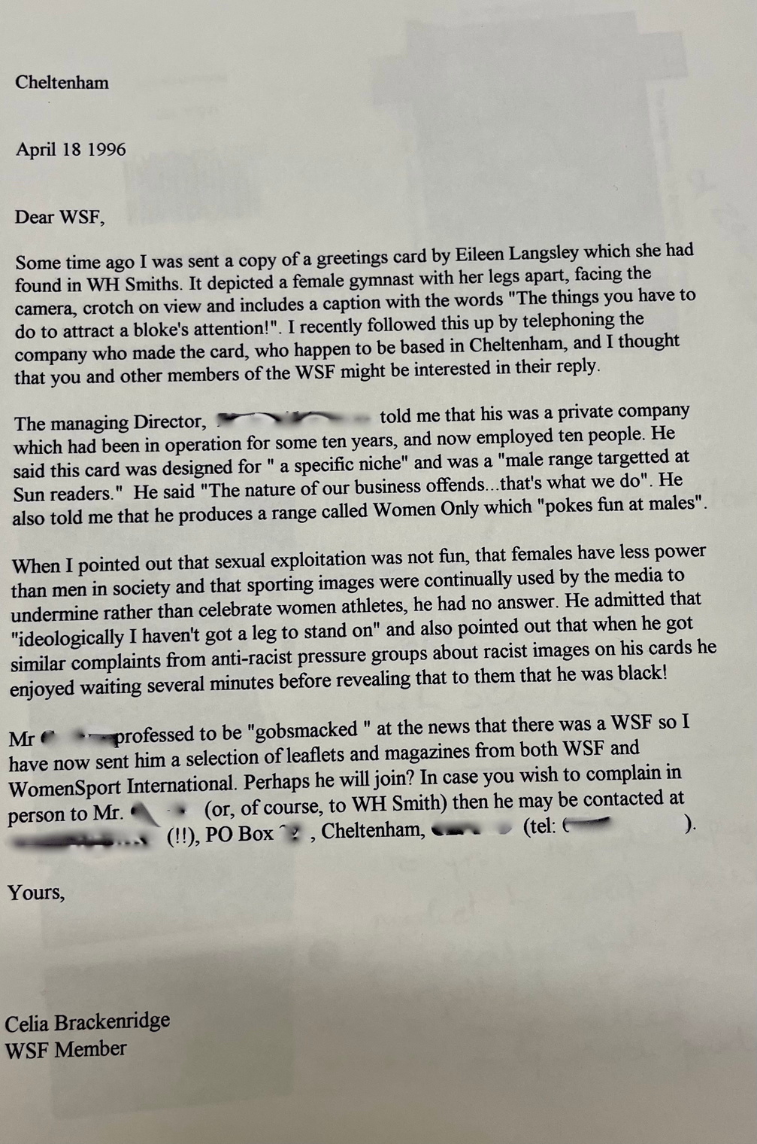
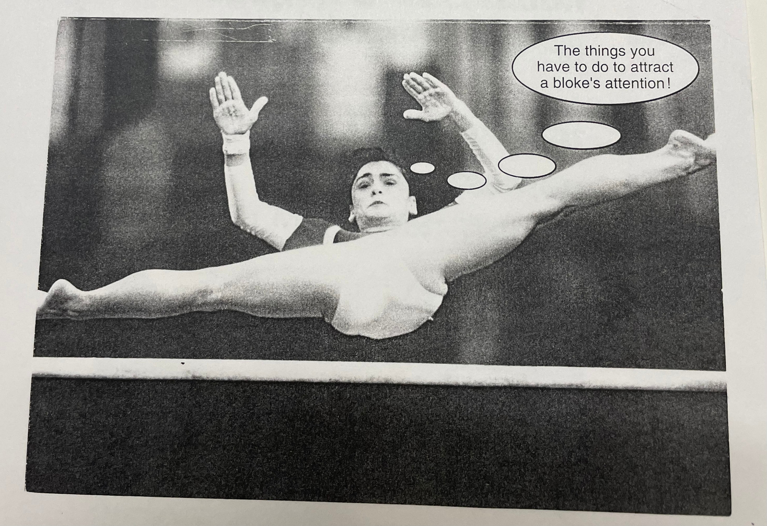
SEXUALISATION WITHIN FEMALE SPORT

Slide 9
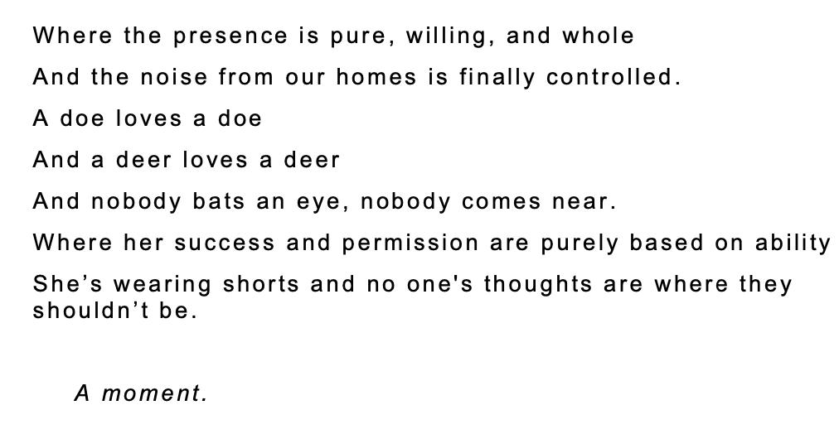
PLAY EXAMPLE EXTRACT

Slide 10
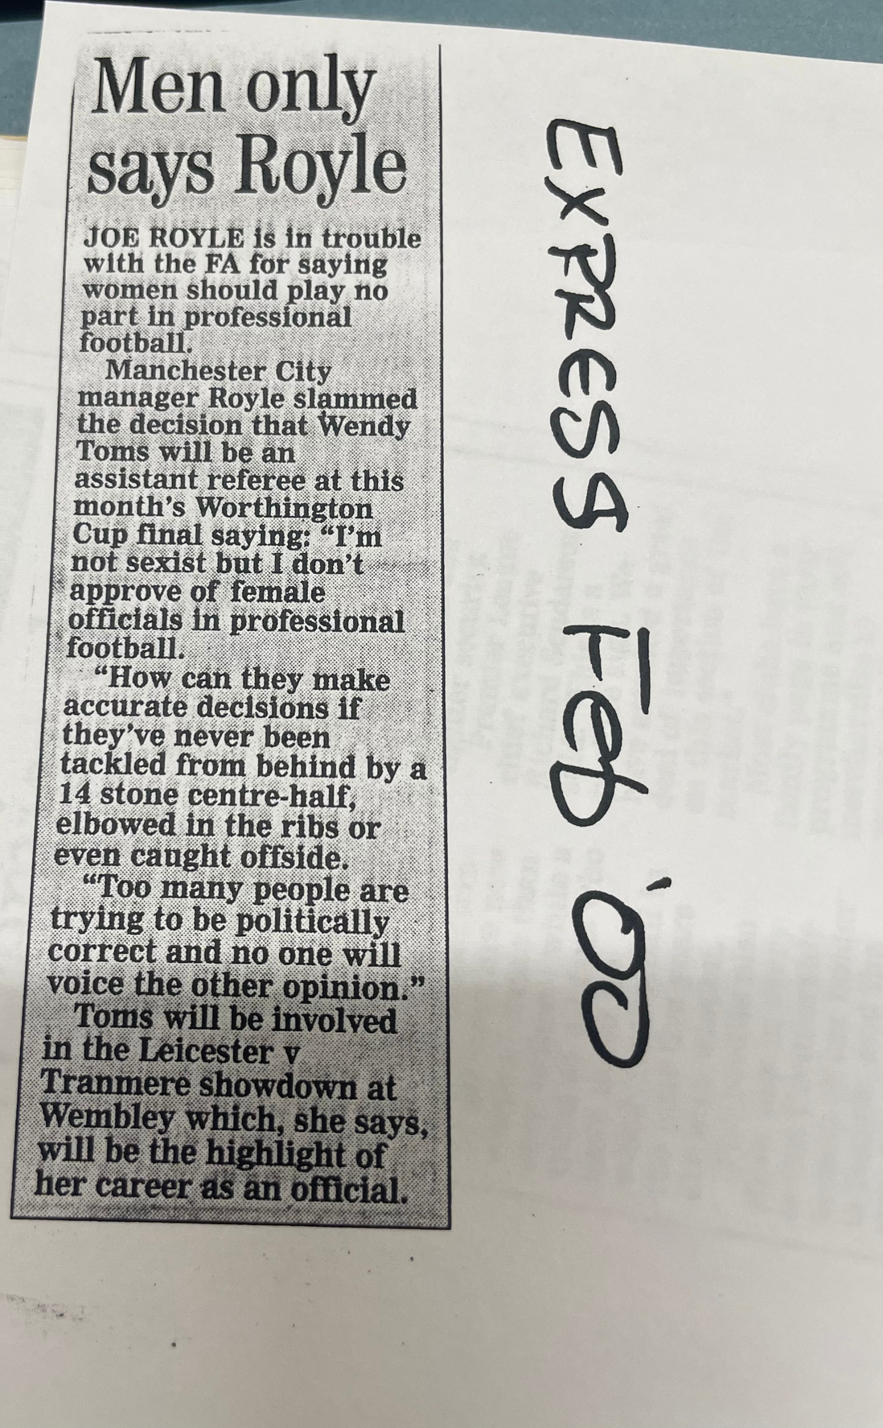
IS THERE A PLACE FOR WOMEN IN “MEN’S”SPORT?

Slide 11
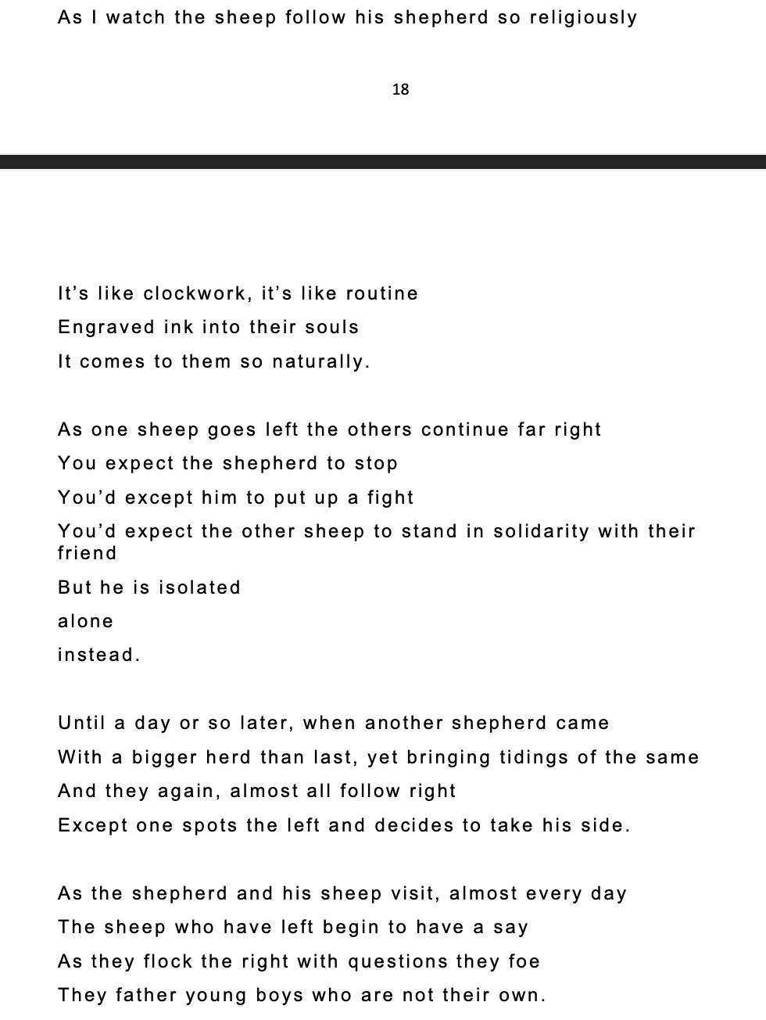
PLAY EXAMPLE EXTRACT

Slide 12
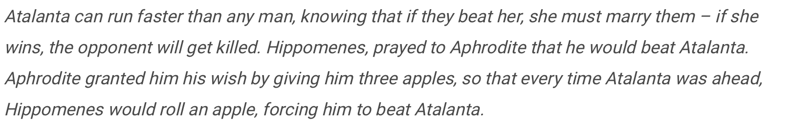
ATALANTA’S
APPLES
by Anne McArthur

Slide 13
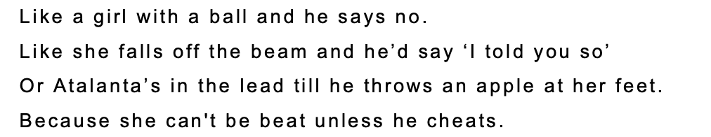
PLAY EXAMPLE EXTRACT

Slide 14
sophiehurst148@gmail.com

