Slide 1
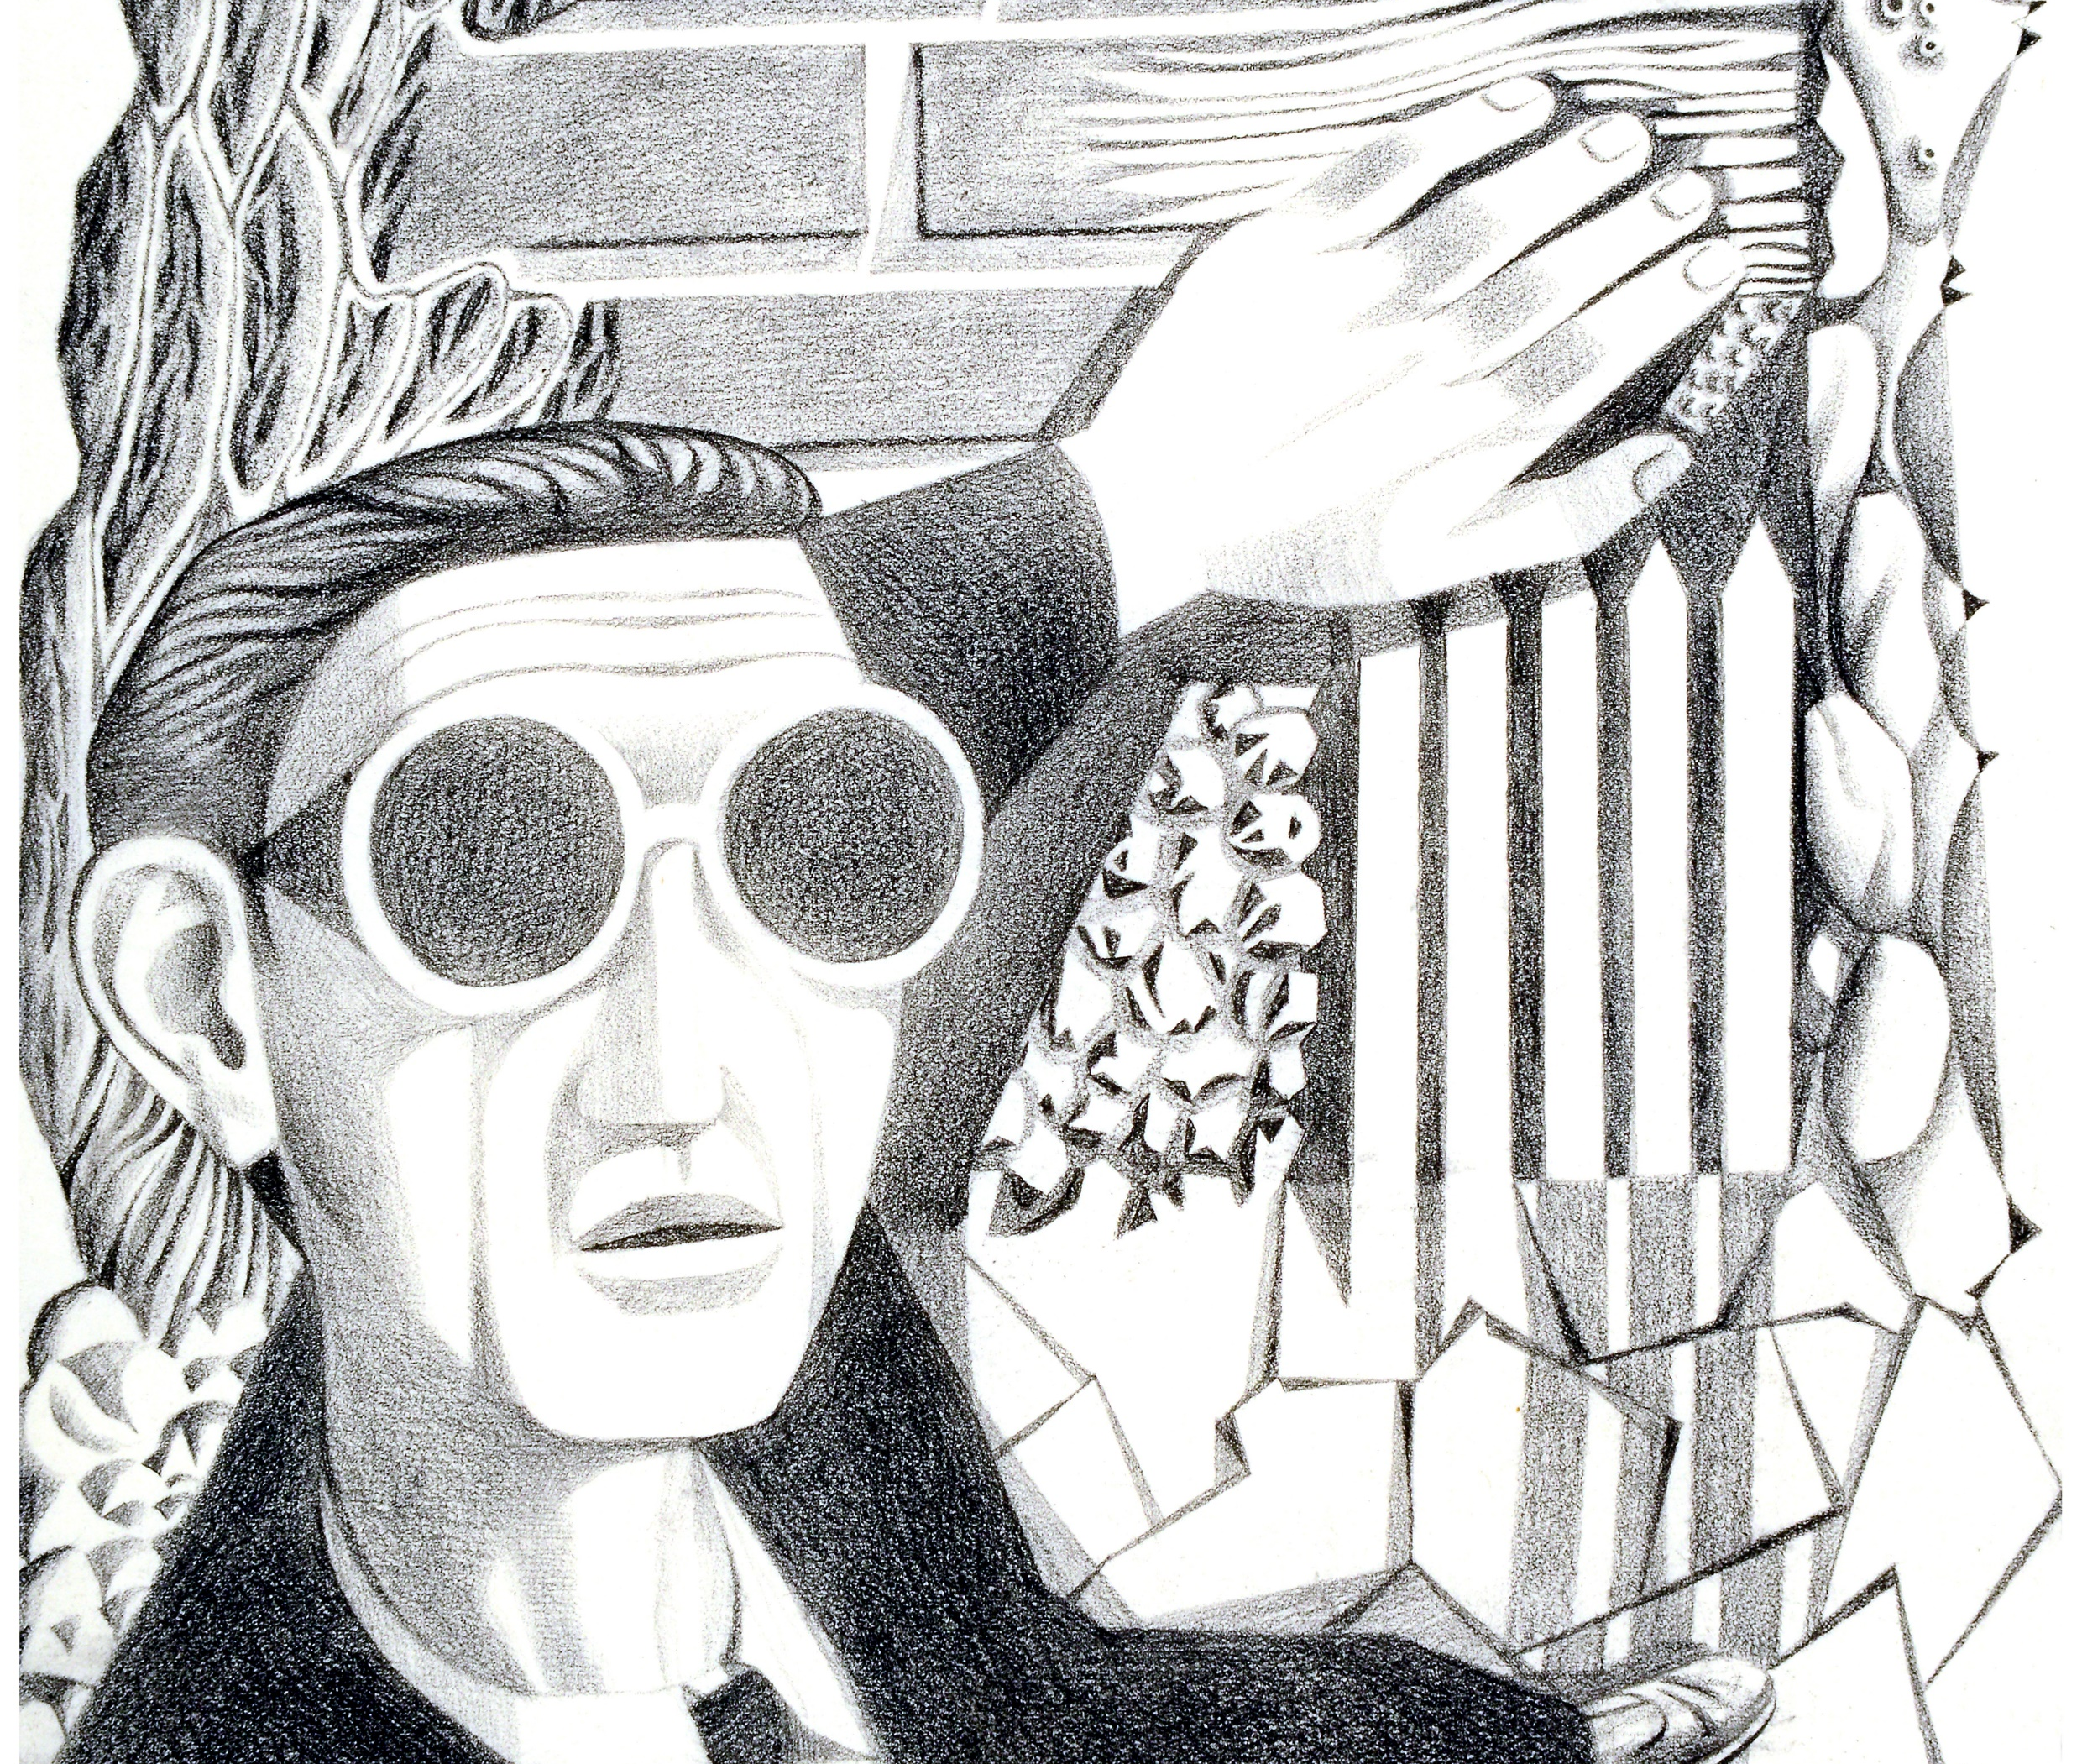
Making archives accessible for visually impaired audiences
Ellen Oredsson, Digital Projects Officer (Education & Outreach)
Drawing of blind man: 'Sound and texture are his guides’ Catalogue ref: INF 3/1122.
Notes:
Hello, my name is Ellen Oredsson and I am the Digital Projects Officer within the Education & Outreach department at The National Archives. I’m going to present today about a research project I am about to complete as part of the TNA/RLUK Professional Fellowship Scheme.

Slide 2
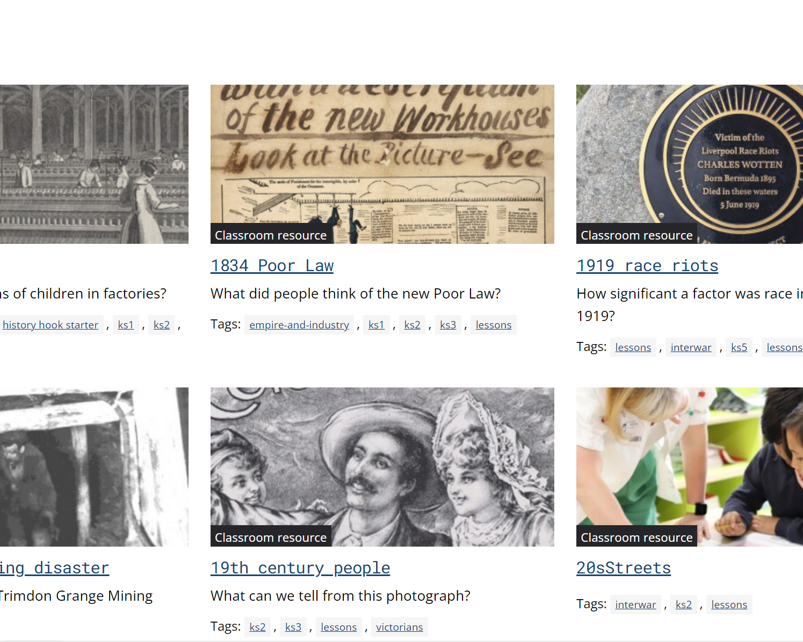
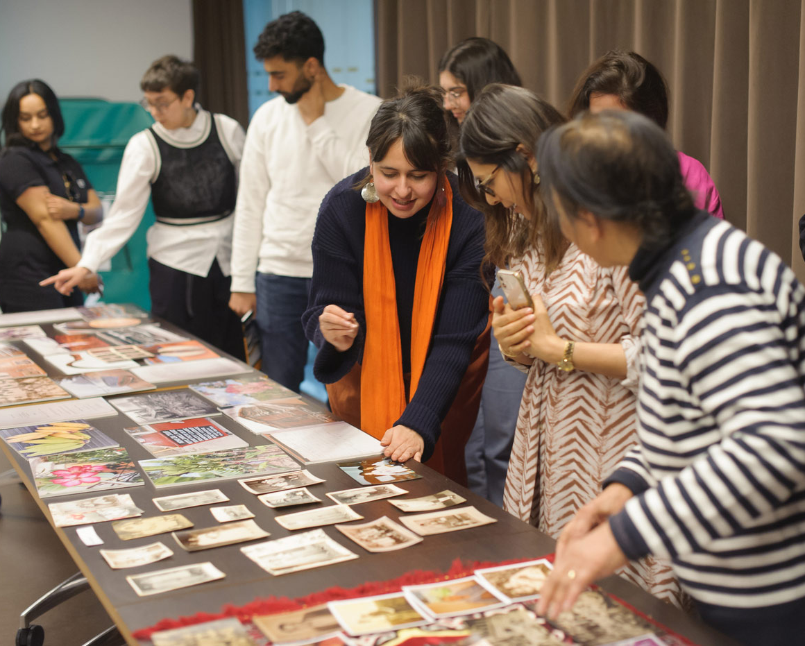
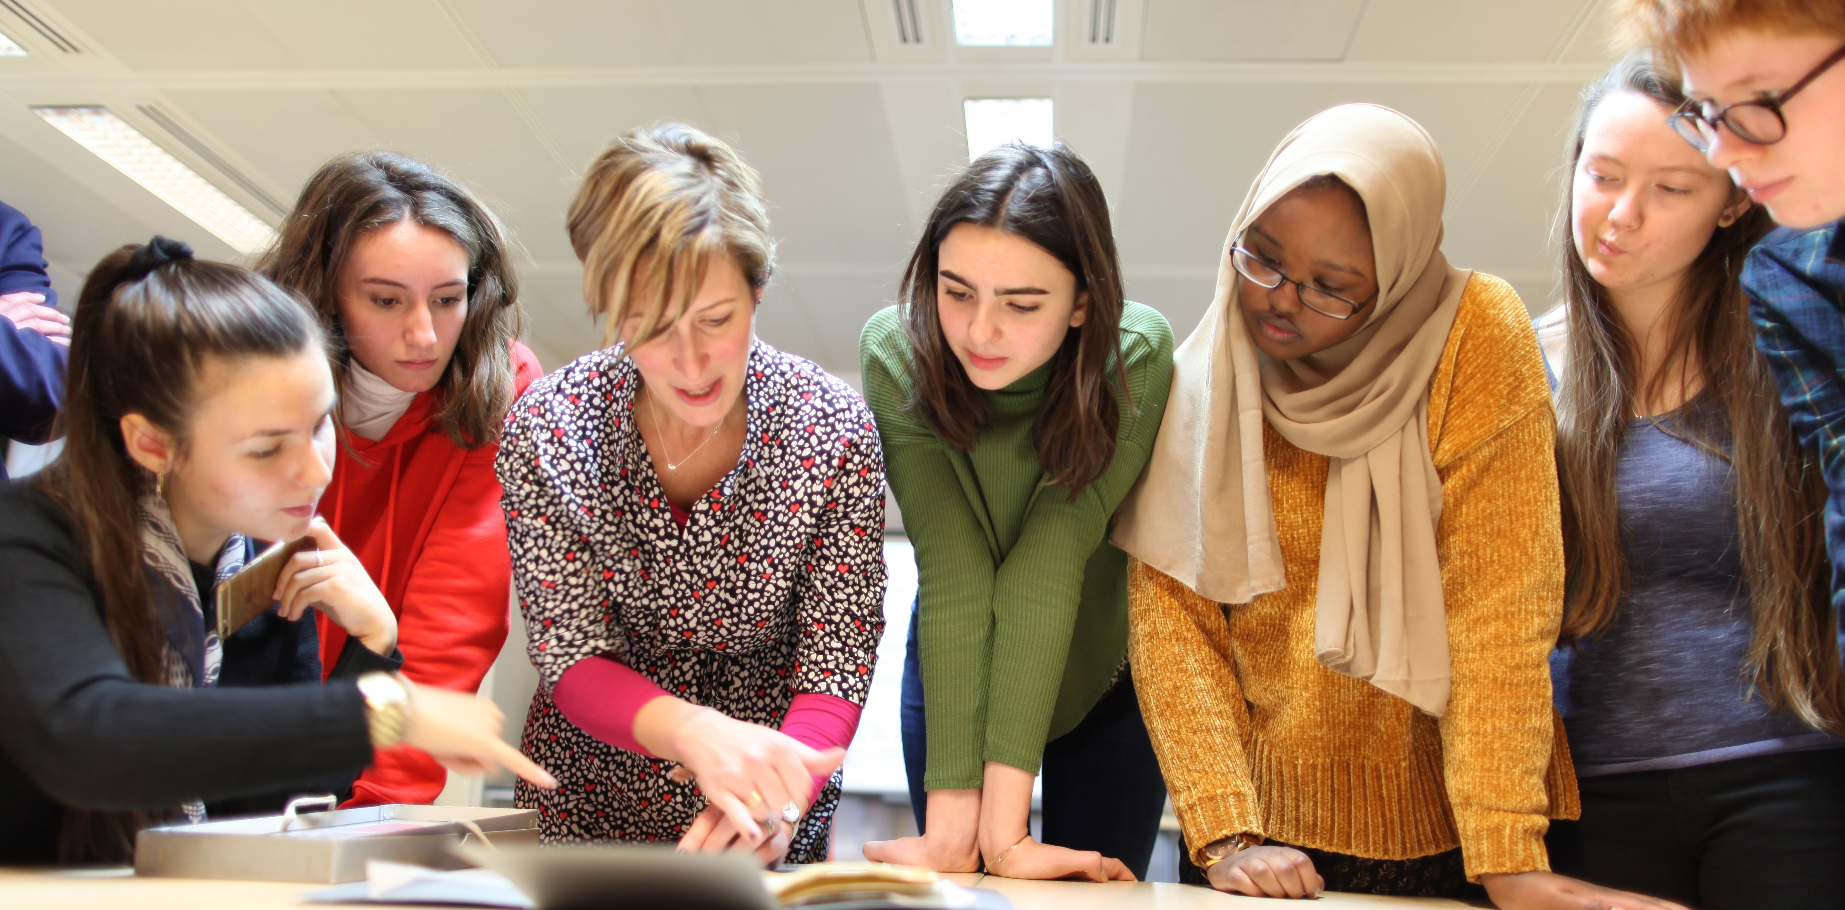
Education & Outreach department
Notes:
We produce and deliver educational resources, experiences and workshops both onsite and online for educators, students, young people and community groups. A key driving force behind our work is to take the historical holdings of The National Archives, consisting of 1,000 years of government records, and use them to teach our audience about history. To do this, we have to find different ways of making these documents engaging and understandable. Here are some examples of different ways in which we do this, from workshops and outreach activities to online resources.

Slide 3
Aims of the project
RLUK/TNA Professional Research Fellowship Scheme 2023-24
Mentors: Eleonora Gandolfi from the University of Surrey and Anna Hvass from the University of Southampton
  How do we make it fun and easy for everyone to learn about archives online?
      How do we better understand these audiences’ needs when it comes to learning, and what kind of technology is available to us?
      How can we go beyond just meeting accessibility requirements?
      What opportunities could this increased level of understanding give us?
  Outputs/outcomes
    Toolkit for archives based on knowledge gathered
    Creation of workshop for blind and visually impaired students
    Creating connections and partnerships within this field
Notes:
One audience group that we have had less experience is blind and visually impaired audiences. This is why I submitted this project to the RLUK/TNA Professional Fellowship Scheme. The question that my project has been guided by has been: “How do we make our archives not just accessible but engaging for visually impaired audiences?” As someone working in the online team, I was aware of the technical accessibility requirements we had to follow, but I wanted to go beyond a checklist and see how we could more directly address and understand the needs of this audience group. On this slide you can see some of the questions I went into this project asking [read them out] and the outcomes of the project [read them out], which I will go into with more detail throughout the presentation.

Slide 4
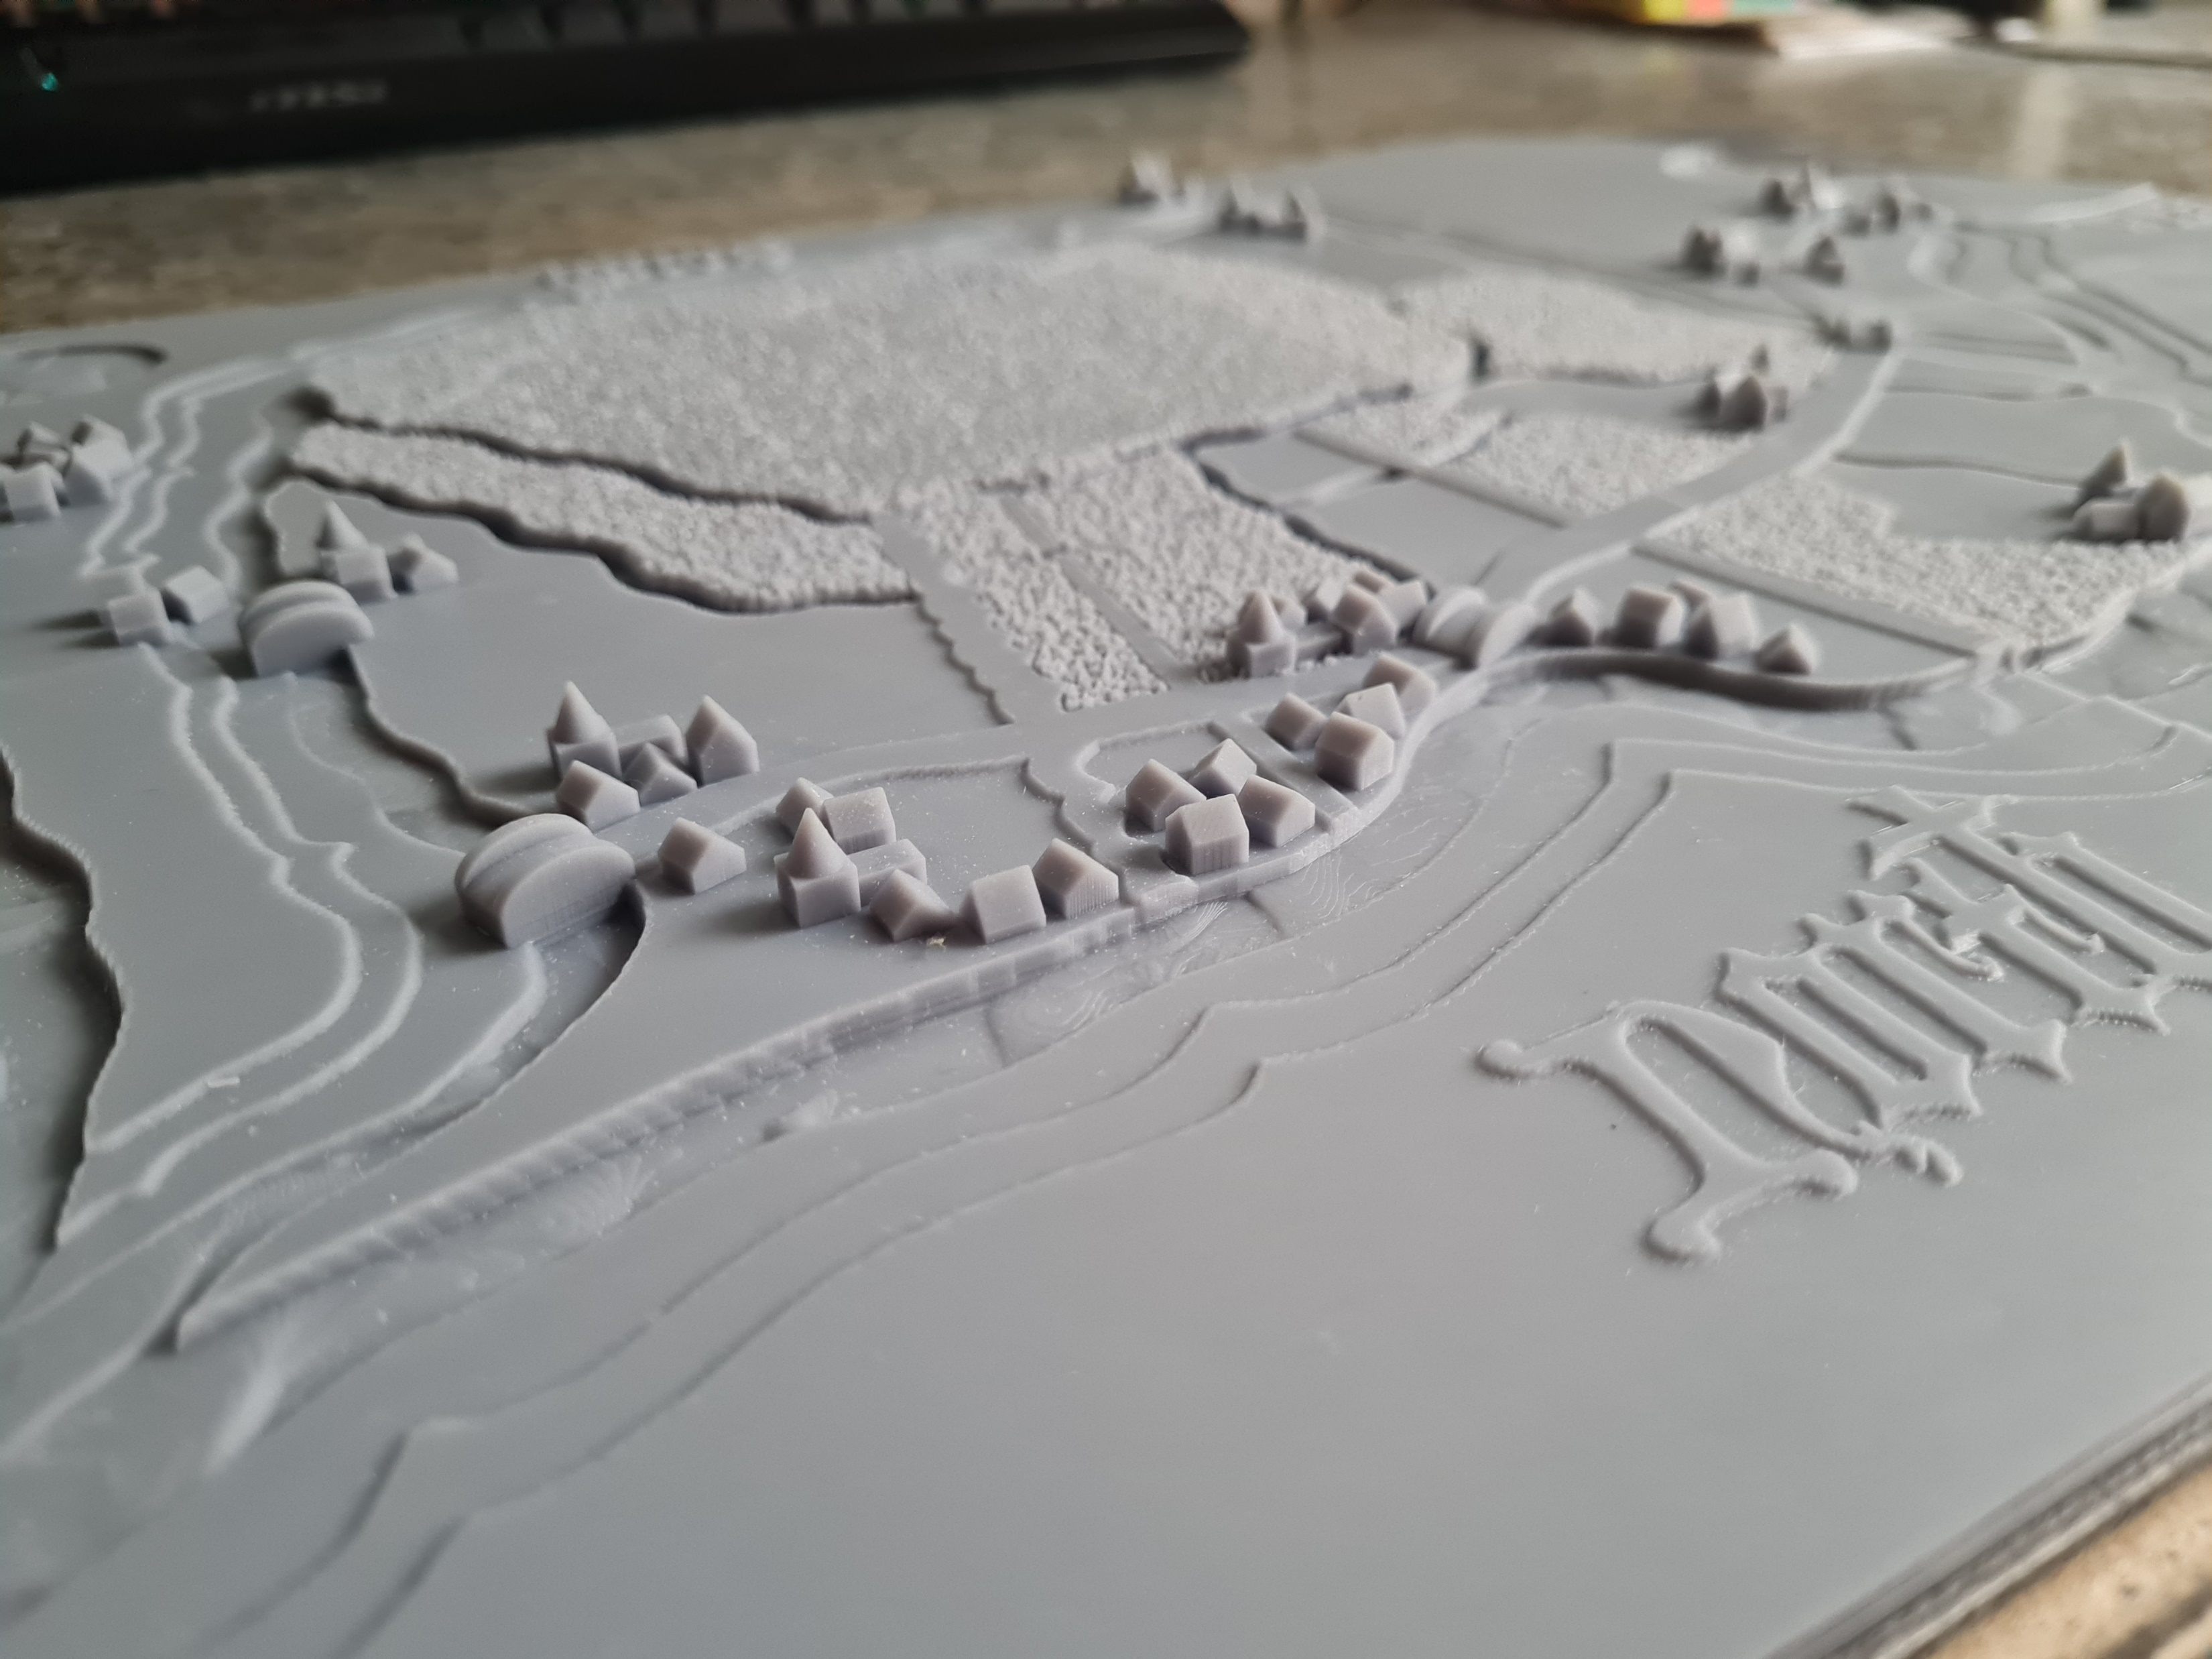
Workshop for New College Worcester March 2024
    Specialist school for visually impaired students
    A group of 11 students from Year 8 & 9
    70% of the students were Braille users
    The workshop introduced them to four different stories from history that align with what they are learning at school’, covering medieval, Tudor, and 19th century history.
    They were first introduced to tactile version of the document. Then, they received a ‘mystery bag’ of sensory items – for example, items that evoke the subject matter of the document, or buttons that produce relevant sounds.
    They got context for what the document they have been exploring is and why it’s important using sheets in large print and Braille.
    They got to touch the original document they have been studying.
    They did a presentation about the document they have become ‘specialists’ on.
    Finally, they got to actually touch original documents that were touched by Henry VIII and Elizabeth I.
Tactile image for the workshop made by George Rhodes, based on a medieval map.
Notes:
This brings me to the final part of my presentation, in which I will discuss a workshop that kind of brings all of this work together. Unfortunately I can’t present on how the actual workshop went, the timing is just a bit off – it is happening this Monday the 18th March. It will be a totally new experiment for us, so it’ll be very excited to see how it goes! This will be an all-day workshop for a group of visually impaired students coming down from New College Worcester, which is a specialist school. A group of 11-12 students from Year 8 & 9. 70% of the students are Braille users.
The workshop will introduce them to four different stories from our collection that align with what they are learning at school, covering medieval, Tudor, and 19th century history. They will first be introduced to a tactile version of the document. Then, they will receive a ‘mystery bag’ of sensory items – for example, materials that evoke the time period or subject matter of the document, or sound buttons that produce relevant sounds. They will get context for what the document they have been exploring is and why it’s important. Finally, they will get to actually touch the original document – after the context and exploration has built up excitement for touching this historically significant item.

Slide 5
Collaborators
  George Rhodes – The University of Westminster / All Able
    Digital Accessibility Team Lead at University of Westminster.
    Completing a PhD on 3D-printed tactile images.
    Producing tactile versions of 4 of our documents used during the workshop.
  Jeanette Normanton-Erry – New College Worcester
    Head of History and Politics at New College Worcester.
    Has shared her experience and expertise to ensure that the tactile images will be as useful as possible for her students.
  Kate Elizabeth Antolak – teaching consultant
    Has both experience as a teacher, including for visually impaired students, and lived experience as a blind Braille user.
    Came on board as advisor for our team in preparing for the workshop.
Notes:
Now, I want to return to the principle I set out in the beginning, that of collaboration. This workshop sits on the solid foundation of this principle, as it could not happen without some truly fantastic and talented people. Externally here are the people that are involved. I formed a collaboration with George Rhodes, who is Digital Accessibility Team Lead at University of Westminster and is also completing a PhD on 3D-printed tactile images. His research focuses on how tactile images can be improved further and be easier to both produce and read. As part of our collaboration, he is producing tactile versions of 5 of our documents that will be used during the workshop and then be placed on our website for anyone with a 3D printer to download and use.
Secondly, I have been working with Jeanette Normanton-Erry, who is Head of History at New College Worcester and has decades of experience teaching visually impaired students (in fact, she was part of a previous National Archives project, Prisoner 4099, in 2007). As well as organising for her students to take part in the workshop, she has also been an invaluable help when developing the tactile images.
Finally, there is Kate Elizabeth Antolak. Now, while our teaching team has taught students with low vision before, teaching Braille users (students who are almost or completely blind) will be a new experience. To help with this, I was lucky enough to be able to hire Kate Elizabeth Antolak as an official advisor to the project. She has both experience as a teacher, including for visually impaired students, and lived experience as a blind Braille user herself. Our consultations with her have been invaluable and have helped prepare us for what might or might not work down to every step of the workshop and the preparations for it.

Slide 6
Collaborators within The National Archives
    Hannah Carter – Education Manager
    Rachel Hillman – Deputy Head of Education & Outreach
    Clare Horrie – Education Web Manager
    Elspeth Mcgregor – Education Assistant
    Alice Middlemiss – Document Production Adviser and repository tour guide
    Natalie Brown and Sarah Petter – Collection Care
Notes:
In addition to external collaboration, this workshop literally could not happen without the invaluable help of the people involved from The National Archives. Hannah Carter who is Education Manager will be delivering the workshop. She has been developing the absolutely amazing workshop together with Rachel Hillman, Deputy Head of E&O. Rachel and Clare Horrie, Education Web Manager, have been working with me on developing the workshop from the start of my collaboration with George, and this development has been greatly assisted by Elspeth Mcgregor as well. Alice Middlemiss from DSD will be delivering the repository tour and taking on a completely new audience with new tour strategies. Finally, Natalie Brown and Sarah Petter from Collection Care have helped prepare documents and document material samples for the students that are especially sensory (some smelly documents, for example!)

Slide 7
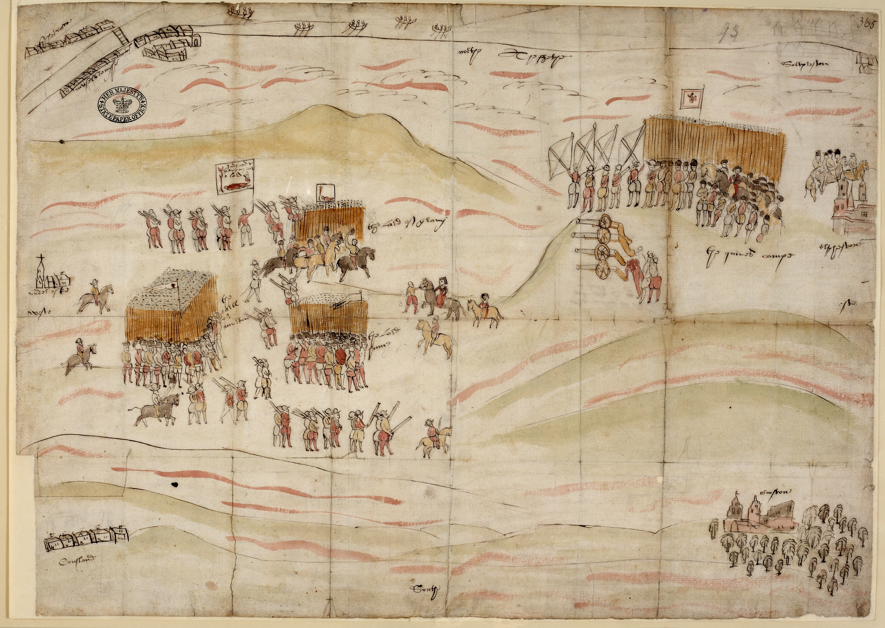
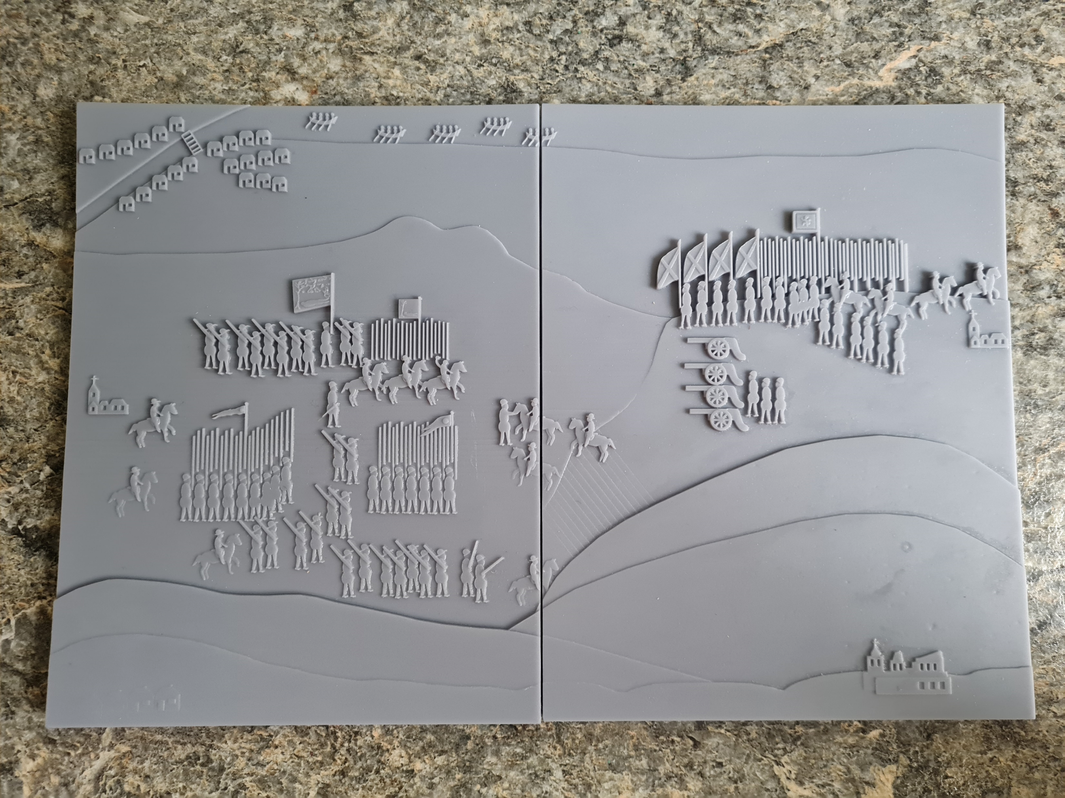
Meeting at Carberry Hill between Mary, Queen of Scots, and lords opposed to her, 1567. MPF 1/366/2
Tactile version made by George Rhodes

Slide 8
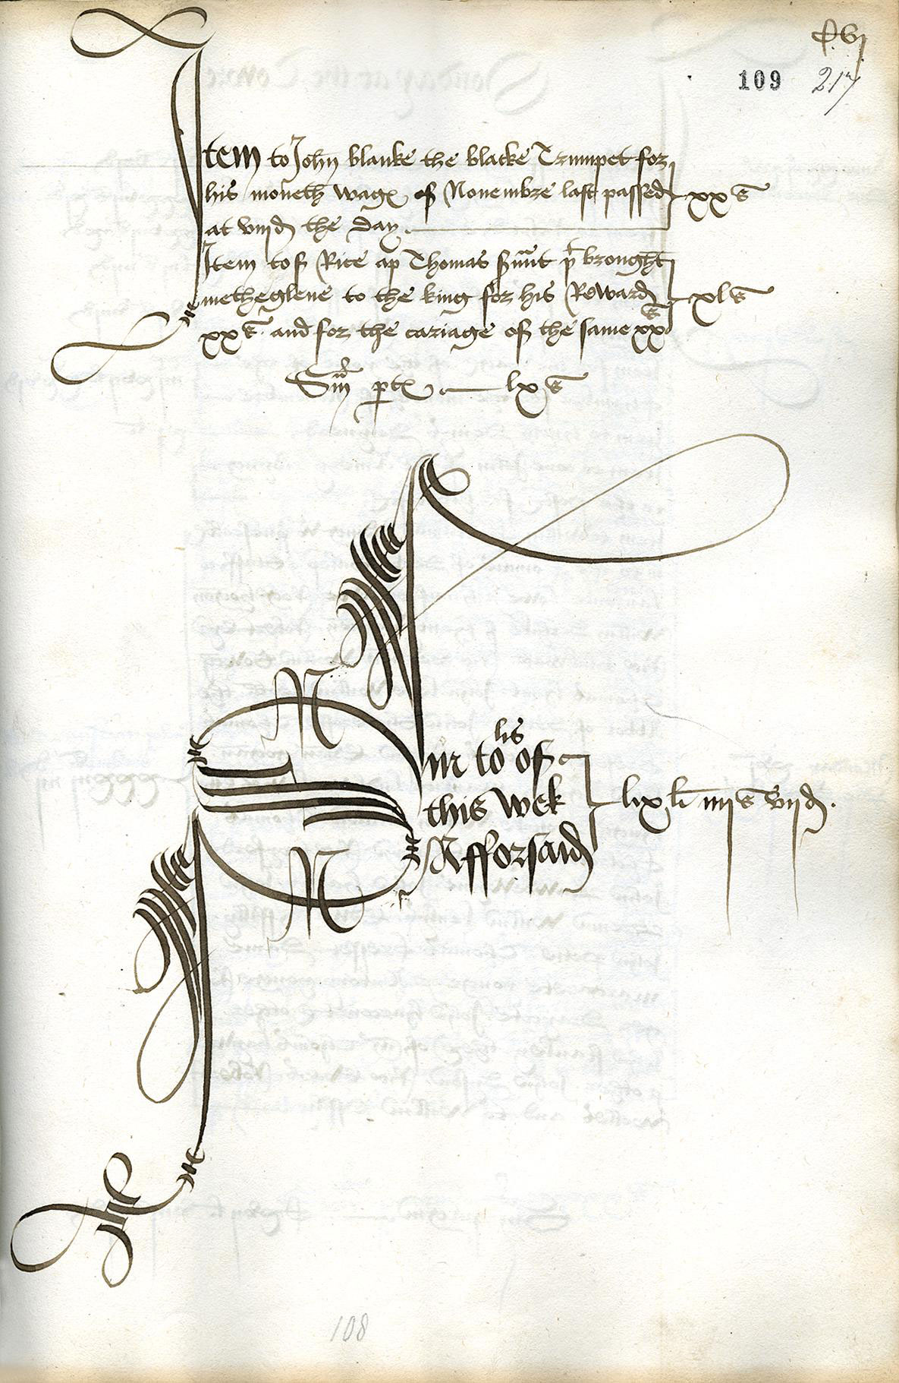
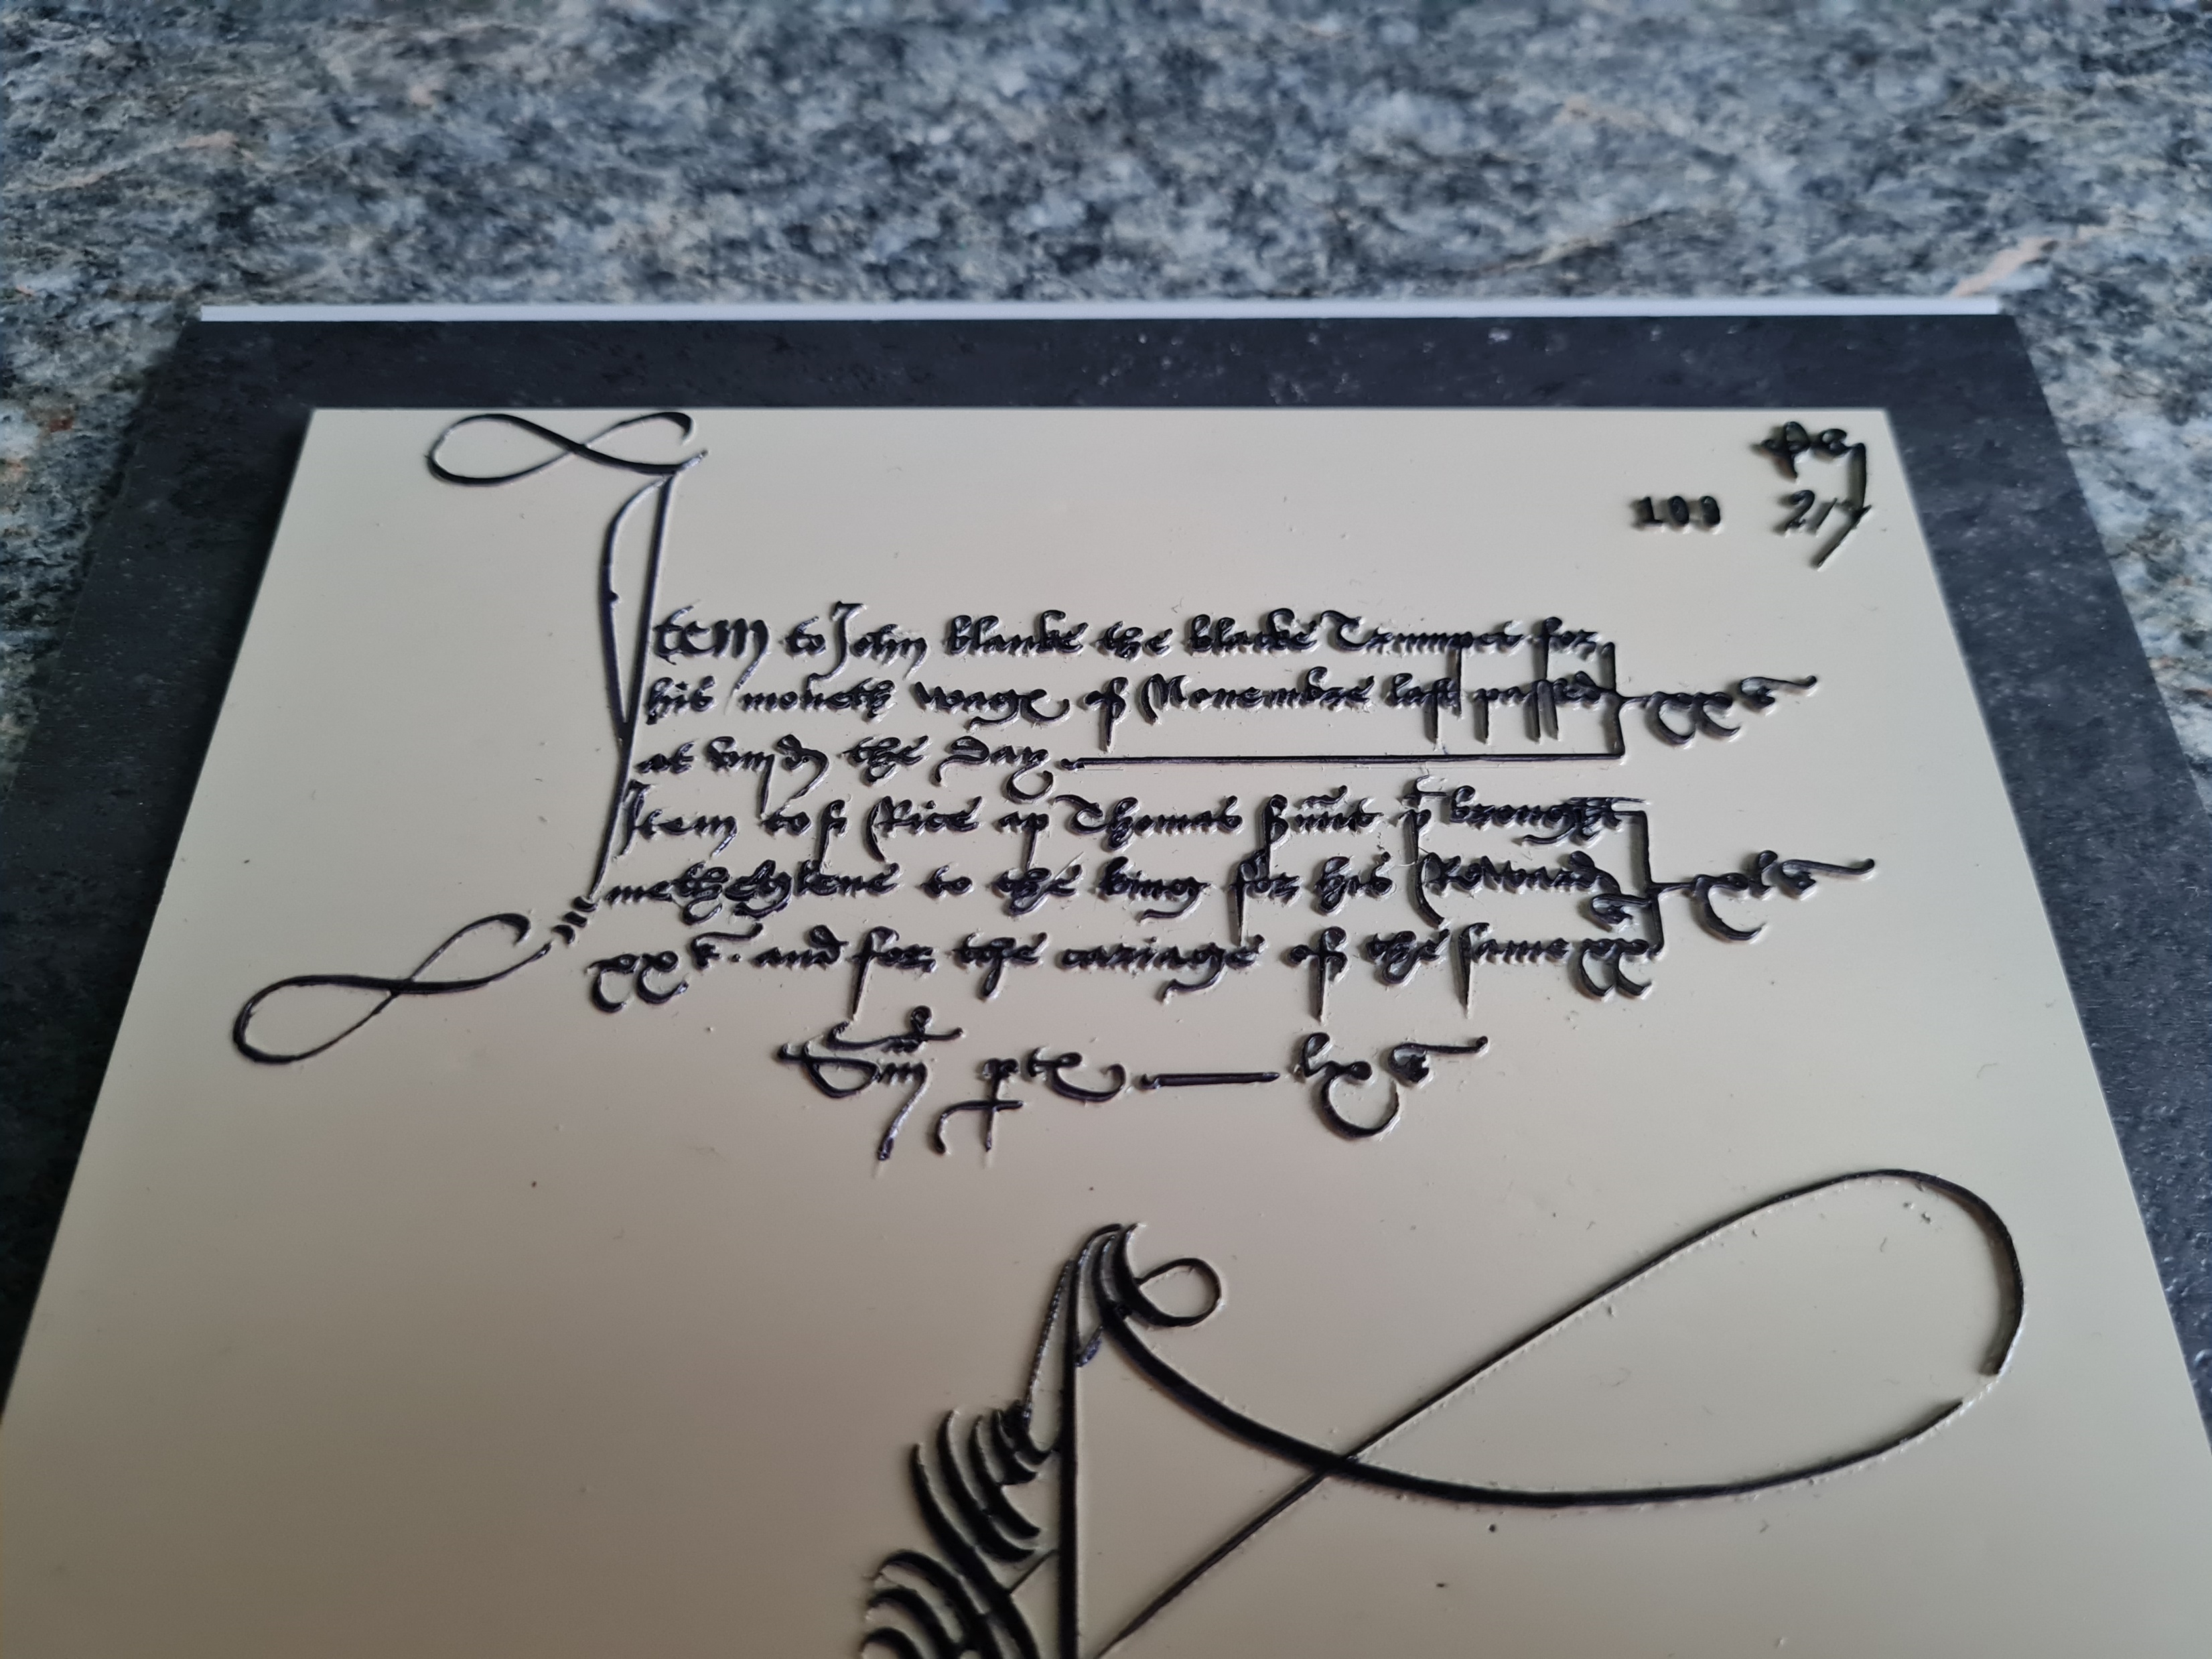
Tactile version made by George Rhodes
John Blanke’s wage slip. E 36/214, f. 109

Slide 9
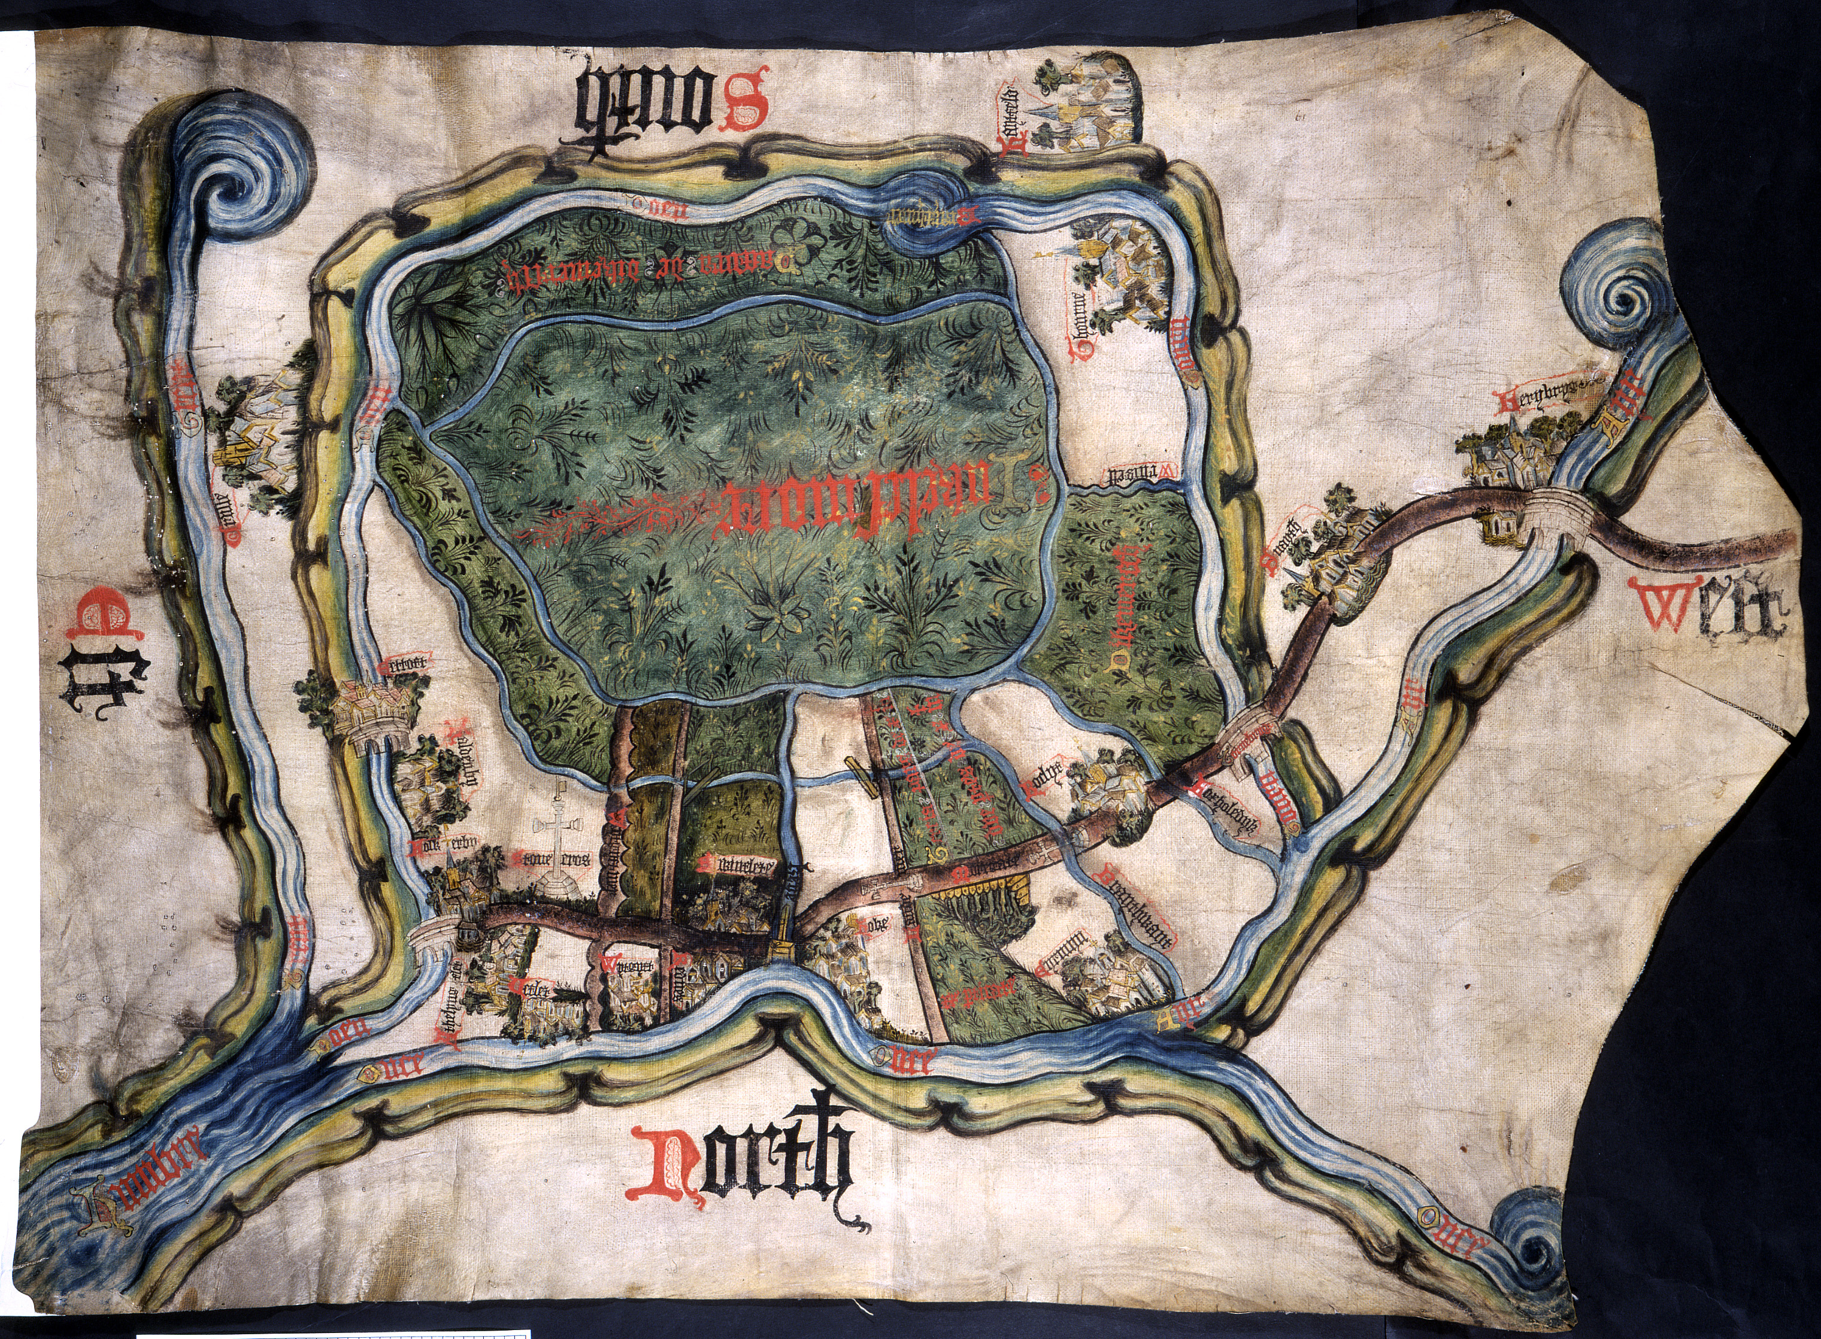
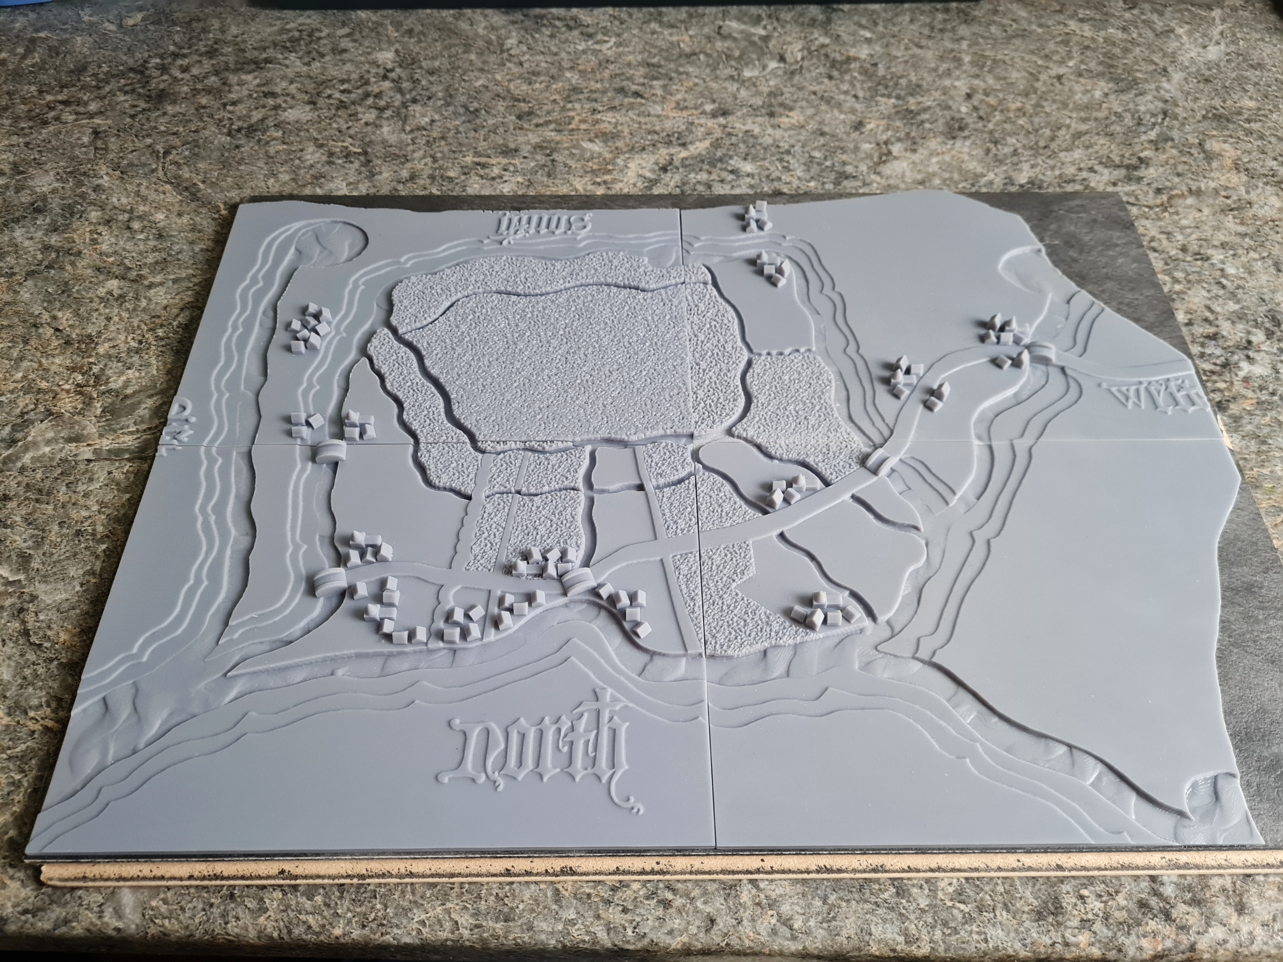
Map illustrating a land dispute, c.1450. MPC 1/56
Tactile version made by George Rhodes

Slide 10
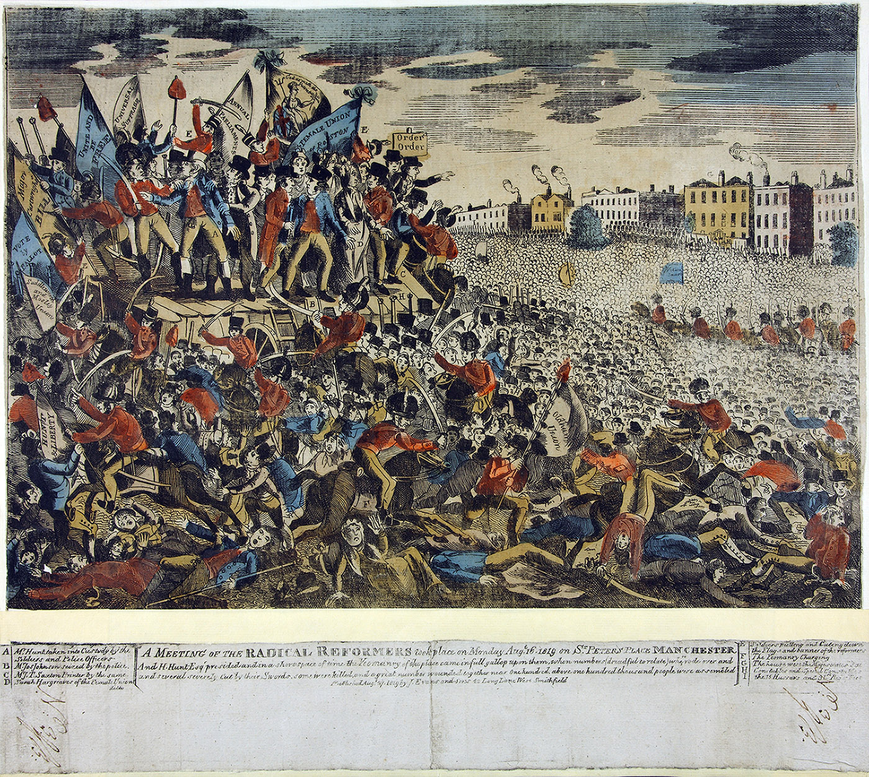
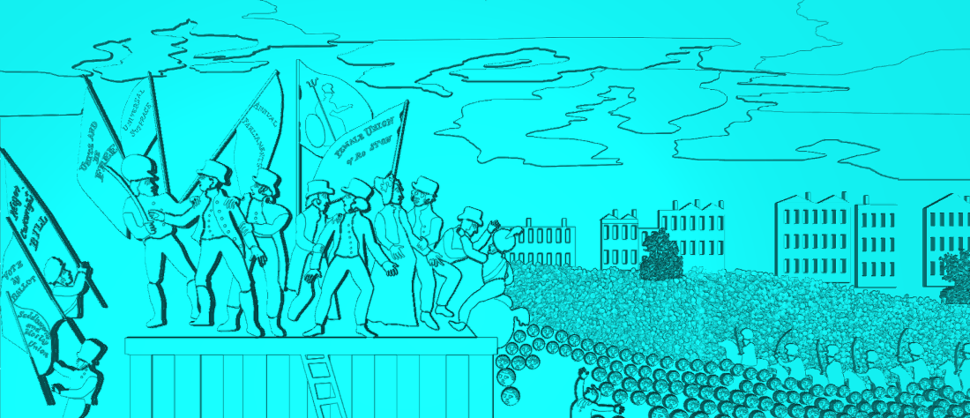
Tactile version (draft) made by George Rhodes
Engraving showing events at St Peter’s Fields on 16 August 1819 in Manchester. MPI 1/134

Slide 11
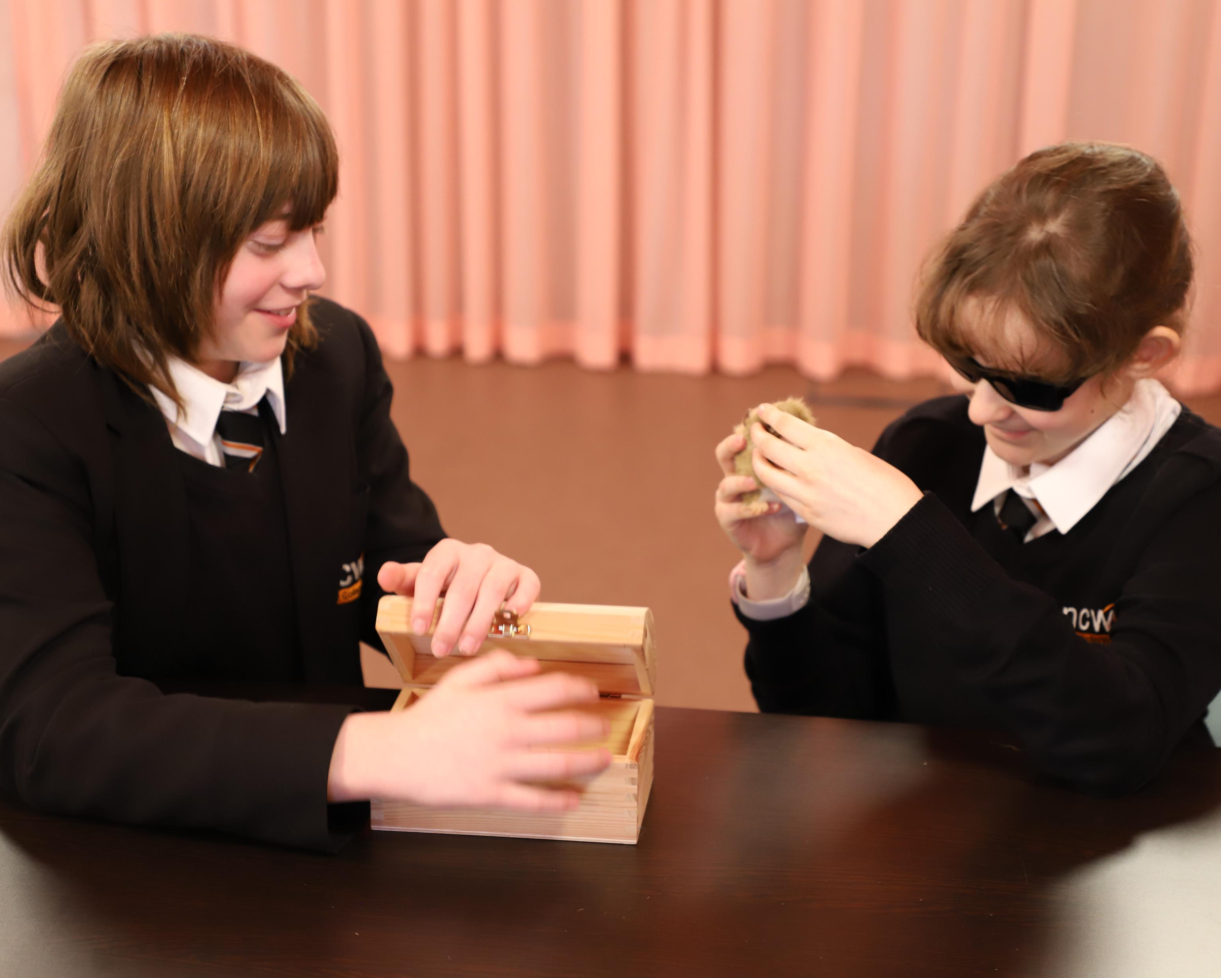
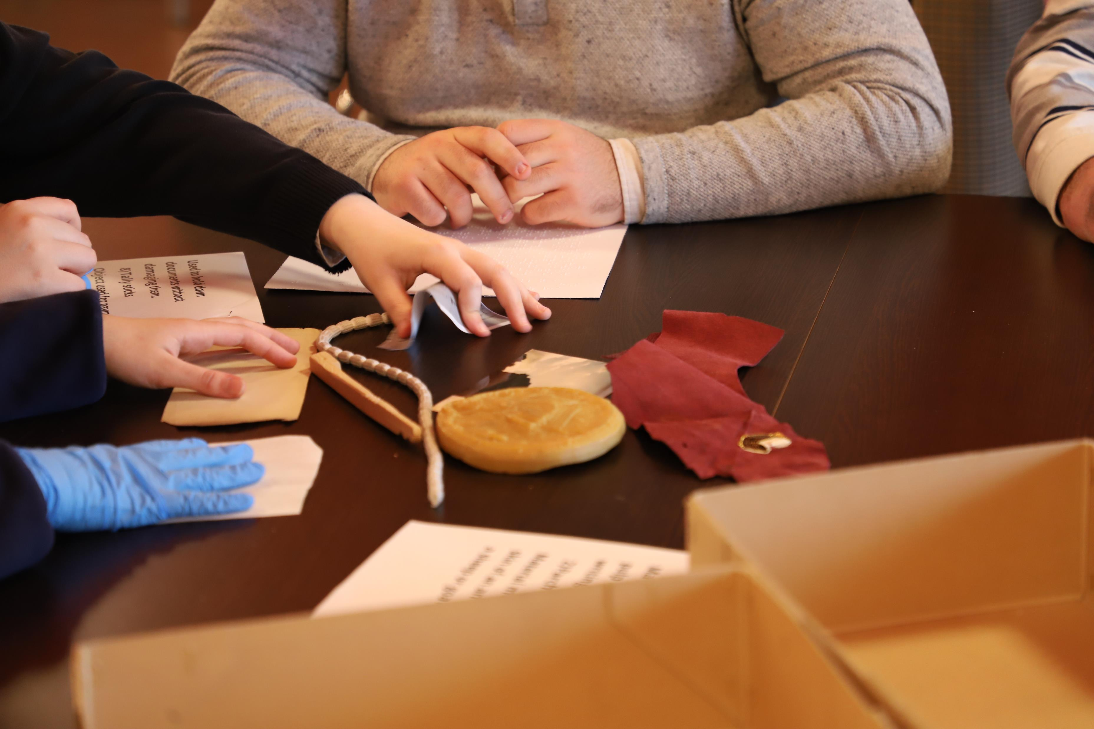
Photos from workshop with New College Worcester. © The National Archives

Slide 12
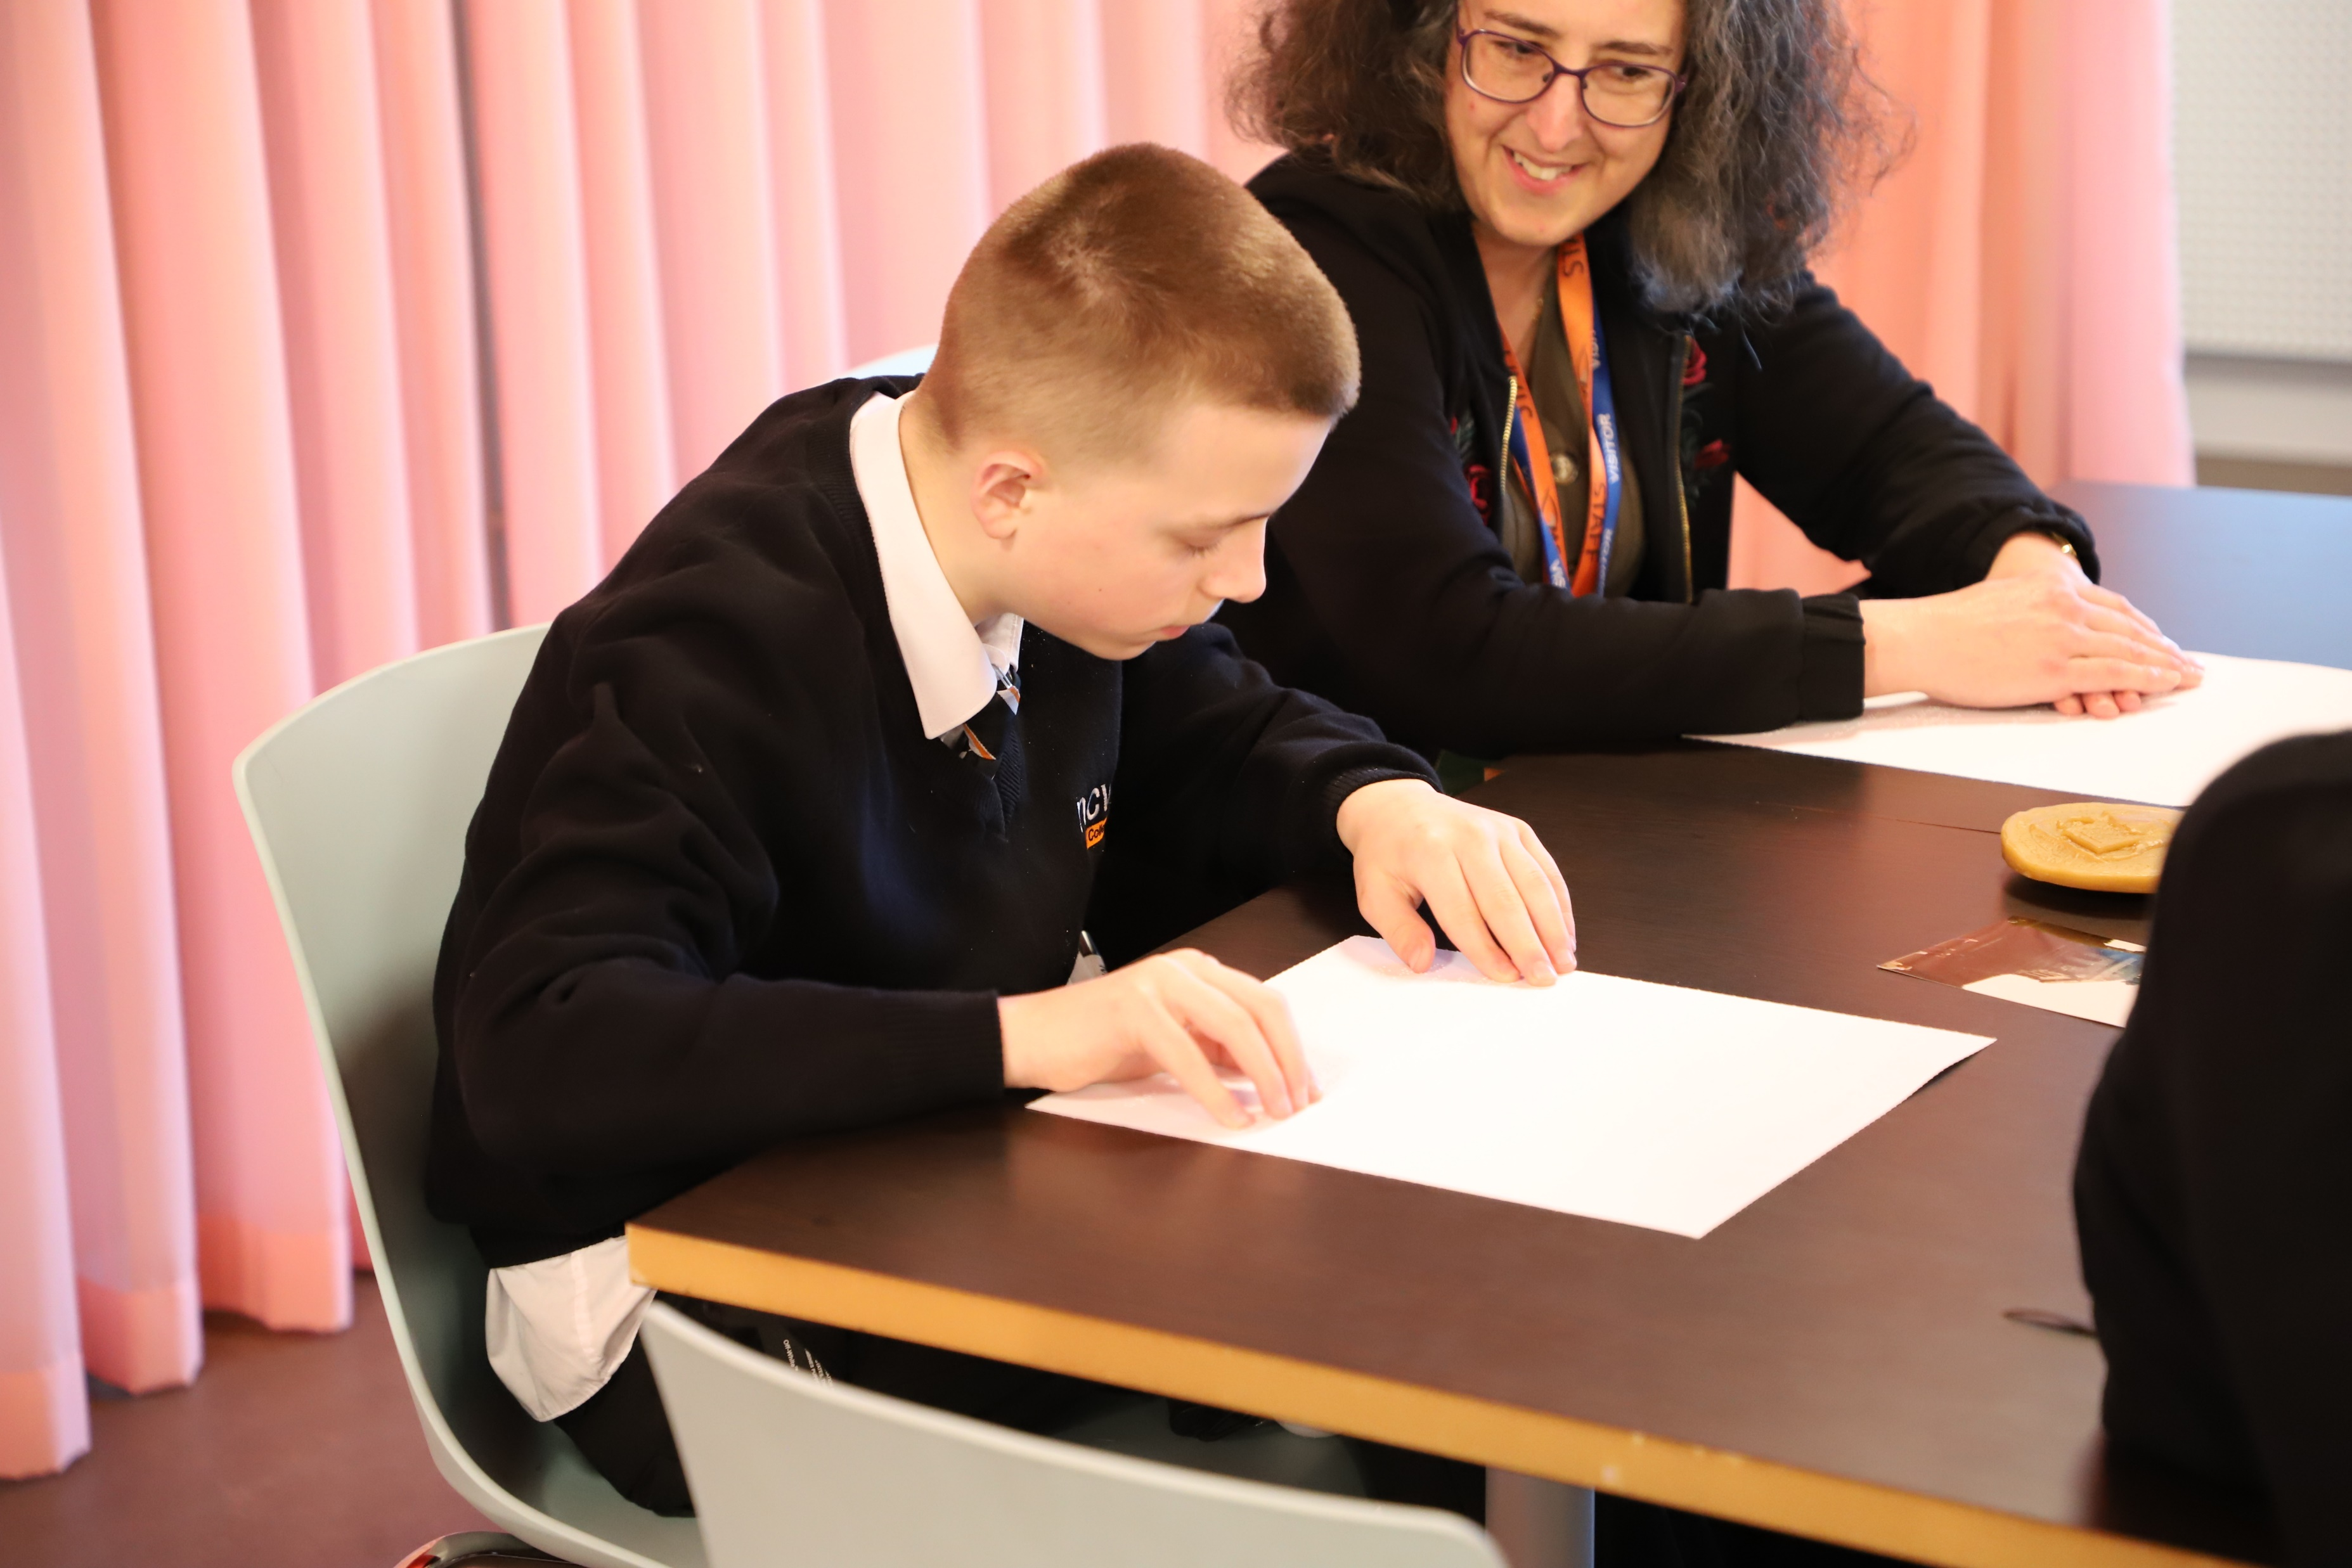
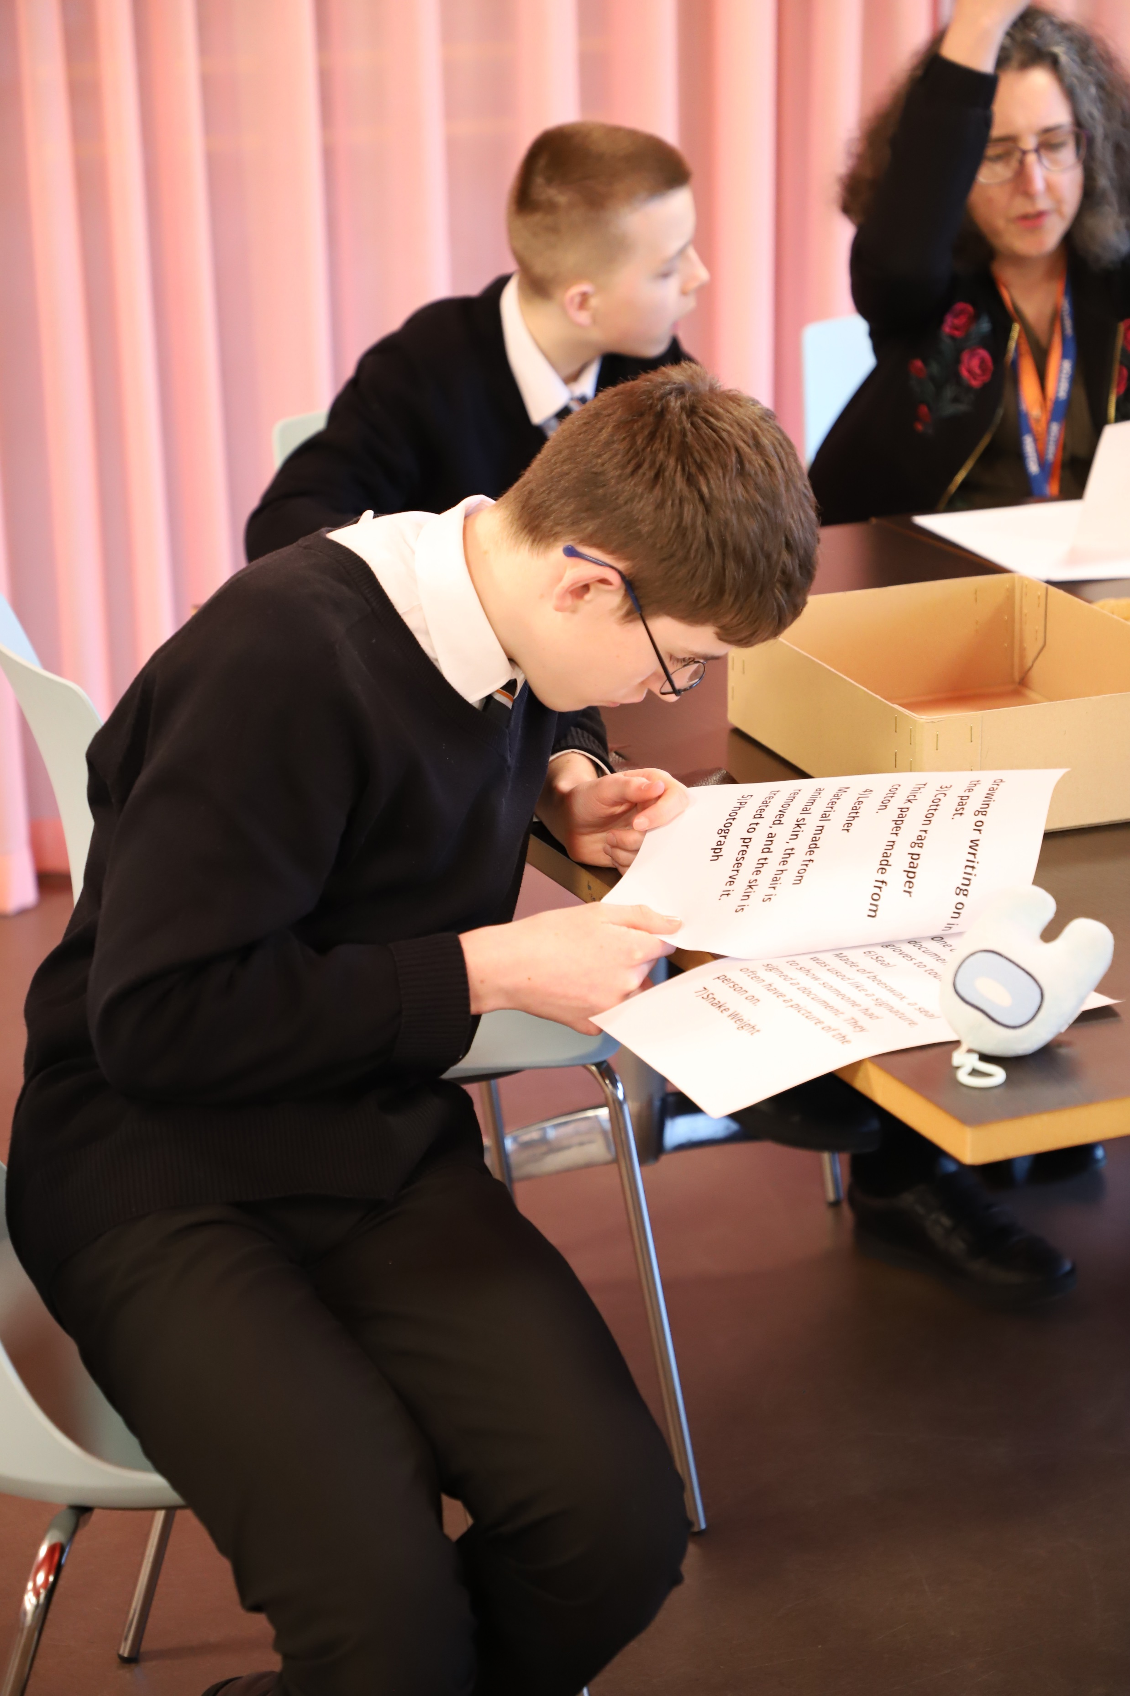
Students reading instructions using Braille and large print. © The National Archives

Slide 13
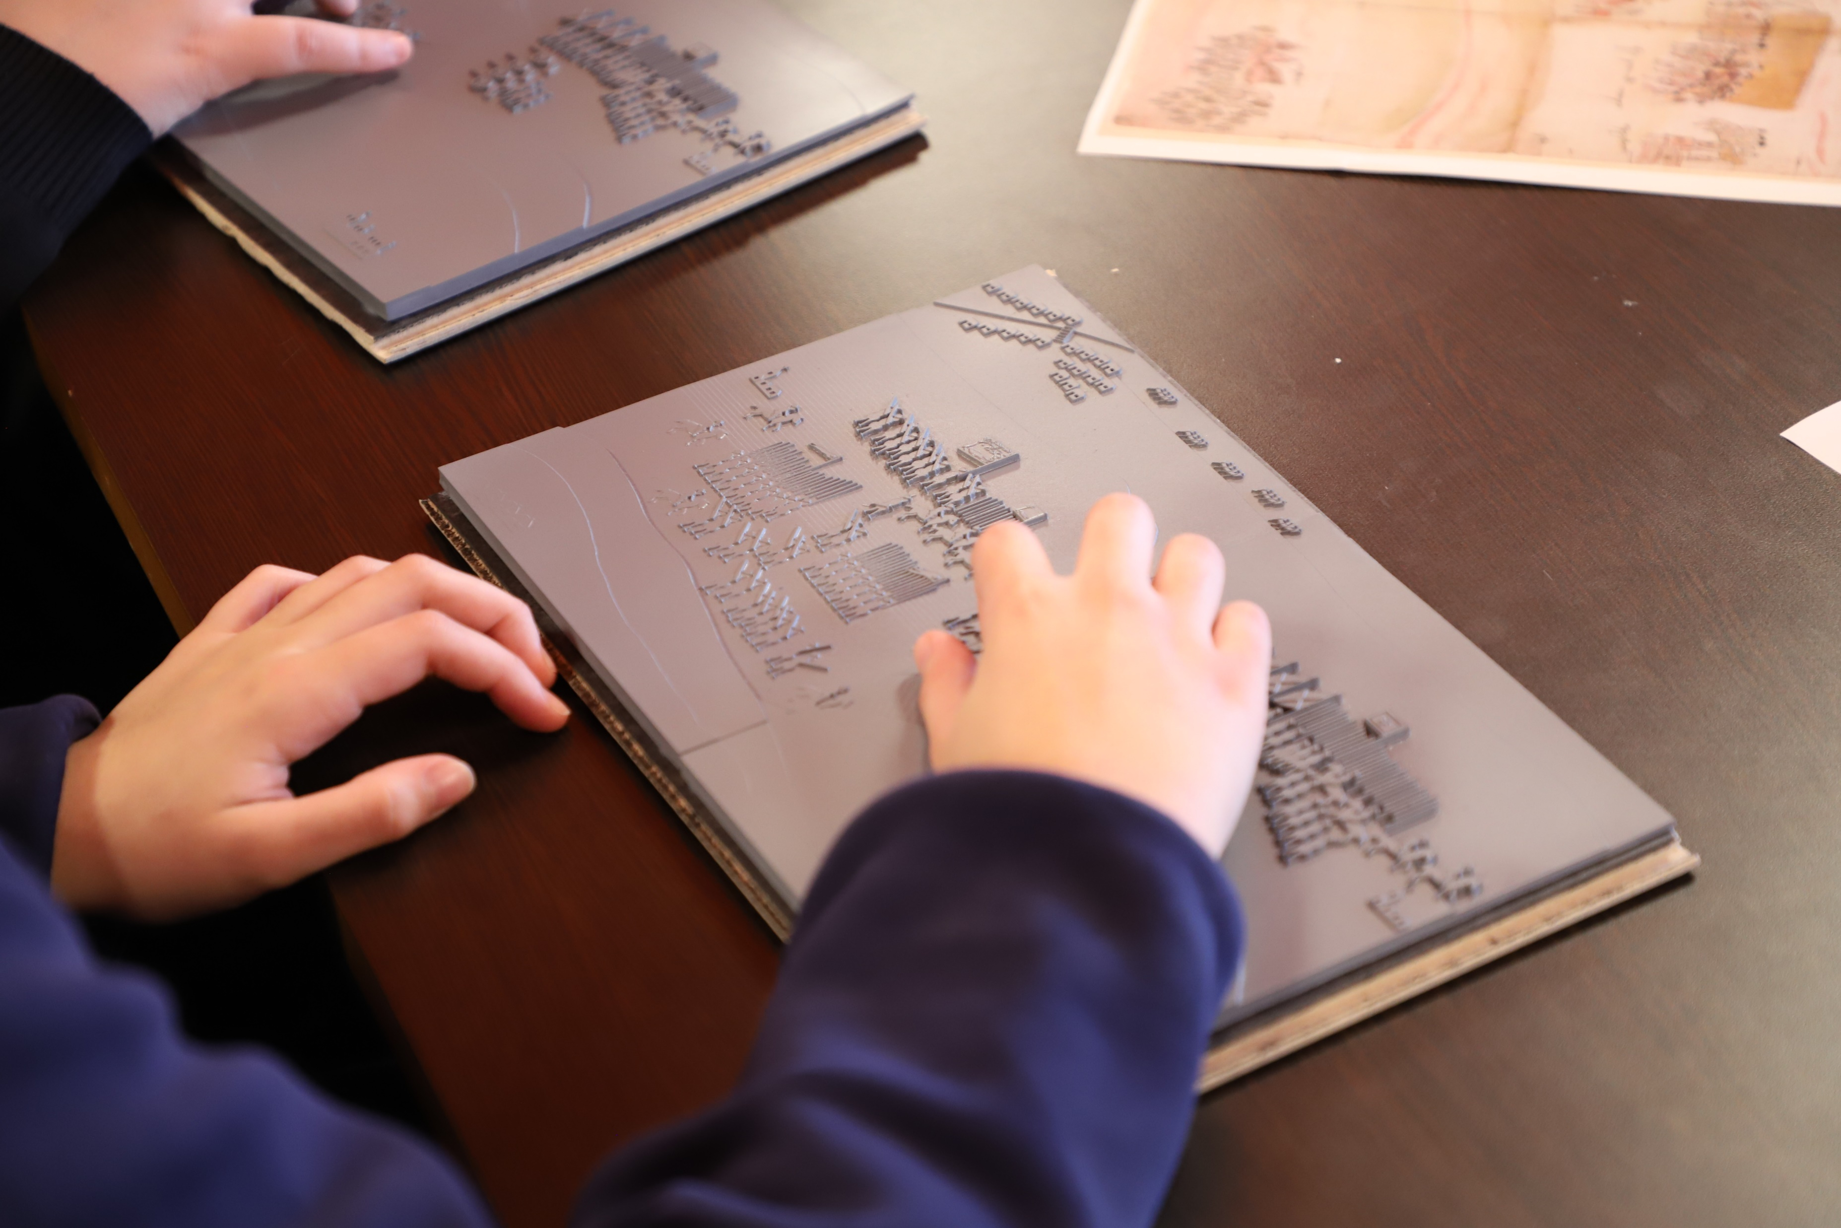
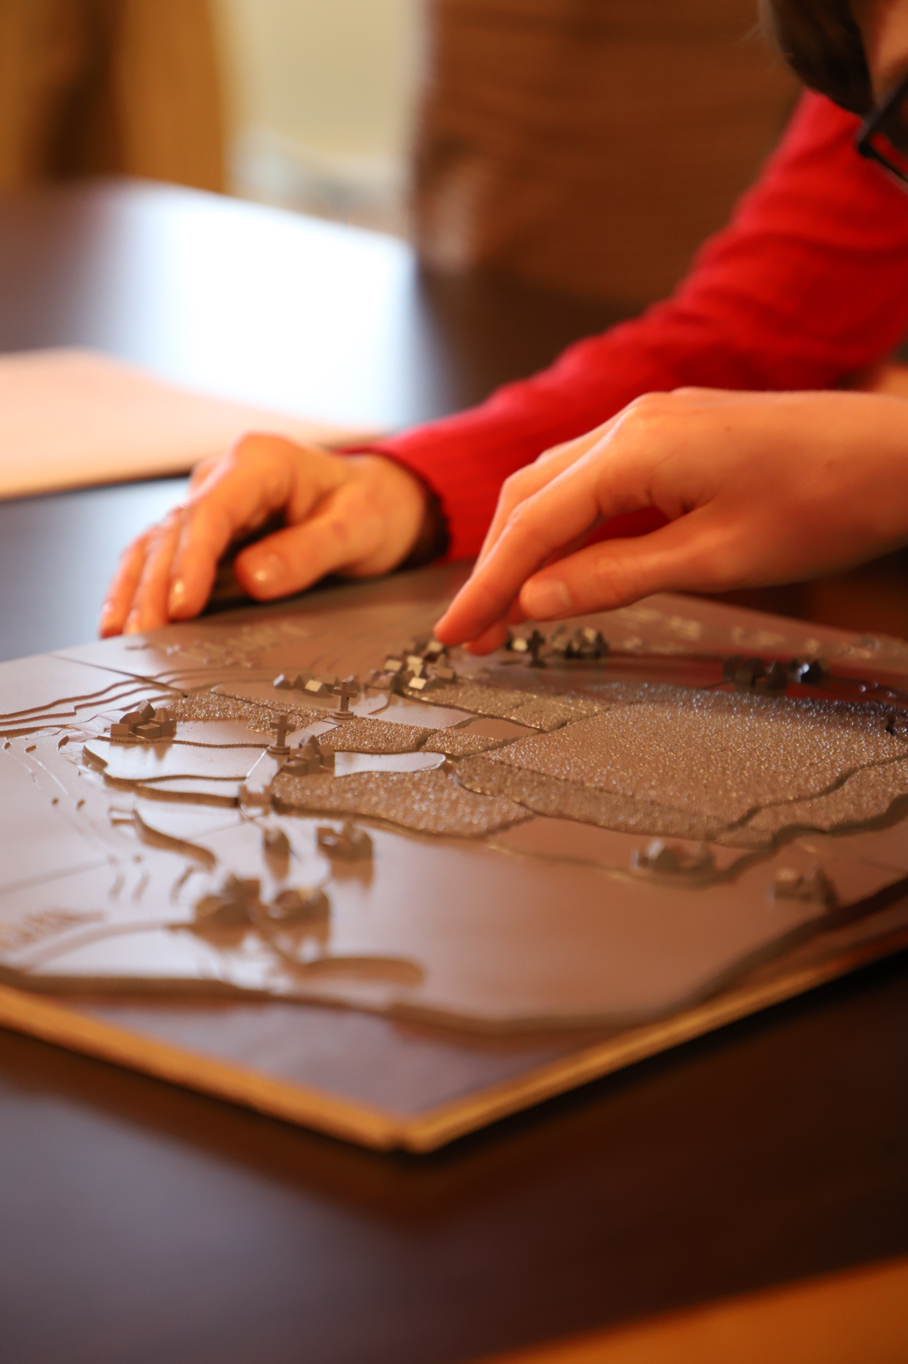
Students exploring tactile images. © The National Archives

Slide 14
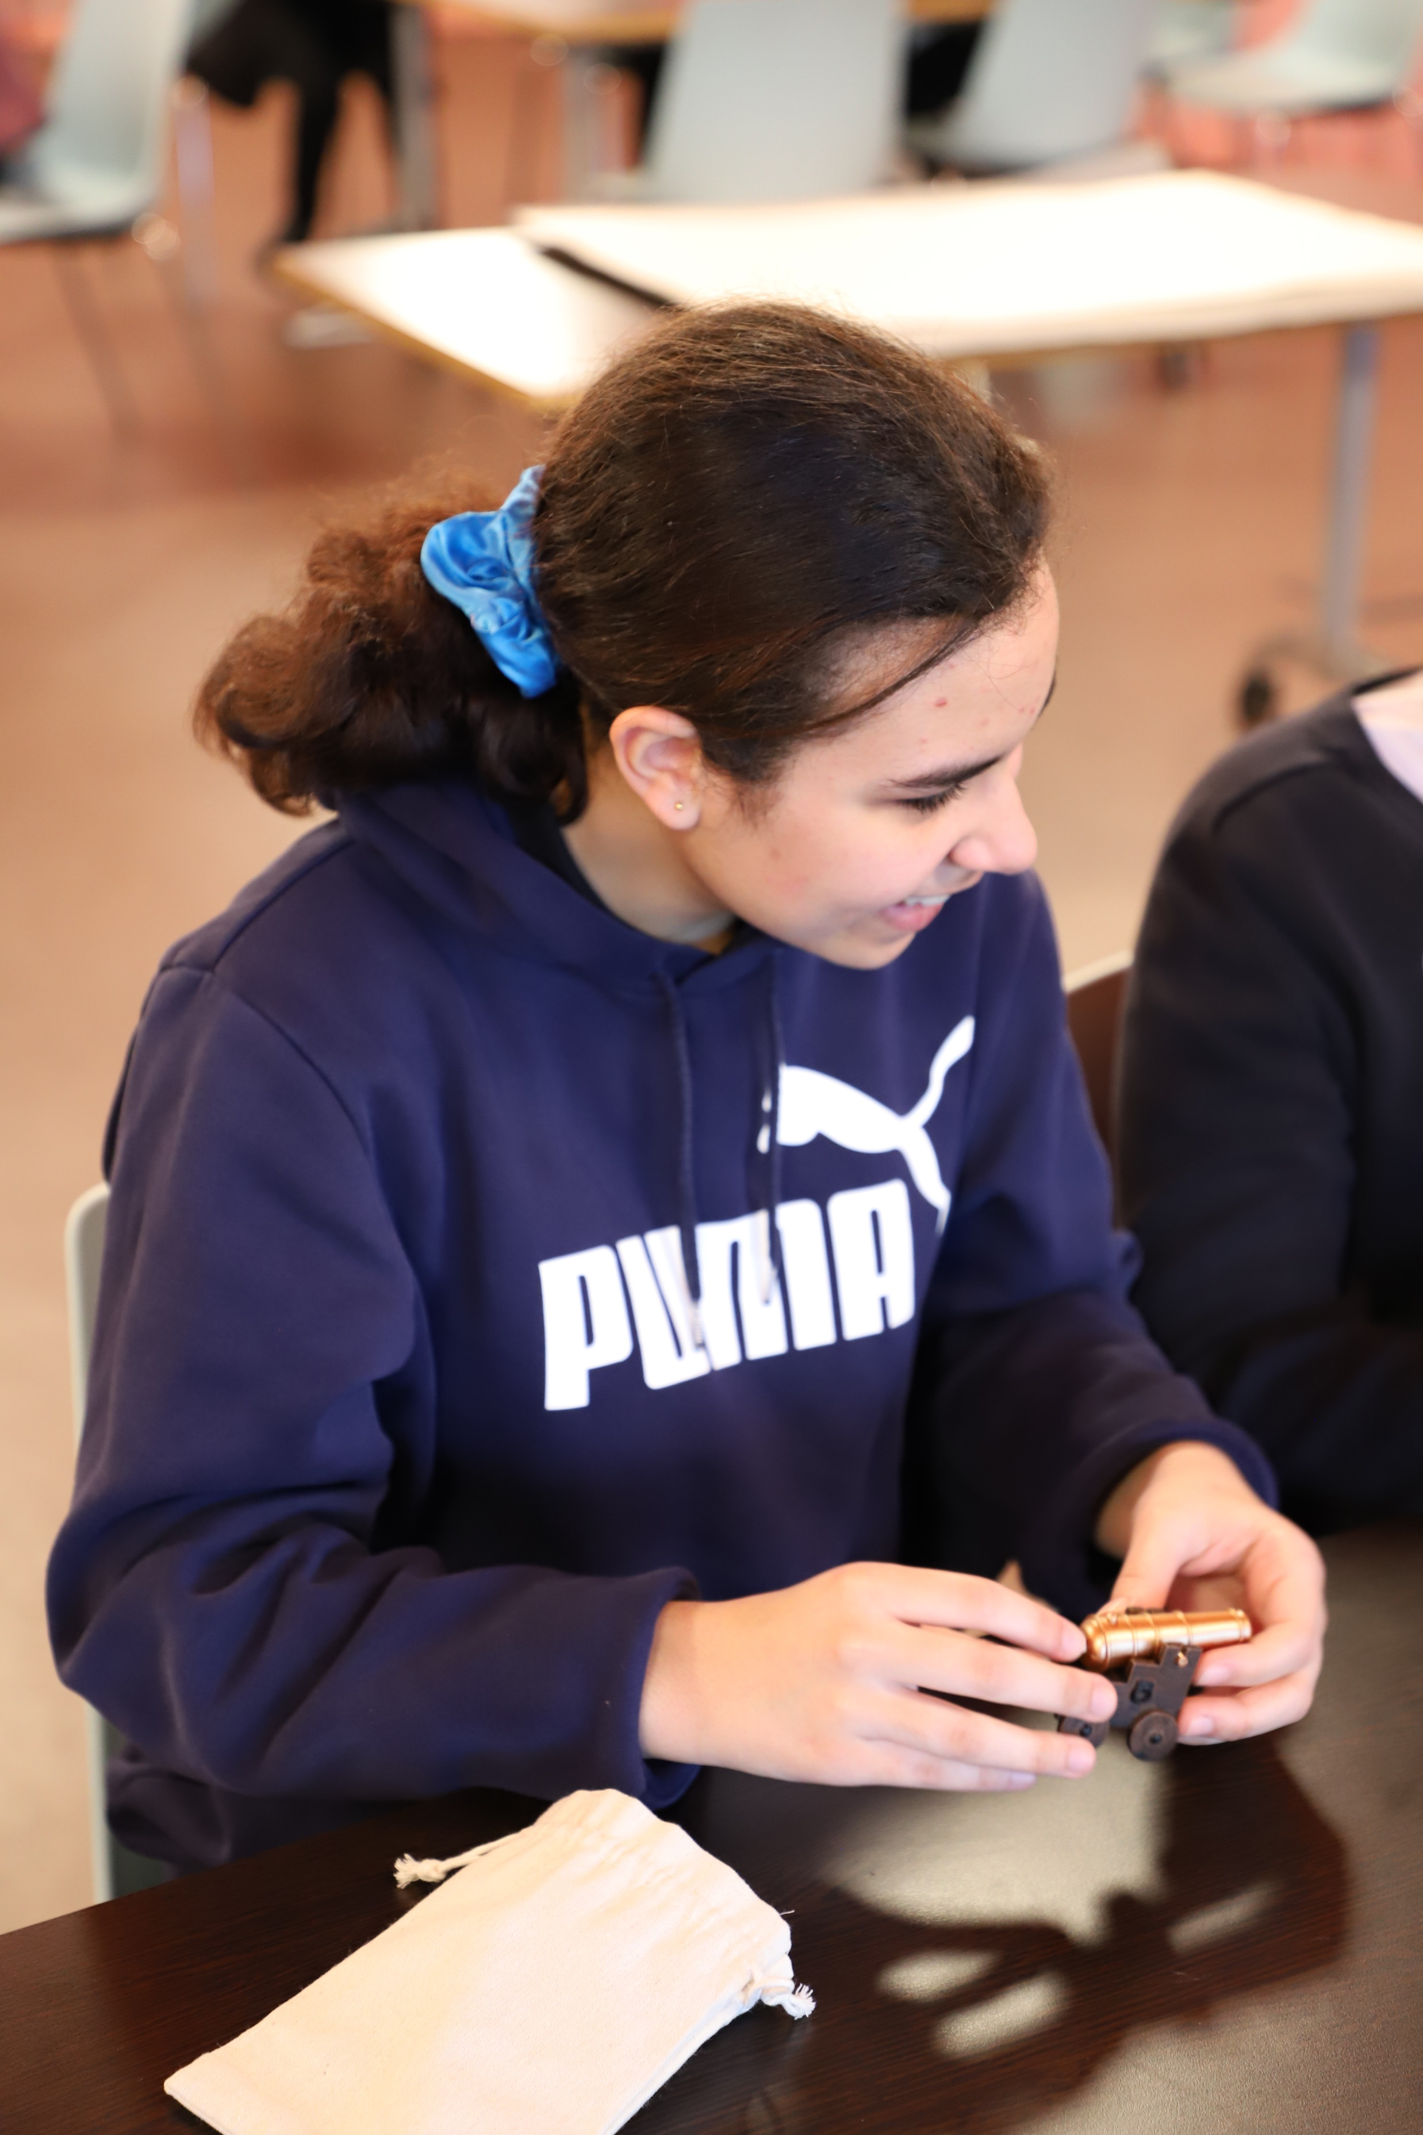
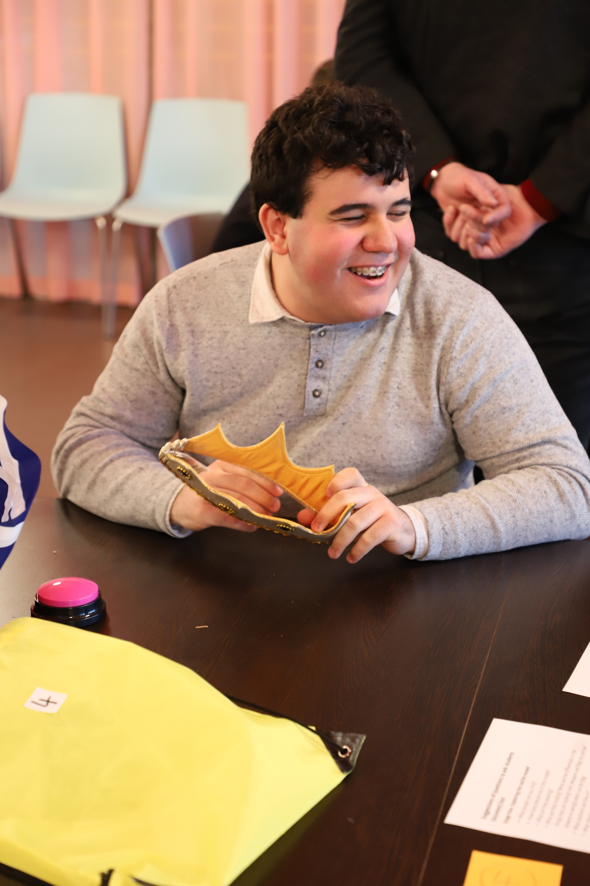
Students exploring objects in their hint bags. © The National Archives

Slide 15
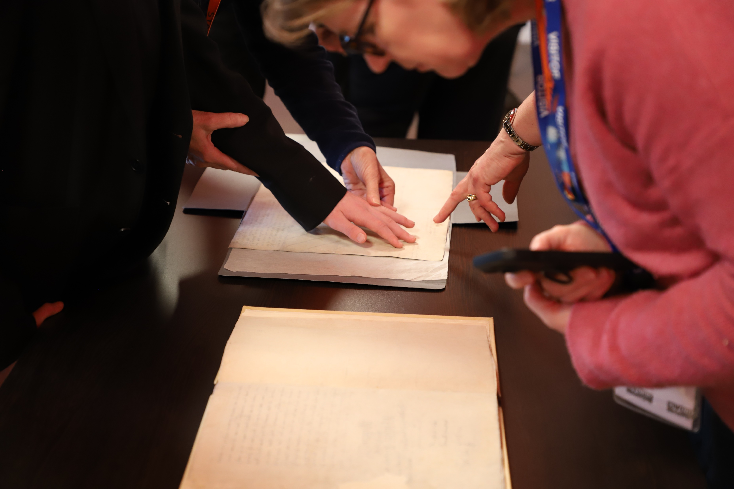
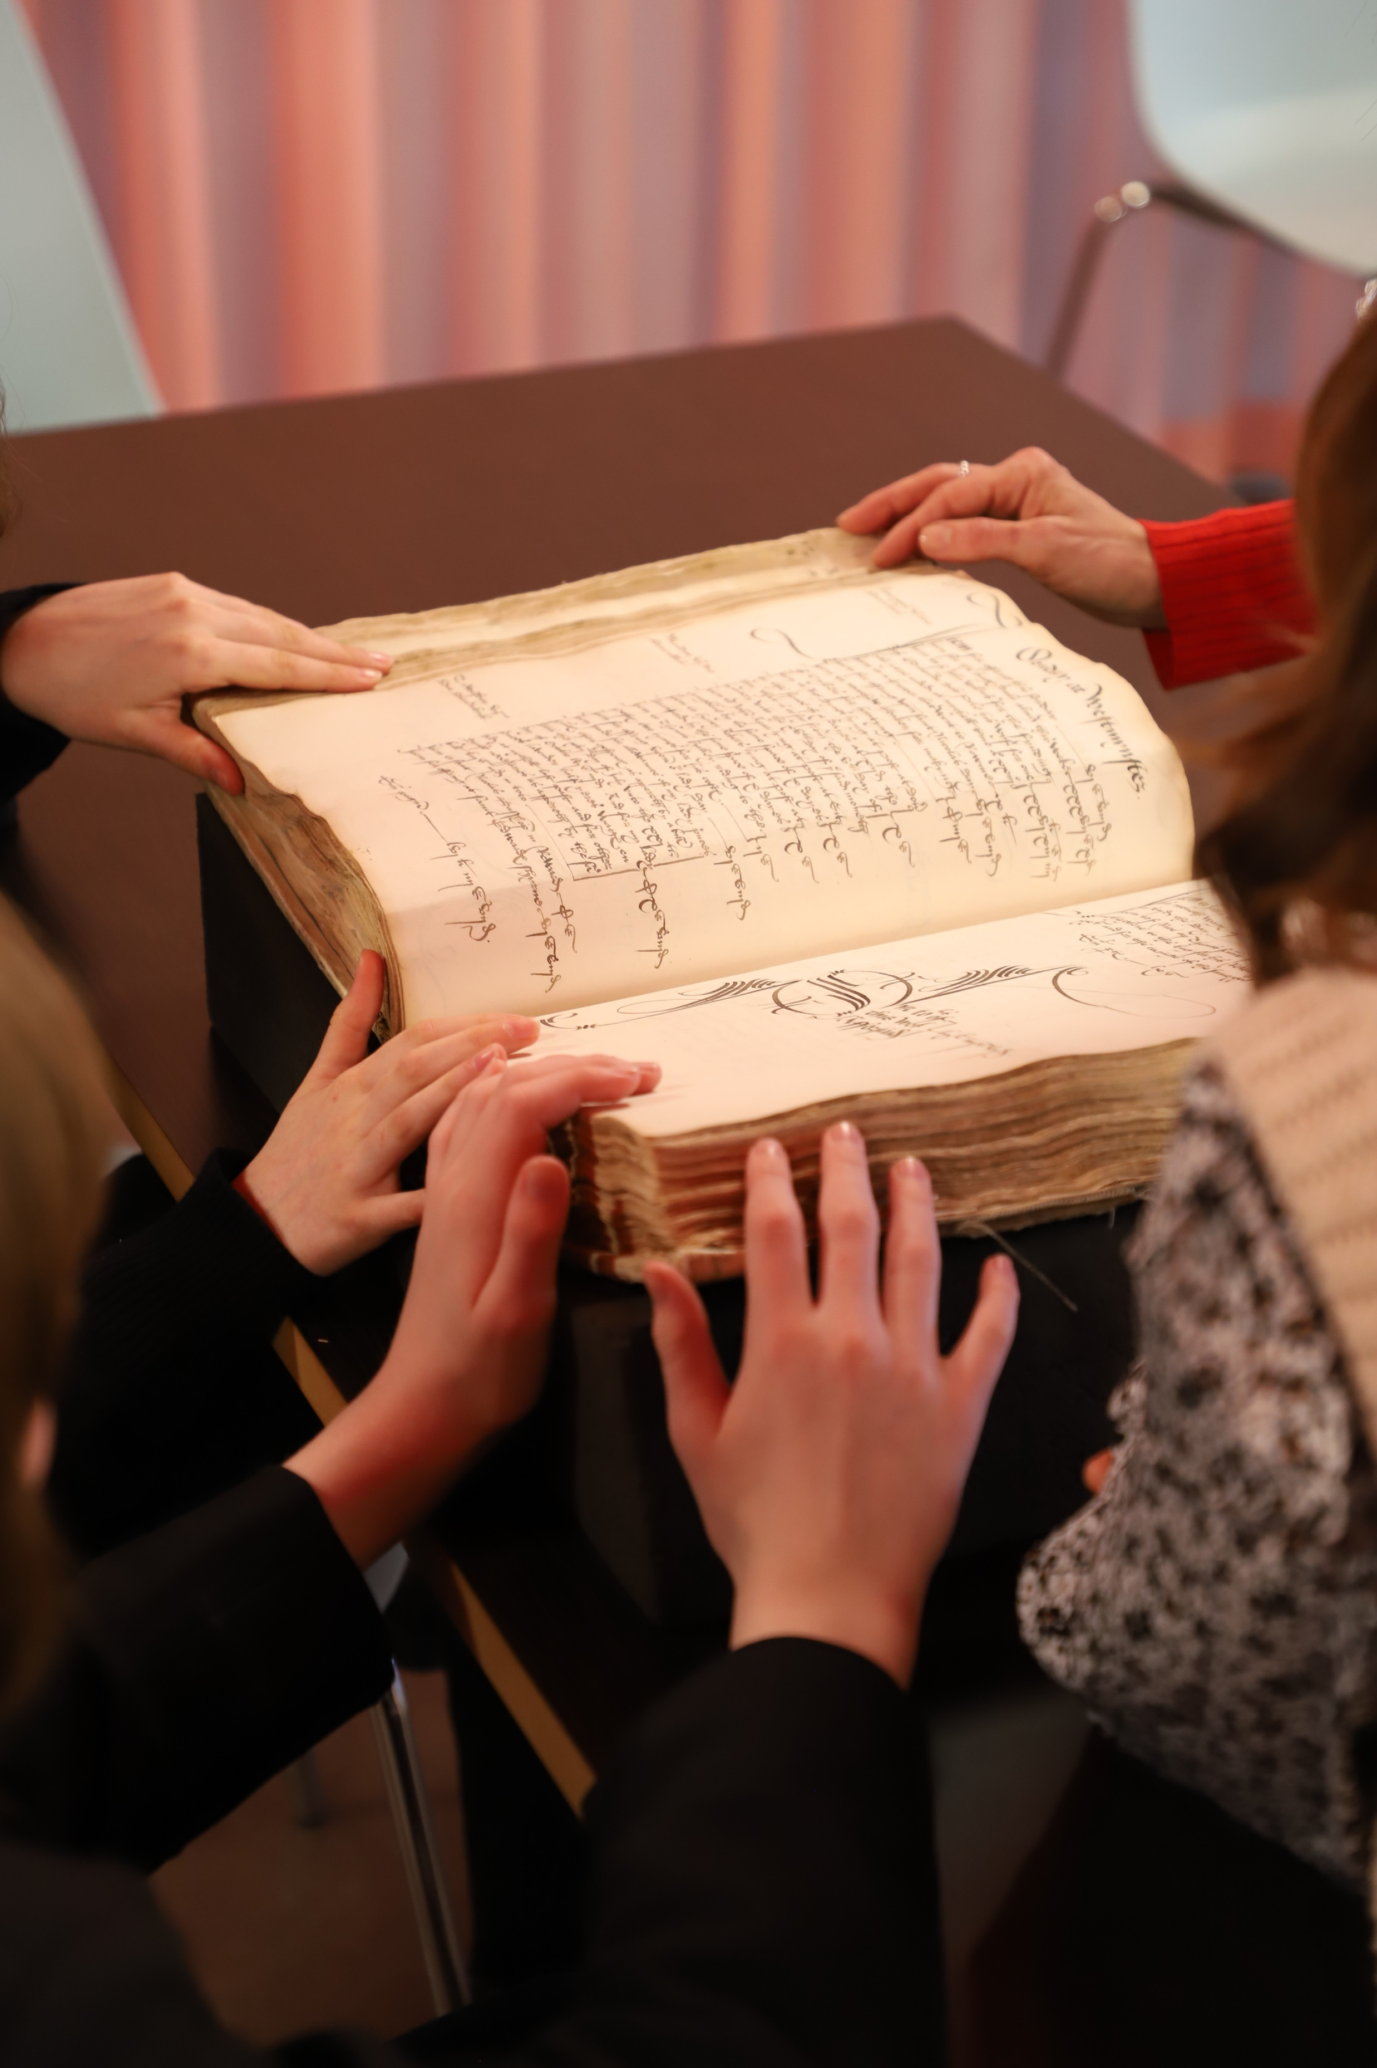
Students touching original documents, including documents touched by Elizabeth I and Henry VIII. © The National Archives

