Slide 1
Developing an online resource to support the use of AI for student learning and research
Paula Funnell
Faculty Liaison Librarian, Medicine & Dentistry
p.a.funnell@qmul.ac.uk

Slide 2
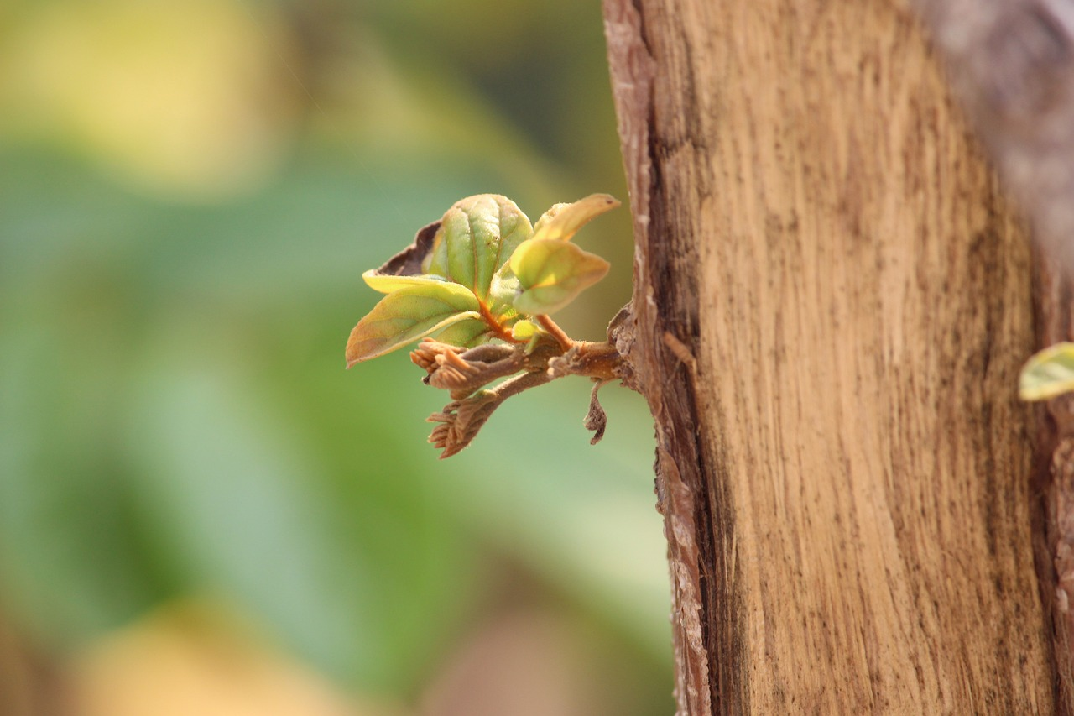
Background
AI is a hot topic in higher education
Concerns around academic misconduct
Huge opportunities provided by these tools
Need to provide guidance to students on using AI constructively, ethically and in line with the principles of academic integrity

Slide 3

Faculty
Collaborative approach
AI resource
Library
E-learning
Students

Slide 4
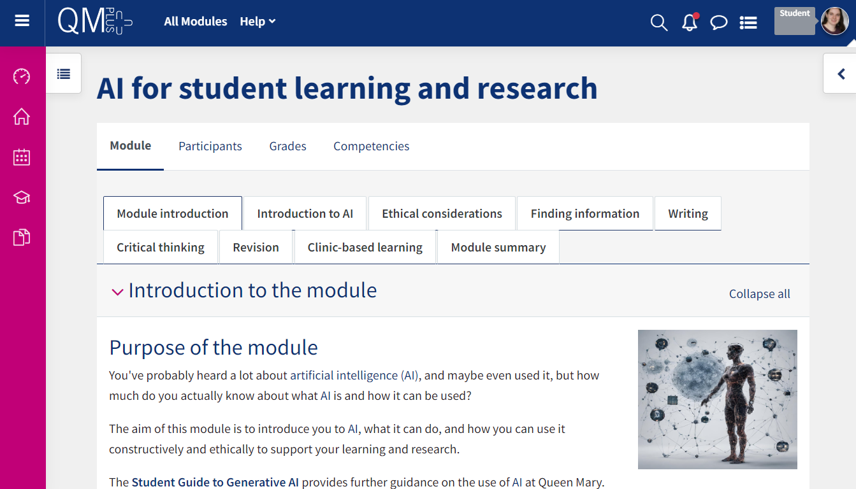
An online resource
Developed a QMplus (Moodle) resource
Aimed at Medicine & Dentistry as a pilot
Content guided by staff and students
Team members worked on different parts of the resource

Slide 5

Activity
Choose an AI image generation tool (links in chat)
Copy the prompt from the chat
If there is an option, choose the “photo” style
What do you notice about the photos created?

Slide 6
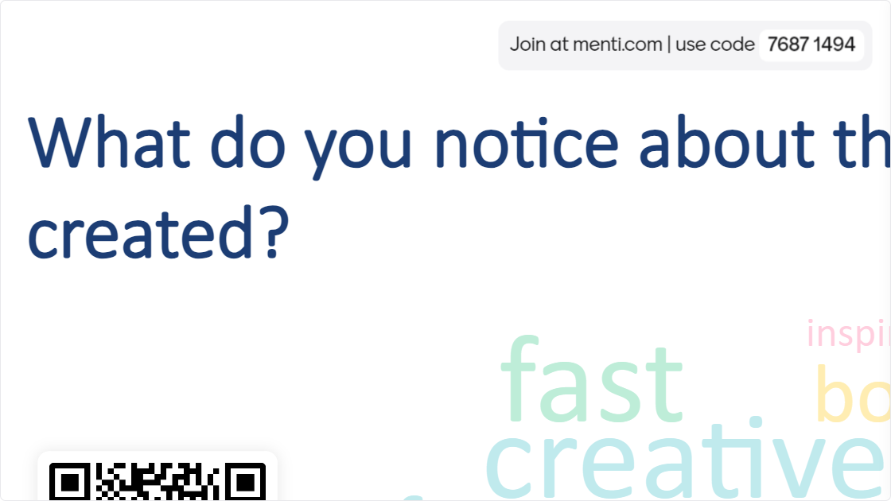

Slide 7

Challenges
Commitment
Lead academic stepped away
Enrolment issues
Differing views
Managing activities around existing workloads

Slide 8

Impact
Impact
In the first six months:
  5160 accessed the resource
  577 actively engaged
  402 downloaded certificates for completing core elements
Integrated into medicine and dentistry year 1 curricula
Used widely across FMD
Awarded funding
Won QM education excellence award

Slide 9
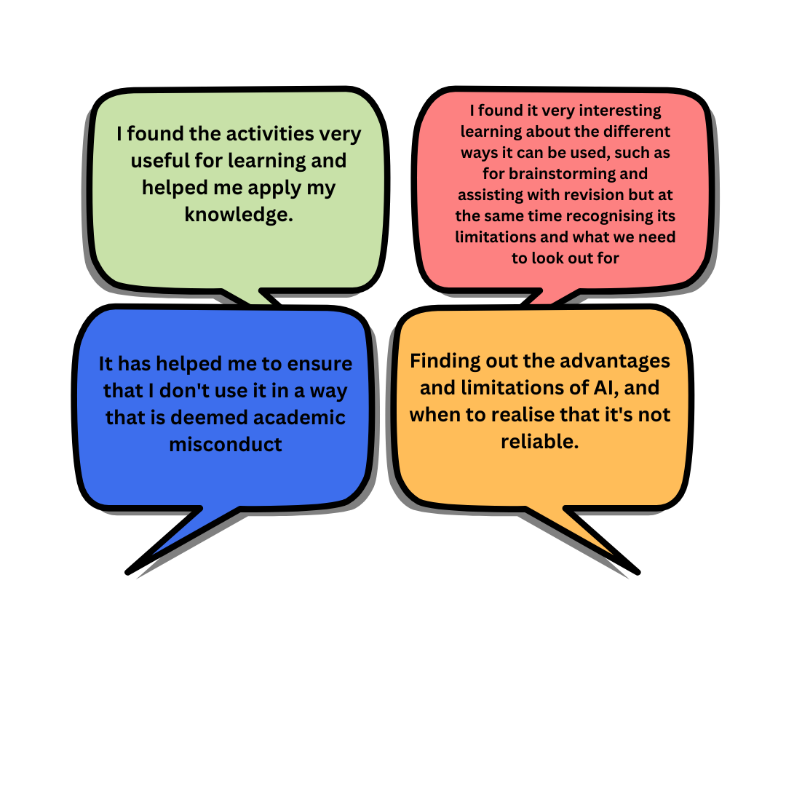
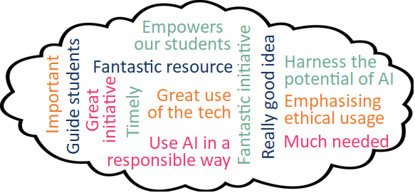
Feedback

Slide 10
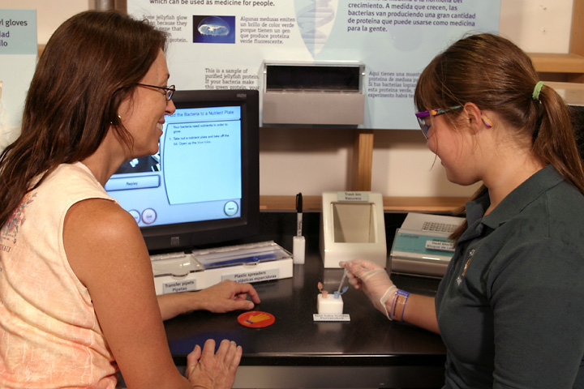
Activity
Use Perplexity (link in chat) or any generative AI tool you have access to
Enter the prompt keywords for artificial intelligence
Do the keywords look relevant and useful?

Slide 11
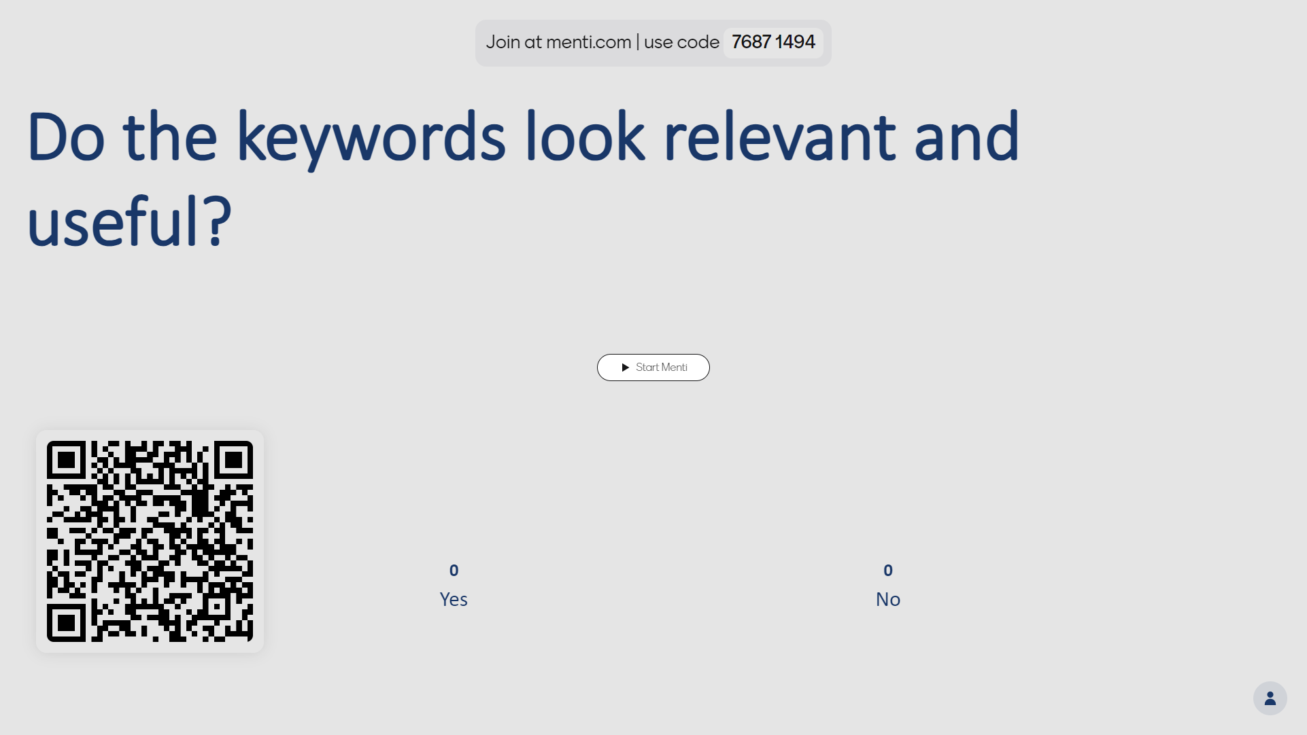

Slide 12

Moving forward
Development of resource
AI literacy skills teaching
Rolling out across the University?

Slide 13


Slide 14
Thank you

Slide 15
End slide

