Slide 1
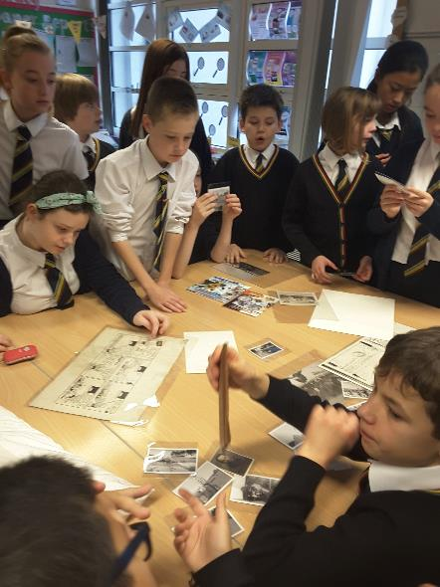
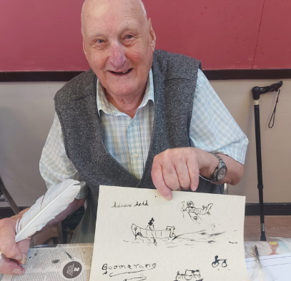
Mentally Healthy Tayside
Using archives to support wellbeing
Caroline Brown
University of Dundee Archive Services

Slide 2
Mentally Healthy Tayside
Using archives to support wellbeing
Archives and general wellbeing
Working with people with learning disabilities
Archives and mental health care
Caroline Brown
University of Dundee Archive Services

Slide 3
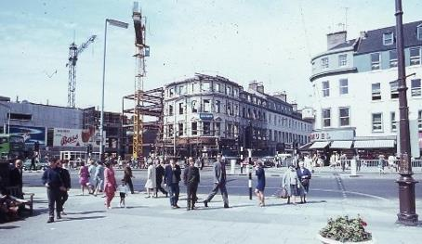
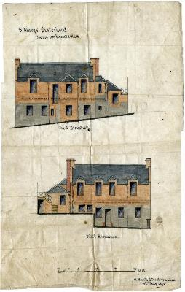
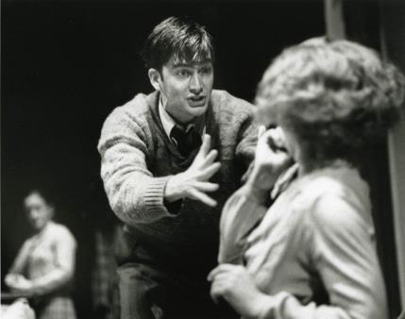
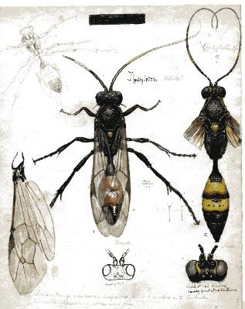
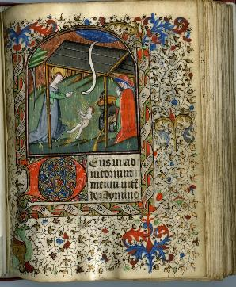
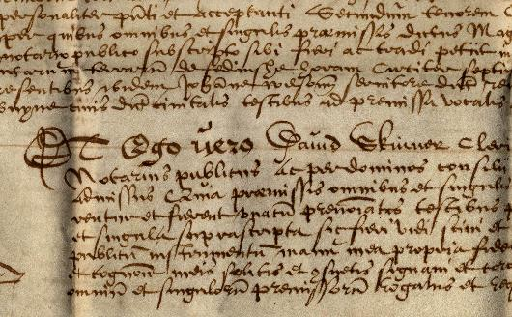

Slide 4
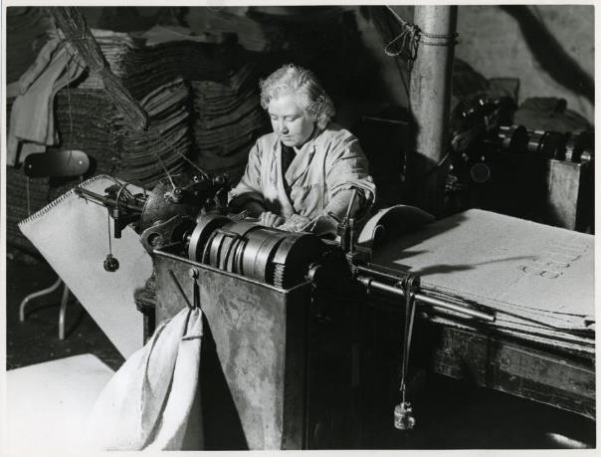
‘Archives - as records - wield power over the shape and direction of historical scholarship, collective memory, and national identity, over how we know ourselves as individuals, groups, and societies’
Schwartz and Cook 2002, p. 2

Slide 5
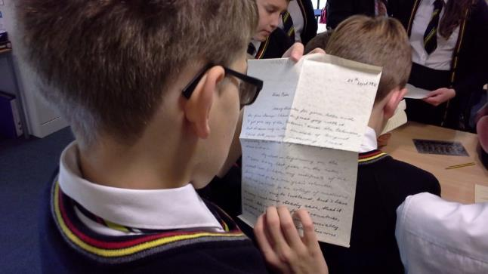
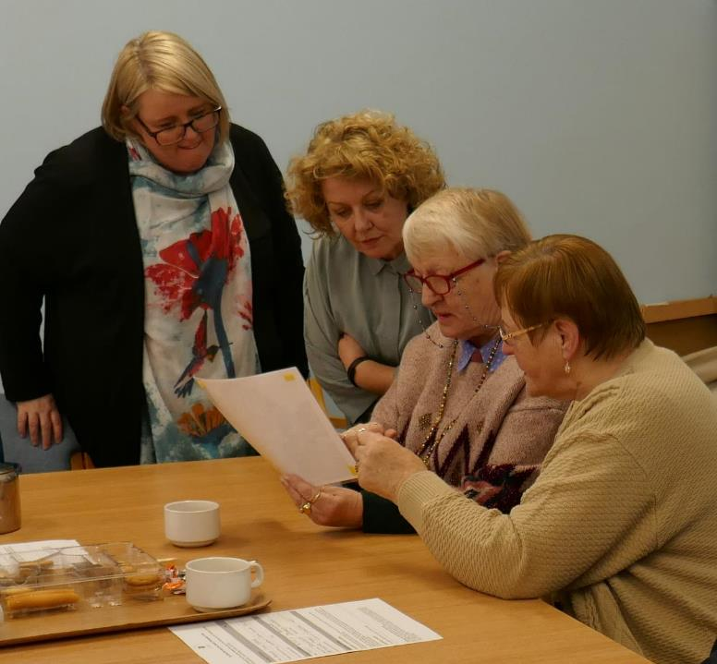
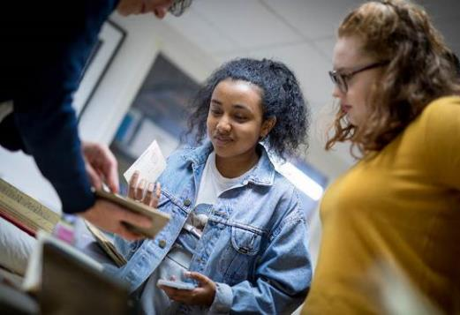
‘Archives - as records - wield power over the shape and direction of historical scholarship, collective memory, and national identity, over how we know ourselves as individuals, groups, and societies’
Schwartz and Cook 2002, p. 2

Slide 6
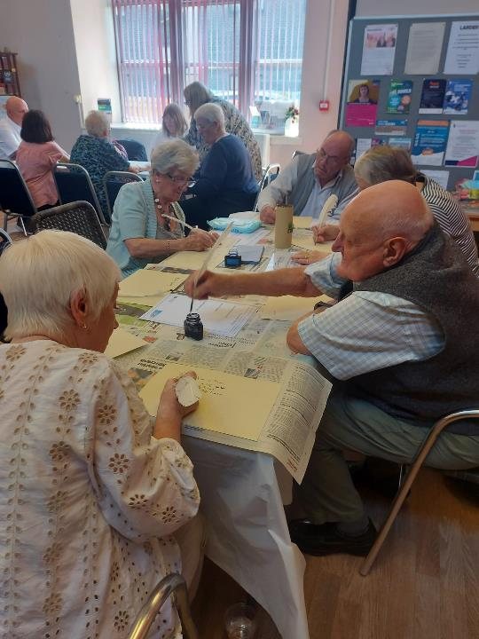
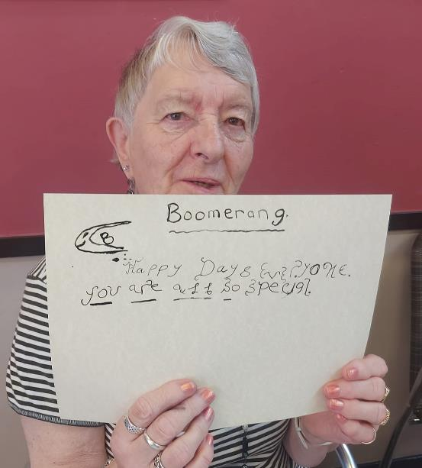

Slide 7
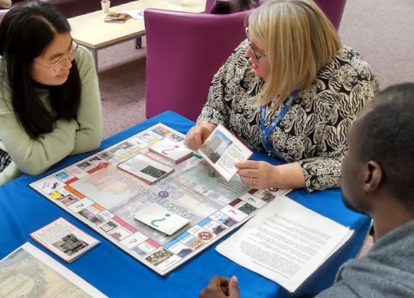
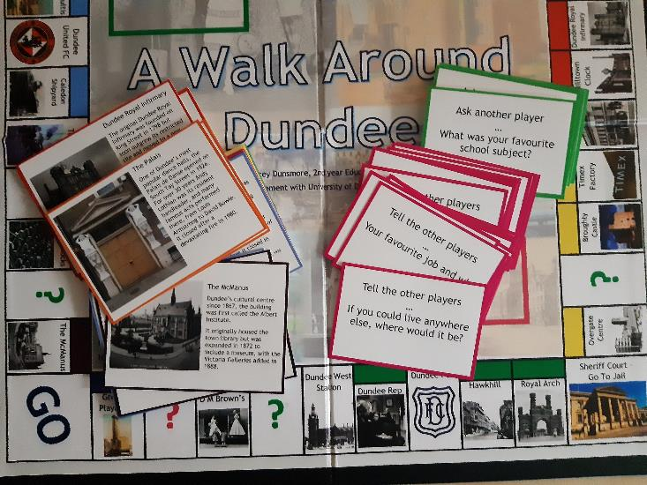

Slide 8
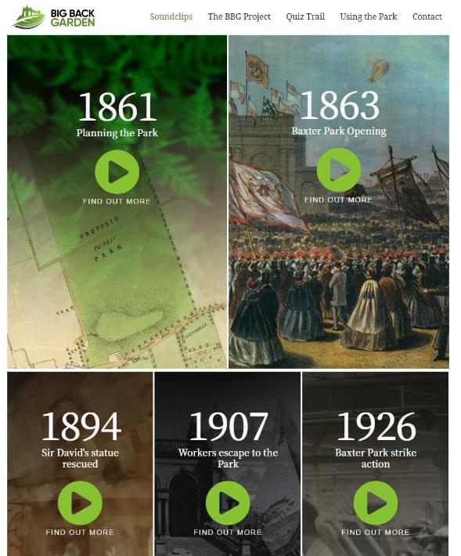
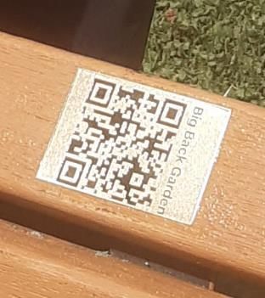
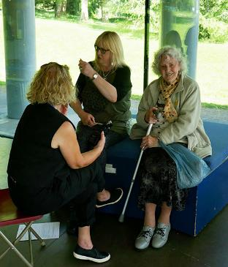
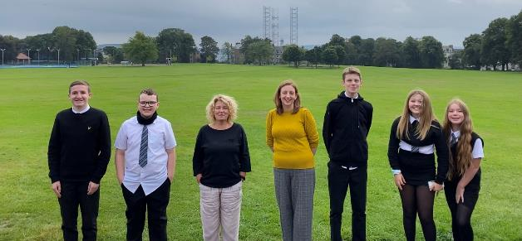
Notes:
BBG major project exploring history of Baxter Park through archival material used to create a sense of identity and to make places relevant to today’s inhabitants and how this contributes to well-being. Morgan Academy pupils - similar outcomes of pride, better understanding and appreciation of Baxter Park.

Slide 9
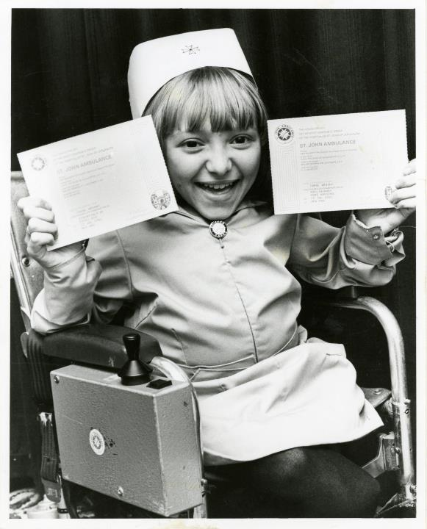
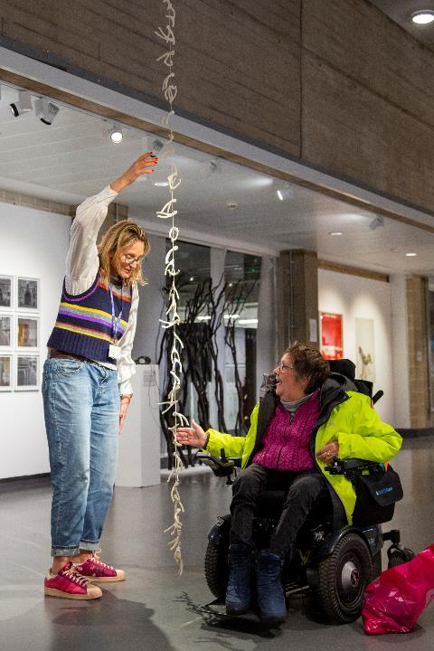

Slide 10
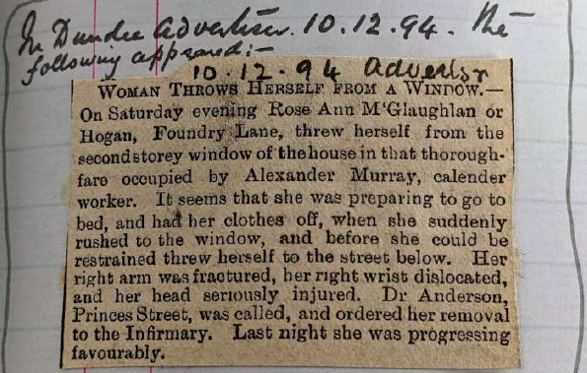
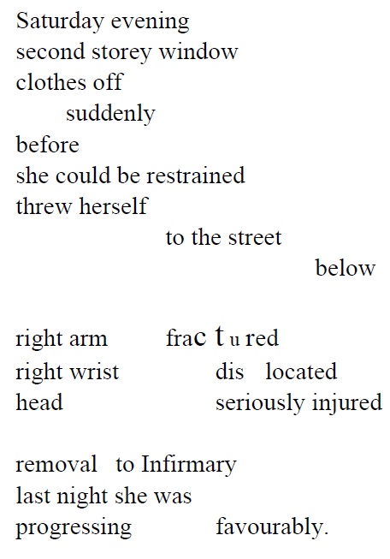
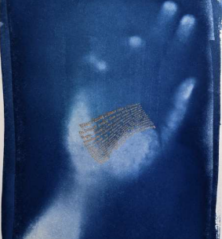
Words and artwork by Katie Potapoff

Slide 11
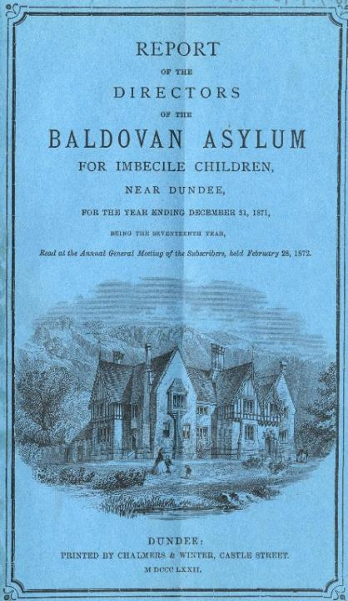
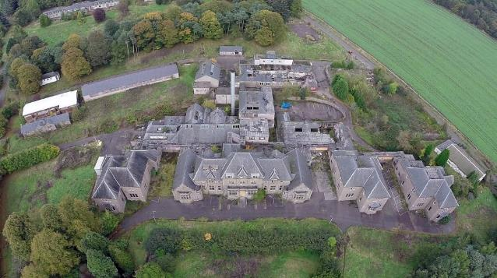
Strathmartine Hospital Histories

Slide 12
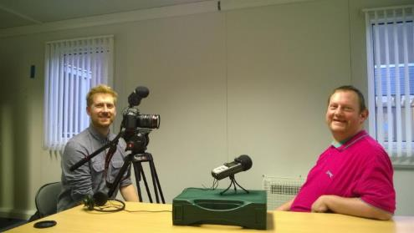
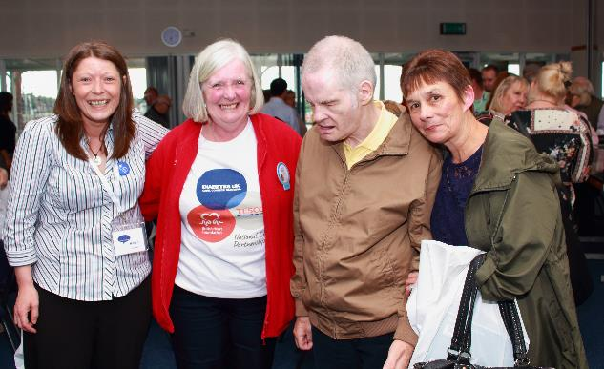

Working in partnership with people who would not normally be involved with archives.

Slide 13
People tell their stories
Hold institutionalised care to account
Inform students and policy makers

Slide 14
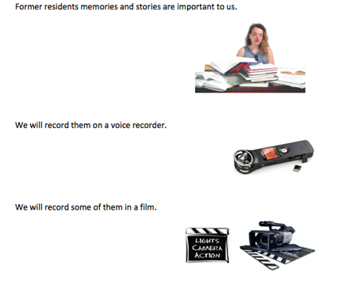
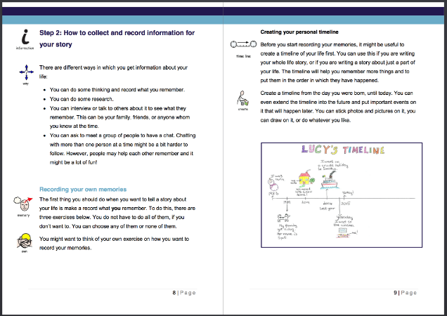
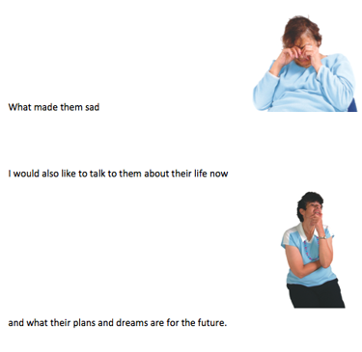
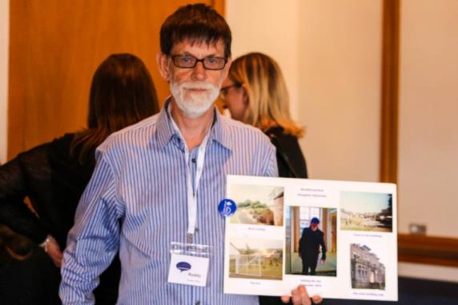

Slide 15


Slide 16
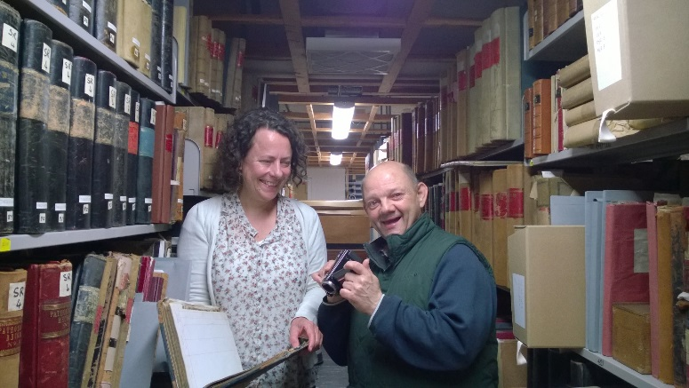

Slide 17
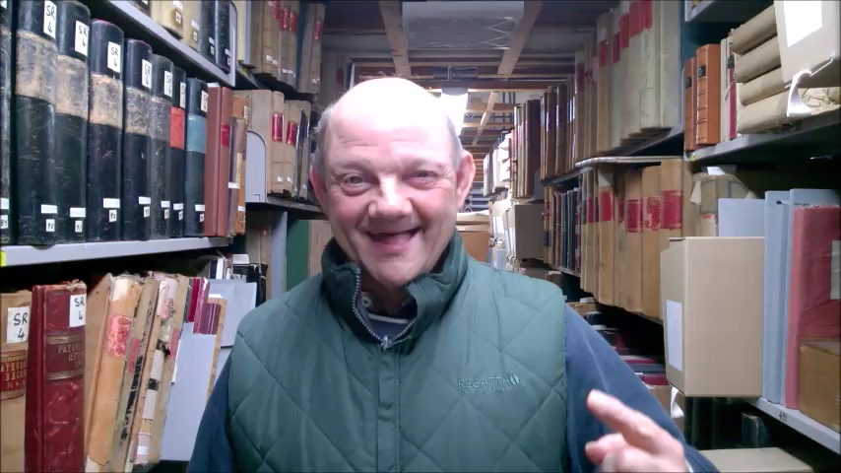

Slide 18
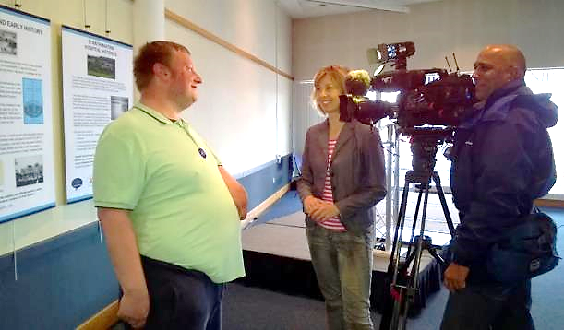
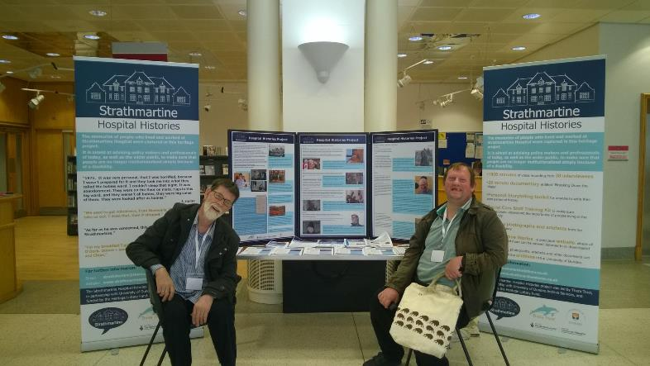

Slide 19
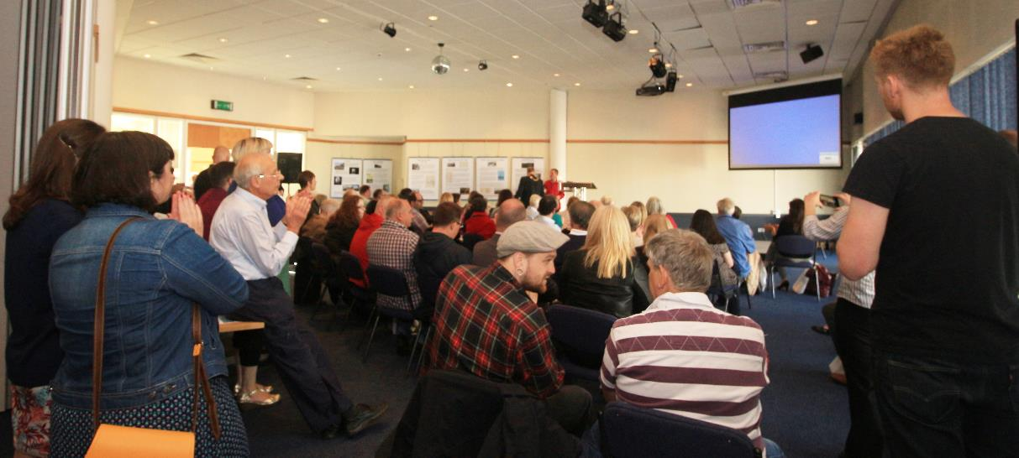

Slide 20
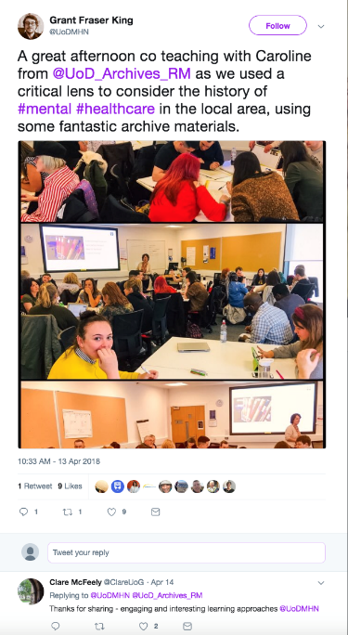
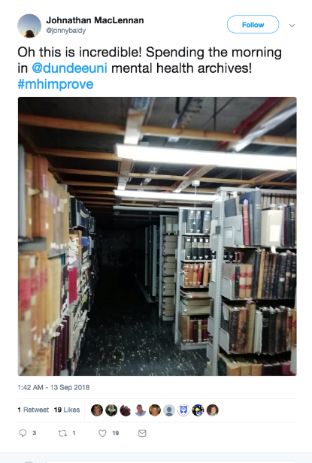

Slide 21
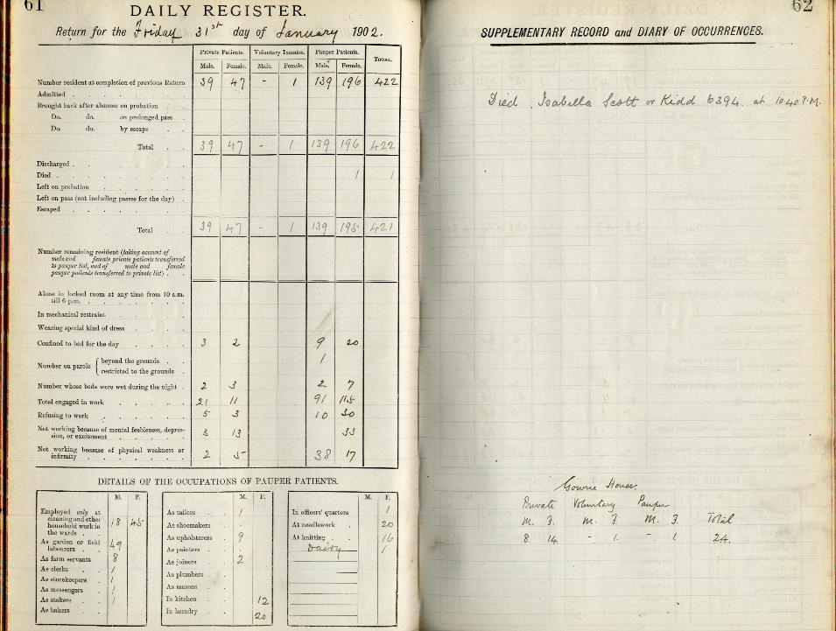

Slide 22
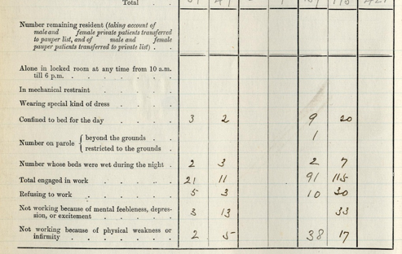

Slide 23
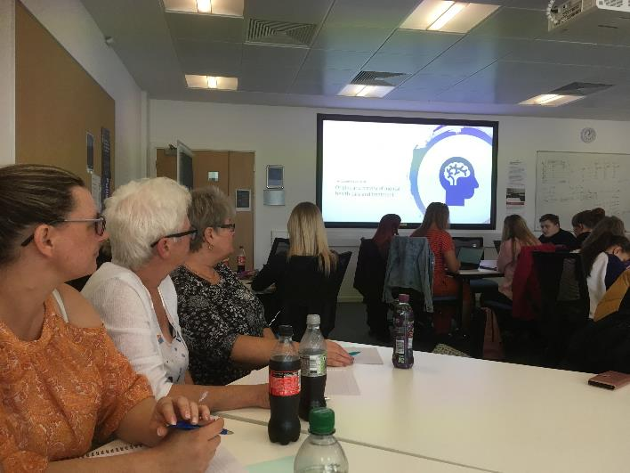
Mentally Health Tayside
Open archives to people who hadn’t used them before
Research history of local asylums
Enjoy learning and interacting
Have conversations about care today
Tell their own stories, have a voice

Slide 24
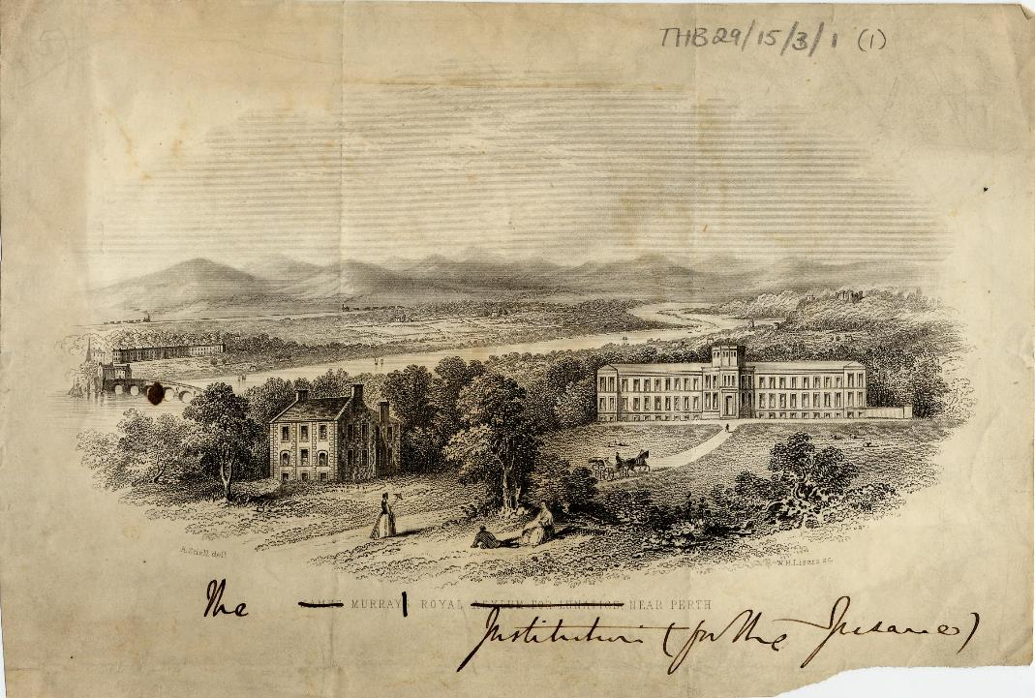

Slide 25
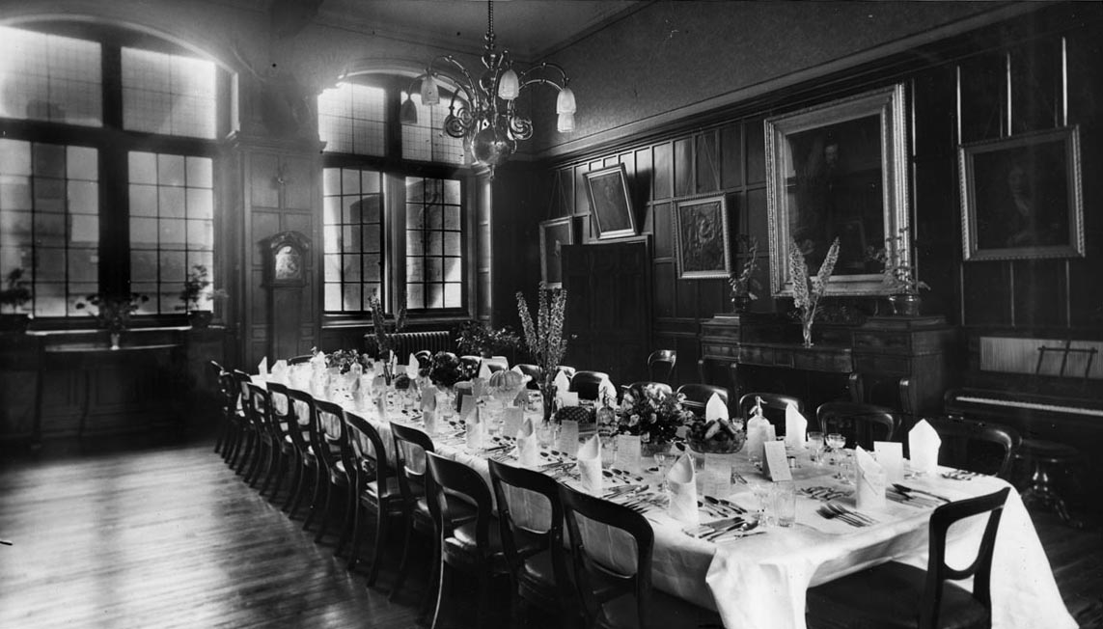
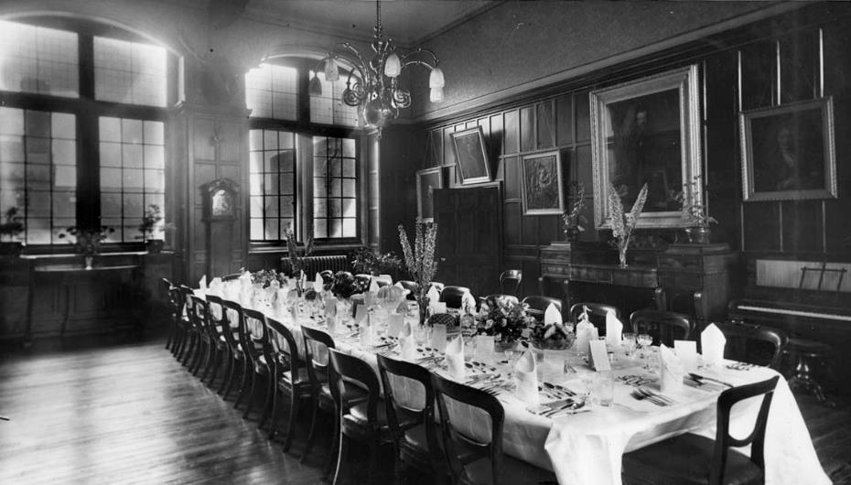

Slide 26
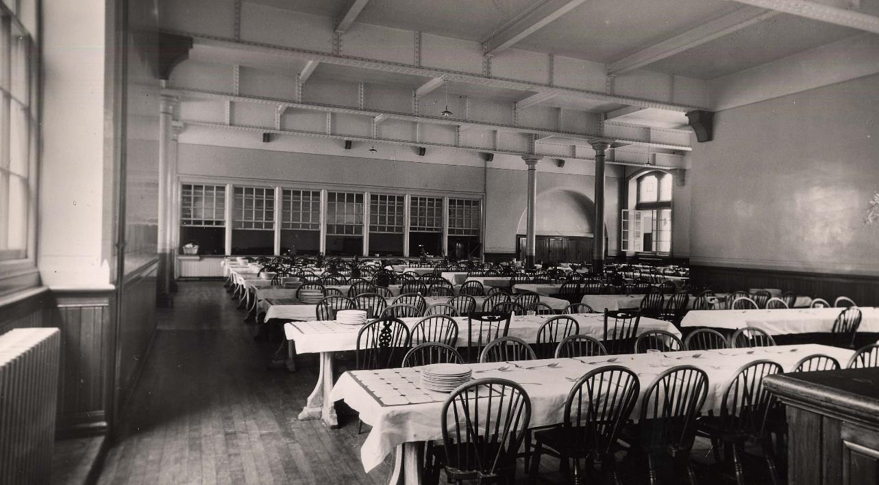

Slide 27
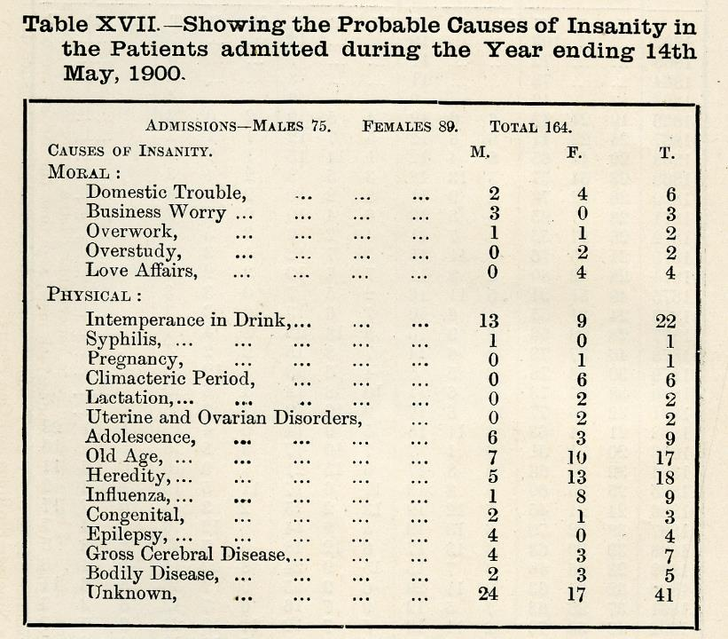

Slide 28
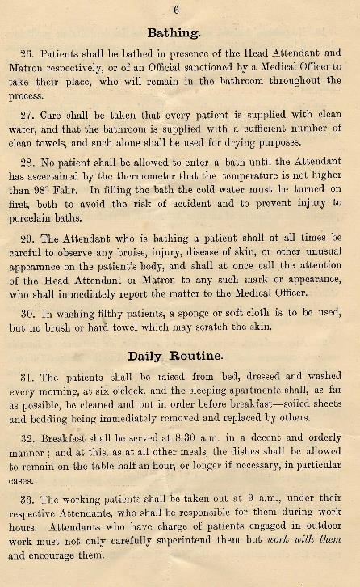
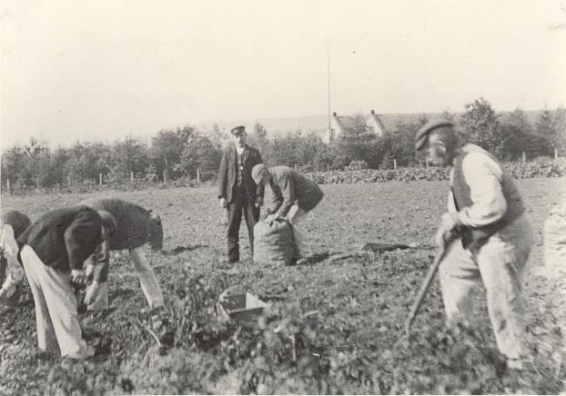

Slide 29




Slide 30





Slide 31



Slide 32




Festival of the Future 2019

Slide 33
“All I can say is WOW!!!! Nothing prepared me for the amazing mind blowing things we saw, read about discussed and discovered ... To make improvements to our troubled Mental Health Service today, we need to look back through the years and compare notes…I feel strongly that students (nurses, doctors, caregivers) should get down to the archives and take a good look at these records ... Change in Mental Health is needed so look back and see what worked, what was beneficial to the patients … I can honestly say that being a mental health patient for over 30 years this experience has got me buzzing. I’m feeling better and more positive than I have in a very long time. I actually felt like I knew some of the people we researched. They came alive, I could imagine how they were living and feeling. I was going back in time.”

Slide 34


