Slide 1



Legless in London
Dr Ryan Sweet
Senior Lecturer in Humanities
Swansea University
r.c.sweet@swansea.ac.uk

Slide 2
Talk overview
What is Legless in London?
Underpinning academic work
Inclusivity guidelines
Next steps
Your questions
The project that led to it
How to play

Slide 3

What is Legless in London?

Slide 4

About
The project is generously funded by:
Me: cultural and literary historian of the nineteenth century with a specialism in disability studies.
Inclusive Board Game Project aims:
  Create an inclusive board game inspired by my 2022 book Prosthetic Body Parts in Nineteenth-Century Literature and Culture.
  Prepare a set of inclusivity guidelines for board games makers.
And is a collaboration between:

Slide 5
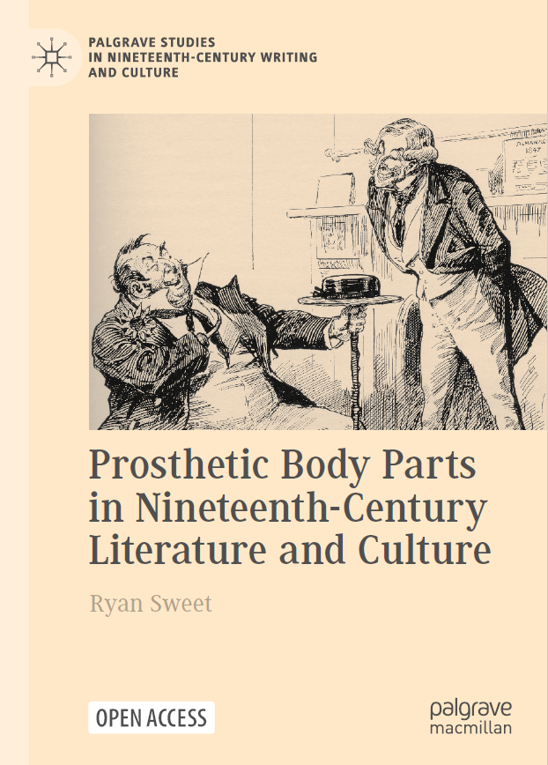
Prosthetic Body Parts in Nineteenth-Century Literature and Culture (2022)
Explores how prosthesis users and prosthetic body parts were represented in nineteenth-century British and American literature, journalism, film, art, and culture.
Argues that literary representations of prostheses challenged the emerging social privileging of physical wholeness.
  Questioning the logic of prostheticizing.
  Presenting the prosthesis / prosthesis user as threateningly powerful.

Slide 6
A flavour of the book—the opening paragraph
“How were artificial limbs, eyes, teeth, and hair imagined and presented in nineteenth- and early twentieth-century literature, journalism, and visual culture? In what ways did cultural imaginaries of prostheses reflect or respond to real-life developments of these technologies and the lived realities of their users? To what extent did these sources endorse or challenge the social mandate for physical normalcy that fed the appetite for and development of prosthetic devices that could conceal physical difference from public view? … Such lines of enquiry matter if we are to better understand where the enduring hegemony of physical wholeness comes from and how society responded to this concept when it emerged most strongly. Responding to these questions also helps us to comprehend how normalcy became entwined with and reinforced by other social prejudices and how ascendant cultural forms such as literature, media sources, and visual artwork played vital roles in challenging normative thinking. By revisiting these materials, we learn how we might build on this approach today in order to develop a less stigmatizing social system.” (Sweet, 2022, p. 1)

Slide 7
Why make this into a board game?
Disability is underrepresented in culture and especially board games.
The few representations in board games are often problematic.
Disability history and culture offers rich material for board games, which are seeing a cultural resurgence.
Board games are not always as inclusive as they could be.
To extend the audience for the message about normalcy’s dominance being historically contested.
To create a role-playing game that offers players a more nuanced representation of disability through the medium of fun.

Slide 8
The team
Designers
Ryan Sweet (Swansea University)
Melvin Bell (Focus Games Ltd.)
Taylor Paterson (Focus Games Ltd.)
Joanne Craven (Focus Games Ltd.)
Dalius Demenciukas (Focus Games Ltd.)
Consultants
Rachel Stelmach (Disability Arts Cymru)
Claire Ryan
Rhianedd Collins
Lewys Tectonic

Slide 9
What we did
Pre-project focus group: board games and accessibility.
Discussions with Focus Games—initial concept and mechanics.
Workshops with Focus Games and consultants.
Full prototype of game, playtested with over 30 individuals.
Collected feedback, discussed as a group, and decided corrections.
Final prototype.
Inclusivity guidelines discussed and drafted throughout workshops.
Further playtesting with over 50 users.
Revised the game and prepared it for production.

Slide 10
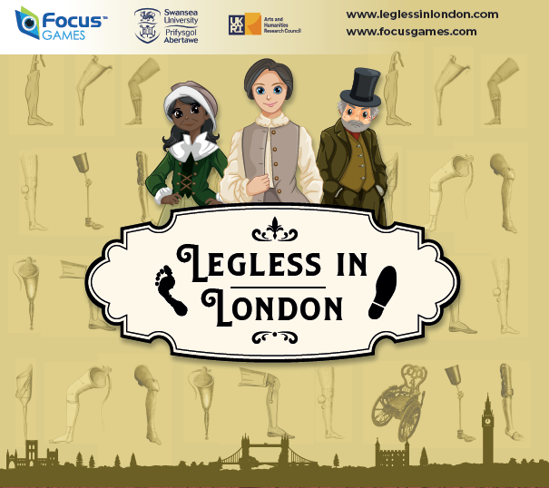
Legless in London’s aims
Get players to think from the perspective of an amputee in Victorian Britain.
Recognise the challenges and opportunities that disabled people faced.
Emphasise the agency of disabled people.
Get players to consider historical issues related to disability in comparison with today and how disability is (or is not) represented in other games and cultural works.
Be fun, engaging, and not didactic!

Slide 11
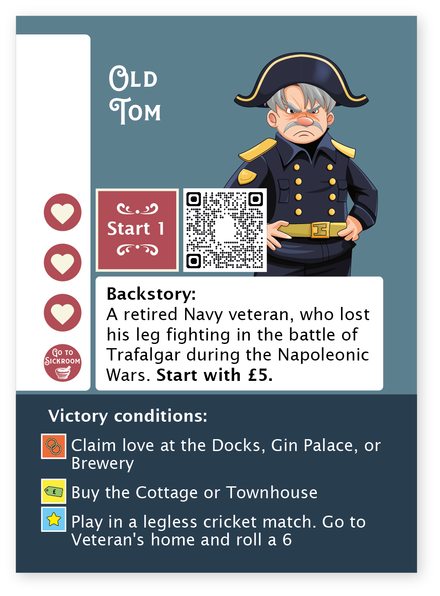
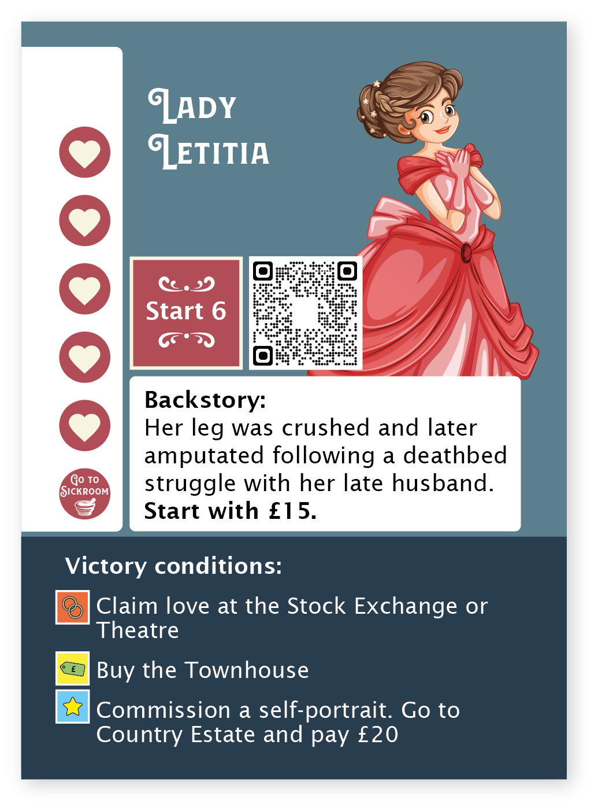
How to play

Slide 12
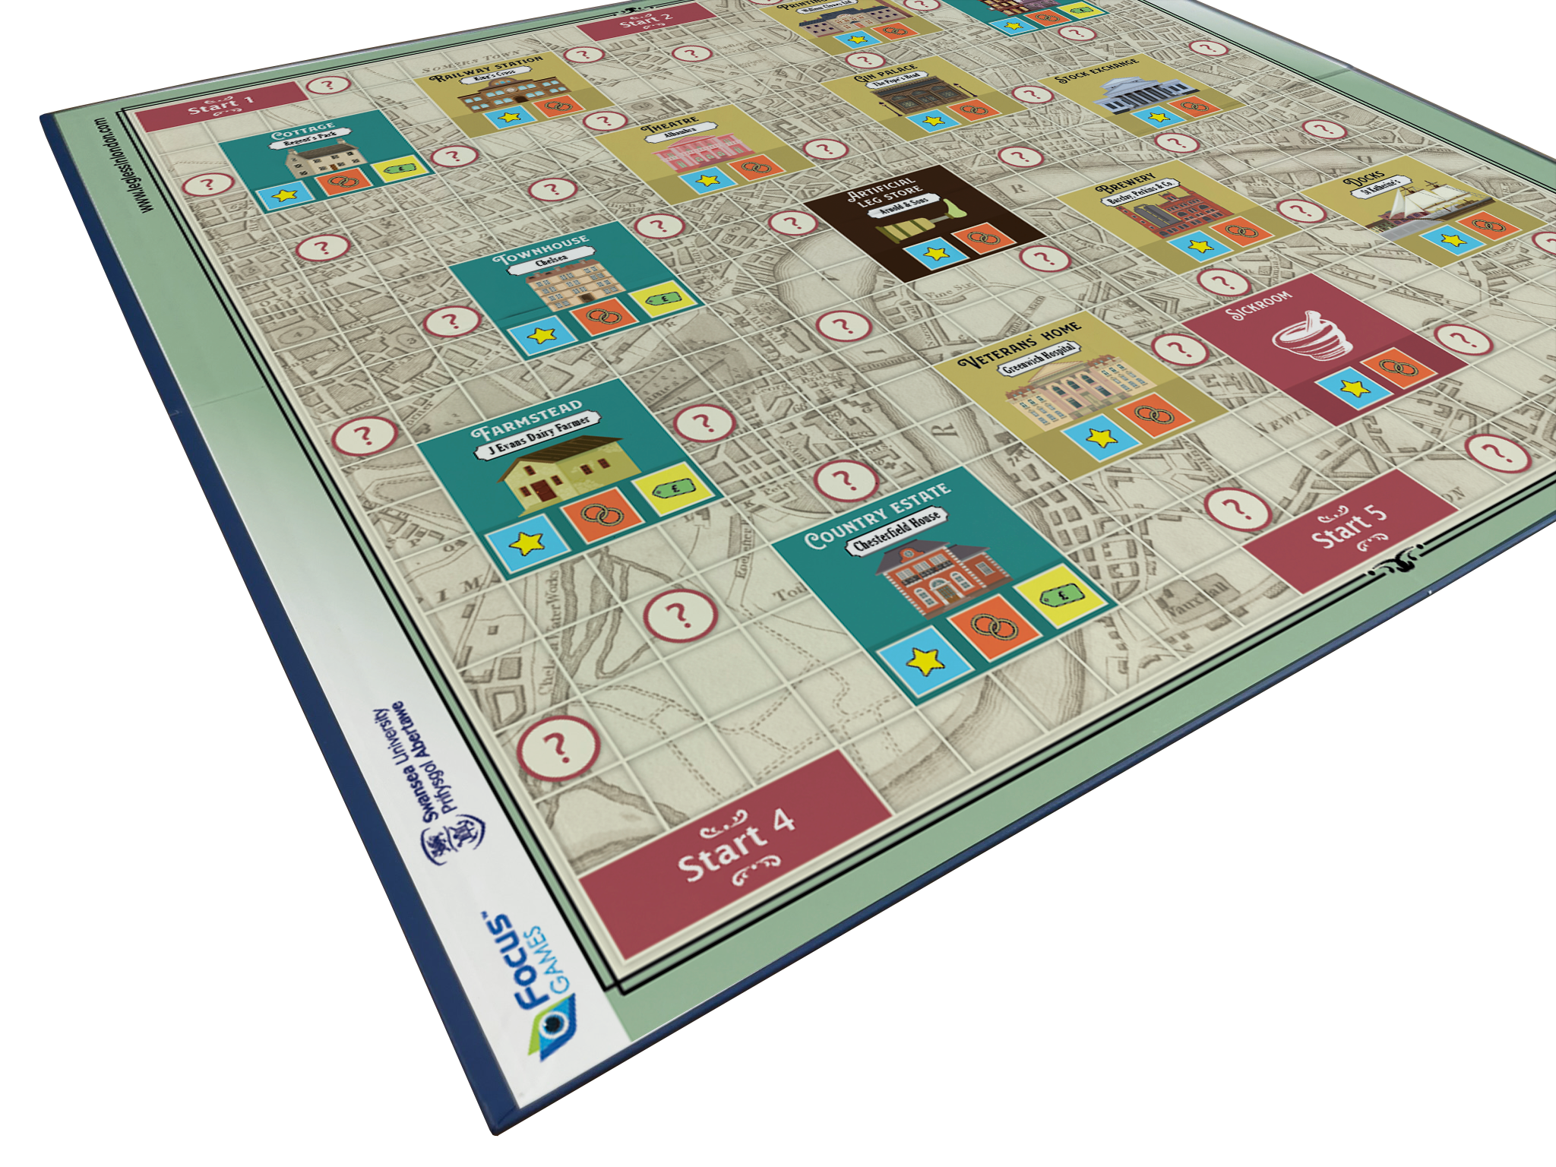
The board

Slide 13
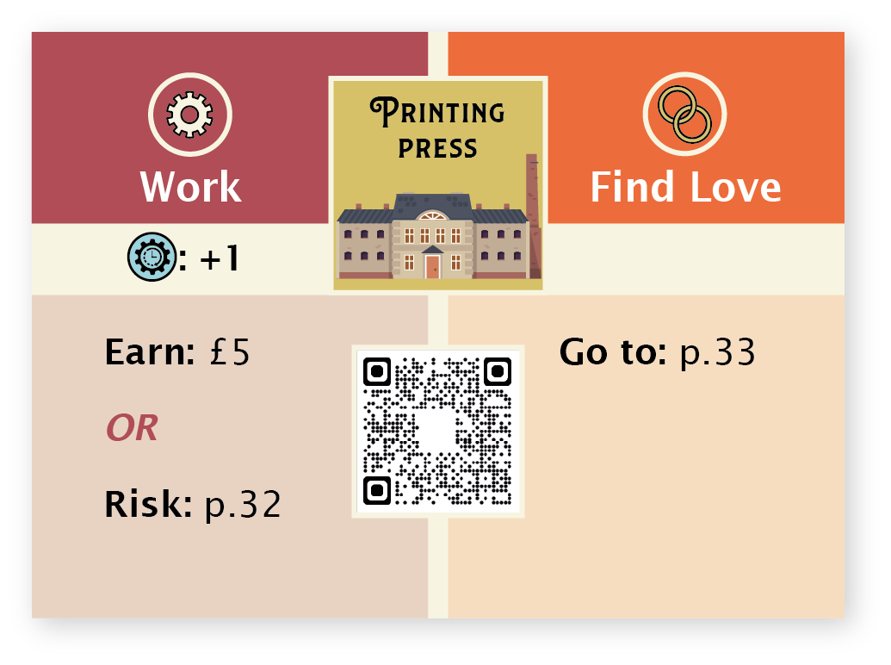
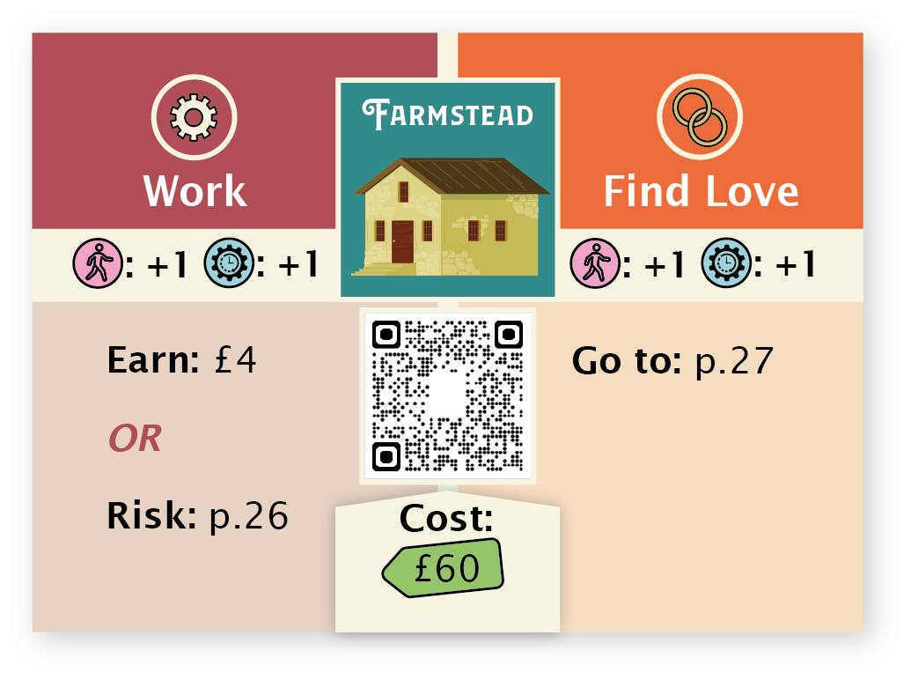
Location cards

Slide 14
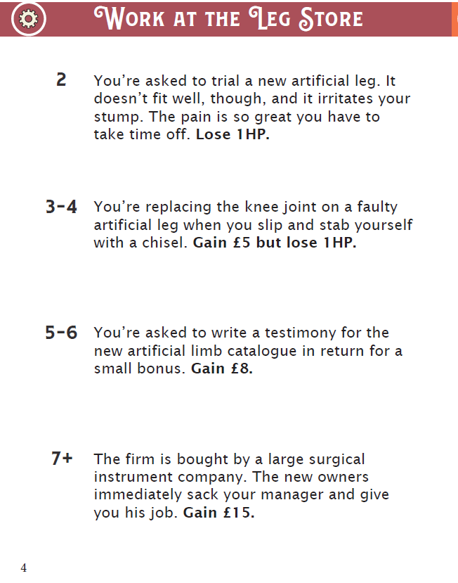
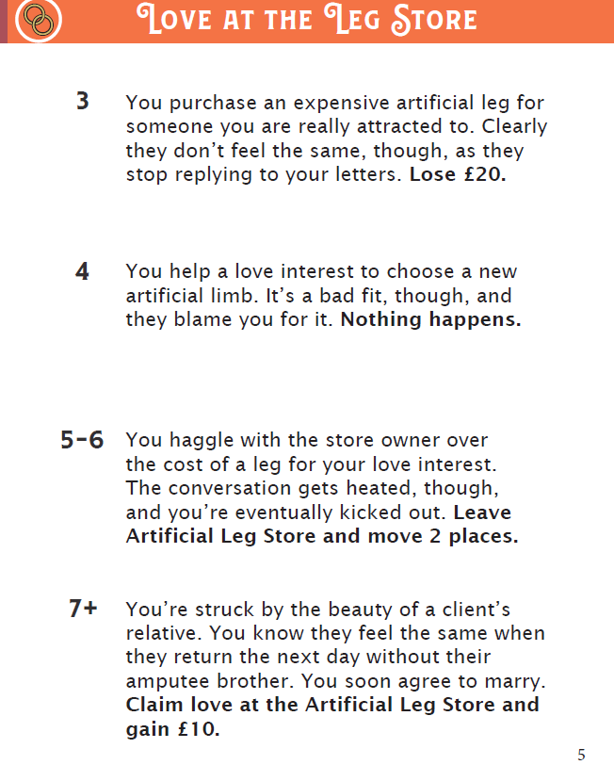
Risk booklet

Slide 15
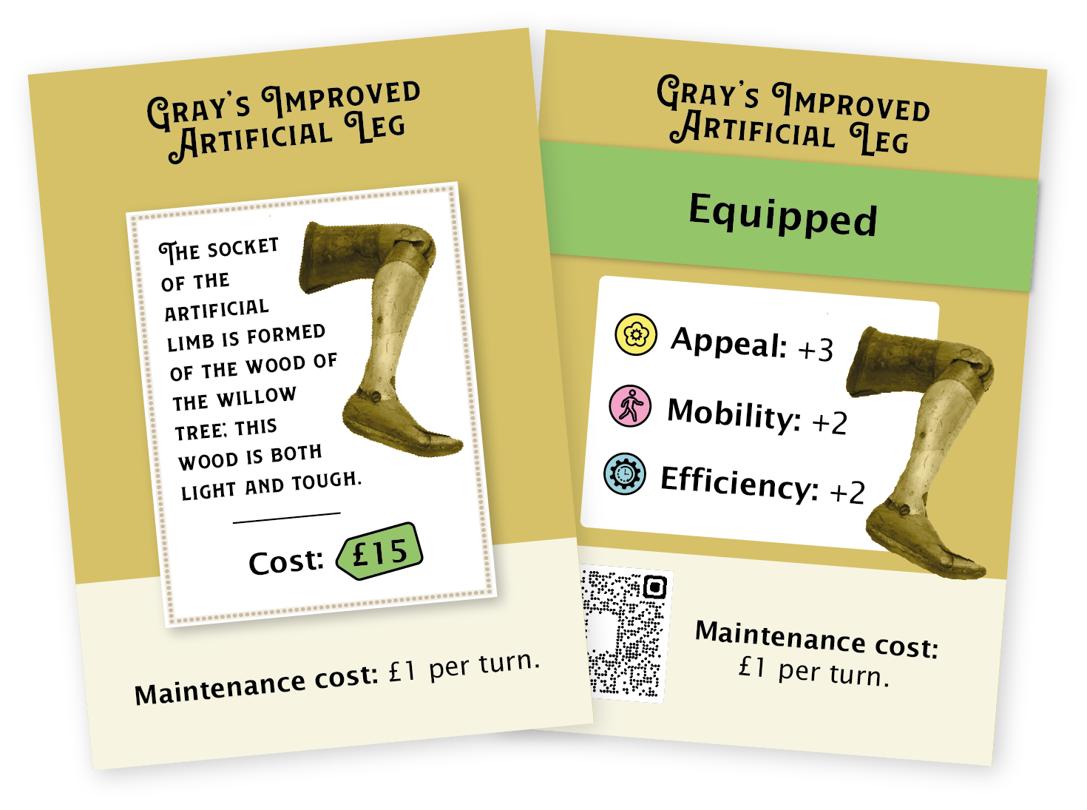
Artificial leg cards

Slide 16
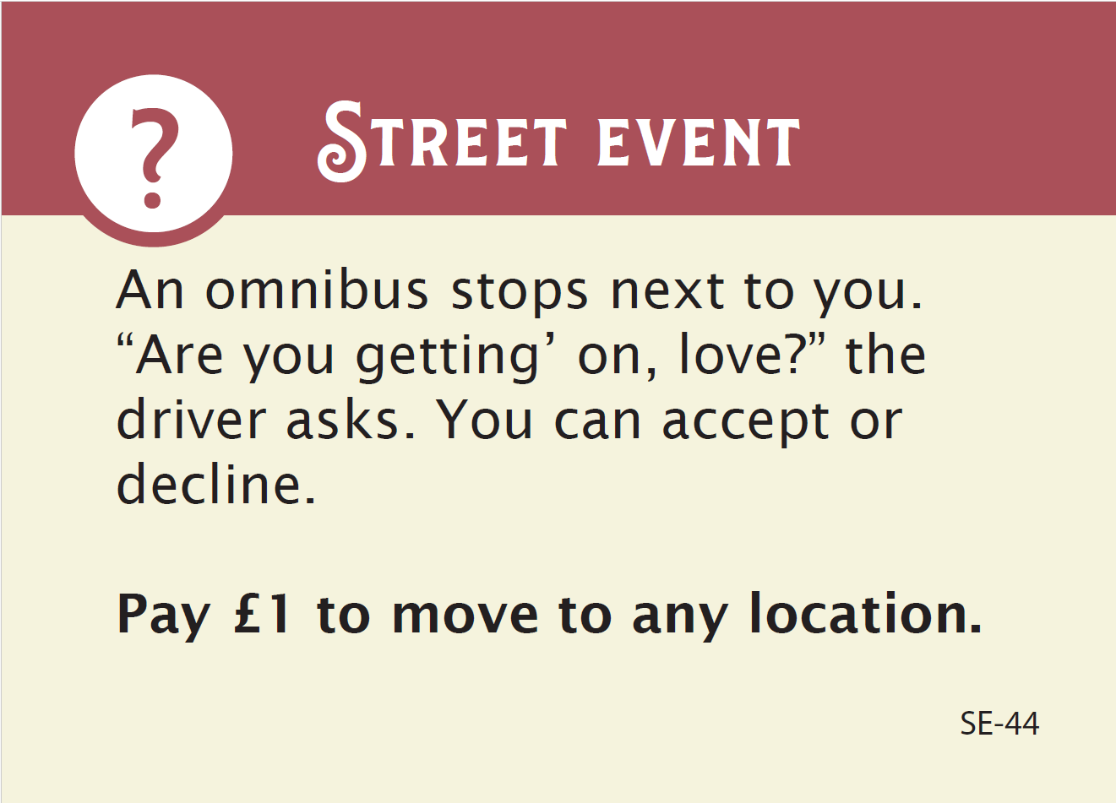
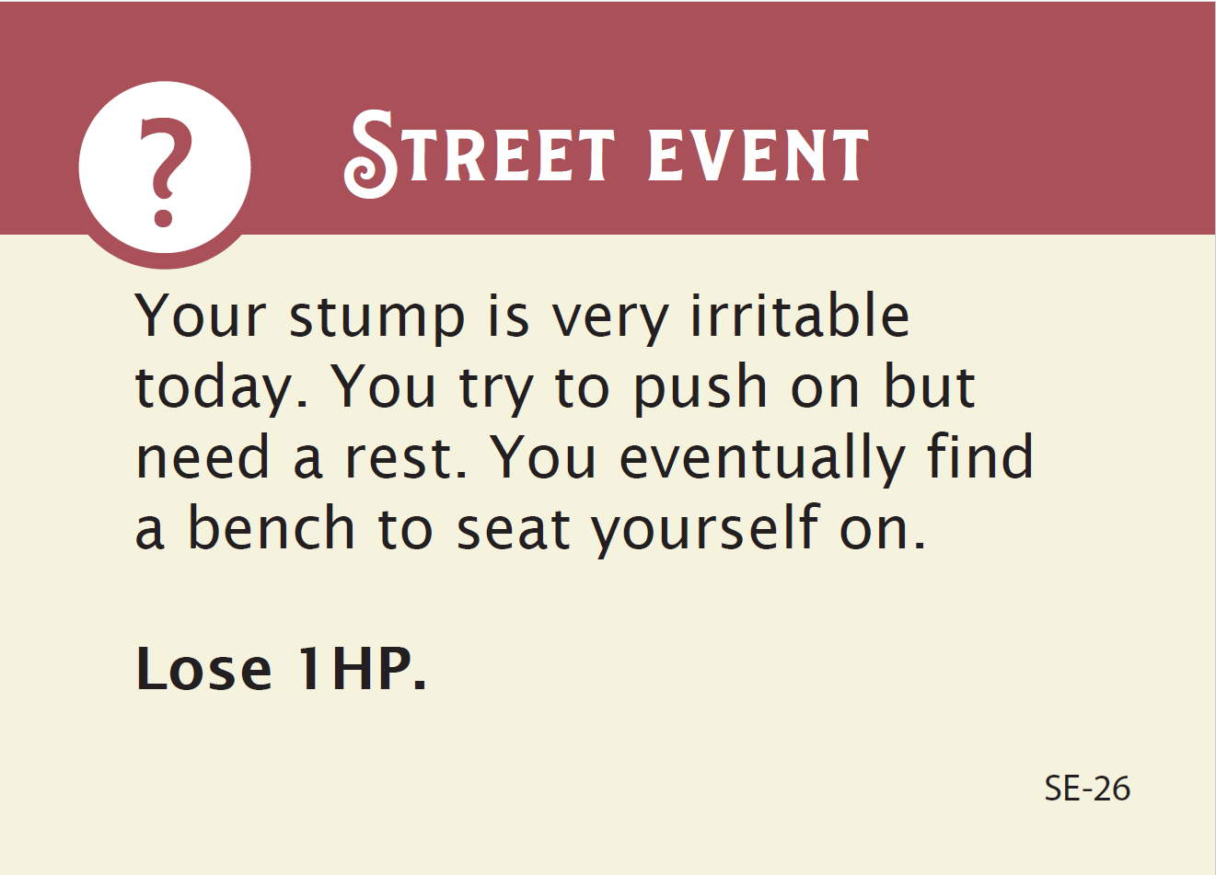
Street event cards

Slide 17
Player experiences
“Legless in London is a game you could easily become immersed in and have a lot of fun…. It’s well thought through with an array of characters.” – Jon
“Great game… Makes talking about disability & its effect (modern & historical) easier & less taboo.” – Mat
“Very accessible for those with ADHD with short-term goals in sequence. Street events are really fun too!” – Maddy
“Really cool board game! Great way of teaching about the experiences of disabled people in history.” – Callum
“Loved the ease in which a complete novice can pick up the game.” – Sam
“Fun game – loved the story element and the characters.” – Iola

Slide 18
Accessibility features
Easy Read rules.
QR codes linking to HTML versions of text—compatible with screen readers.
Large sans serif font used where possible.
Large stable pieces that are easy to grip.
Components tested for ease of use.
Matt, non-slip finishes.
Uncluttered designs with accessible colour palates.
Avoided using colour as the only means of differentiation.
Web and mobile app that allows players to perform many of the game’s actions without burdensome dexterity requirements.

Slide 19
Inclusivity guidelines (1/2)
Inclusivity Recommendations for Board Games Design
  Ranked from A-C.
    A = Recommendations that are easy and cheap to implement, which have the potential to improve accessibility for a wide number of players.
    C = Recommendations that may be more complex and costly to implement but could improve accessibility for players with specific impairments.
  Within these three sub-rankings, the recommendations are further grouped using the POUR framework (Perceivable, Operable, Understandable, Robust).

Slide 20
Inclusivity guidelines (2/2)
  Accessibility Checklist
    Table in which designers/makers can give a score (0-3) and a rationale in relation to each recommendation.
      0 = not considered
      3 = considered and fully achieved
Underpinning ideas:
  Short, accessible, easy to use.
  In line with design principles/ways of working in the industry.

Slide 21

Next steps
Take the game to market—production, marketing, distribution, sales, etc.
Organise play events with relevant user groups—you?
Revise Inclusivity Guidelines and position in relation to other guidelines available.
Engage other board games makers/designers with the guidelines.
Consider other versions of the game—digital and/or different geographies, e.g. “Legless in Llanelli”.

Slide 22
Key takeaways for me
Experience
Teamwork
Gamification as a way of thinking
Potential for disability work in gaming

Slide 23
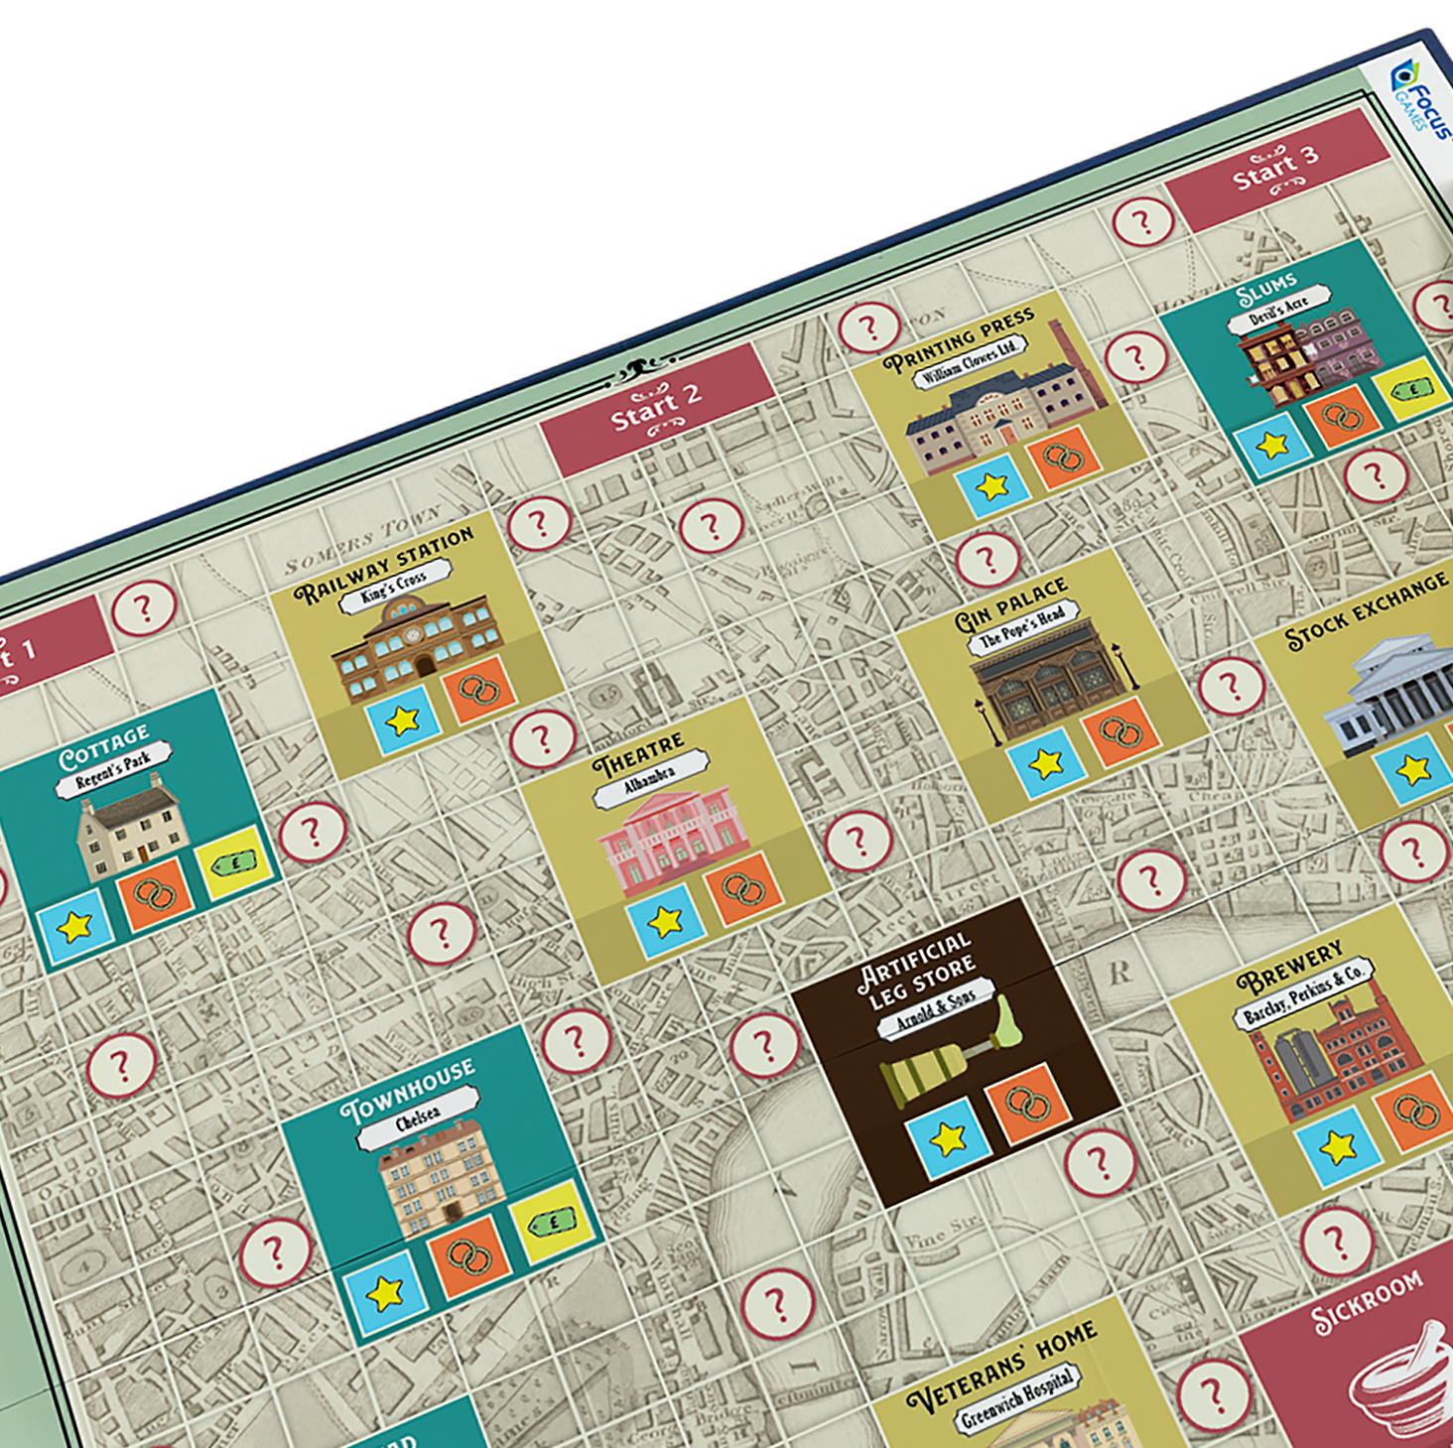
For more on Legless in London and/or to pre-order the game
Visit www.leglessinlondon.com

