Slide 1
#HiVis2025

Slide 2
What is Hi-Vis Fortnight?
An annual two-week celebration, 1st-14th June, of accessible reading and library services for blind, partially sighted and print disabled people across the UK.
It's organised by Share the Vision which is a coalition charity made up of multiple organisations such as RNIB, Calibre Audio, Libraries Connected, CILIP, SLIC, ClearVision and SCONUL.

Slide 3
Assets and Support
Share the Vision (also known as Reading Sight) will share assets via their website or JISCMail.
Theme
Poster templates
Logos and images
Social media templates
Toolkits and event ideas
Speakers or print disabled people in your area

Slide 4
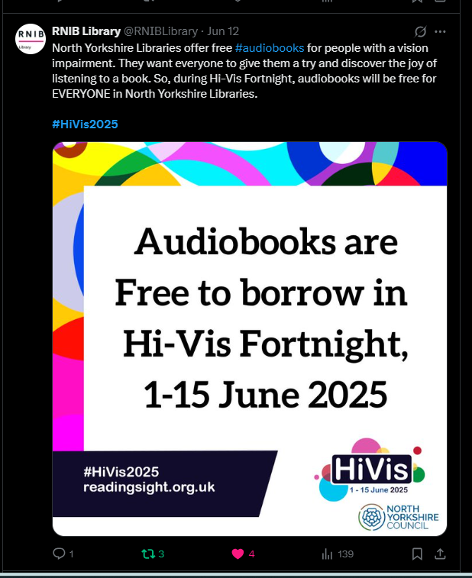
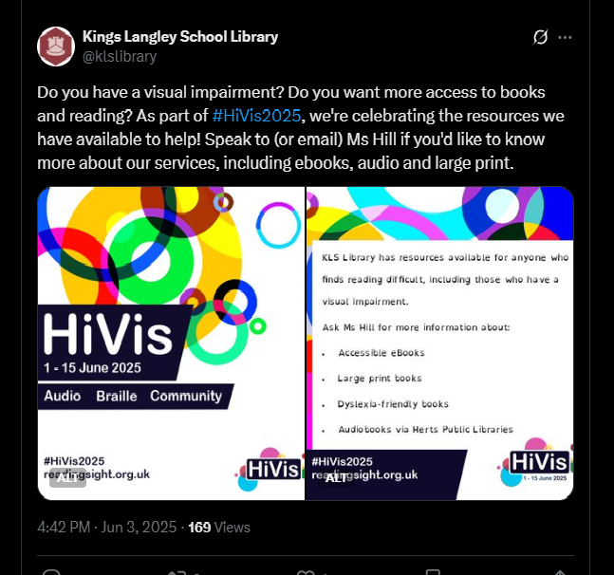
Social Media

Slide 5
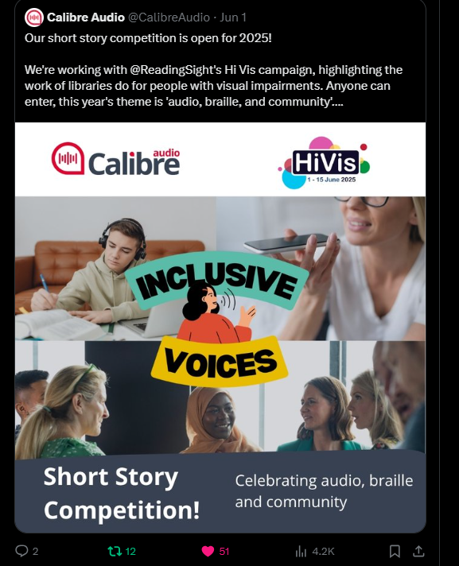
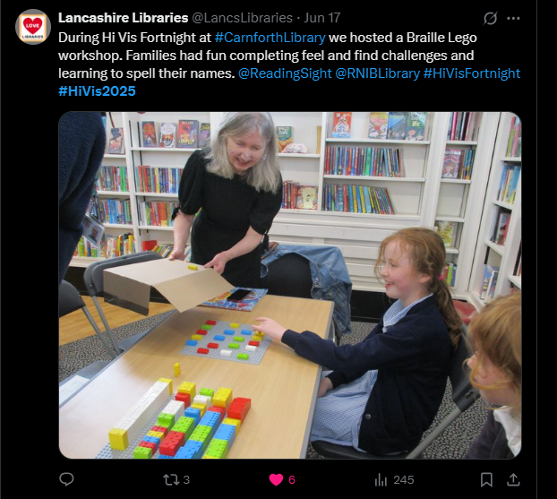
Events

Slide 6

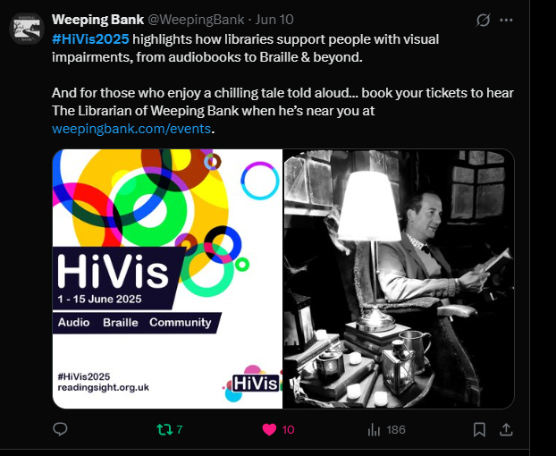
Braille and Theatre

Slide 7
What we do with your good work
Highlight how accessible libraries are to the blind and partially sighted community
Link you up with sight loss organisations
Prepare a report each year to showcase to national bodies such as SCONUL, CILIP and Libraries Connected
Use information to tie in to further accessibility strategies

Slide 8
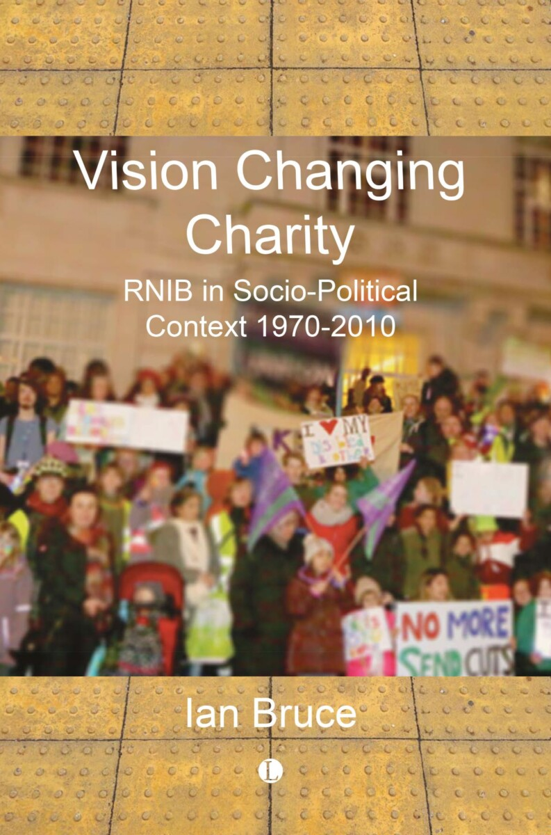
One more thing!
A free copy of this book is available to you and if you’d like Ian to come and speak or come for an event just let Lara know via her email. On the last page.

Slide 9
Any Questions?
Reach out to me at lara.marshall@rnib.org.uk

