Slide 1
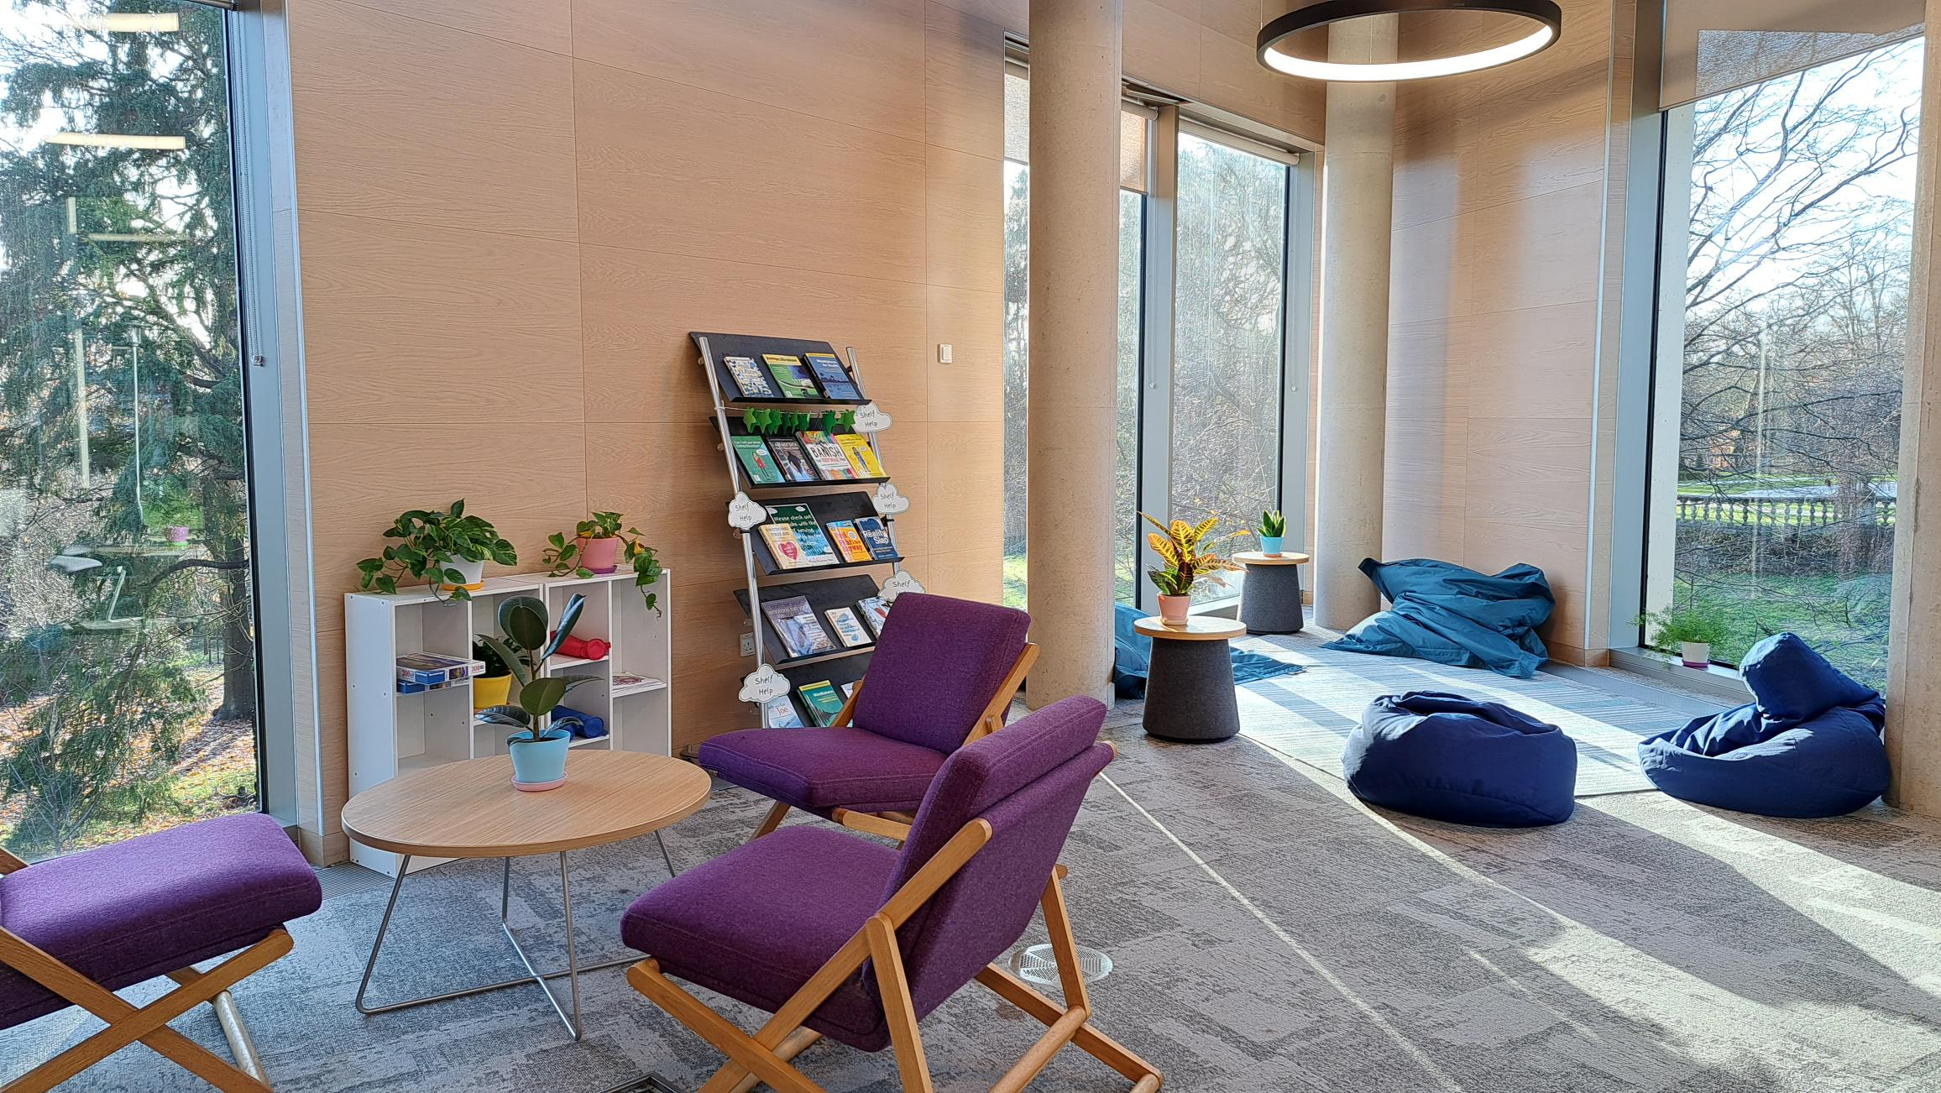
Working with users to create a more accessible library
Eva Garcia Grau and Clare Hunter
Royal Holloway, University Of London

Slide 2
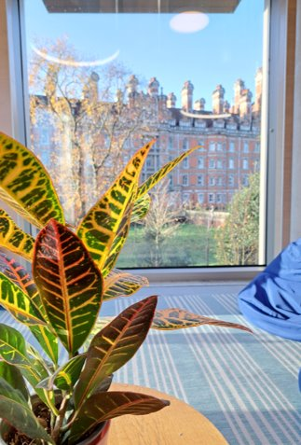
What drove our project?
Feedback from other services
Requiring more details on the problems students were facing
The dropped curb effect

Slide 3
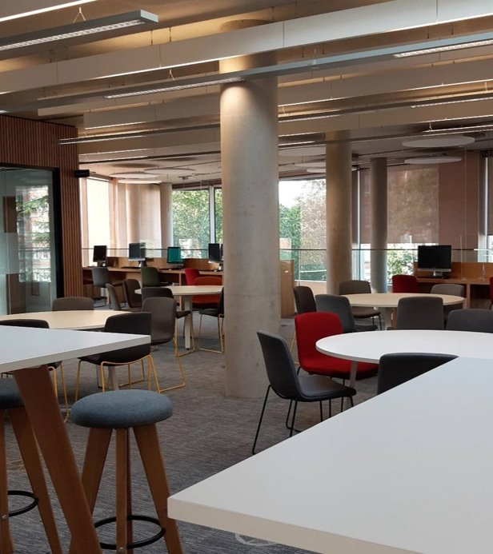
Choosing a methodology
Semi-structured interviews to draw out what students really thought and felt
Open questions to allow students to give feedback on areas that were important to them

Slide 4
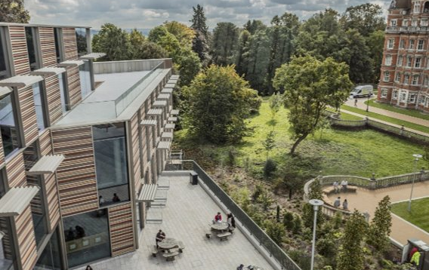
Sourcing participants
We wanted to capture the lived experience of students who do (or don't use the library)
We reached out via the SU and social media with limited success
We reached out to students registered with our Disability and Neurodiversity service which had an extremely positive response

Slide 5
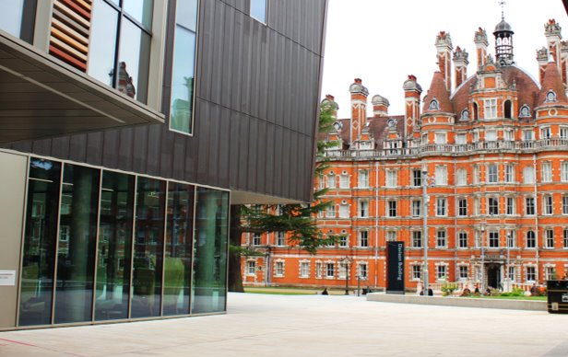
Making our interviews accessible
Gave participants the choice of in person or online interviews
Scouted accessible locations across campus
Practiced interviewing technique
Sent our participant packs to those who agreed to take part, including questions in advance
Ensured we got University ethical approval

Slide 6
What did we ask?
What are the main barriers/difficulties in the library?
If you could change one thing about the library, what would you change?
What is working well?
What do you think makes a good study environment?
What do you think makes a good online library?
Where would you look to find information on accessibility services? What kinds of information would be useful?
Is there anything else you’d like to tell us?

Slide 7
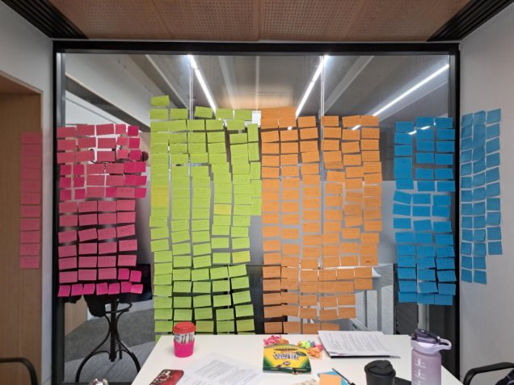
Analysing the feedback
Transcribed the anonymised interviews
Each point was copied on to
a post-it note
Used the Affinity Mapping process to group like feedback together and find overarching themes

Slide 8
What did the students tell us? Positives
“Staff is very kind and are always trying to help us. Whenever I ask the staff, they have been really helpful,”
“The quantity and quality of the books we
have is amazing, I can find any kind of
article and book that I want.”
“The format of the website works well and likes it when there are tiles that will clearly show what it will do when you click on them.”
“Like that everything you need is on the ground floor e.g. printers, IT desk, accessible.”

Slide 9
What did the students tell us? Challenges
“It would be great if I can go, I can get a cup of tea, go straight to a space that I know is going to be there, be ready, be safe, I am not going to be too overwhelmed with my headphones. There will be a space ready for me that I don’t have to look for."
"(would like) proper back and arm rests, current chairs not as easy to sit on and would like more cushioning."
“On Librarysearch, I often find it a bit hard to find exactly what I’m looking for.”
“…feels criminal to even move in silent study. Ideal would be having an amount of noise but not obnoxious people talking really loudly.”

Slide 10
What were the major themes we found?
Study spaces -
  Group study too noisy and chaotic but silent study too quiet
  Preference for enclosed/not overlooked working space
  Accessible technology suite not so accessible
Difficulties with resource discovery
Accessibility information not always easy to locate
Feedback went beyond library services

Slide 11
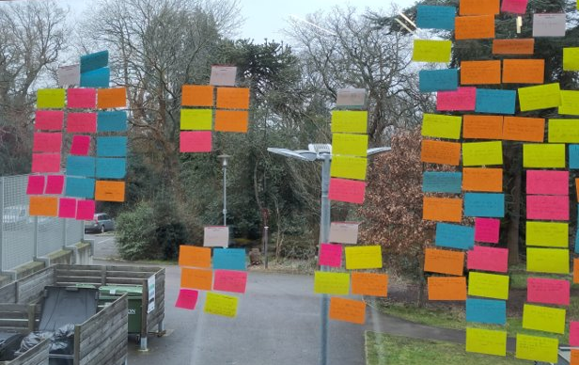
Working to find solutions
Brainstormed solutions with no limits
Chose our favourite ideas
Prioritised our ideas based on how easy they were to implement and how original they were

Slide 12
What did we do for our students?

Slide 13
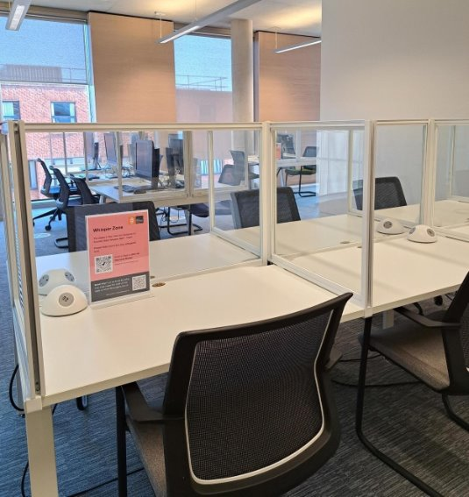
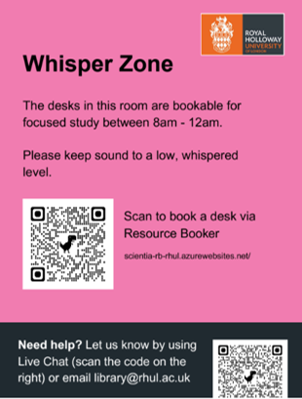
Whisper Zone

Slide 14
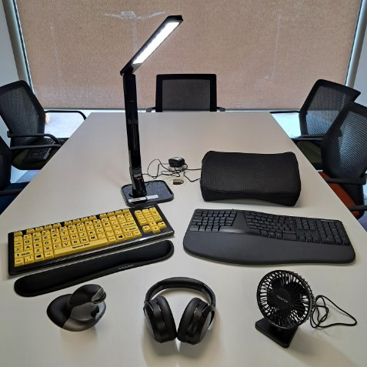
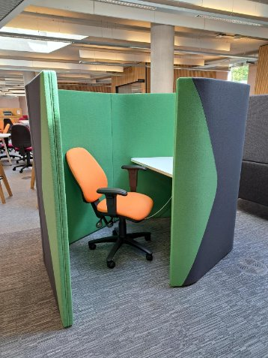
Updating our furniture and accessible equipment

Slide 15
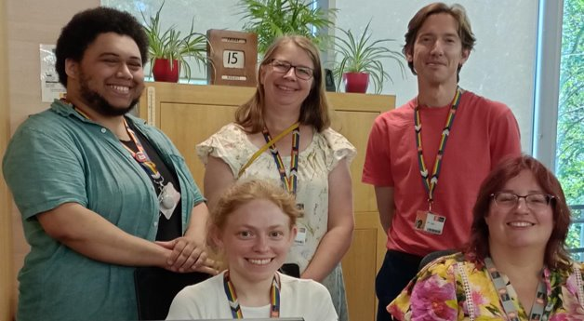
A bookable tour programme

Slide 16
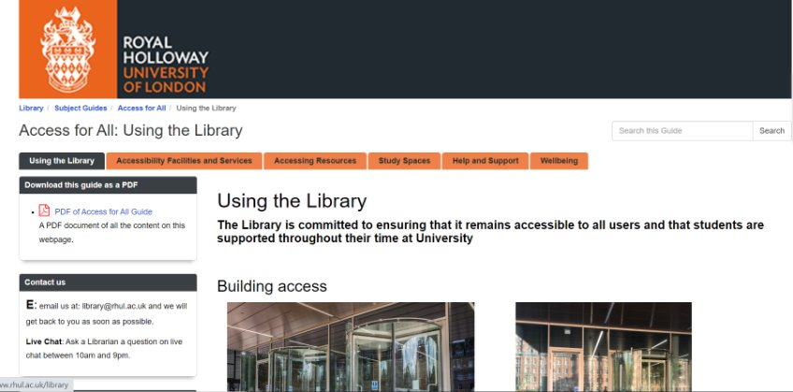
Improved accessibility information

Slide 17
Changes we couldn't make at this time
We couldn’t expand the ATS to a second area in the Whisper Zone due to a lack of funds
Some furniture and equipment for 2-person study was also out of budget
Technical and time issues for improving book location information/LibrarySearch maps
A main square for accessibility information on LibrarySearch was also not achievable

Slide 18
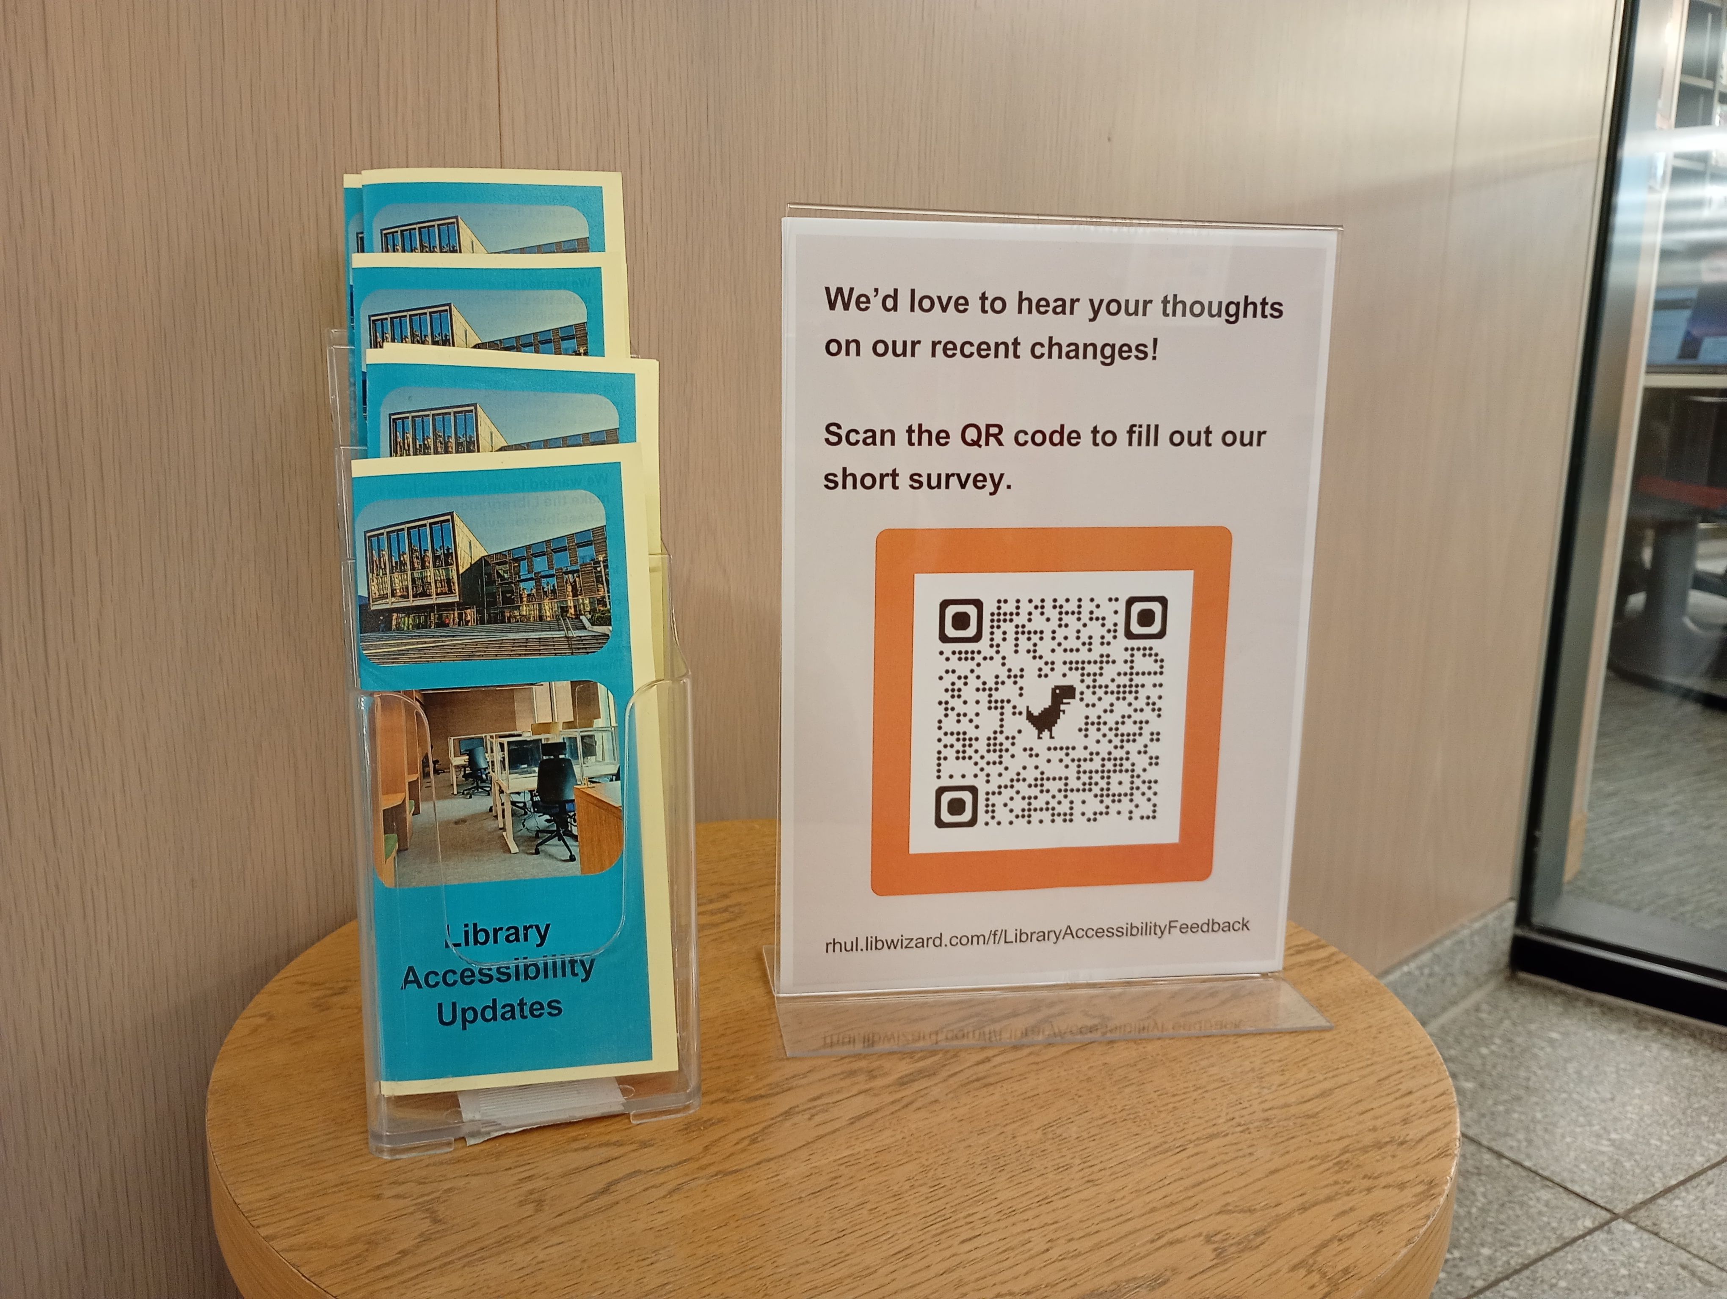
Feedback on our project and changes
We have promoted our changes
We have upcoming projects to give further feedback on these upcoming in the new year
New equipment is well borrowed

Slide 19
What our students told us about the project
I’m glad that
I could contribute with the research.
Doing things like this makes me think “Oh you actually care”.
Thank you for doing this, it is really nice that you care.

Slide 20

Any questions?
Eva Garcia Grau
Eva.GarciaGrau@rhul.ac.uk
Clare Hunter
c.hunter-2@rhul.ac.uk

