Slide 1

Designing for Difference:
Co-creating a Sensory Guide to the Hive
ALISS Disability Champions Forum
25th November 2025
Victoria Collins
Student Engagement Coordinator
University of Worcester Library Services
Notes:
vee

Slide 2
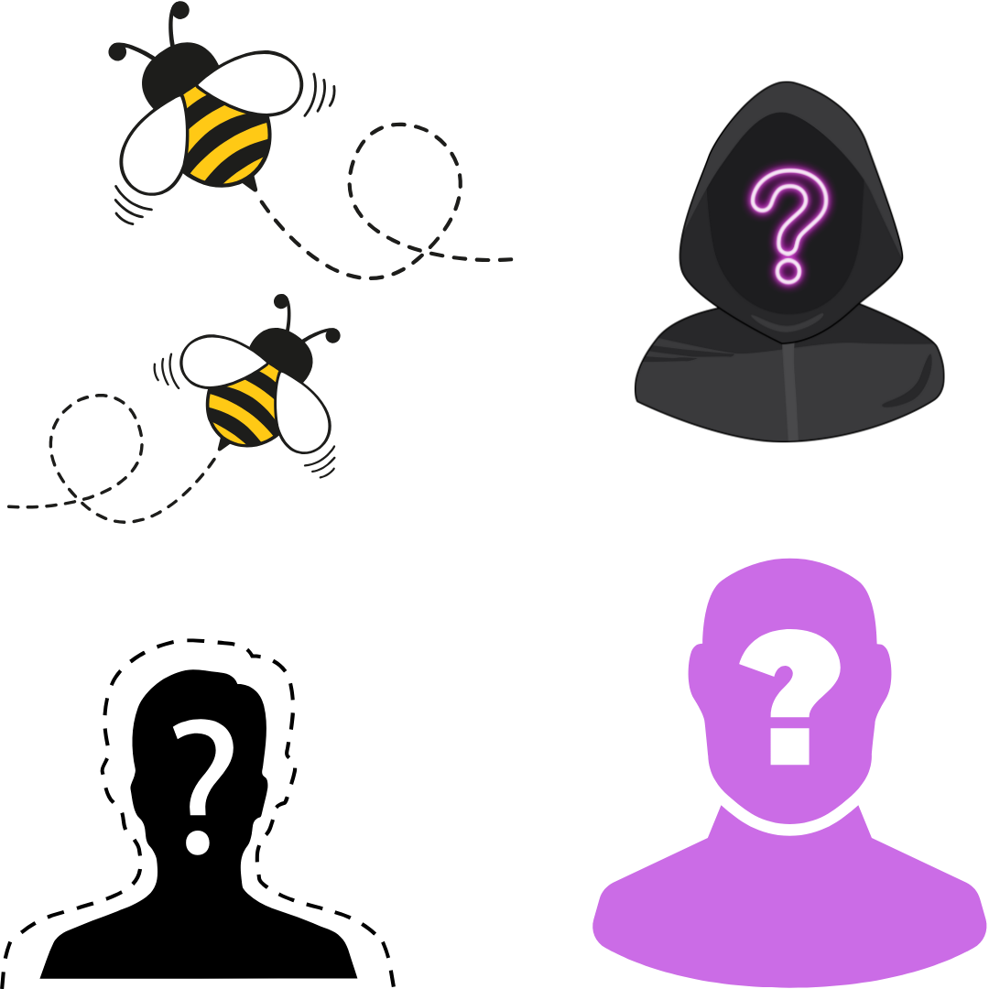



Background to the Library Student Team
2016: The Bees: Volunteer Library Representatives
2018-2022: Mystery Shoppers hired to contribute the student voice to our Customer Service Excellence (CSE) accreditation
2022: Launch of the Library Student Team
Manchester
Library Student Team
Warwick
Library Associates
Notes:
Vee:

Slide 3
The shift in approach: from consultants to co-creators
“from consultants to co-creators and true partners” (Blake, 2020, p. 426)
“the importance of building trust between staff and students within partnerships; in sharing and creating goals” (Bovill et al., 2016, p. 205)
“students are experts in the experience of being students” (Healey and Healey, 2019, p. 9)
Notes:
Vee

Slide 4

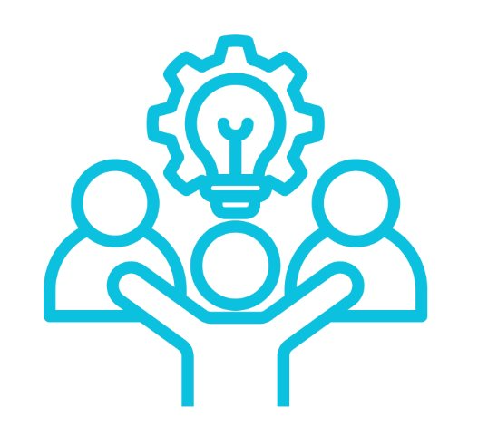

The Origins of the Sensory Guide
Initial prompt created from our student engagement and EDI priorities for the year
Project proposed and developed by students who identified a gap in support for neurodiverse and anxious users
Shaped by inclusive practice, drawing on principles that make spaces easier to navigate for everyone
Notes:
Ana

Slide 5
Intention for the guide
Reduce sensory overload
Reduce library anxiety
Set expectations clearly
Give students control and choice
Make The Hive feel welcoming and predictable
Accessible in multiple formats
Notes:
Vee

Slide 6
The student-led production process
Student Brainstorming and Consultation phase
Observation phase: students spent time observing and noting sensory triggers, busy times, light levels and noise patterns.
Students collaborated with staff for script creation, filming and recording voiceovers
Early drafts shared with peers for testing
Notes:
Ana

Slide 7
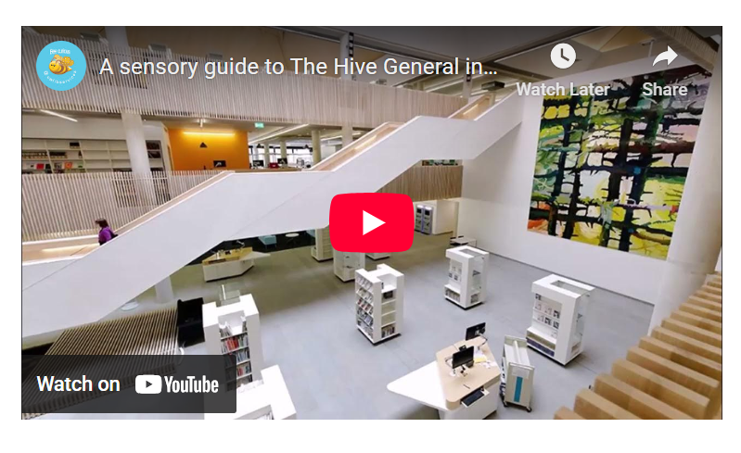
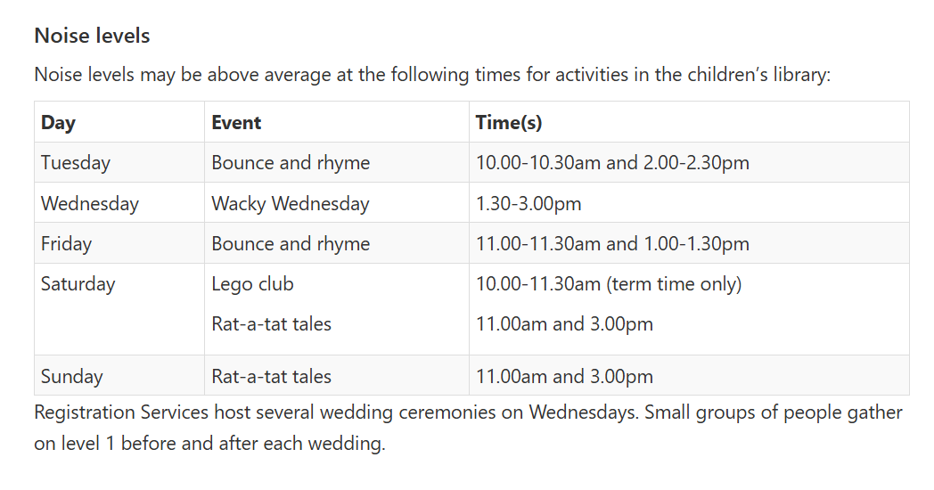
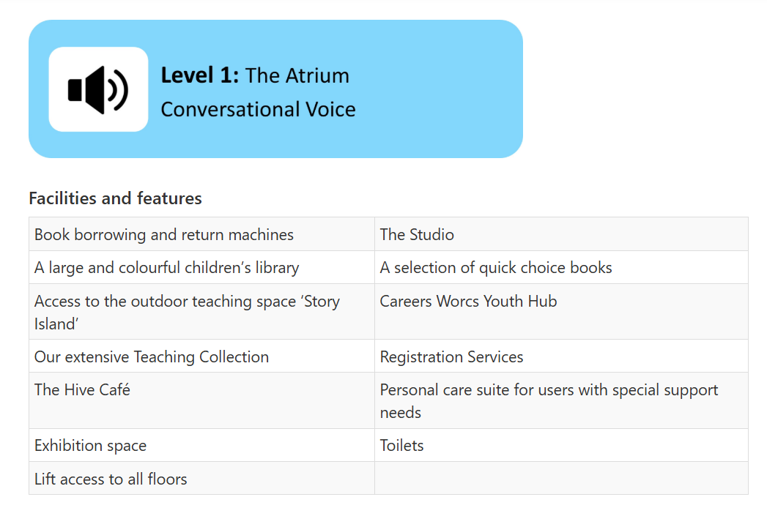
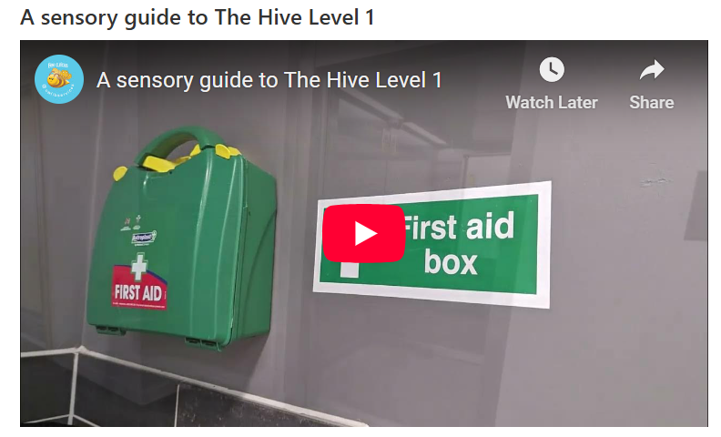
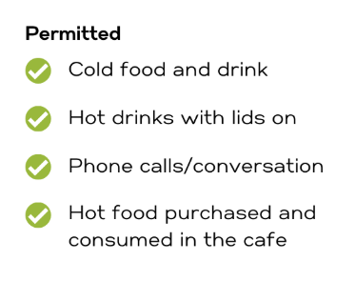
The Finished Product
https://library.worc.ac.uk/sensory-guide-to-the-hive
Notes:
Vee

Slide 8

Sector comparison: Where this fits
Nottingham Trent University: Sensory maps and virtual tours
University of York: Sensory rooms and video tours
University of Edinburgh: sensory maps and visual guides
University of Worcester Library Services at The Hive: a hybrid, student designed and built model
Notes:
Madalene

Slide 9
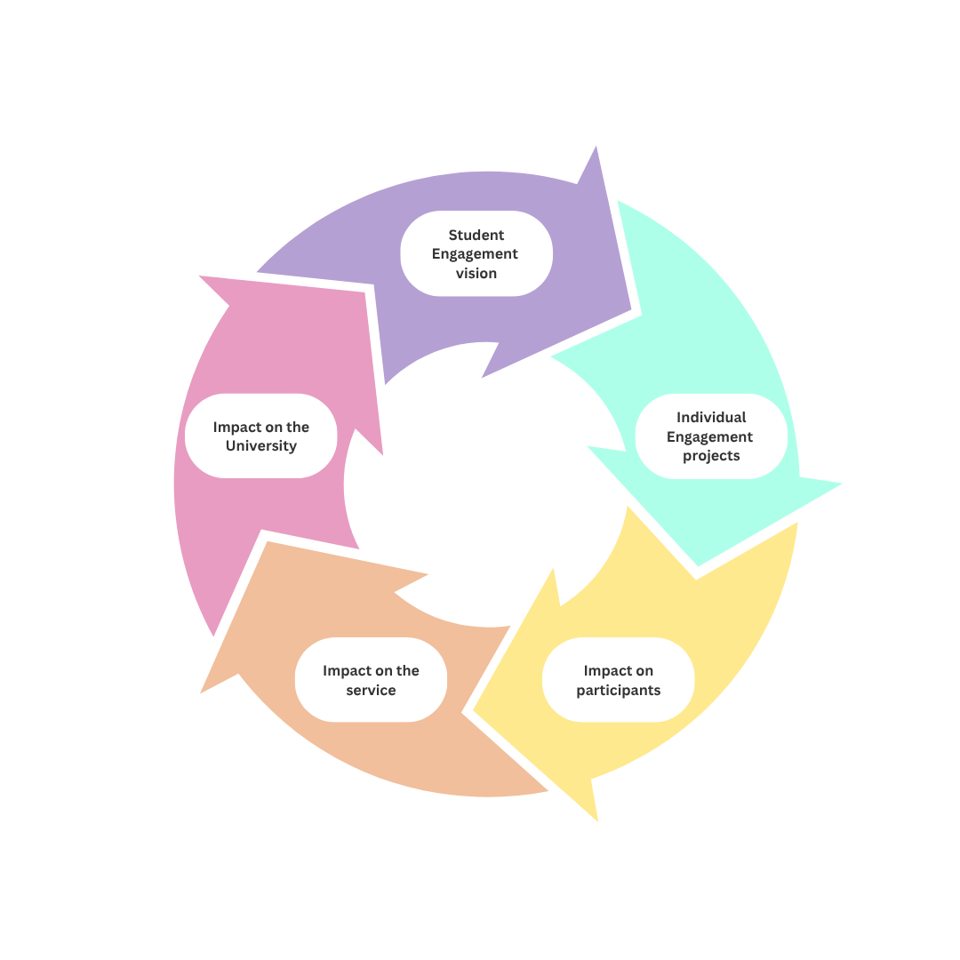
Our approach to impact
Notes:
Madalene

Slide 10
Anticipated and Reported impact
Supports students with sensory sensitivities and library anxiety by providing a clear preview of the space
Helps students plan and navigate the Hive with confidence
Informs staff practice and inclusive library provision
Students involved in the creation of the guide developed skills and understanding
Notes:
Madalene

Slide 11
What's next?
Review of the Sensory Guide
Updates as required to reflect changes within the building and in response to feedback
Interactive maps for The Hive (in progress) with consideration for Neurodiverse users.
Notes:
Madalene

Slide 12




Questions?
v.collins@worc.ac.uk
Notes:
All

Slide 13
References
Blake, J., Aston, S. and Grayson, N. (2020) ‘From the outside in: Bringing student engagement to the centre’, New Review of Academic Librarianship, 26(2-4), pp. 419–432. Available at: https://doi.org/10.1080/13614533.2020.1777172
Bovill, C., and Bulley, C. (2011) 'A model of active student participation in curriculum design: Exploring desirability and possibility, in C. Rust. (ed.), Improving student learning global theories and local practices: Institutional, disciplinary and cultural variations. Oxford: The Oxford Centre for Staff and Educational Development, pp. 176–188.
Bovill, C. et al. (2016) ‘Addressing potential challenges in co-creating learning and teaching: Overcoming resistance, navigating institutional norms and ensuring inclusivity in student–staff partnerships’, Higher Education, 71, pp.195-208. Available at: https://doi.org/10.1007/s10734-015-9896-4
Healey, M. and Healey, R. (2019) Students as partners guide: Student engagement through partnership. Available at: https://www.advance-he.ac.uk/knowledge-hub/students-partners-guidestudent-engagement-through-partnership
Notes:
All

