Slide 1
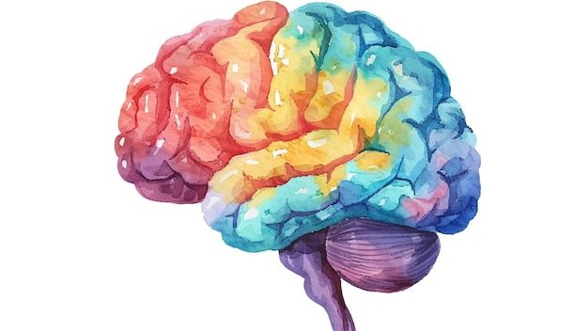
Supporting Autistic University Students
An overview of common stereotypes, myths & assumptions

Slide 2
Presentation Outline
Language/Diagnostic Criteria
Theories of Autistic Cognition
Double Empathy Problem
Mental health impact of camouflaging, burnout and suicidality
Autistic Student Experience including support + accommodations
Organisations to signpost to
References

Slide 3
Language
Autism Spectrum Disorder (ASD) vs Autism Spectrum Condition (ASC)
Person-first (person with autism) vs identity-first language (autistic person)
Stigmatising language used in research
Notes:
Identity-first, non-deficit based language preferred by autistic adults. ASD more likely to be used in medical spaces and ASC more likely to be used in community/educational settings as a non-stigmatising alternative.
Professionals more likely to use person-first e.g. person with autism language in order to separate the person from the condition. Autistic people more likely to use identity first language and view autism as part of their identity and similar to other identity categories e.g. person with Irishness.
Stigmatising language used in research – can be quite upsetting but important for context.

Slide 4
Diagnostic Criteria
criterion A: persistent deficits in reciprocal social communication and social interaction
criterion B: restricted, repetitive patterns of behaviour, interests or activities
criterion C: symptoms must be present in the early developmental period
criterion D: symptoms cause clinically significant impairment in social, occupational, or other important areas of functioning
criterion E: these disturbances are not better explained by intellectual disability or global developmental delay.
Notes:
There have been significant increases in seeking and receiving diagnoses of autism, with UK adult autism diagnosis rates increasing from 1 in 100,000 in 1998, to 20 in 100,000 by 2018 [9], and the most recent estimated adult prevalence being around 1.1%.
Rates of diagnosis have increased hugely due to the broadening of diagnostic criteria – including inclusion of Aspergers Syndrome.
Ratio between men and women is currently estimated to be between 3:1 and 5:1 - changing now due to increased understanding and access, still average wait times to be assessed are extremely long and inequalities persist. Women more likely to be late diagnosed - social expectations for women are different – masking, diagnostic overshadowing – more likely to be diagnosed with mental health conditions first.
Criteria are formed based on external observation – particularly significant given the division between externalising/internalising symptoms. Women more likely to mask/score lower on externalising symptoms e.g. stimming. Also more likely to have socially normative areas of interest e.g. related to celebrities. Internalising symptoms are less disruptive and so are often missed.

Slide 5
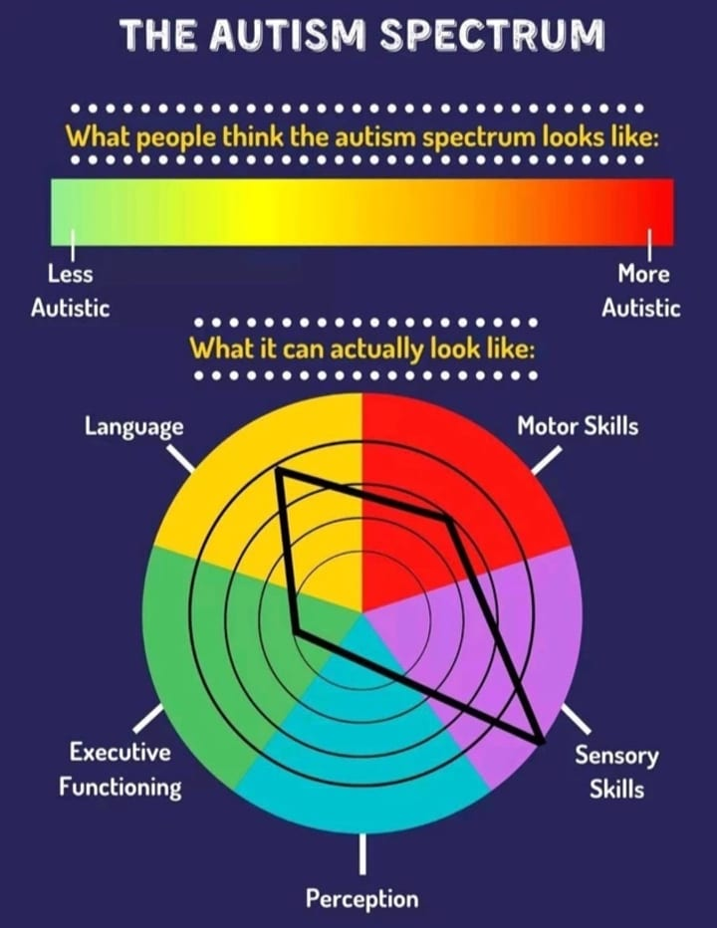
High vs Low Functioning Labels
Autism Spectrum Image by The Autism Spectrum - CAMHS Professionals
Notes:
The idea of a spectrum implies a linear system of functioning from ‘less’ to ‘more’ autistic. These labels can often be related to assumptions we have about capacity/what it means to be a functioning member of society e.g. the ability to communicate verbally is highly prioritised so many nonverbal individuals would be considered ‘low functioning’ in accordance with these standards. However, there is an active attempt to push back against functioning labels and recognise that people’s functioning can differ depending on day.
The spectrum is more accurately portrayed as a wheel which illustrates where an individual exists along a continuum with several different subsets e.g. language and sensory skills are areas of strength for this person but they may require more support around executive functioning. This is referred to as a ‘spiky profile’ of functioning. HFA/LFA is also sometimes referred to as low vs high support needs. There can be an assumption that if one has managed to make it to university, one must have low support needs which invisibilises the difficulties faced by autistic students who might be very strong academically but require support in other areas that are less visible and requires high degree of executive functioning e.g. self-care activities.

Slide 6
Theories of Autistic Cognition
Theory of Mind (Baron-Cohen et al., 1985))
Weak Central Coherence Theory (Frith & Happé, 1994)
Extreme Male Brain Theory (Baron-Cohen, 2002)
Enhanced Perceptual Functioning (Mottron, 2006)
Monotropism (Murray, Lawson & Lesser, 2005)
Social Motivation Theory (Chevallier et al., 2012)
Notes:
Majority of existing theories are quite deficit based – looking at comparisons between autistic and non-autistic people. Autistic people are often seen as failing in some way - even if they outperform neurotypicals, this is somehow seen as a negative e.g. weak central coherence theory suggests a bias towards local processing – enhanced ability to perceive details – this is perceived as a deficit in global thinking e.g. seeing the bigger picture. Idea that there may be an evolutionary adaptation to having individuals who are better at detail orientation – use of these skills in various contexts e.g. the US military has specific programs to recruit autistic individuals for this reason.
Probably one of the most (in)famous theories of autistic cognition is the idea that autistic people lack a theory of mind i.e. the ability to attribute mental states to other people, particularly in instances where they differ from your own. Only autistic people, “together with robots and chimpanzees” lack a theory of mind (Pinker, 2002, p. 62; see also Mitchell, 1997) and are therefore “biologically set apart from the rest of humanity in lacking the basic machinery” (Baron-Cohen, 2009, p. 73)
Extreme Male Brain Theory – empathising + systemising – idea that autism is a representation of an extreme male profile
Social motivation theory - “ASD can be construed as an extreme case of diminished social motivation and, as such, provides a powerful model to understand humans’ intrinsic drive to seek acceptance and avoid rejection.”
Progression towards less stigmatising theories over time
What all of these theories point to though is that the experience of the world may be qualitatively different as an autistic person - In autism study, it’s all about the eyes < Yale School of Medicine – focusing on different stimuli
What myths/stereotypes do we think might arise as a result of these theories?

Slide 7
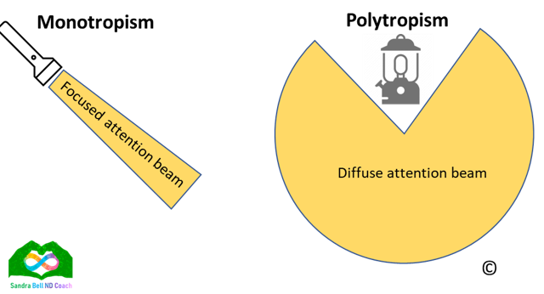
Monotropism
Monotropism image by Sandra Bell ND Coach
Notes:
Monotropism refers to an attentional style which prioritises intense focus on a limited number of stimuli. Polytropic individuals may be better at switching attention between various tasks and multi-tasking as their focus is less in-depth.
The idea that autistic individuals are monotropic is a non-deficit focused explanation of several aspects of the autistic experience e.g. experiences of hyperfocus/flow when focused on areas of interest.
Hyperfocus refers to periods of intense concentration on particular tasks – often lasting for multiple hours. Can be advantageous for university study for example but also present difficulties in other areas e.g. neglecting self-care tasks, eating, sleeping.
Autistic inertia –difficulty getting started/switching tasks - how switching tasks can be disruptive.
Autistic anxiety - rumination and perseveration over worries or uncertainties - Loops of Concern. A short self-help guide to tackling… | by Sonny Hallett | Medium
Shows how theories do not need to be deficit based to have explanatory power.

Slide 8
Common Stereotypes/Myths
THE idea that autistic people are socially disinterested – e.g. Social Motivation Theory
The idea that autistic people don’t possess empathy – e.g. Theory of Mind
The idea that autistic people are male E.G. EXTREME MALE BRAIN THEORY
‘We are all on the spectrum somewhere’
Notes:
The idea that autistic people are socially disinterested – dehumanising - ignores the fact that some of the actions autistic people perform in social situations are actually quite adaptive - e.g. not making eye contact is helpful in terms of paying attention, stimming helps people regulate
The idea that autistic people don’t possess empathy – considered a core quality of what it means to be human. In fact, some autistic individuals report experiencing hyper-empathy – may not be perceived as such due to differences in emotional and social presentation (Kimber, Verrier, Connolly, 2024)
Idea that we are all on the spectrum somewhere – often meant as a well meaning phrase but ignores that reality that autism is a disability which has distinct cognitive underpinnings and incurs disadvantages in the current social environment

Slide 9
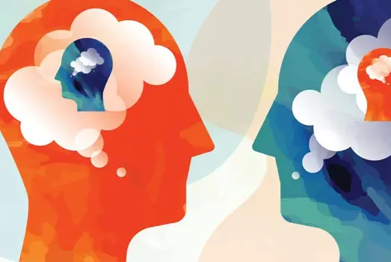
How might these myths impact the social experiences of autistic people?
Research suggests that non-autistic people:
Struggle to interpret the mental states, gestures and facial expressions of autistic people (Heasman & Gillespie, 2018; Casartelli et al., 2020)
Form negative first impressions, hold negative stereotypes and make unfavourable judgements about autistic people (Dickter et al., 2020; Sasson et al., 2017)
Are likely to overestimate how much they accommodate autistic people during interactions (Heasman & Gillespie, 2019b).
Notes:
Research suggests that non-autistic people:
Struggle to interpret the mental states of autistic people, including gestures and facial expressions (Heasman & Gillespie, 2018; Casartelli et al., 2020)
Form negative first impressions, hold negative stereotypes and make unfavourable judgements about autistic people e.g. reading them as awkward, less likeable and less trustworthy (Dickter et al., 2020; Sasson et al., 2017)
Are likely to overestimate how much they accommodate autistic people during interactions (Heasman & Gillespie, 2019b).
Autistic adults report frequent experiences of misunderstandings by others and little acceptance by the non-autistic community, which has negative effects on their mental health (Camus et al., 2022).

Slide 10
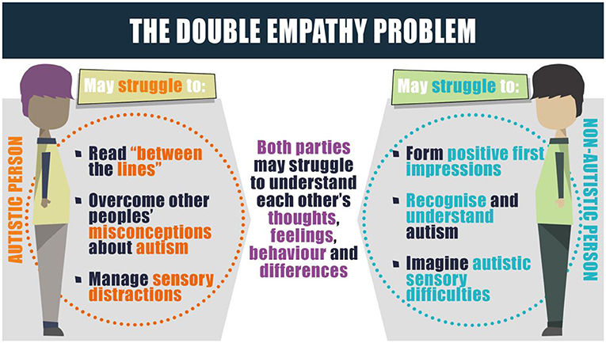
Double Empathy Problem (DEP)
Milton (2012) identified a bidirectional breakdown in communication between autistic and nonautistic speakers – suggests that there is an empathy gap or a ‘mismatch of salience’
The Double Empathy Problem from Crompton et al. (2021)
Notes:
Milton (2012) – the idea that there is a bidirectional breakdown in communication between autistic and nonautistic speakers – rather than locating the deficit within the autistic person, he outlines an empathy gap between people or a ‘mismatch of salience’
Empirical evidence for DEP:
Autistic people develop rapport and communicate as effectively with other autistic people as non-autistic people do with each other (Crompton, Hallett et al., 2020; Crompton, Ropar et al., 2020).
Have different friend trait-preferences to non-autistic people (DeBrabander et al., 2019; Dunn et al., 2023) – for example even though both autistic and non-autistic observers rate autistic participants as awkward, this is only a deterrence for interaction for non-autistic people but may actually be prized by autistic people.

Slide 11
Interrogating the assumption that Autistic people are socially disinterested
Engage in reputation management for the purposes social integration e.g. masking
Continue to do so despite the costs associated with this strategy e.g. suicidality/autistic burnout
Continue to engage in inaccessible sensory environments despite the potential impact of this e.g. meltdowns/shutdowns
Alternative visions of autistic sociality

Slide 12
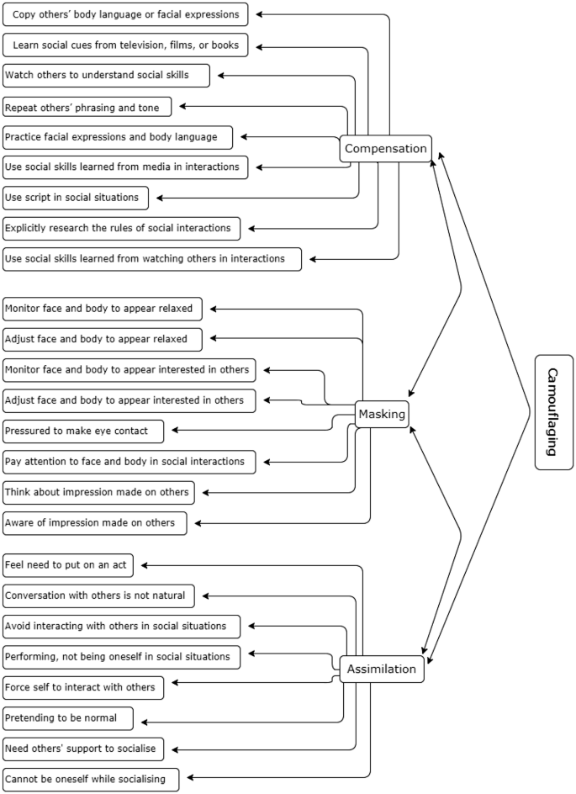
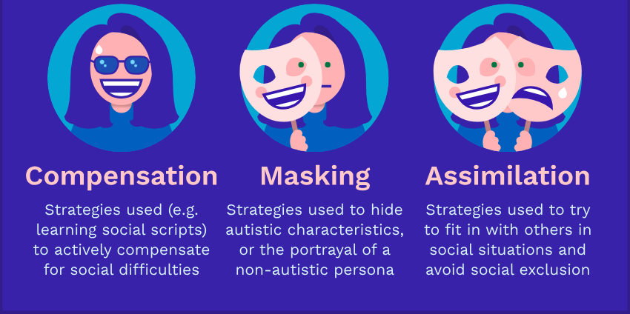
Camouflaging
What constitutes camouflaging and how does it differ from everyday social adaptation?
Dimensions of Camouflaging from Hull et al. (2019)
Camouflaging Diagram by Embrace Autism/
Notes:
Based on research from 2019 by Laura Hull et al., the following 3 subcategories of camouflaging were defined:^{[7]}
Compensation — Strategies used to actively compensate for difficulties in social situations.
Examples: copying body language and facial expressions, learning social cues from movies and books
Masking — Strategies used to hide autistic characteristics or portray a non-autistic persona.
Examples: adjusting face and body to appear confident and/or relaxed, forcing eye contact.
Assimilation — Strategies used to try to fit in with others in social situations.
Examples: Putting on an act, avoiding or forcing interactions with others.
Masking/camouflaging has been shown to be associated with poor mental health outcomes for autistic people
Survey by NAS found that 94% of autistic adults experience anxiety + 50% have a clinical diagnosis.
70% of neurodivergent people report co-occurring mental health diagnoses in contrast to the prevalence rates amongst HE students overall being around 30%.
Camouflaging has been found to be a risk marker for suicidality. Participants in qualitative studies have reported anxiety as a result of not being their ‘true selves’ in social situations. It is also reported that camouflaging is mentally and physically taxing and has a negative impact on constructs like identity and experiences of acceptance by others.

Slide 13
Suicidality
Studies have shown that up to 66% of autistic adults have thought about taking their own life.
35% have attempted suicide.
Around 1% of people in the UK are autistic, yet up to 15% of people hospitalised after attempting suicide have a diagnosis of autism.
Notes:
Suicidality – Sarah Cassidy - Studies have shown that up to 66% of autistic adults have thought about taking their own life, and an alarming 35% have attempted suicide. Around 1% of people in the UK are autistic, yet up to 15% of people hospitalised after attempting suicide have a diagnosis of autism.
Reasons for this:
Masking
Pressures related to functioning in a neurotypical society
Autism-specific factors such as perfectionist/black and white thinking
External risk factors – isolation, unemployment, lack of appropriate mental health support
General models of suicidal thoughts and behaviours e.g. feeling like you are a burden on those around you.
One phenomenon which has been connected to suicidality in autistic people is autism burnout.

Slide 14
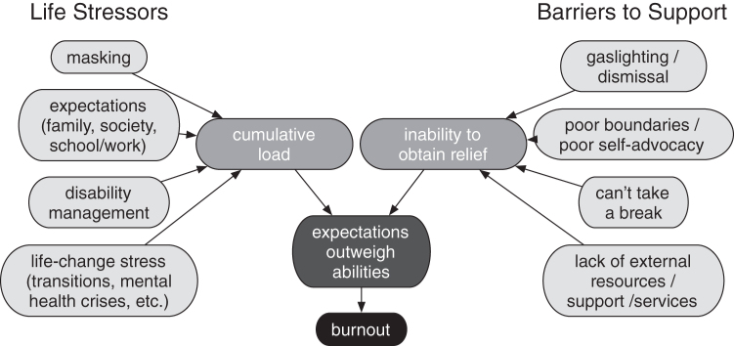
Autism burnout
Autistic burnout is a syndrome conceptualized as resulting from chronic life stress
and a mismatch of expectations and abilities without adequate supports. It is characterized by
pervasive, long-term (typically 3+ months) exhaustion, loss of function, and reduced tolerance to stimulus (Raymaker et al., 2020)
Autistic Burnout Conceptual Model by Raymaker et al. (2020).
Notes:
Not a clinical diagnosis but a community developed concept which is now beginning to be supported in research.
Autistic burnout is a syndrome conceptualized as resulting from chronic life stress and a mismatch of expectations and abilities without adequate supports. It is characterized by pervasive, long-term (typically 3+ months) exhaustion, loss of function, and reduced tolerance to stimulus.
Participants experienced something called autistic regression where skills they might once have had are now absent. This can include the ability to communicate verbally, live independently etc. Participants reported being less able to tune out environmental stimuli and being overstimulated more frequently and experiencing increased meltdowns and shutdowns.
Masking highlighted as the most prominent life stressor.
Inabilty to get relief – issues dismissed – told that everyone experiences stress and they need to ‘get on with it’
Struggling with boundaries, saying no, self-advocacy skills
Lack of access to effective support
Many people reported first seeking a diagnosis at this time due to the loss of compensation abilities.

Slide 15
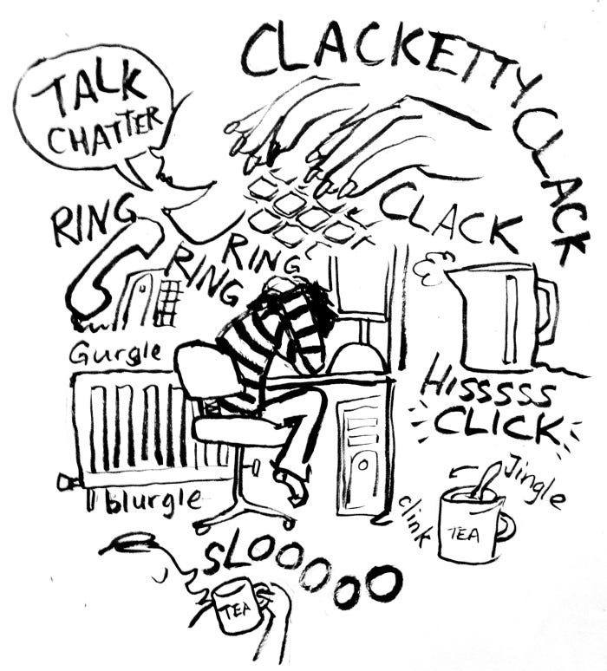
Habituation
Decreased response to stimuli after repeated presentations.
Many autistic people experience this less and so their perceptive/sensory experience is often both more accurate and intense.
If further reduced, can impact capacity to engage in employment/ navigate the social environment due to sensory overwhelm.
Illustration by Sonny Hallettm
Notes:
Your brain is actively creating your experience of the world – it is suggested that many neurotypical people are better able to tune out aspects of their environment that their brain deems irrelevant e.g. lights, humming of a fridge. Autistic people experience this less and so their perception is often more accurate/intense – more so-called noise/irrelevant information to consider. If this is reduced, this can have implications for the ability of an autistic person to engage in employment, navigate the social environment etc.

Slide 16
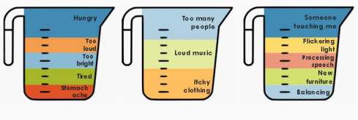
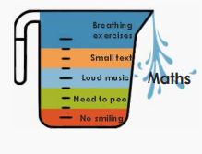
Capacity Jug model
Capacity Jug Model by Dr. Holly E.A. Sutherland
Notes:
Capacity Jug model developed by Dr Holly Sutherland – illustration of the invisible demands that may be placed on an autistic person.
Autistic individuals may experience difficulties with both interoception – perception of bodily signals e.g. hunger, thirst and alexithymia, a difficulty identifying one’s emotions – which can make recognizing one’s needs in a given moment complicated.
Discussion in the literature about whether this is inherent to autism or whether it is an artefact of navigating a neurotypical society in which autistic modes of expression are not prioritized.
Meltdown/shutdowns – both a response to this sense of overwhelm. Meltdowns usually involve more externalising symptoms including physical symptoms which can present a danger to the person e.g. hitting one’s head.
Shutdowns involve more internalising symptoms – individual may be nonverbal/dissociate/feel numb.
Best supportive approach in the case of meltdowns/shutdowns is to reduce demands on this person – accept that they may not be able to communicate verbally, do not interact with them physically unless this has been agreed in advance. Some individuals may be able to recognise before they reach the point of meltdown/shutdown and engage in coping strategies to deescalate the situation e.g. stimming. Some autistic people have assistance dogs who are adept at recognising when they are about to become overwhelmed – may act like a weighted blanket by lying on the person and providing pressure.
Autistic individuals often report a high degree of shame after experiencing meltdowns – particularly if they have been witnessed by another person. Reassuring the person that you are not judging them and that everyone gets overwhelmed by emotions from time to time.
Interesting to consider in terms of pathological demand avoidance – not a clinical diagnosis but a profile – has also been renamed within the autistic community as ‘persistent drive for autonomy’.

Slide 17
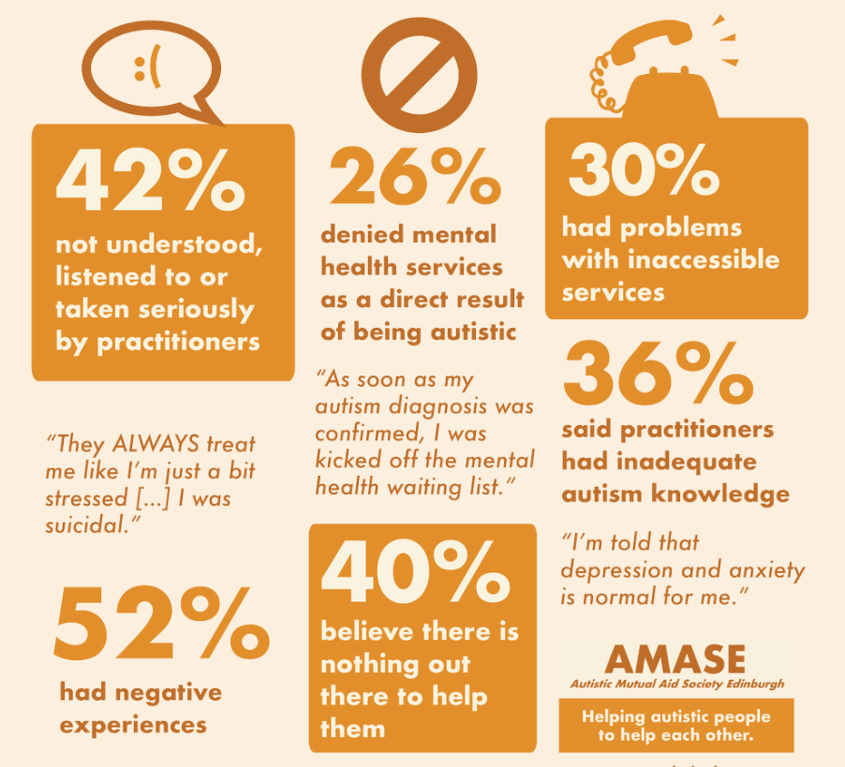
Accessing Support as an Autistic Person
High rate of co-occurrence with mental health conditions e.g anxiety, depression, eating disorders; physical health conditions e.g. Ehlers-Danlos syndrome, digestive issues; and other forms of neurodiversity e.g. ADHD
Low proficiency among practitioners in terms of how to support autistic individuals
Differences in pain perception and mutual communication difficulties can make accessing care difficult
Image from ‘Too complicated to treat’? – AMASE
Notes:
Now we have seen that autistic individuals face significant challenges in terms of the mental health – what is their experience of navigating mental health services?
High rate of comorbidity with mental health conditions e.g anxiety + depression, physical health issues e.g. Ehlers-Danlos syndrome, digestive issues, eating disorders + associated physical health impacts, other forms of neurodiversity e.g. ADHD
Included statistics here from the AMASE report – indicates that 26% of a sample of 50 Scottish autistic people denied mental health services as a result of being autistic and 52% had negative experiences
Low proficiency in terms of practitioner confidence in treating an autistic person – only 36% said practitioners had adequate autism knowledge and 42% said they were not listened to or taken seriously
Double empathy problem in healthcare – differences in pain perception – may underreport symptoms or find it difficult to describe what they are experiencing due to interoception/alexithymia difficulties

Slide 18
Autistic Student Experience – Common Themes
Lack of adjustments/support
Overwhelming sensory environment
Social exclusion – “hidden curriculum”
Similar to suicidality, it may connect to black + white/linear thinking/perfectionism
Navigating neuronormative course requirements
Number of autistic university students is increasing – but they are at a higher risk of dropping out – why is this the case?
Notes:
How do these experiences translate to the university environment?
Thirty-six percent of autistic undergraduate students who enrolled in 2019 did not complete their degree after three years. The rate compares to 29% for the general student population and is higher than that for any other disability group.
A Disabled Students UK survey found that only 21% of autistic students received the support they required.
The sensory environment presents a significant challenge – may limit attendance at lectures, ability to engage in extra-curricular activities e.g. social activities and clubs which may take place in noisy environments. Autistic people often report self-medicating in order to cope with the sensory overwhelm of these environments. This can increase their risk of addiction – research in this area is beginning to show that autistic individuals are potentially at an increased risk of developing a substance misuse disorder. Another area where harmful assumptions have had a negative impact – research in this area has lagged because of assumption that autistic people would not want to be in these environments.
As we have seen, due to the double empathy problem and other factors, autistic students may find it difficult to integrate socially. This means that they are often missing out on the hidden curriculum e.g. ways to navigate university life that you learn from other students. They are also at higher risk of interpersonal victimisation e.g. financial exploitation, sexual violence and other forms of abuse.
Similar to suicidality – it may connect to black + white thinking/perfectionism
Navigating neuronormative course requirements e.g. eye contact during presentations, assumptions about capacity
Can also translate into employment outcomes:
HESA + Graduate Outcomes Survey data (between 2012 and 2018) only 34% of autistic graduates are in full-time employment compared to a rate of 57% for graduates disclosing other disabilities, and 68% disclosing no disability. Autistic graduates were also more likely to earn below £20,000 than both disabled and non-disabled graduates and are more likely to be underemployed e.g. employed in roles that do not require university qualifications.

Slide 19
Support/Accommodations – Social Environment
Models of support for autistic individuals have often been focused on social skills training or Applied Behaviour Analysis (ABA) – based on modelling neurotypical communication
Can lead to masking, which is associated with poor mental health outcomes
Autistic people commonly report being invalidated, particularly at certain identity intersections e.g. being autistic and LGBTQIA+, community support with similar others as a means of ameliorating this
Increasing autism understanding among non-autistic people as a means of reducing prejudice
Creating accessible spaces on campus to socialize with similar others
Notes:
Models of support for neurodivergent individuals have often been focused on social skills training/ABA – the idea that there is a superior/neuro-normative way of communicating that autistic individuals need to learn to survive in the world
Can lead to masking/increase shame – association between masking + poor mental health outcomes
Autistic people commonly report being invalidated, particularly at certain identity intersections e.g. being autistic and LGBTQIA+, community support with similar others as a means of ameliorating this
Increasing autism understanding among non-autistic people as a means of reducing prejudice
Creating accessible spaces on campus to socialize with similar others

Slide 20
Support/Accommodations – Sensory Environment
Epistemic humility
Sensory profile
Control/agency e.g. dimmable light switches, earplugs, ability to leave the room during lectures
Increasing understanding of stimming as a coping strategy
Notes:
Epistemic humility – ensuring assumptions are left to one side – common refrain is that if you have met one autistic person, you have met one autistic person so not assuming what someone might need
Autistic individuals may not be aware of their sensory needs due to invalidation as previously mentioned – may be useful to complete a sensory profile/sensory scan so that they are aware of potential areas of difficulty in the university environment
Control/agency has been suggested to be an important feature for sensory sensitivities (Simmons, Kapp) so accommodations should prioritise this aspect e.g. dimmable light switches, earplugs, ability to leave the room during lectures
Increasing understanding/awareness of stimming as a coping strategy – trying not to discourage stimming overall but finding alternatives if engaged in a harmful stim e.g. rubber band flicking, hitting head against a pillow rather than a wall

Slide 21
Support/Accommodations – Academic context
Flexibility in assessment criteria – recognizing essential criteria vs socially normative expectations
1
Being aware of making assumptions about capacity/potential – consideration of spiky profile
2
Giving clear detailed instructions and explaining rationale for activities can increase motivation
3
Recognising autistic strengths e.g. hyperfocus/flow, monotropism, justice orientation, attention to detail
4
Learning should be scaffolded – breaking it down into manageable chunks but also allowing for more in-depth exploration
5
Implementing regular feedback opportunities, offering assignment templates so that criteria are less abstract
6
Notes:
(1) Flexibility in assessment criteria –recognizing what is essential to performing a certain role and what constitutes a socially normative assumption
(2) Assumptions about capacity/potential – spiky profile can increase the risk of invalidation/influence assumptions about ability to succeed on a particular course – nonverbal communication - not speaking does not equal not understanding – delays in developing spoken speech but then may speak in full sentences
(3) Giving clear detailed instructions and explaining rationale for particular activities can increase motivation
(4) Recognising autistic strengths e.g. hyperfocus/flow, monotropism, justice orientation, attention to detail – important for increasing self-confidence
(5) Learning should be scaffolded – breaking it down into manageable chunks but also allowing for more in-depth exploration. Ability to present information in a different way –potentially less linear, potentially more linked to areas of interest
(6) Implementing regular feedback opportunities, offering assignment templates so that criteria are less abstract

Slide 22
Alternative visions of autistic sociality
Parallel play/body doubling
Information sharing/info-dumping
Autistic pebbling
Autistic Pride Flag by https://www.autisticempire.com/autistic-pride.
Notes:
Coming back to the assumption that autistic people are socially disinterested – I wanted to leave you with a few community developed terms to consider.
A distinct autistic communication style is beginning to be outlined - autistic individuals appear to prioritise honesty in social interactions rather than conforming to social expectations/niceties.
May prefer to engage in parallel play – doing separate activities side by side – has significant implications for productivity.
Appear to have a preference for a monologue-ing based conversational style – in-depth discussion of a particular interest vs ‘small talk’. Also called info-dumping, often focused on an area of special interest.
Autistic pebbling refers to a practice of bringing small tokens that often have no monetary value but high sentimental value as a pro-social behaviour. Based on a practice where penguins give each other pebbles ☺

Slide 23
Useful Organisations to Signpost to
Ambitious about Autism
Autistica
Embrace Autism
National Autistic Society
NeuroClastic
AMASE – Autistic Mutual Aid Society Edinburgh
Academic Autism Spectrum Partnership in Research and Education
Autscape: Home
Autism in Adulthood | Mary Ann Liebert, Inc., publishers
Who we are – The Participatory Autism Research Collective

Slide 24
References
Baron-Cohen, S. (2002). The Extreme Male Brain Theory of Autism. Trends in Cognitive Sciences, 6(6), 248-254. https://doi.org/10.1016/S1364-6613(02)01904-6
Baron-Cohen, S., Leslie, A. & Frith, U. (1985). Does the autistic child have a “theory of mind”?. Cognition, 21(1), 37-46. https://doi.org/10.1016/0010-0277(85)90022-8
Cage, E., & Howes, J. (2020). Dropping out and moving on: A qualitative study of autistic people's experiences of university. Autism, 24(7), 1664-1675. doi: 10.1177/1362361320918750.
Cage E, & Troxell-Whitman Z. (2019). Understanding the Reasons, Contexts and Costs of Camouflaging for Autistic Adults. Journal of Autism and Developmental Disorders, 49(5),1899-1911. doi: 10.1007/s10803-018-03878-x.
Chapman R, & Botha M. (2023). Neurodivergence-informed therapy. Developmental Medicine & Child Neurology, 65(3), 310–317. https://doi.org/10.1111/dmcn.15384
Chevallier, C., Kohls, G., Troiani, V., Brodkin, E.S., & Schultz, R.T. (2012). The social motivation theory of autism. Trends in Cognitive Sciences, 16(4), 231-239. doi: 10.1016/j.tics.2012.02.007.
Crompton, C. J., Ropar, D., Evans-Williams, C. V., Flynn, E. G., and Fletcher-Watson, S. (2020). Autistic peer-to-peer information transfer is highly effective. Autism 24:1704–12. doi: 10.1177/1362361320919286
Crompton, C. J., DeBrabander, K., Heasman, B., Milton, D., Sasson, N. J. (2021). Double Empathy: Why Autistic People Are Often Misunderstood. Frontiers for Young Minds. 9, 554875. doi:10.3389/frym.2021.554875
Frith, U. & Happé, F (.1994). Autism: beyond “theory of mind”. Cognition, 115-132. https://doi.org/10.1016/0010-0277(94)90024-8
Gernsbacher, M.A., Yergeau, M. (2019). Empirical Failures of the Claim That Autistic People Lack a Theory of Mind. Archives of Scientific Psychology, 7(1),102-118. doi: 10.1037/arc0000067.
Hallett, S. & Crompton, C.J. (2018). ‘Too complicated to treat’? Autistic people seeking mental health support in Scotland. Autistic Mutual Aid Society Edinburgh (AMASE), www.amase.org.uk/mhreport
Heasman, B. et al. (2024). Towards autistic flow theory: A non‐pathologising conceptual approach, Journal for the Theory of Social Behaviour, 54(4), 469–497. doi:10.1111/jtsb.12427.
Heasman, B., & Gillespie, A. (2019). Neurodivergent intersubjectivity: distinctive features of how autistic people create shared understanding. Autism, 23, 910–21. doi: 10.1177/1362361318785172
Horlin, C., Almond, K., Bowen, A. et al. (2024). Thriving… or Just Surviving? Autistic Journeys in Higher Education. Curr Psychiatry Rep, 26, 771–776. https://doi.org/10.1007/s11920-024-01560-x
Hull, L. et al. (2019). Development and Validation of the Camouflaging Autistic Traits Questionnaire (CAT-Q). Journal of Autism and Developmental Disorders, 49, 819–833. https://doi.org/10.1007/s10803-018-3792-6
Jaswal, V. K., & Akhtar, N. (2018). Being versus appearing socially uninterested: Challenging assumptions about social motivation in autism. Behavioural and Brain Sciences. doi: 10.1017/S0140525X18001826.

Slide 25
References
Kapp, S. K., Steward, R., Crane, L., Elliott, D., Elphick, C., Pellicano, E., & Russell, G. (2019). ‘People should be allowed to do what they like’: Autistic adults’ views and experiences of stimming. Autism, 23(7), 1782-1792. https://doi.org/10.1177/1362361319829628
Kenny, L., Hattersley, C., Molins, B., Buckley, C., Povey, C., & Pellicano, E. (2016). Which terms should be used to describe autism? Perspectives from the UK autism community, Which terms should be used to describe autism? Perspectives from the UK autism community. Autism, 20(4), 442–462. https://doi.org/10.1177/1362361315588200.
Kimber, L., Verrier, D., Connolly, S. (2024). Autistic People's Experience of Empathy and the Autistic Empathy Deficit Narrative. Autism in Adulthood, 16(3), 321-330. doi: 10.1089/aut.2023.0001.
Mottron, L. et al. (2006). Enhanced perceptual functioning in autism: An update, and eight principles of autistic perception, Journal of Autism and Developmental Disorders, 36(1), 27–43. doi:10.1007/s10803-005-0040-7.
Murray, D., Lesser, M., & Lawson, W. (2005). Attention, monotropism and the diagnostic criteria for autism. Autism, 9(2), 139-156. https://doi.org/10.1177/1362361305051398.
Pearson, A., Rose, K. & Rees, J. (2023). 'I felt like I deserved it because I was autistic': Understanding the impact of interpersonal victimisation in the lives of autistic people. Autism, 27(2), 500-511. doi: 10.1177/13623613221104546.
Raymaker, D. M., Teo, A. R., Steckler, N. A, Lentz, B., Scharer, M., Delos Santos, A., Kapp, S. K., Hunter, M., Joyce, A., Nicolaidis, C. (2020). “Having All of Your Internal Resources Exhausted Beyond Measure and Being Left with No Clean-Up Crew": Defining Autistic Burnout. Autism in Adulthood, 2(2), 132-143. doi: 10.1089/aut.2019.0079.
Robertson, A. E. & Simmons, D. R. (2015). The sensory experiences of adults with autism spectrum disorder: A qualitative analysis. Perception, 44(5), 569-86. doi: 10.1068/p7833.
Sutherland, H., Crompton, C. J., Long, J., & Fletcher-Watson, S. (2025). ‘Read My Lips, Not My Body’: A Thematic Analysis of Autistic People’s Social Communication Preferences, Experiences, and Expectations. Neurodiversity, 3. https://doi.org/10.1177/27546330251333919.
Taboas, A., Doepke, K., & Zimmerman, C. (2023). Preferences for identity-first versus person-first language in a US sample of autism stakeholders. Autism, 27(2), 565-570. doi: 10.1177/13623613221130845.

