Slide 1

Access and Amplification
17th March 2026
Ryan Reid

Slide 2
DISCLAIMER
It says on the email that this project is a living history project. Turns out I didn’t know what living history meant
What I was trying to say was that this project was based on the lived experience of disabled, neurodiverse and LGBTQIA+ people, and I thought that’s what the term meant.
However, one of my interviewees told me last Thursday that isn’t what the term “Living History’ means. She does historical re-enactment, which is what living history actually refers to.
Sorry for any confusion.

Slide 3
What is Access and Amplification?
Access and Amplification is a project undertaken by Wessex Film and Sound Archive, with funding provided by the British Film Institute, to improve the representation of disabled people, neurodivergent people and the LGBTQIA+ community within our collections
The project also aims to increase the amount of film material of and about Basingstoke, as that is the least documented of the Hampshire towns in the archive
We are working with Celebrating Disability, a disability consultancy organization, to help people of various disabilities have their say in this project
We are also reaching out to local history organisations, such as Hampshire Cultural Trust and Basingstoke Archeological and Historical Society, to find new material relating to the town’s history

Slide 4
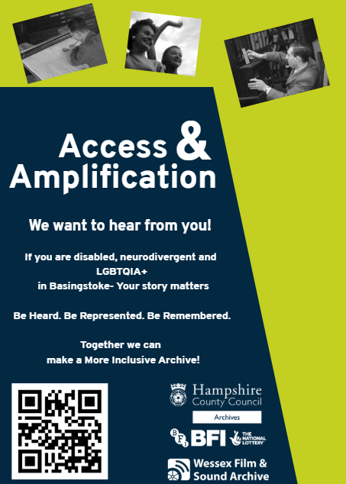

How this project was created and is funded
This project was put forward in order to improve the lives of disabled, neurodiverse and LGBTQIA+ people in an active way and not just through empty rhetoric
The project is funded entirely through BFI grants rather than through HCC, so no public money/Hampshire County Council money is being spent.
The overall aim of the project is to document disabled, neurodiverse and LGBTQIA+ history on record as well as get more audio and visual material of Basingstoke.

Slide 5
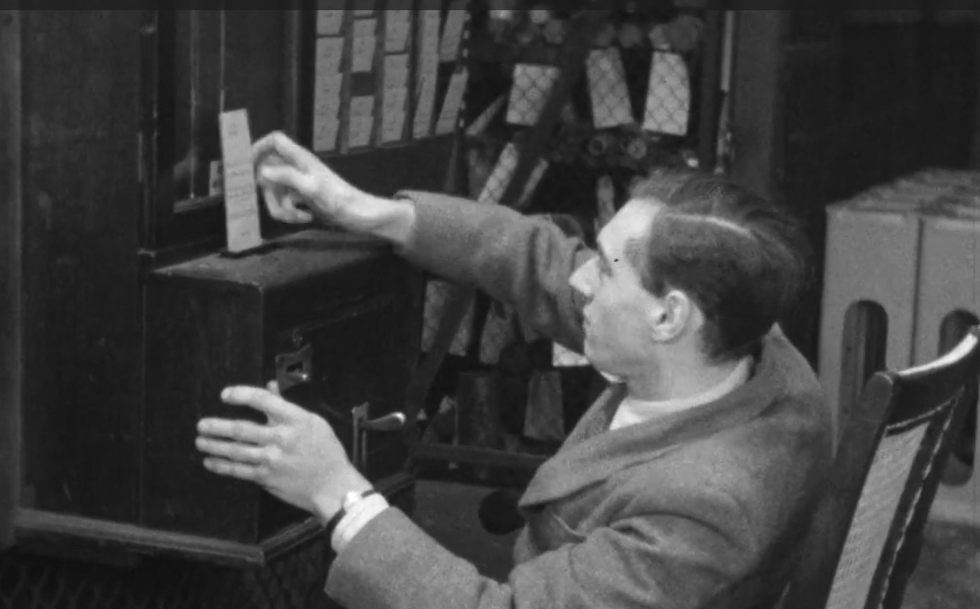
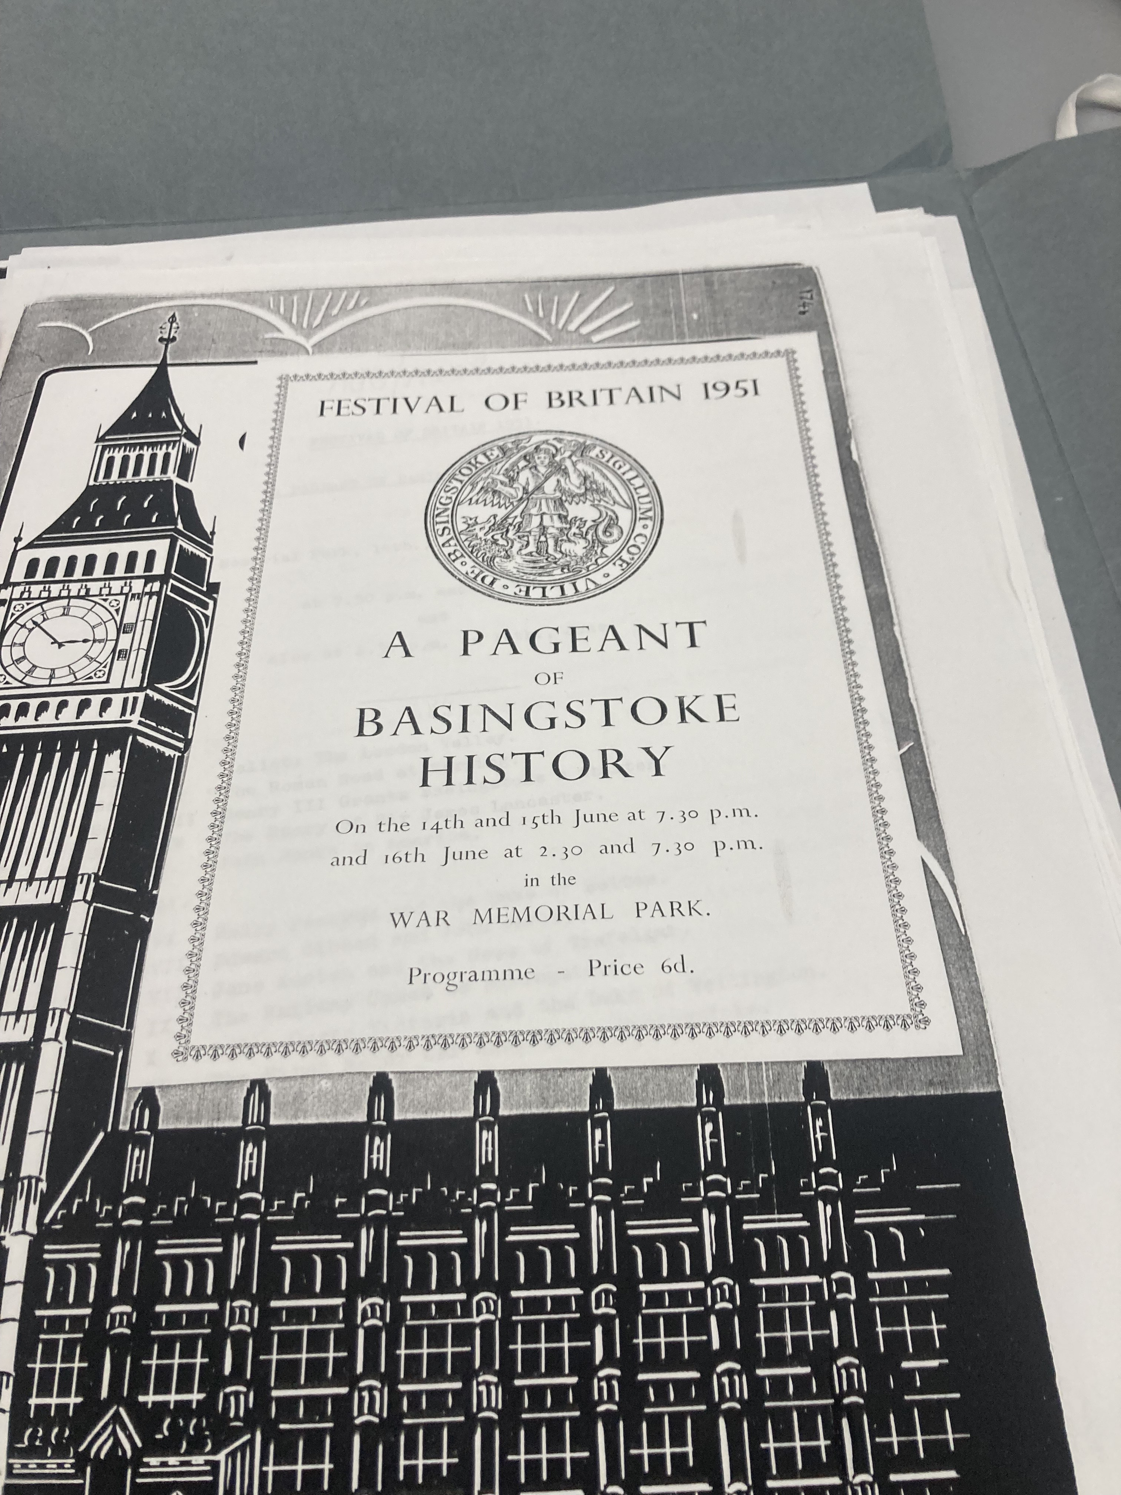
Why this project scope?
Lack of accessibility within WFSA, both in the literal sense and stories that disabled, neurodiverse and LGBTQIA+ people can relate to
Lack of Basingstoke-centric items when compared to items about other locations in Hampshire

Slide 6
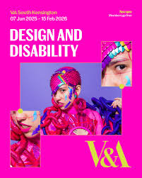
Why Disability?
Lack of accessibility within our archives
The footage we do have of disability is potentially full of outdated descriptions that we would now consider offensive
A lot of the footage is from outside observers and not from the disabled people themselves
Success of disability-centric exhibitions (see right)

Slide 7
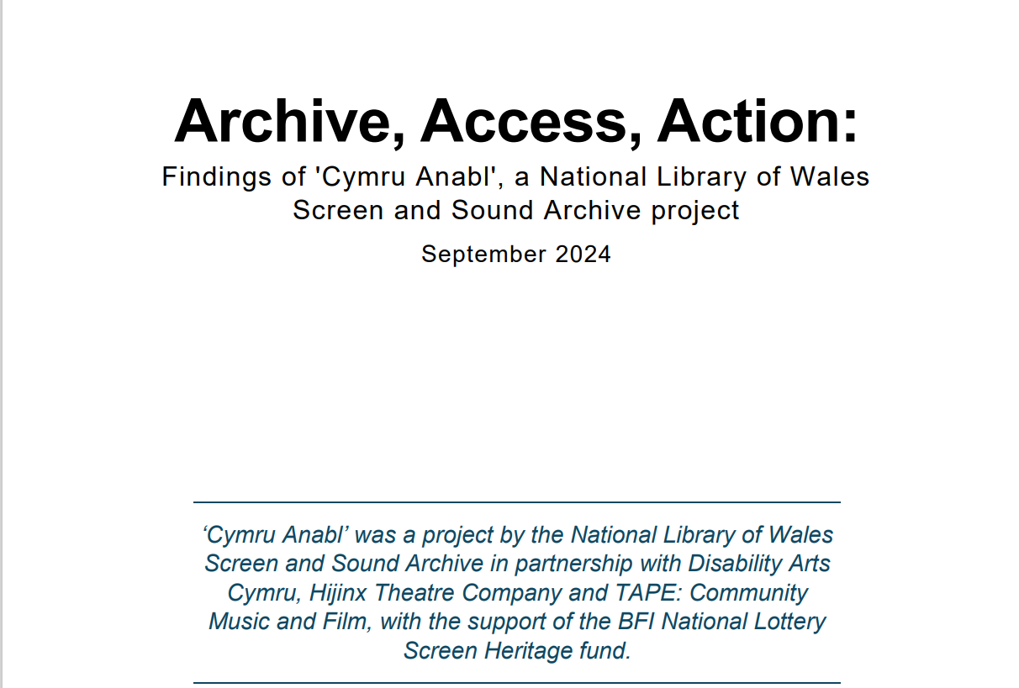
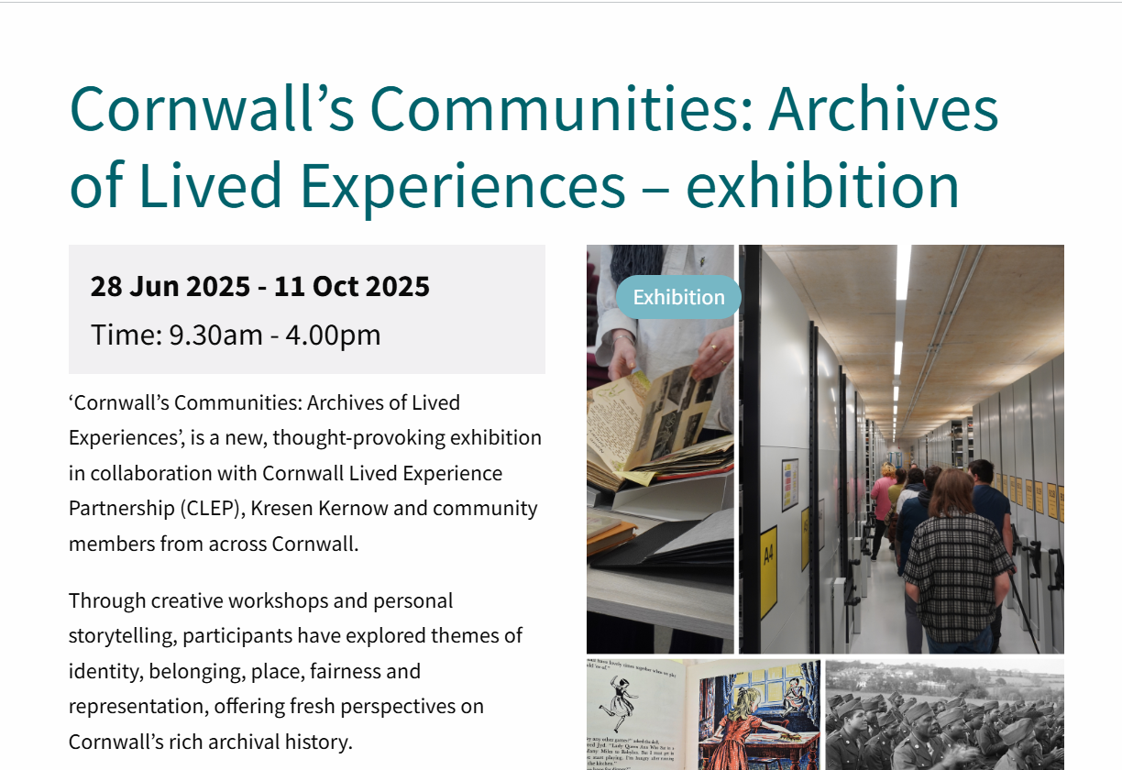
Success of other ‘Archives and Disability’ projects
The National Library of Wales (top) and Kresen Kernow (bottom) both undertook projects to make their archives more accessible
They helped people with disabilities feel more involved in their local archives and showed them that disability history can be, and deserves to be, celebrated.
Additionally, it proves that a project based around disability is feasible
We aim to do something similar, but focused on a single town

Slide 8
Disability and society
In some ways, society can end up implicitly reinforcing ableism because it is mostly designed with able-bodied people in mind
Rather that active discrimination, disabled people are simply not given much thought. This is the theme that I want this project to be focused around, alongside discussing similar treatment given to neurodiverse and LGBTQIA+ people

Slide 9
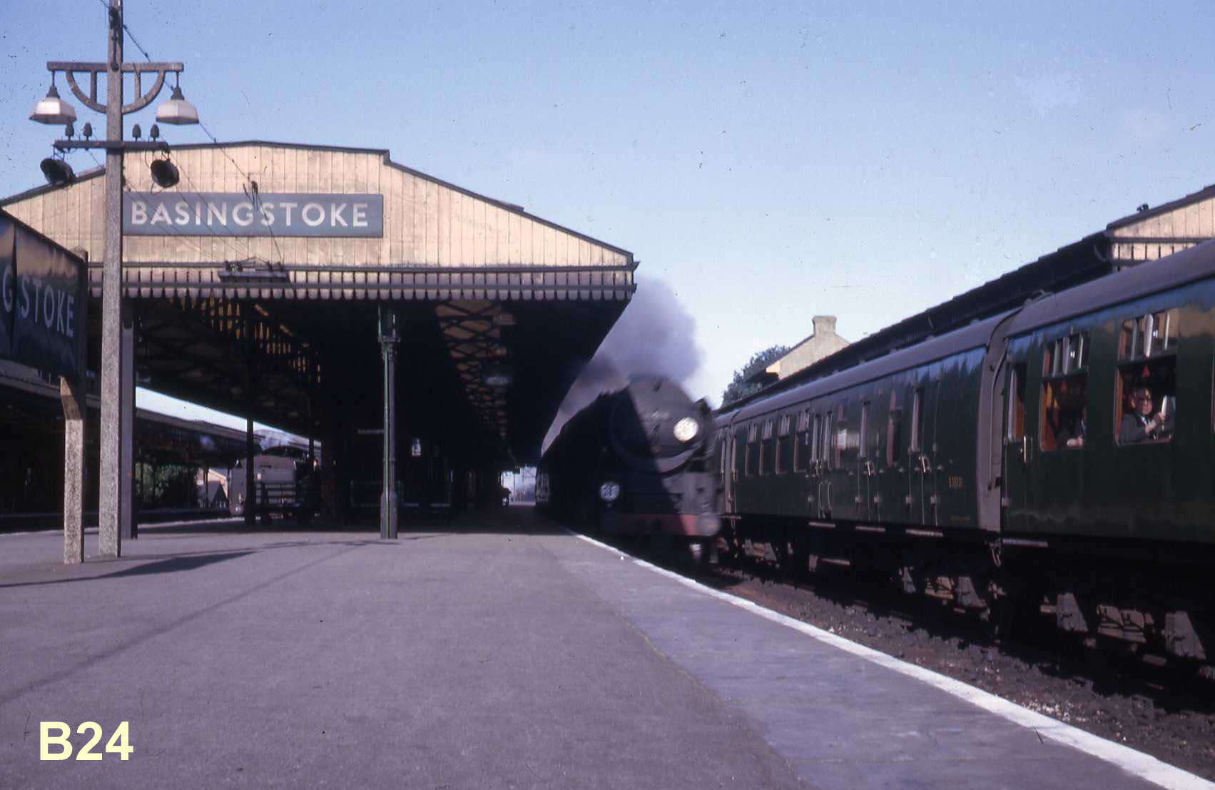
Why Basingstoke?
Lack of Basingstoke material in our collection
Unique identity as a “New Town” of the 1960s
Success of other WSFA projects focused on a specific town, also part of the London Overspill

Slide 10
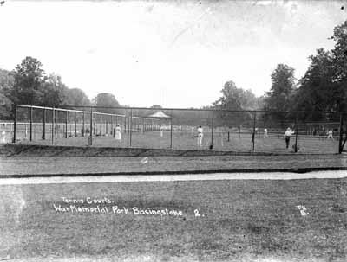
Why everyday people?
If we want better representation of Basingstoke residents, disabled, neurodivergent and LGBTQIA+ people, we should probably ask them directly
I think that ‘history from below’ is more effective than “history from above” (Ordinary people vs great figures)

Slide 11
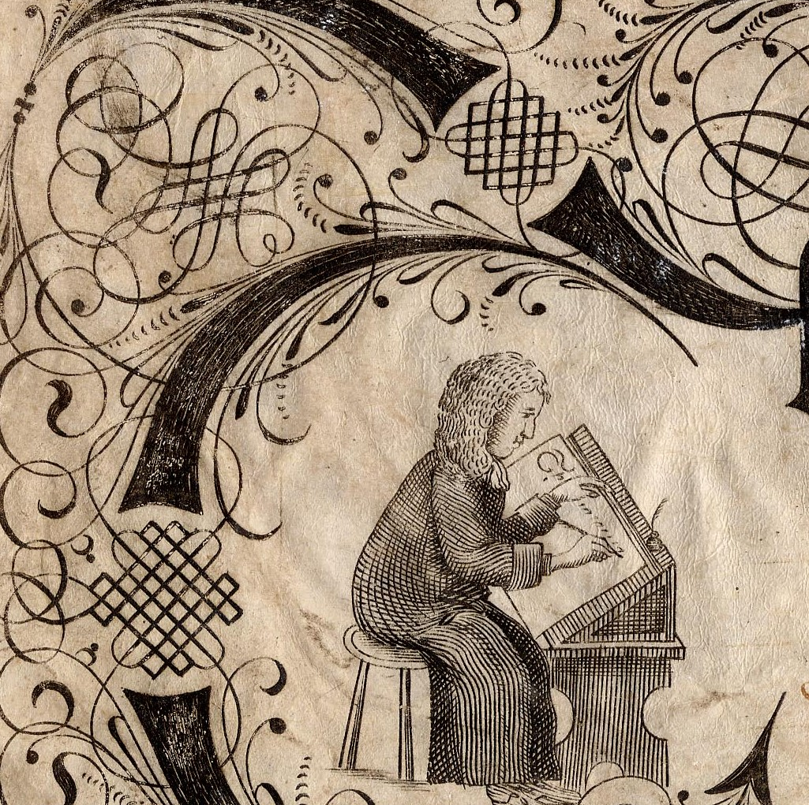
Updating terminology
My colleagues have been going through the material we already have concerning disability and recontextualising them
Adding disclaimers if certain terms used may be considered offensive
Using said material as a discussion point in our workshop to posit whether representation has gone forward since then

Slide 12
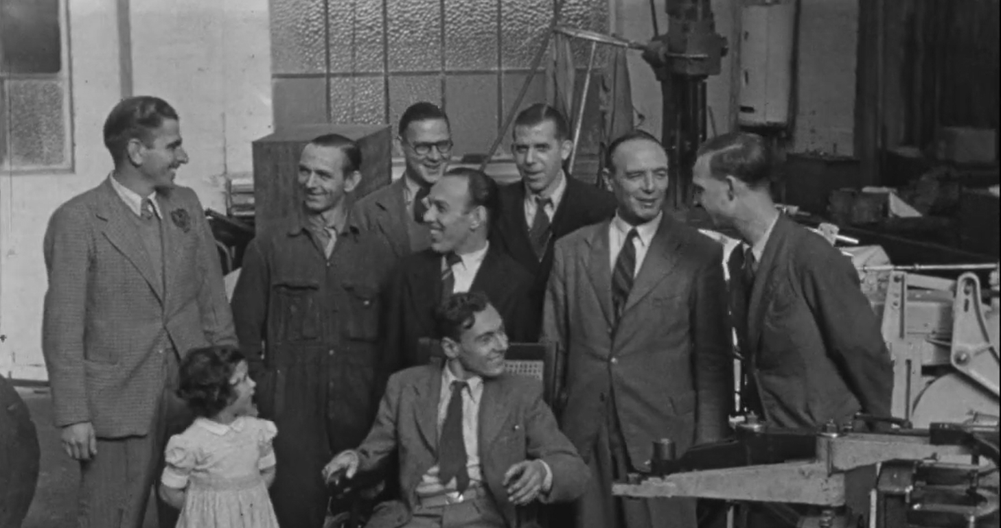
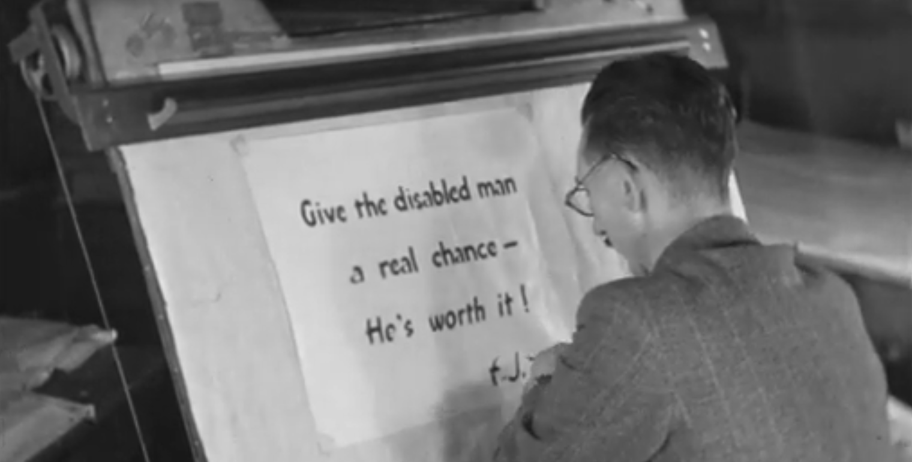
Jack Evans’ Employment of Disabled Persons (1950)
This film was created in 1950 by Jack Evans of Portsmouth to showcase the experiences of medically disabled and war disabled people in his engineering firm
The film was a particular favourite in our workshop
Shows that “necessary adaptations” for disabled people are not a new thing and have been in place for at least three-quarters of a century
Exploration of this film will (hopefully) be a part of our exhibition
Watch it here (https://www.youtube.com/watch?v=jZE-8t3-nWc)

Slide 13

What we have done so far
We have put on ‘Voices of Basingstoke’ workshop for people to discuss, share and record their experiences
I have also put on film screenings in the Discovery Centre for Basingstoke Heritage Society people
I have also done talks to community organisations and disability support groups
I have done follow-up interviews with people who came to the workshops
We are currently planning an exhibition of the project as well (hopefully in Basingstoke Discovery Centre)

Slide 14
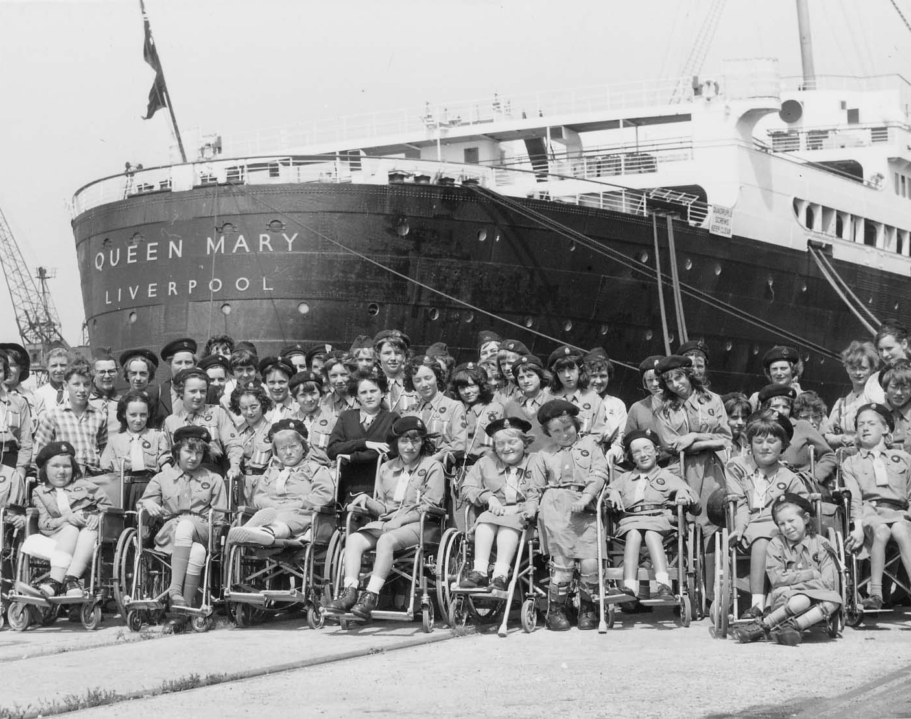
Problems facing disabled, neurodiverse and LGBTQIA+ people
Not all the experiences that our interviewee have recalled have been positive
Difficulty in getting non-disabled people to understand disability
Long wait times for support for all three groups
Feeling that they can’t express their sexual orientation or gender identity in public for fear of backlash/harassment
People expect a universal definition of disabled/neurodiverse/LGBTQIA+ when there is no such thing

Slide 15
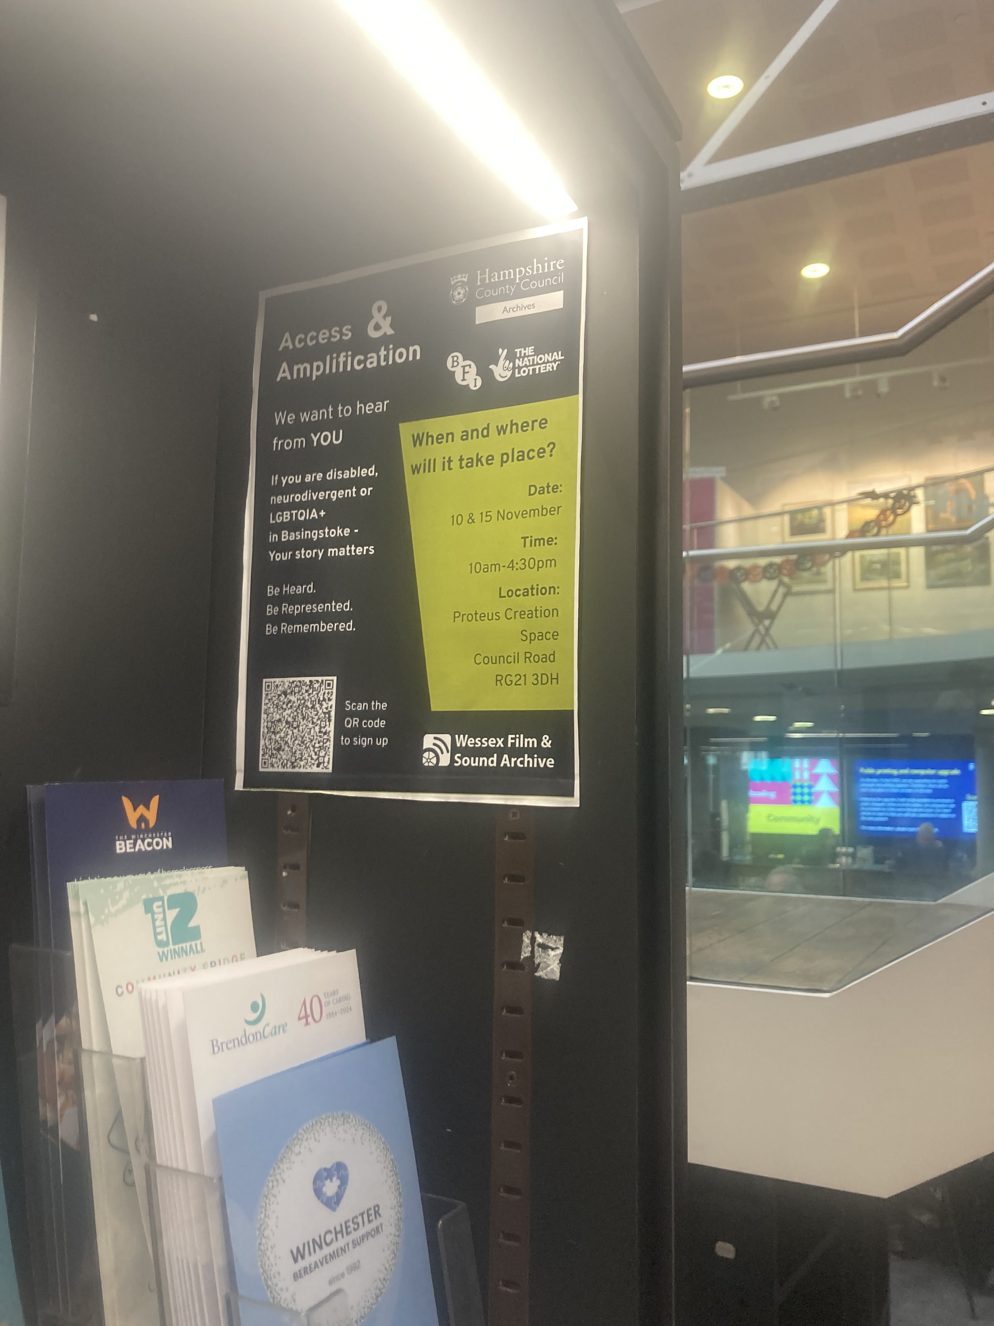
Hurdles in the project
Finding an exhibition space in Basingstoke that was wheelchair accessible was harder than expected
Because of the personal subjects, some people were reluctant to share their experiences
Balancing the Basingstoke History side of the project with the Lived Experience side
Convincing people to be recorded for audio interviews
Sometimes, the interview subjects are not very positive

Slide 16
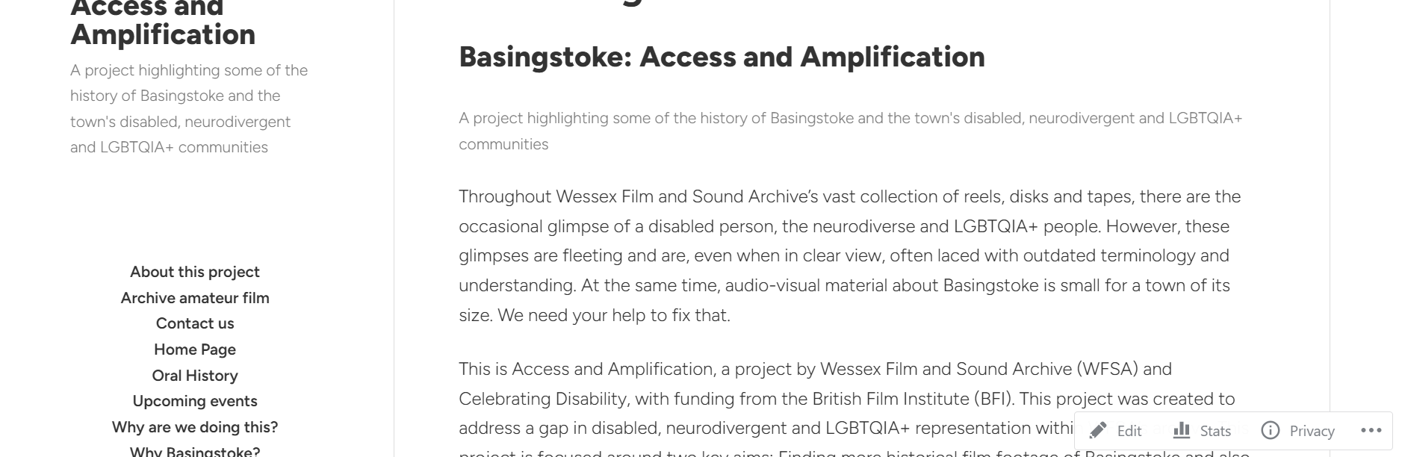

The blog
I created a blog to document the project’s progress, update event information and explain our aims
https://accessandamplificationbasingstoke.wordpress.com
Please do check it out and share it around!

Slide 17

How you can help
How you come in
Talking about your experiences living with a disability for WFSA’s oral history collections
Spreading awareness of why disability and why disability history needs to be documented
Recording how disability affects your day-to-day activities for WFSA’s film archive
Contact archives.enquiries@hants.gov.uk and mark your email for the attention of “Access and Amplification”

Slide 18
Thanks for your time
Any questions?
For further queries, contact archives.enquiries@hants.gov.uk and mark your email for the attention of “Access and Amplification”

