Slide 1
Creating and promoting a sensory study room at the University of Hertfordshire
Kim Barton
Accessibility advisor, University of Hertfordshire

Slide 2
Background
Identified a gap in the provision of sensory related areas on campus
Increasing number of students with ASD enrolling in higher education¹
Looked to improve spaces and areas in the Learning Resources Centres for neurodivergent students and students with additional needs
Wanted to provide a space that had both sensory engagement and regulation provisions, as well as an area for study
1. Bakker, T., Krabbendam, L., Bhulai, S., and Begeer, S. (2019). Background and enrollment characteristics of students with autism in higher education. Res. Autism Spectr. Disord. 67:101424. doi: 10.1016/j.rasd.2019.101424
Notes:
Bakker, T., Krabbendam, L., Bhulai, S., and Begeer, S. (2019). Background and enrollment characteristics of students with autism in higher education. Res. Autism Spectr. Disord. 67:101424. doi: 10.1016/j.rasd.2019.101424

Slide 3
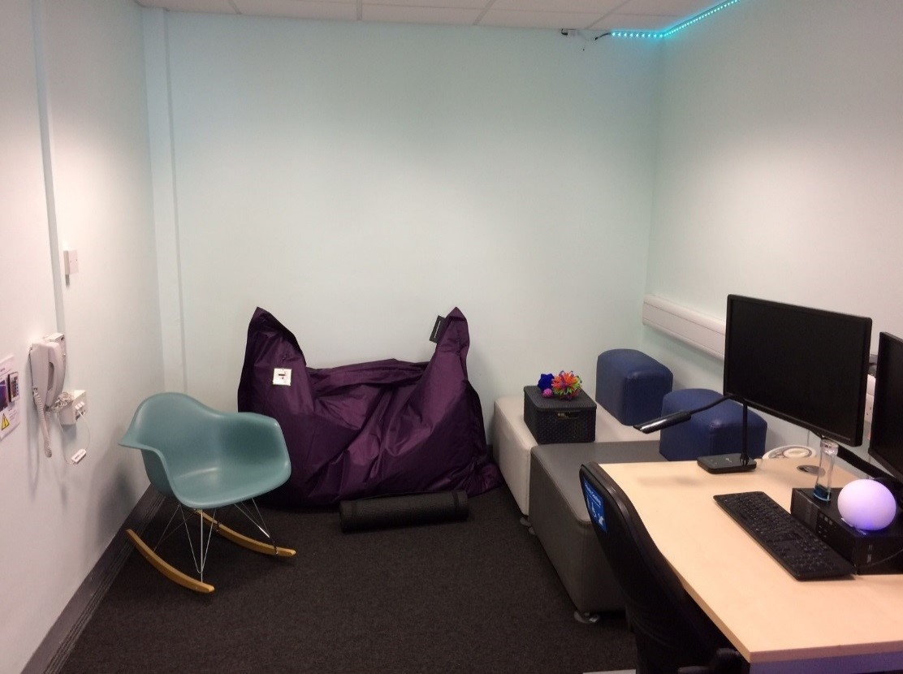
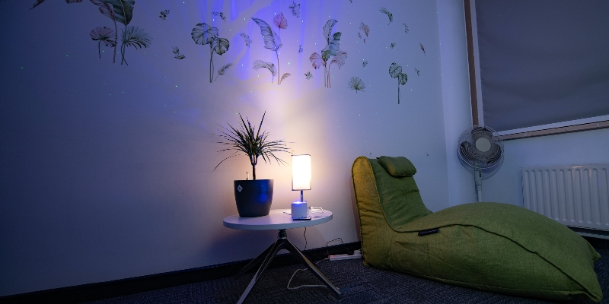
Research
Inspired by other higher education institutions
In particular:
University of Warwick
University of York
http://www.efficiencyexchange.ac.uk/12578/sensory-study-room/
https://www.york.ac.uk/library/visit/sensoryrooms/

Slide 4
Collaborative design
Created with support from:
  Student Wellbeing
  Accessibility and Disability Services Team
  Student’s Union – Elected Officer for Disabled Students’
  Disabled Students Advocate
  User Experience Computing Team
  Academic colleagues

Slide 5
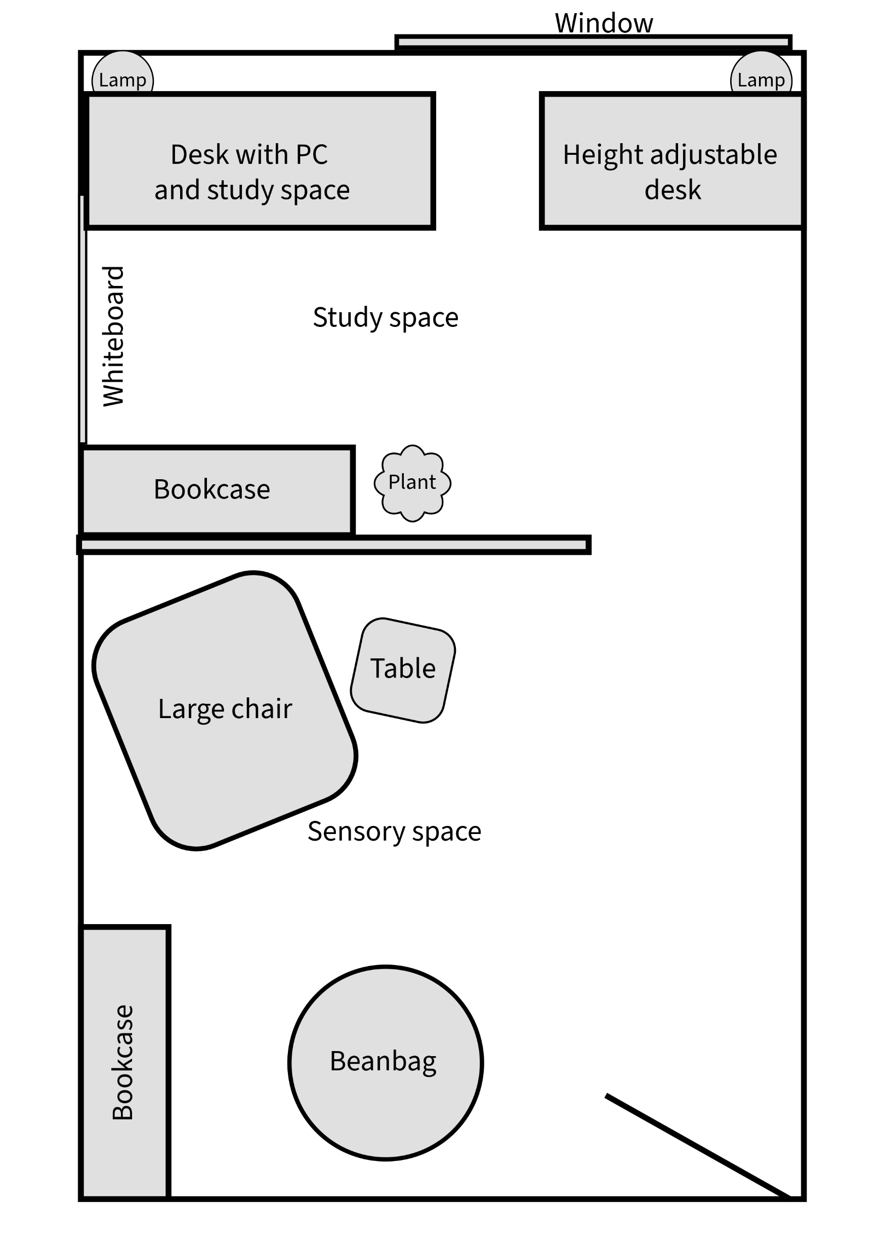
Our plan
Aimed to convert a room in the Learning Resources Centre into a Sensory Study Room
Divided into two areas:
  Sensory area – a relaxed space with comfy seating, engaging lighting, and fidget toys available
  Accessible study area – a space to study with a height-adjustable table, specialist software PC, and alternative keyboard options
Financial challenges

Slide 6
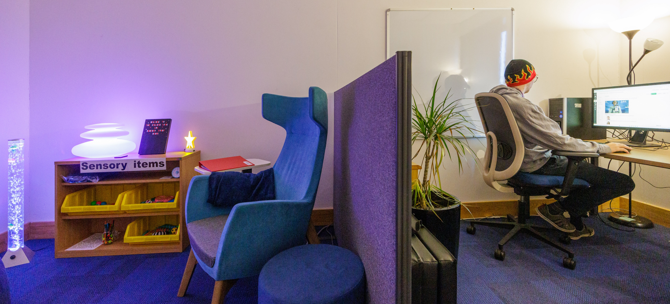
Results

Slide 7
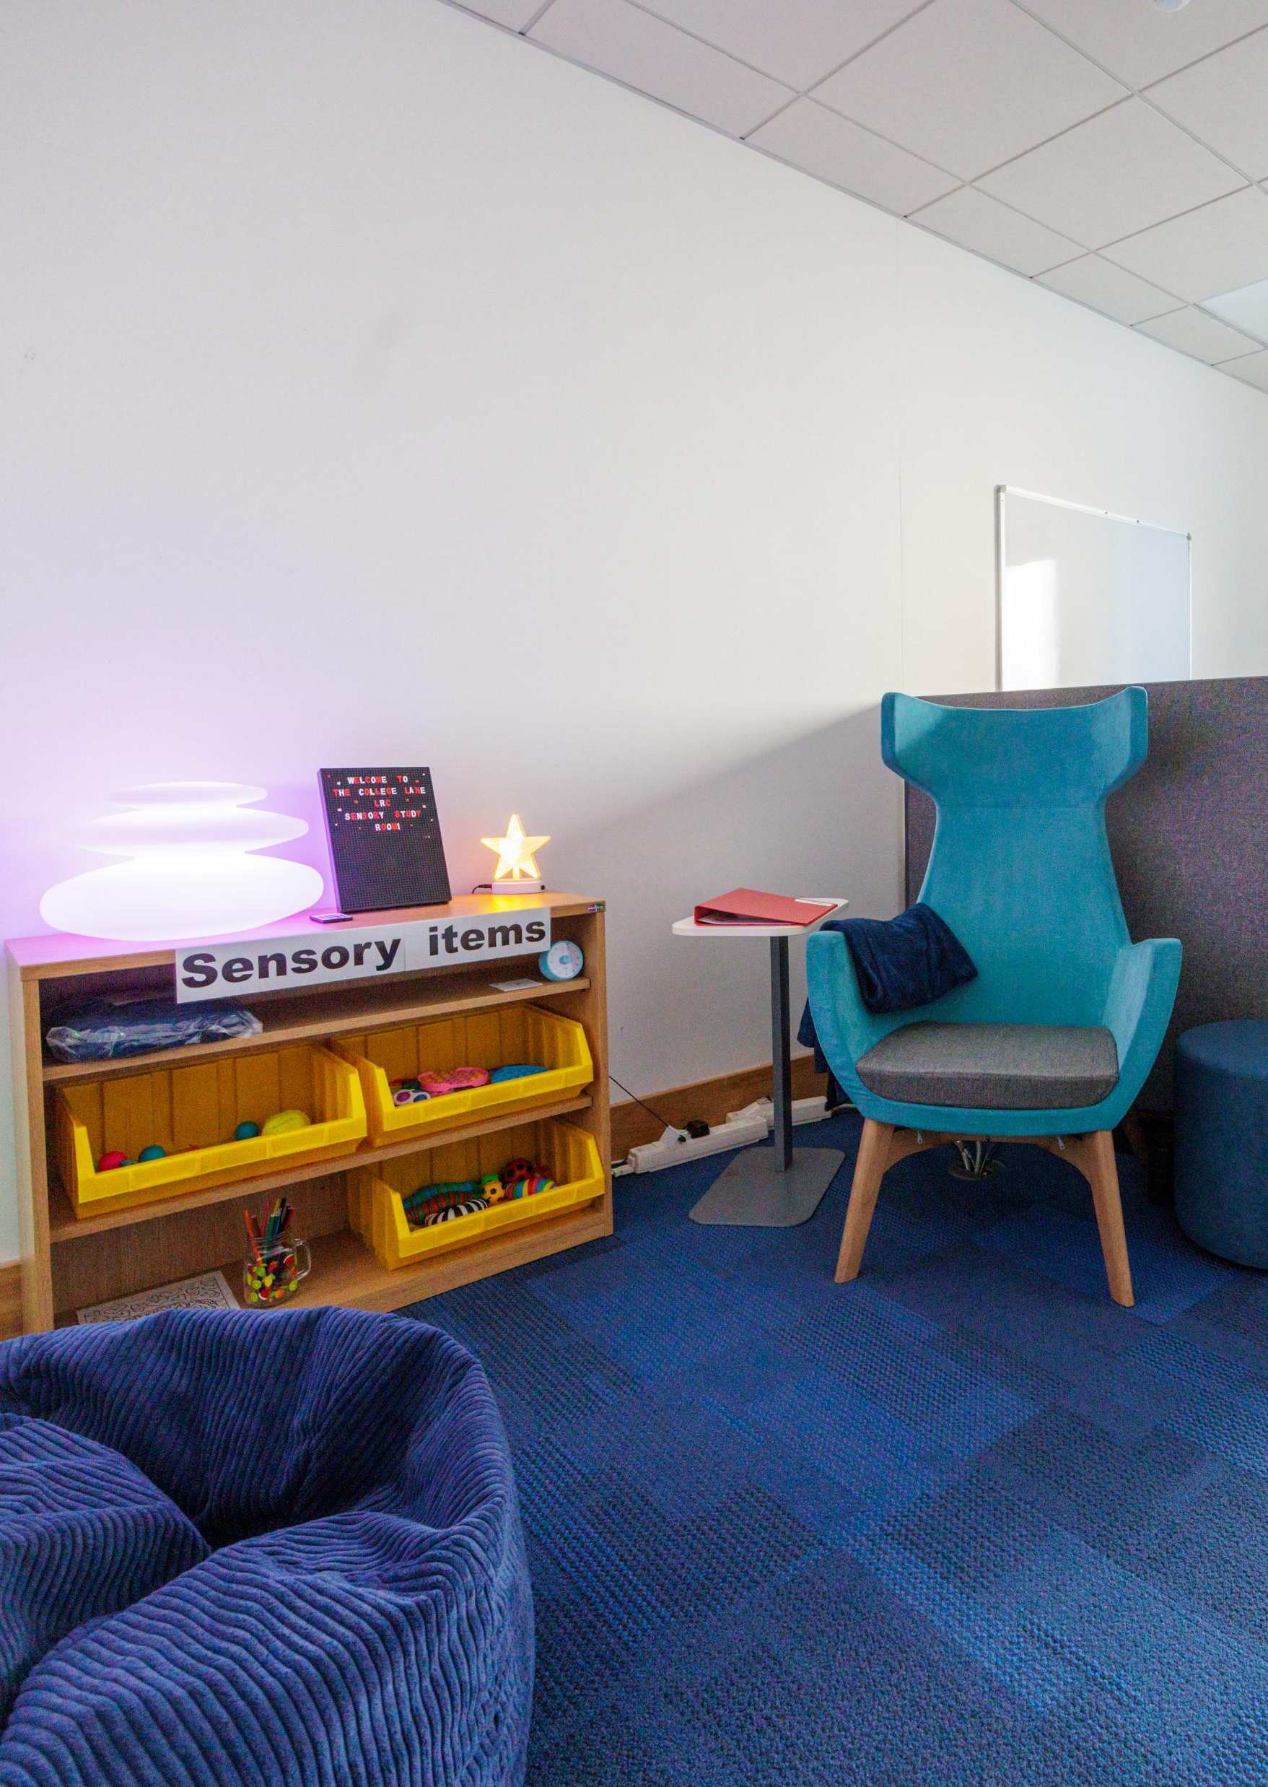
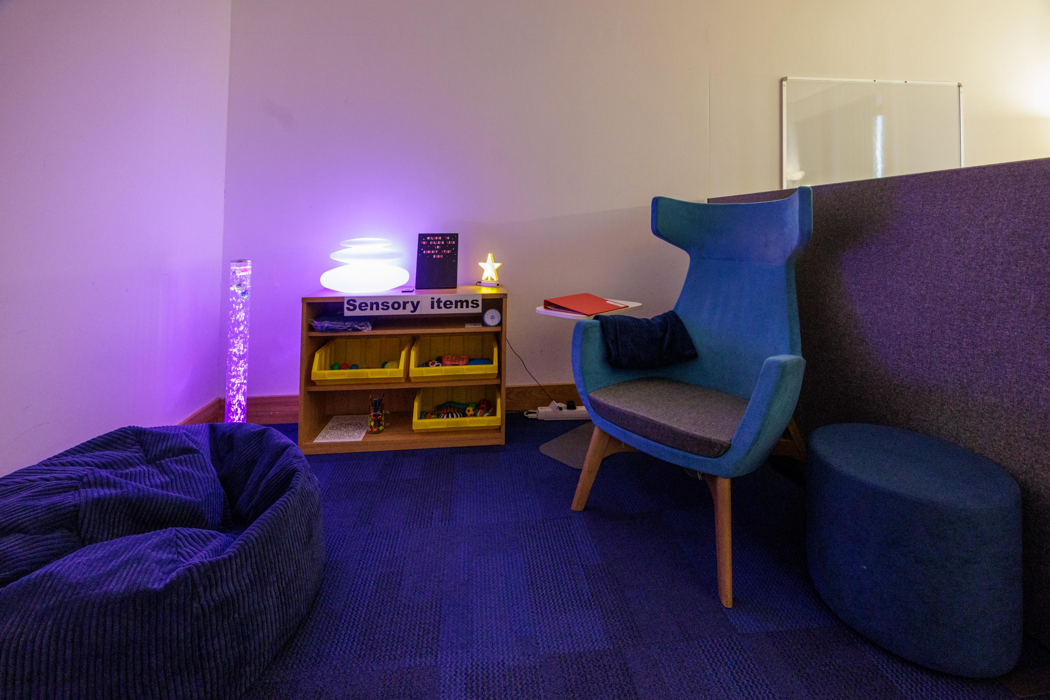
Sensory area

Slide 8
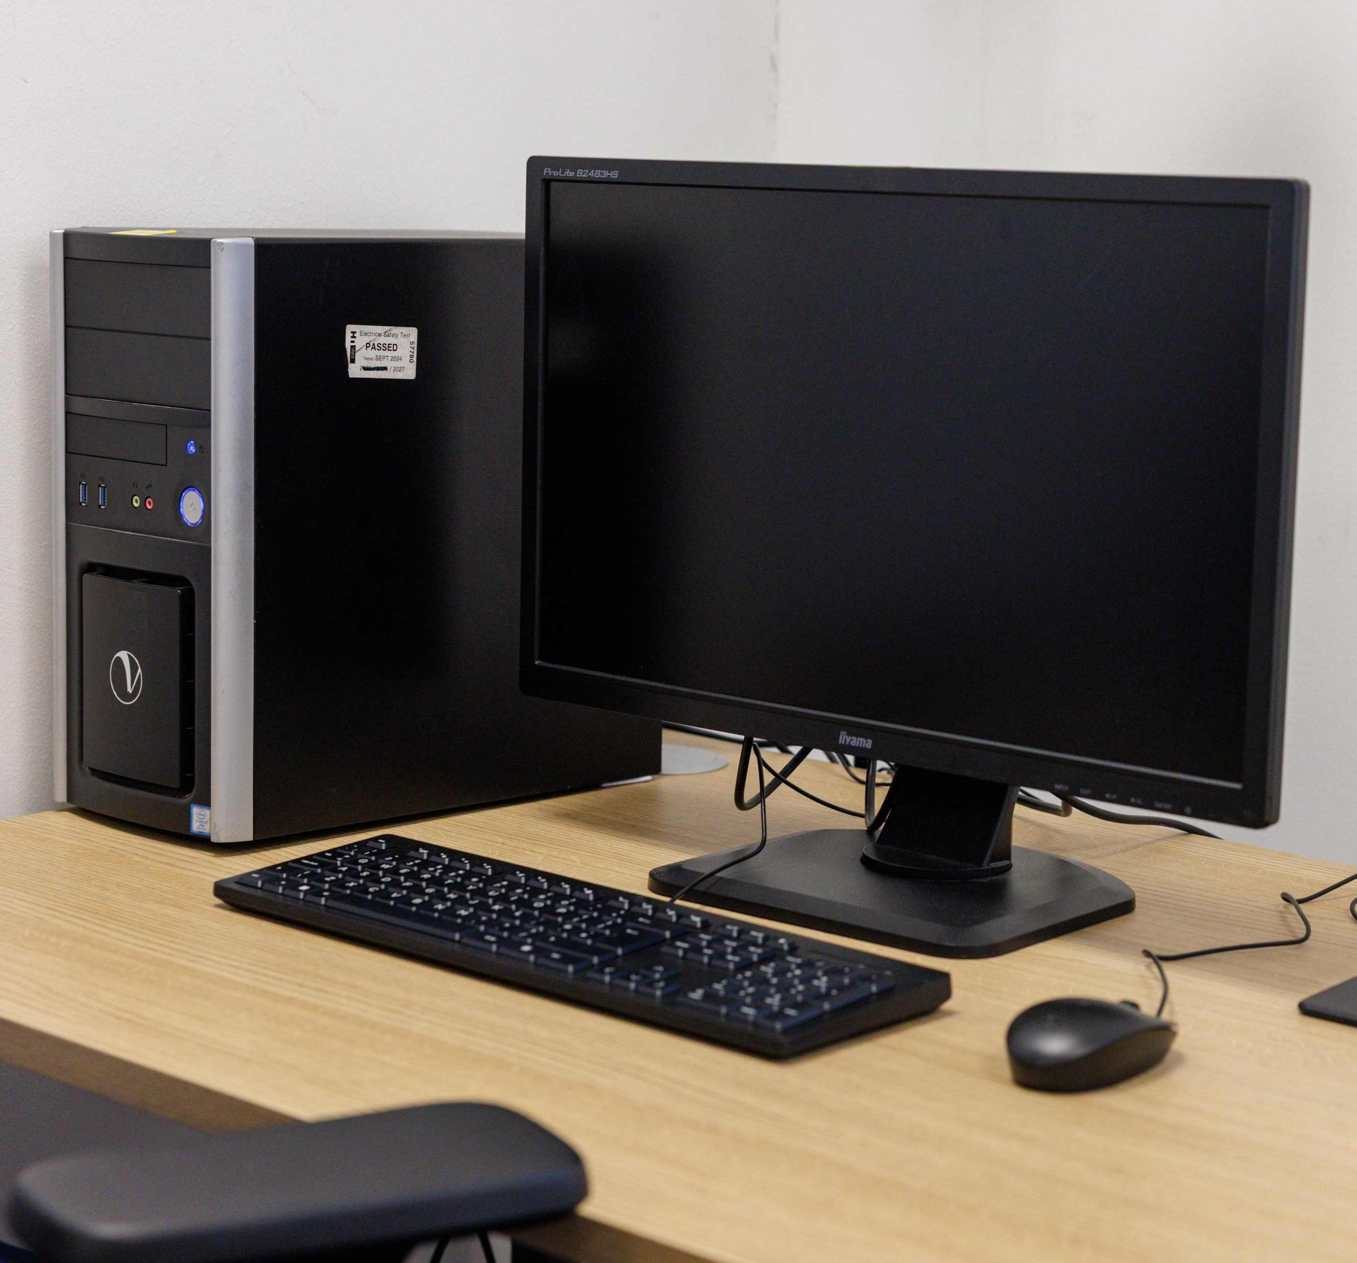
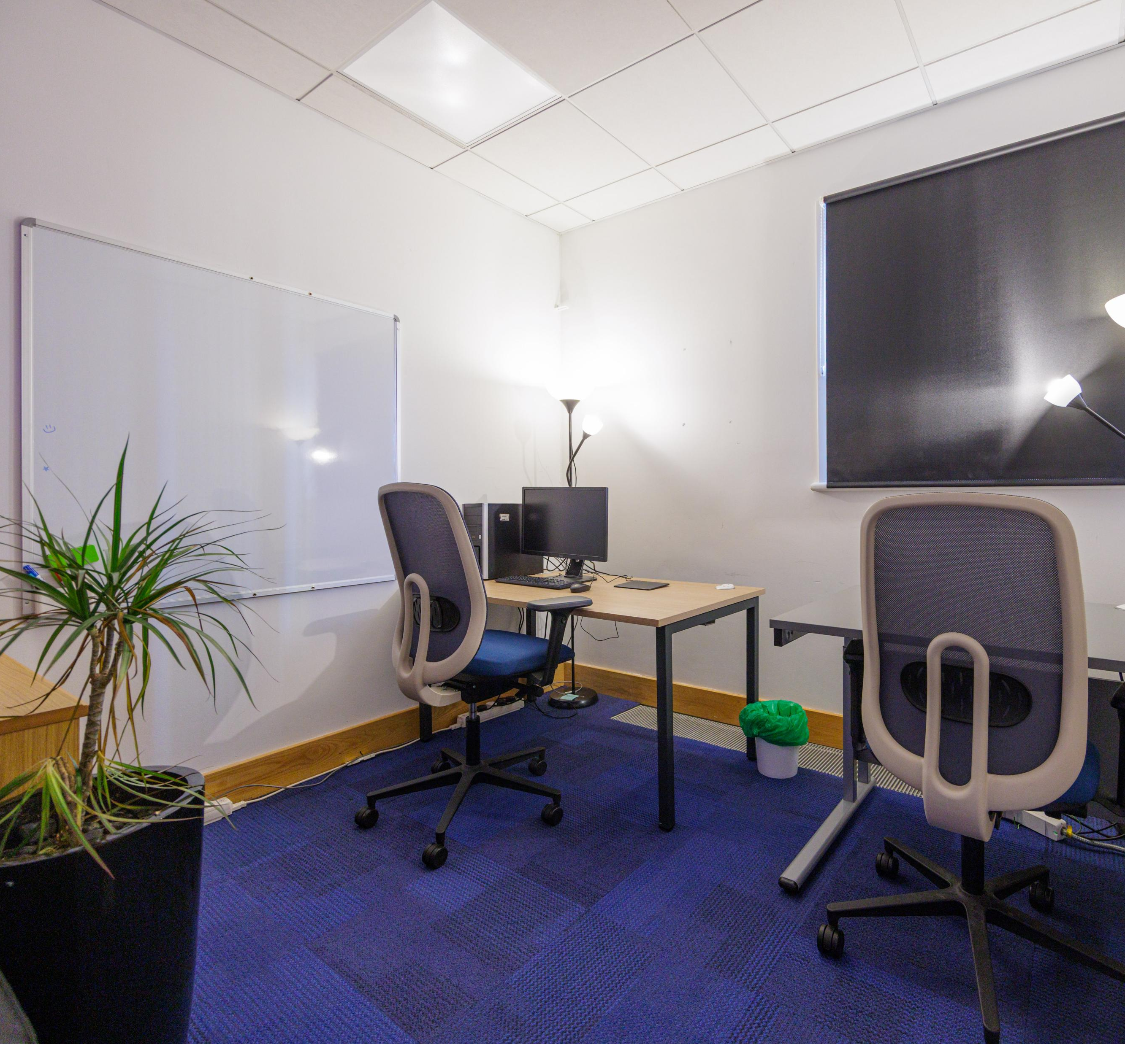
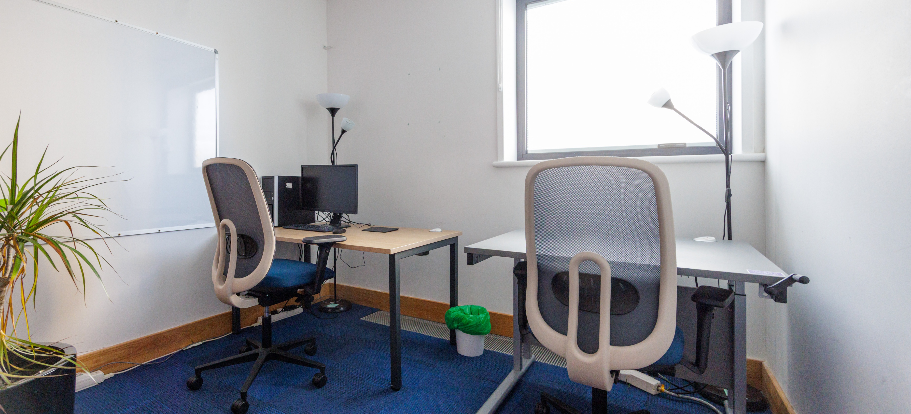
Accessible study area

Slide 9
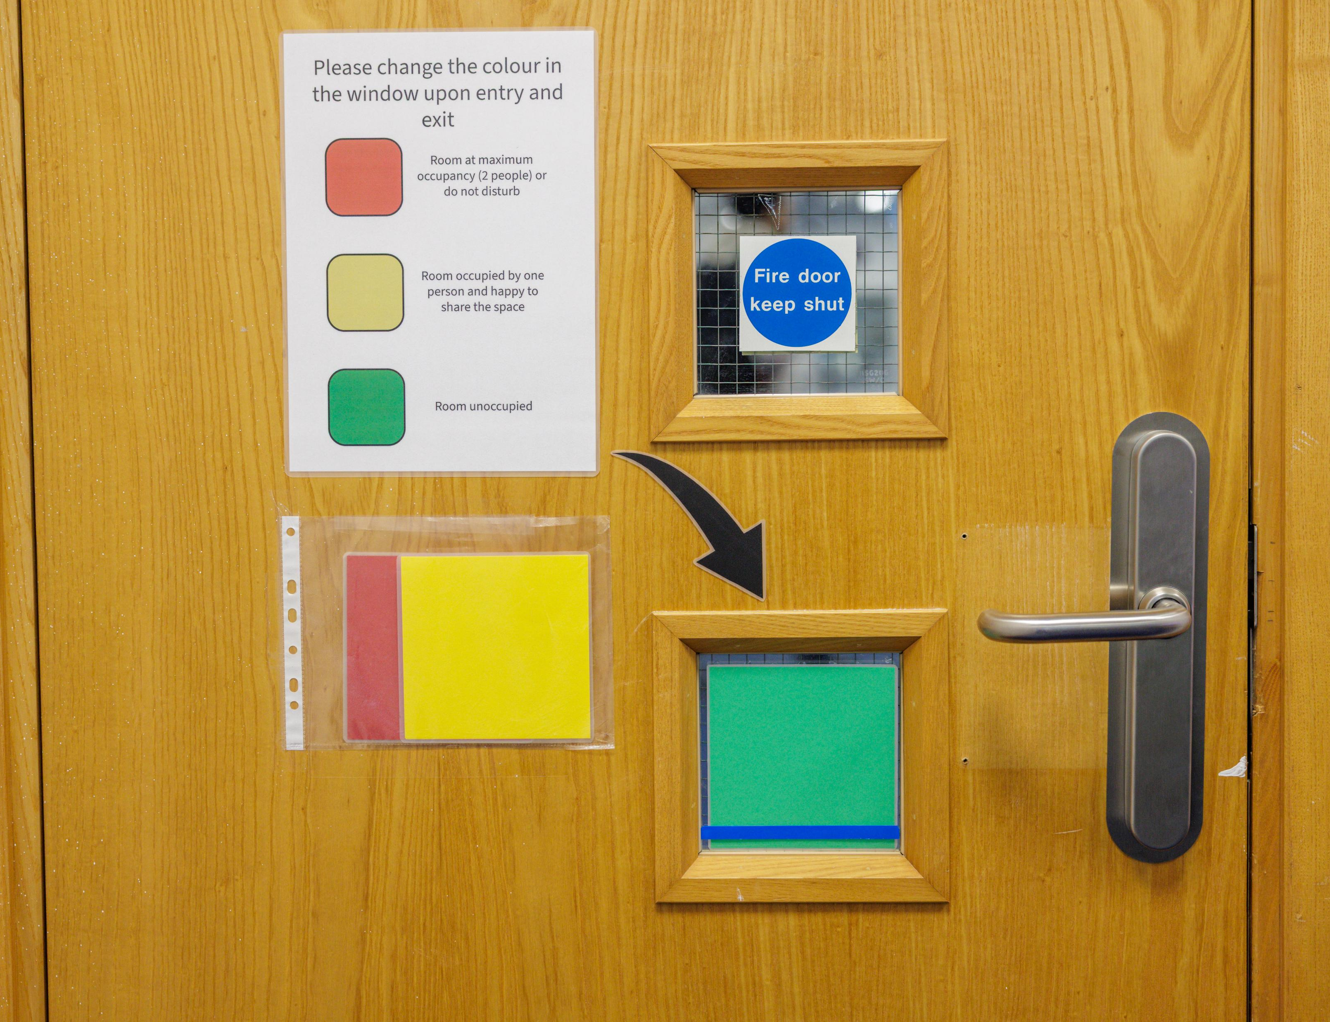
How the room is managed
Student wellbeing referrals
Managed daily by Library Customer Service Team
Traffic light system
Opening hours

Slide 10
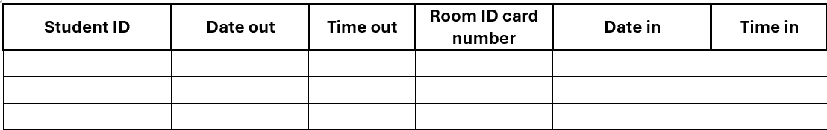
Data
32 student referrals
Referrals have doubled in the last two months
Over half of the visits to the room last longer than 1 hour
Longest visit so far has been 5 hours

Slide 11
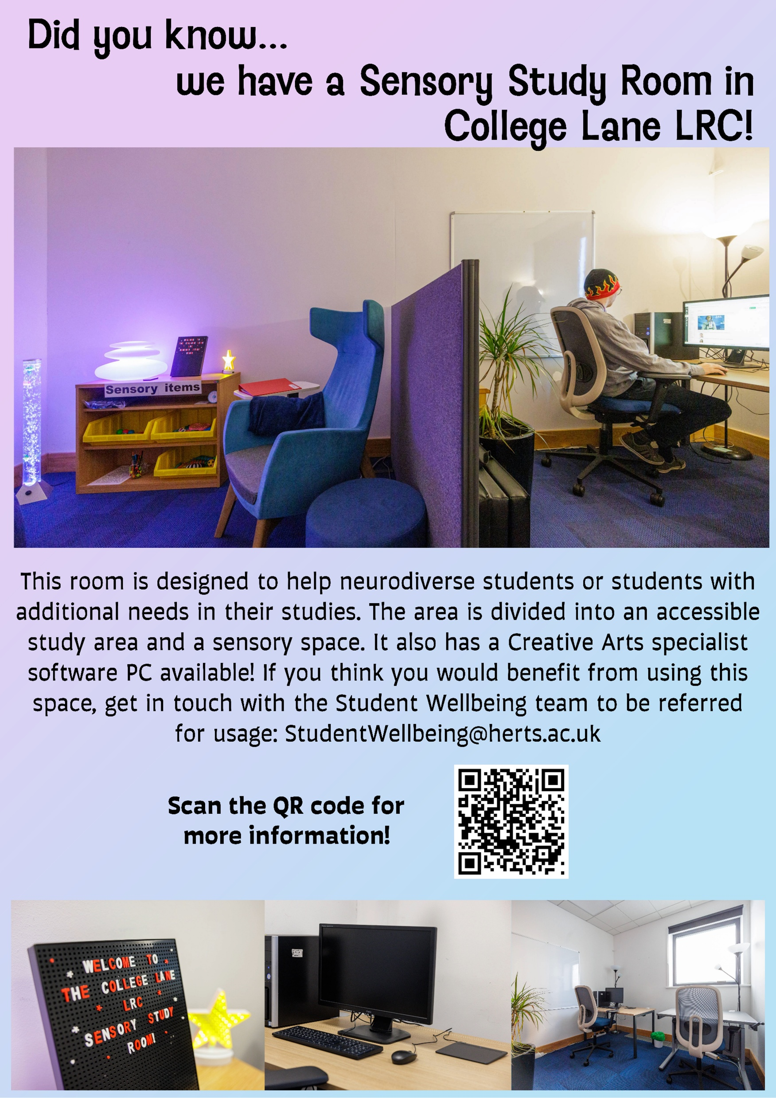
Promotional techniques
Started with promotion via Student Wellbeing only
Changed tactics based on student interaction
  Increased social media presence
  Physical signage and promotional materials
  Student accessibility events showcasing the space
  Promotion of the space during open days
  Informative website

Slide 12
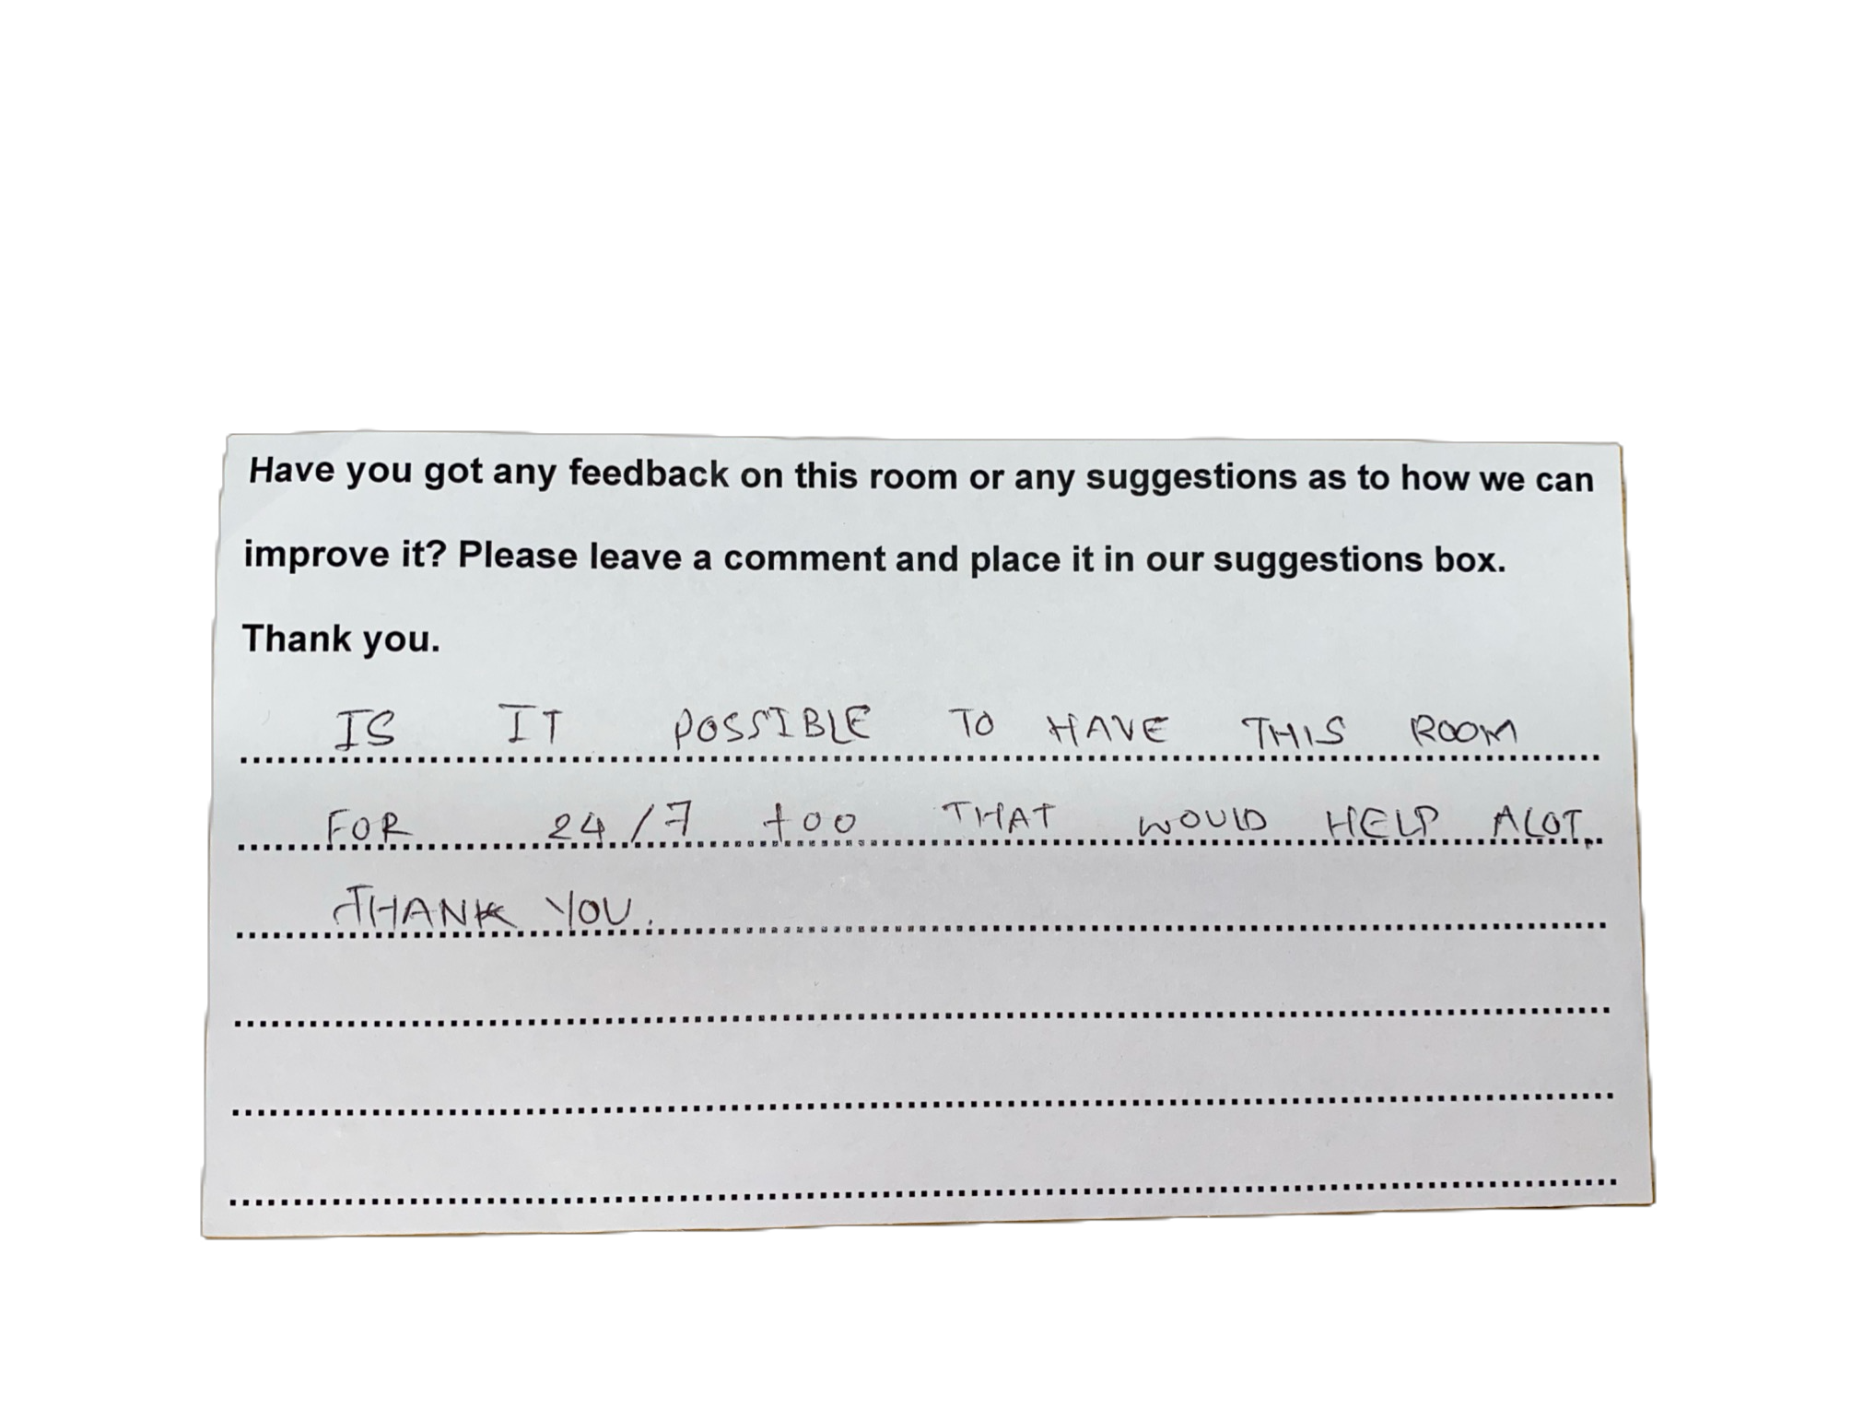
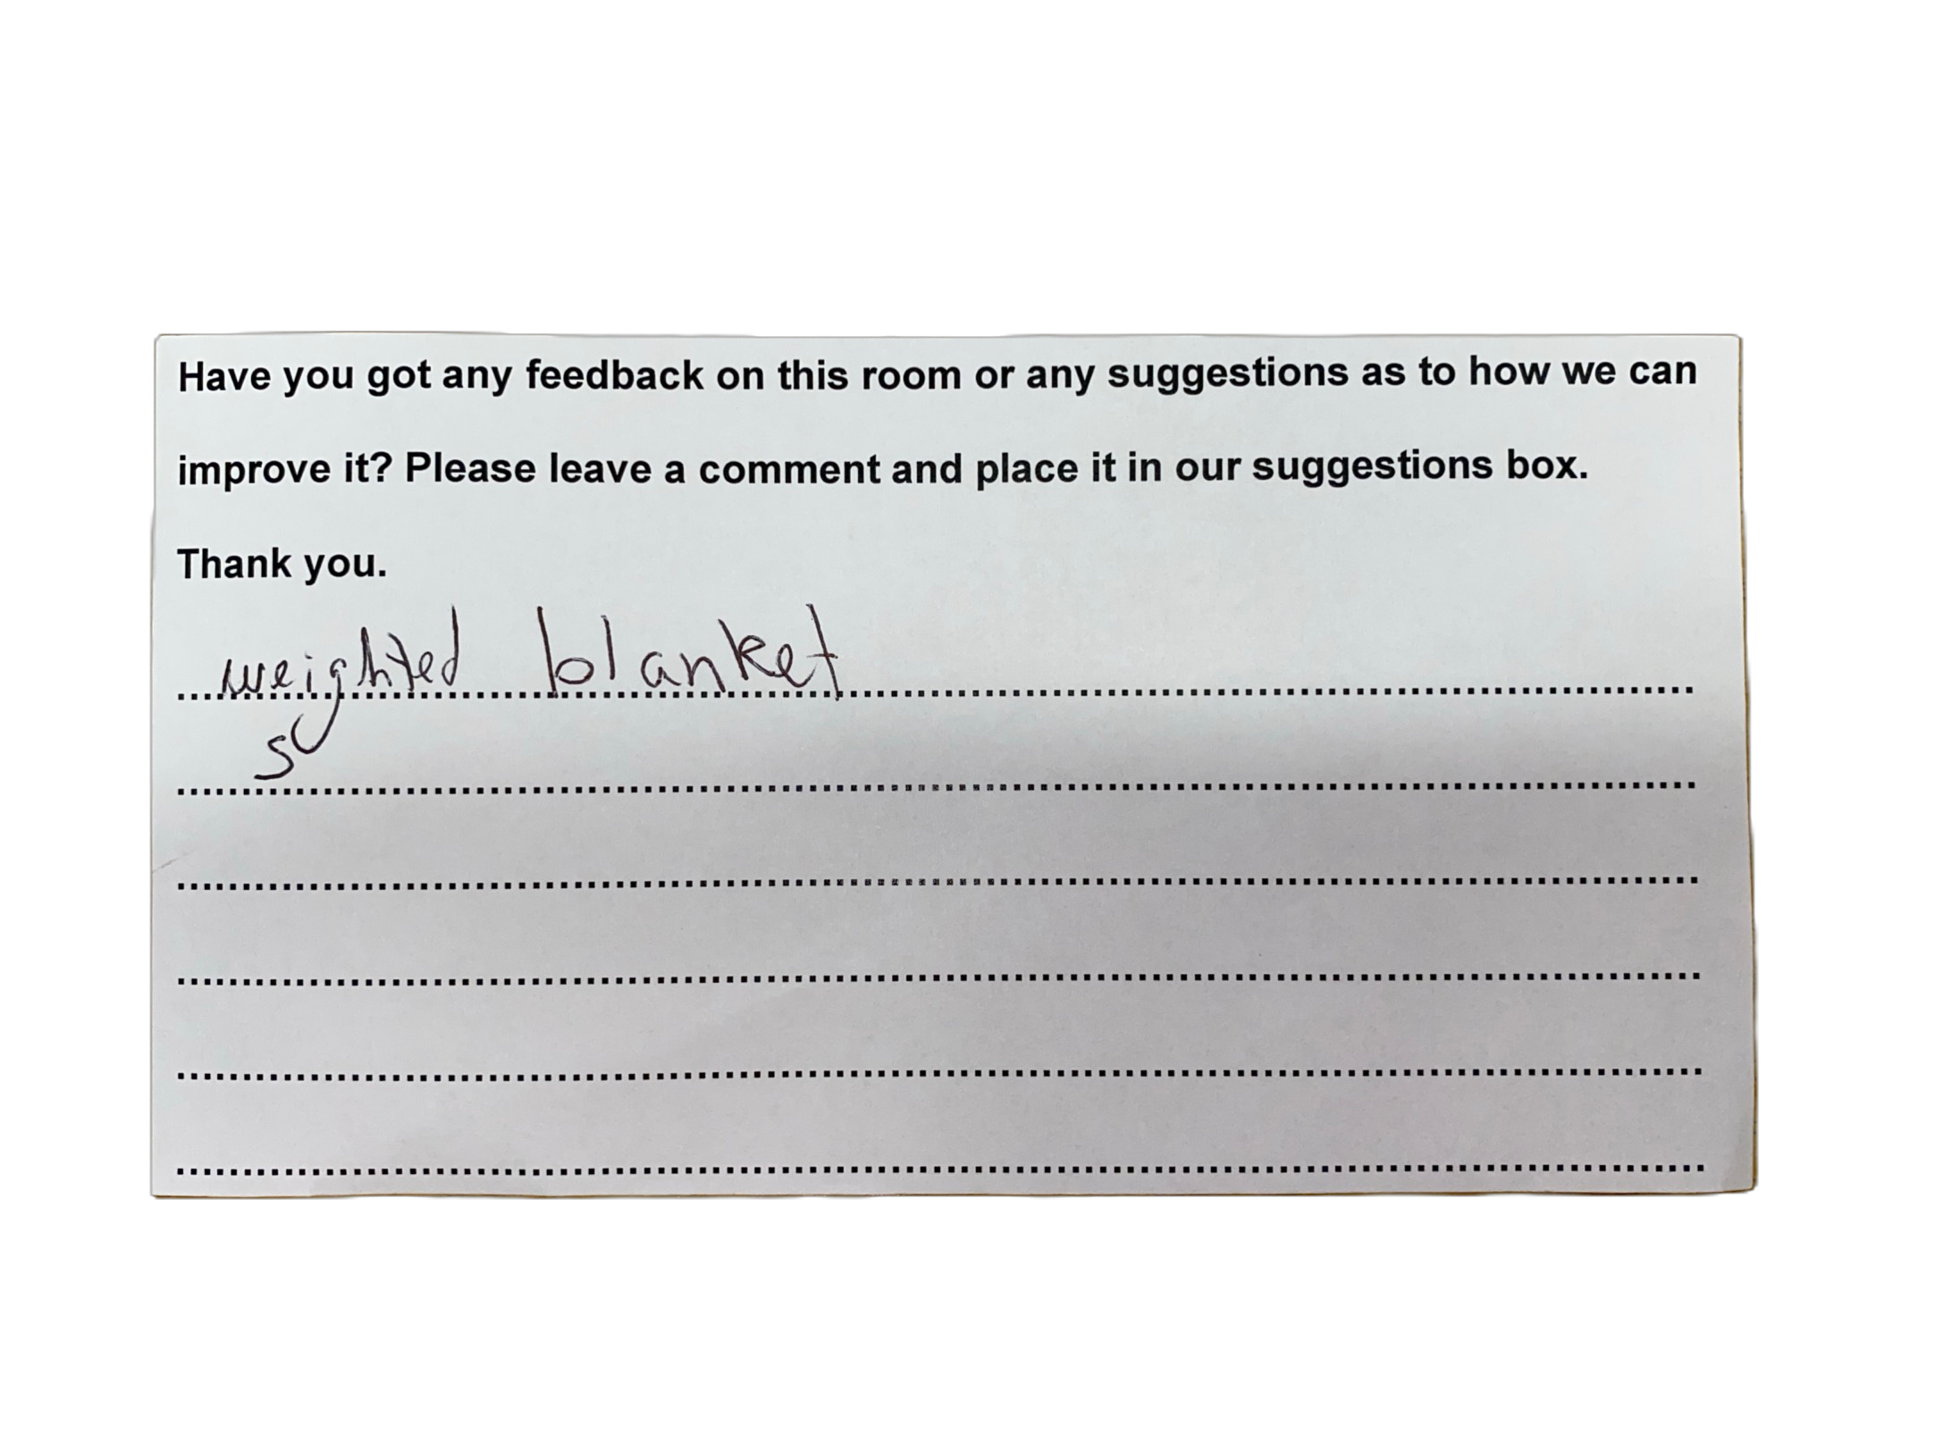
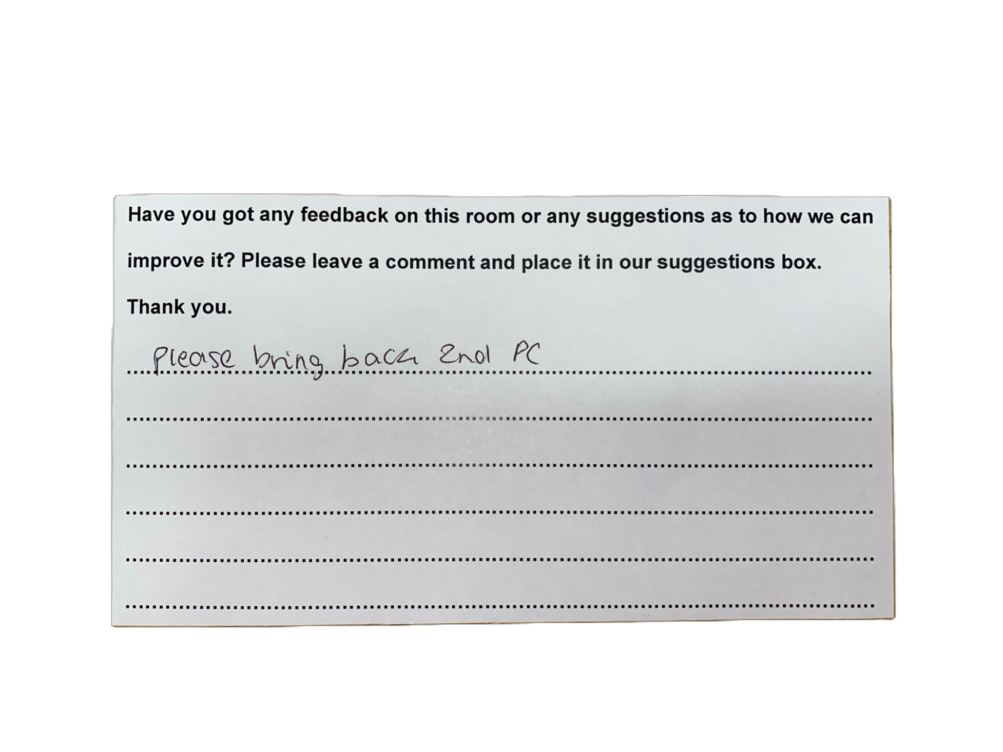
Feedback
Overwhelmingly positive!
Feedback from staff
  Accessibility team
  Occupational health teaching team
  Student support leads in academic schools
  Herts Students’ Union
Routes for student feedback
  Online form via QR code
  Physical feedback box in the room.
  Student Wellbeing team

Slide 13
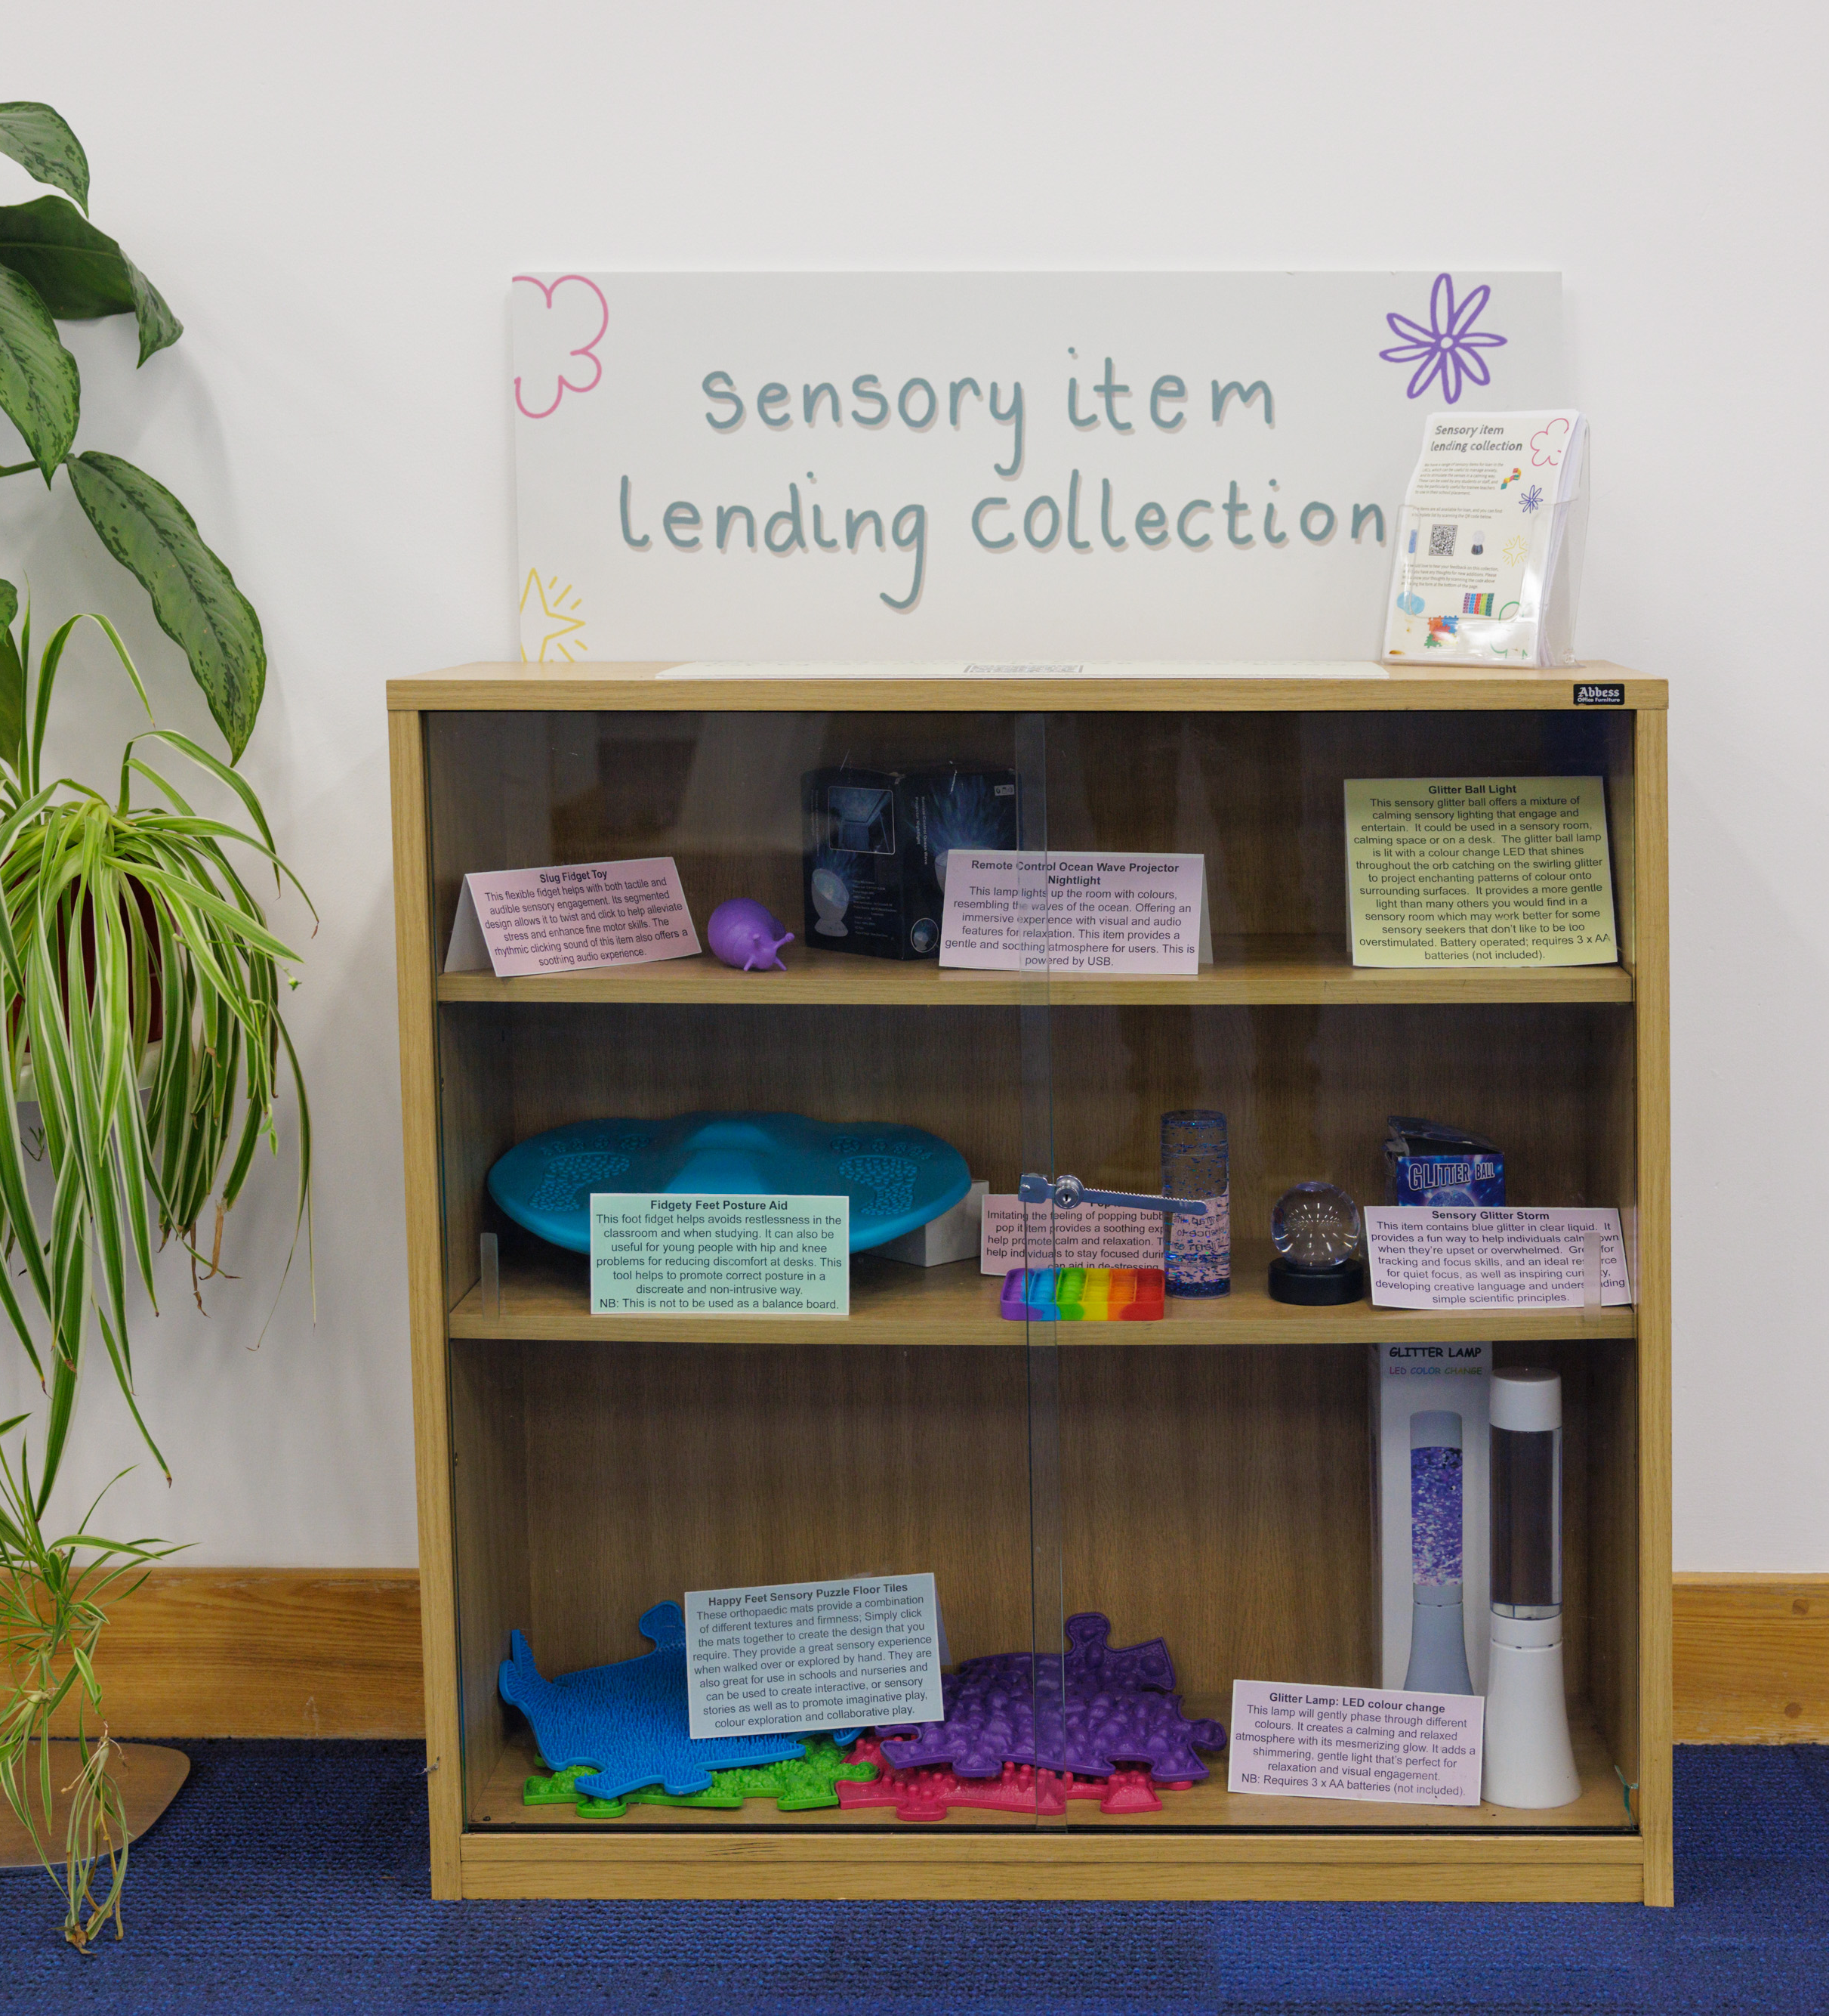
Expansion
Discussions regarding expanding these provisions to our second campus with the support of Hertfordshire Business School
Discussions with the University’s Equality, Diversity, and Inclusion team as well as Staff Wellbeing Champions to work on providing a similar space for staff on campus.
Sensory item lending collection for students and staff.

Slide 14
Thank you for listening!
Contact details:
Kimberley Barton, Accessibility Adviser - k.barton2@herts.ac.uk
Chris Newbitt, Library Customer Service Manager – c.Newbitt@herts.ac.uk
Library Customer Service Team – librarycustomerservices@herts.ac.uk

Slide 15
Thank you

